Slide 1



Res-net Architecture

Slide 2
Introduction with CNN architectures
Need for Res-net
Deep Residual Network
Identity Function
Residual block
How it works?
Representation of Architecture
Code & Implementation

Slide 3
CNN Architectures
Special kind of multi-layer neural networks, designed to recognize visual patterns directly from pixel images with minimal pre-processing.
LeNet-5 (1998 top-5 error rate 26%)
Alex Net (2012 top-5 error rate 15.3%)
ZF Net (2013 top-5 error rate 14.8%)
Google Net/Inception(2014 top-5 error rate 6.67%)
VGG Net (2014 top-5 error rate 7.3%)
Res Net (2015 top-5 error rate 3.6%)

Slide 4
Introduction
Residual Network (Res-Net) is a Convolutional Neural Network architecture which can support hundreds or more convolutional layers
Popular in 2015 with winner of the ImageNet competition was ResNet152 i.e. Residual Network having 152 layers variant.
ImageNet Large Scale Visual Recognition Challenge (ILSVRC).
Where software programs compete to correctly classify and detect objects and scenes.
Having lower complexity than VGG Net.

Slide 5
Why deep networks?
Since 2013, the Deep Learning community started to build deeper networks because they were able to achieve high accuracy values.
Furthermore, deeper networks can represent more complex features, therefore the model robustness and performance can be increased.
While training deeper networks, the problem of accuracy degradation was observed. The culprit for accuracy degradation was vanishing gradient effect which can only be observed in deeper networks.

Slide 6
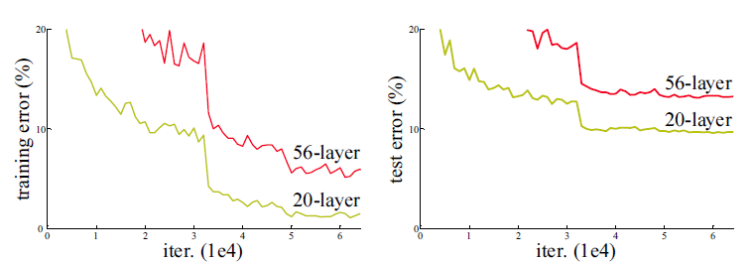
Error with plain networks:

Slide 7
Need for Res-net
During the backpropagation stage, the error is calculated and gradient values are determined.
The gradient becomes smaller and smaller as it reaches the bottom of the network.
Therefore, the weights of the initial layers will either update very slowly or remains the same.
Although vanishing gradient problem was addressed using the normalized initialization of weights, deeper network accuracy was still not increasing.
Started, with introduction of skip connections.

Slide 8
Deep Residual Network
Deep Residual Network is almost similar to the networks which have convolution, pooling, activation and fully-connected layers stacked one over the other.
The only construction to the simple network to make it a residual network is the identity connection between the layers.
In a nutshell, applying identity mapping to the input will give you the output which is the same as the input ( AI = A: where A is input matrix and I is Identity Mapping).

Slide 9
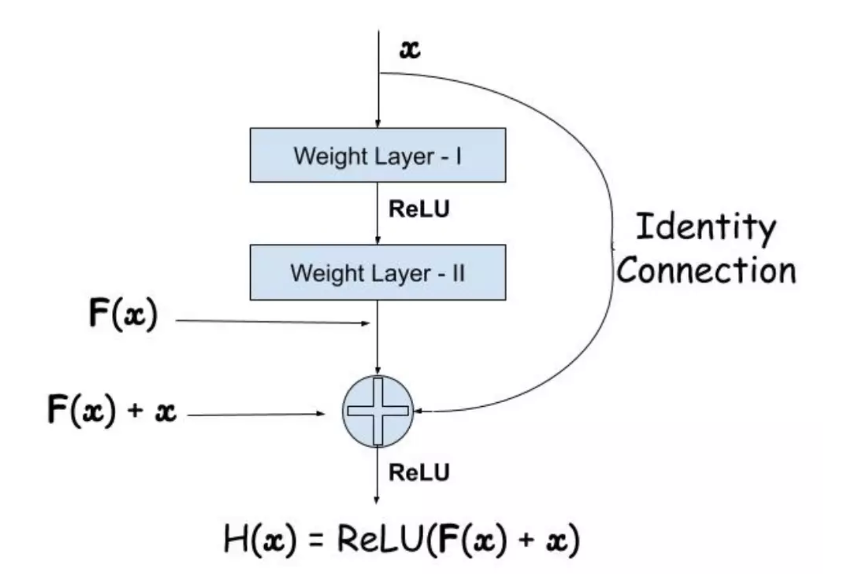
Identity Connection

Slide 10
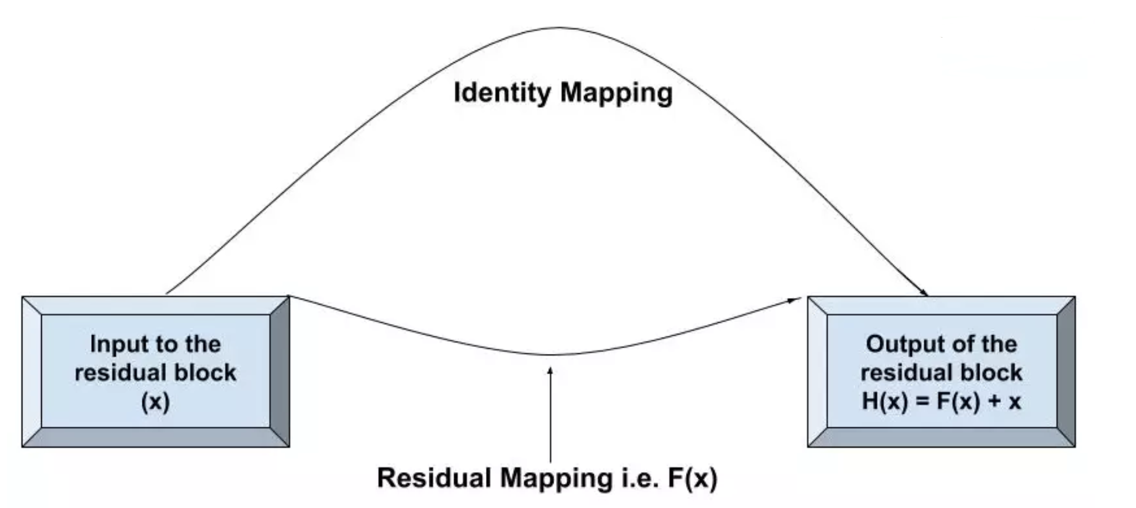
Residual Function
Residual Mapping is acting as a bridge between the input and the output of the block.
The function which should be learned as a final result of the block is represented as H(x). The input to the block is x and the residual mapping.

Slide 11
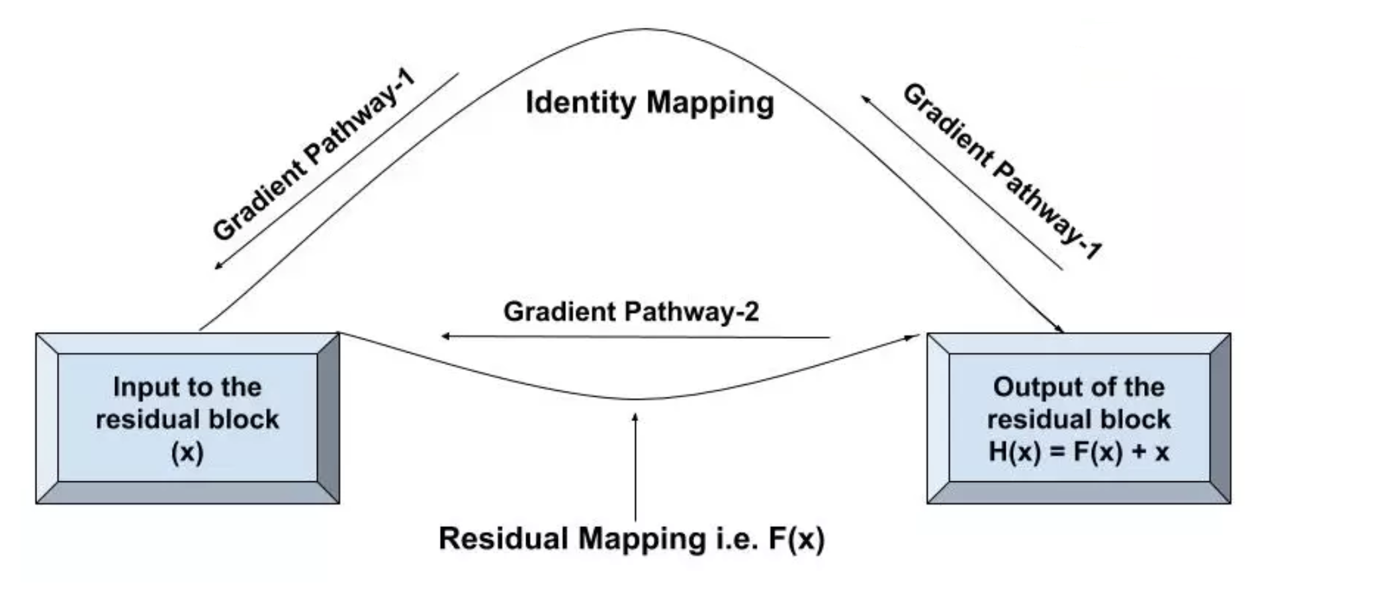
How performance is improved?
Diagram, you can see that there are two pathways: pathway-1 is the identity mapping way and pathway-2 is the residual mapping way.

Slide 12
Gradient Pathway
When the computed gradients pass from the Gradient Pathway-2, two weight layers are encountered which are W₁ and W₂ in our residual function F(x).
In the case of initial layers, the newly computed values will either become small or eventually vanish.
To save the gradient values from vanishing, the shortcut connection (identity mapping) will come into the picture
In Gradient Pathway-1, the gradients don’t have to encounter any weight layer, hence, there won’t be any change in the value of computed gradients.
The residual block will be skipped at once and the gradients can reach the initial layers which will help them to learn the correct weights.

Slide 13
Properties:
The addition of the identity connection does not introduce extra parameters. Therefore, the computation complexity for simple deep networks and deep residual networks is almost the same.
The dimensions of x and F must be the same for performing the addition operation. The dimensions can be matched by using one of the following ways:
Extra Zero entries should be padded for increasing dimensions. This is not going to introduce any extra parameter.
Projection shortcut can be used to match the dimensions ( 1 x 1 convolutions).
y = F(x, {W_{i}}) + W_{s} x

Slide 14
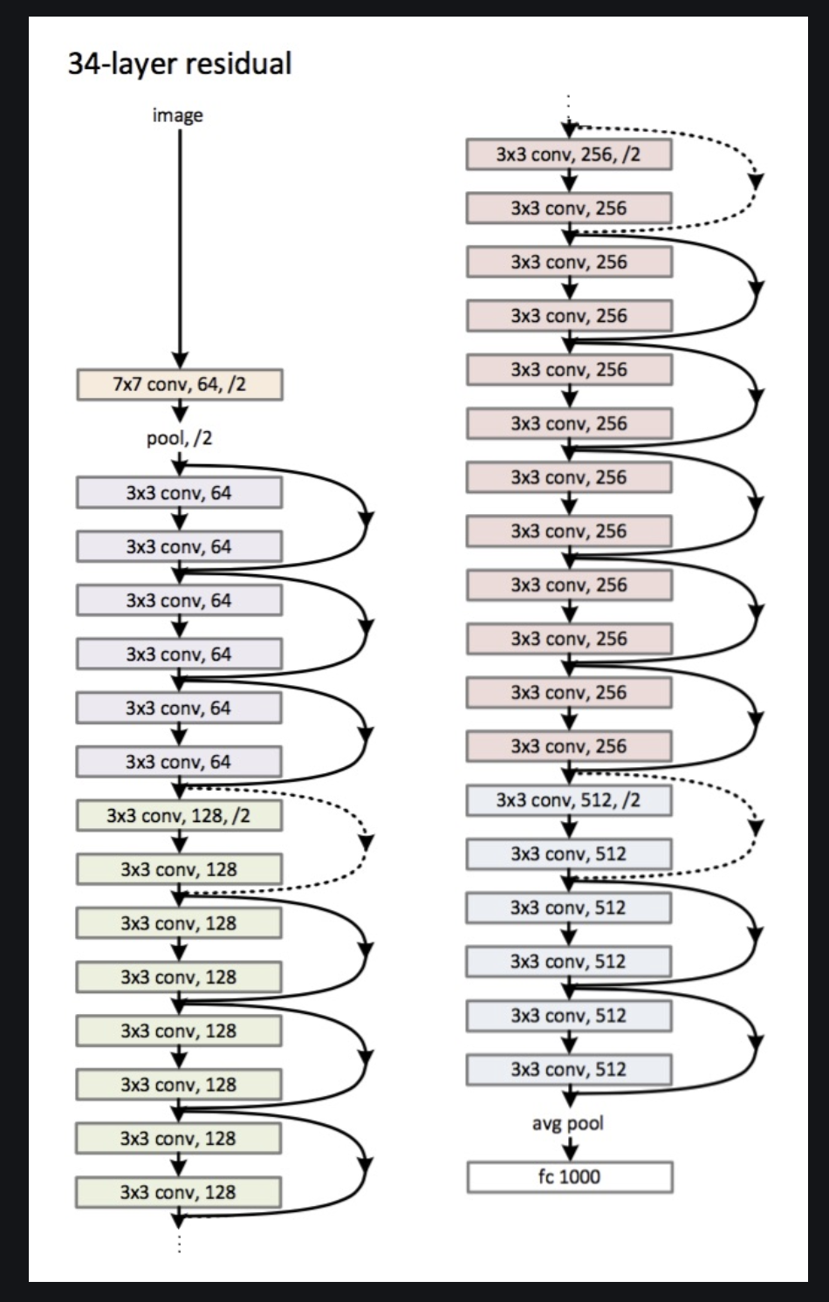

Slide 15
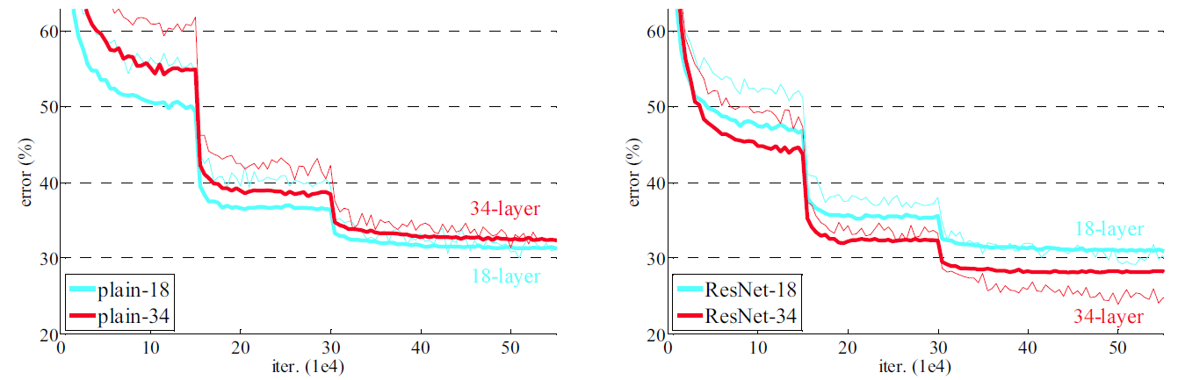
18-Layer and 34-Layer Plain Network (Left), 18-Layer and 34-Layer Res-Net (right)

Slide 16
Key Features of Res-Net:
Res-Net uses Batch Normalization at its core. The Batch Normalization adjusts the input layer to increase the performance of the network. The problem of covariate shift is mitigated.
Res-Net makes use of the Identity Connection, which helps to protect the network from vanishing gradient problem.
Deep Residual Network uses bottleneck residual block design to increase the performance of the network

Slide 17
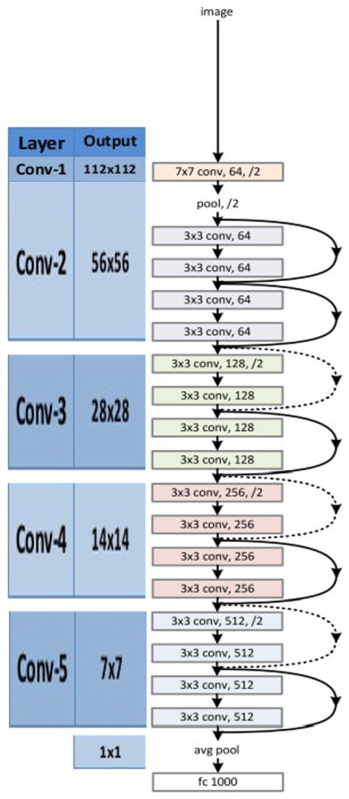
Code and Implementation

