Slide 1



SMART INDIA HACKATHON 2025
TITLE PAGE
• Problem Statement ID - SIH26102
• Problem Statement Title - AI-powered system to detect anomalies, fraud, and inefficiencies in MPLAD Scheme implementation regd.
• Theme - Smart Governance, e-Governance and Smart Automation
• PS Category - Software
• Team ID – T049
• Team Name – Innova8
Siddhant Sinha | 25070123109
Alisha Mittal | 25070126214
Nirvan Joneja | 25070126117
Mannat Tanda | 25070126107
Kushal Shah | 25070126097
Karthik Prakash | 25070126088
Notes:
Welcome judges to AutoGov+ presentation. Team Innova8 (T049), Problem Statement SIH26102. Live demo available at: https://printed-blind-lil-arch.trycloudflare.com

Slide 2
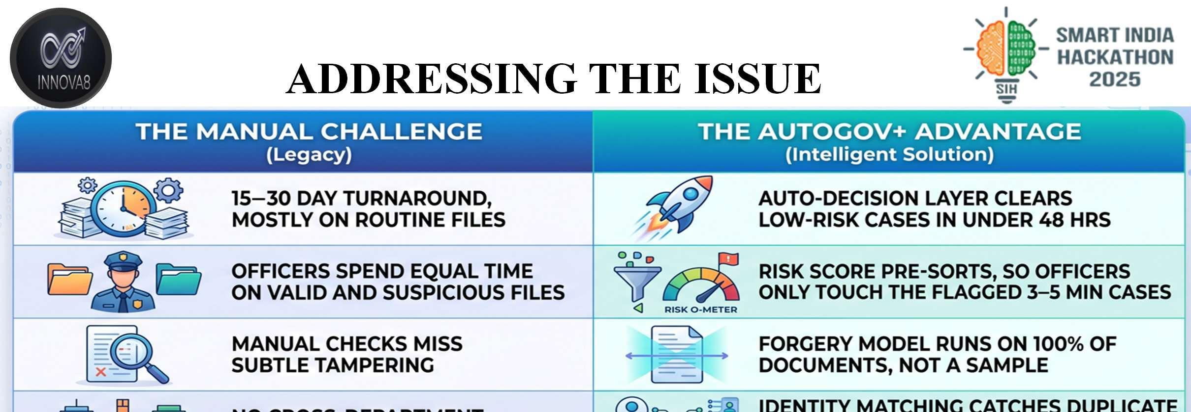
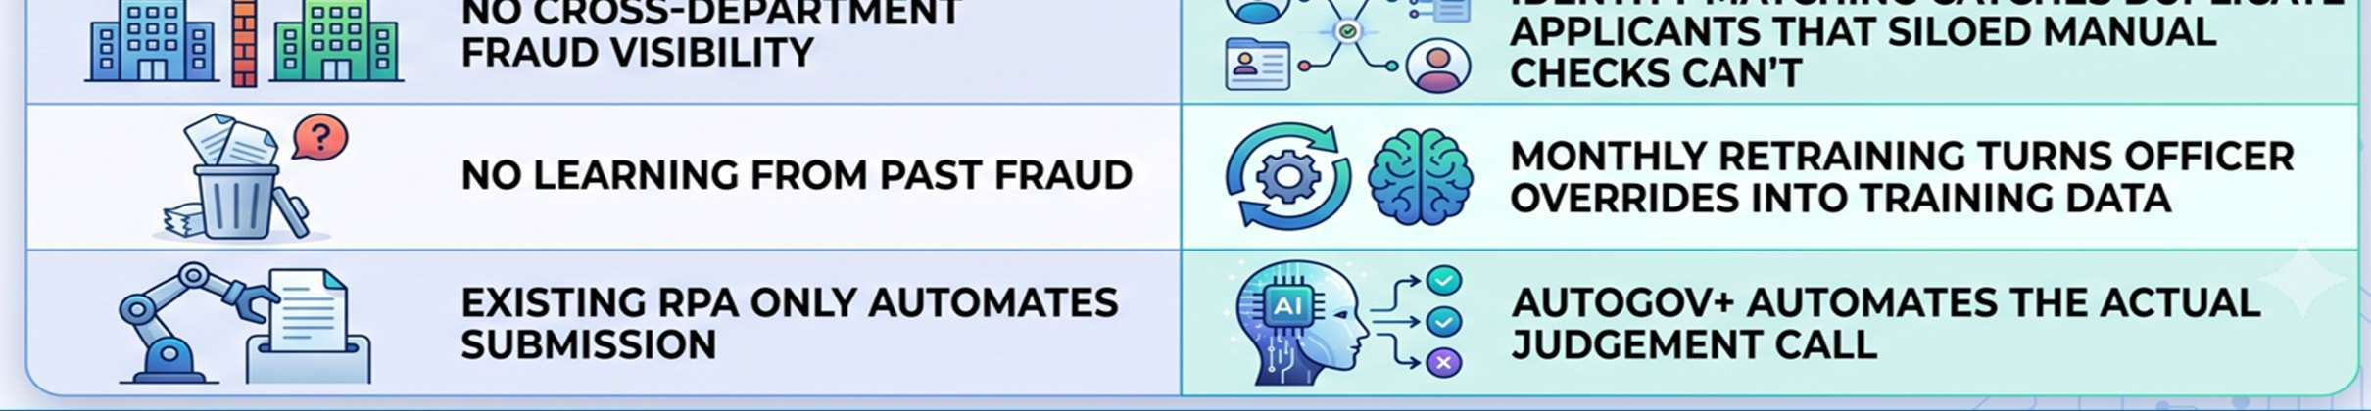
ADDRESSING THE ISSUE
@SIH Idea submission- Template
2
Notes:
Addressing the issue: Manual challenges take 15-30 days, caseworker fatigue, no cross-department fraud checks. AutoGov+ brings auto-decision in seconds, 100% forgery scanning, and automated judgment.

Slide 3
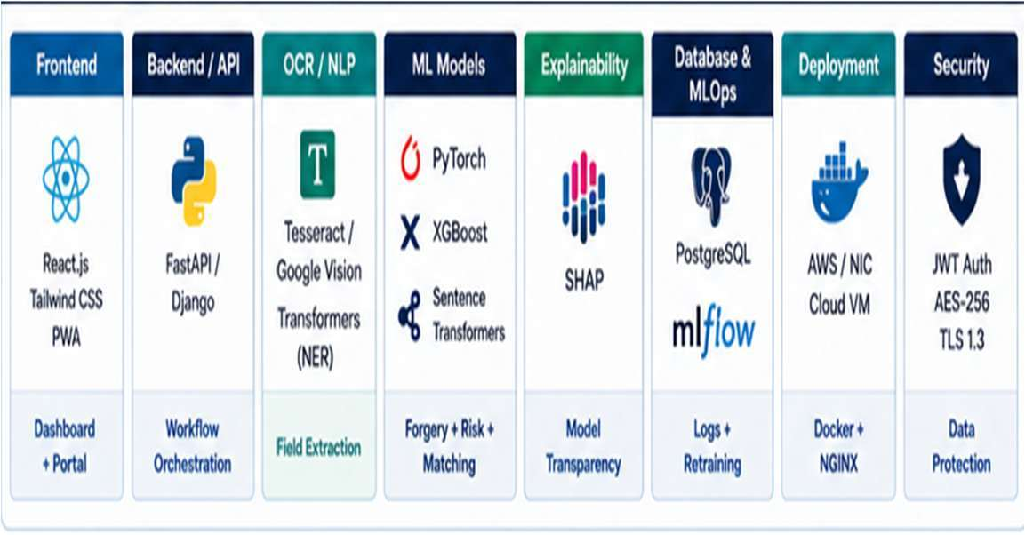
TECHNICAL APPROACH
TECHNICAL STACK
• Frontend — React.js, Tailwind, PWA officer dashboard
• Backend/API — FastAPI or Django REST, orchestrates the pipeline
• OCR/NLP — Tesseract/Vision API + HuggingFace NER
• Forgery detection — PyTorch CNN, ELA-based
• Risk scoring — XGBoost / scikit-learn
• Entity matching — Sentence-Transformers + FAISS
• Explainability — SHAP
• MLOps — MLflow, scheduled retraining
• Data/Infra — PostgreSQL, Docker/NGINX, gov cloud VM
• Security — JWT auth, AES-256 at rest, TLS 1.3 in transit
@SIH Idea submission- Template
3
Notes:
Technical Approach: React PWA, FastAPI/Express, PyTorch CNN ELA, XGBoost, FAISS, SHAP explainable AI, and strict AES-256 with TLS 1.3.

Slide 4
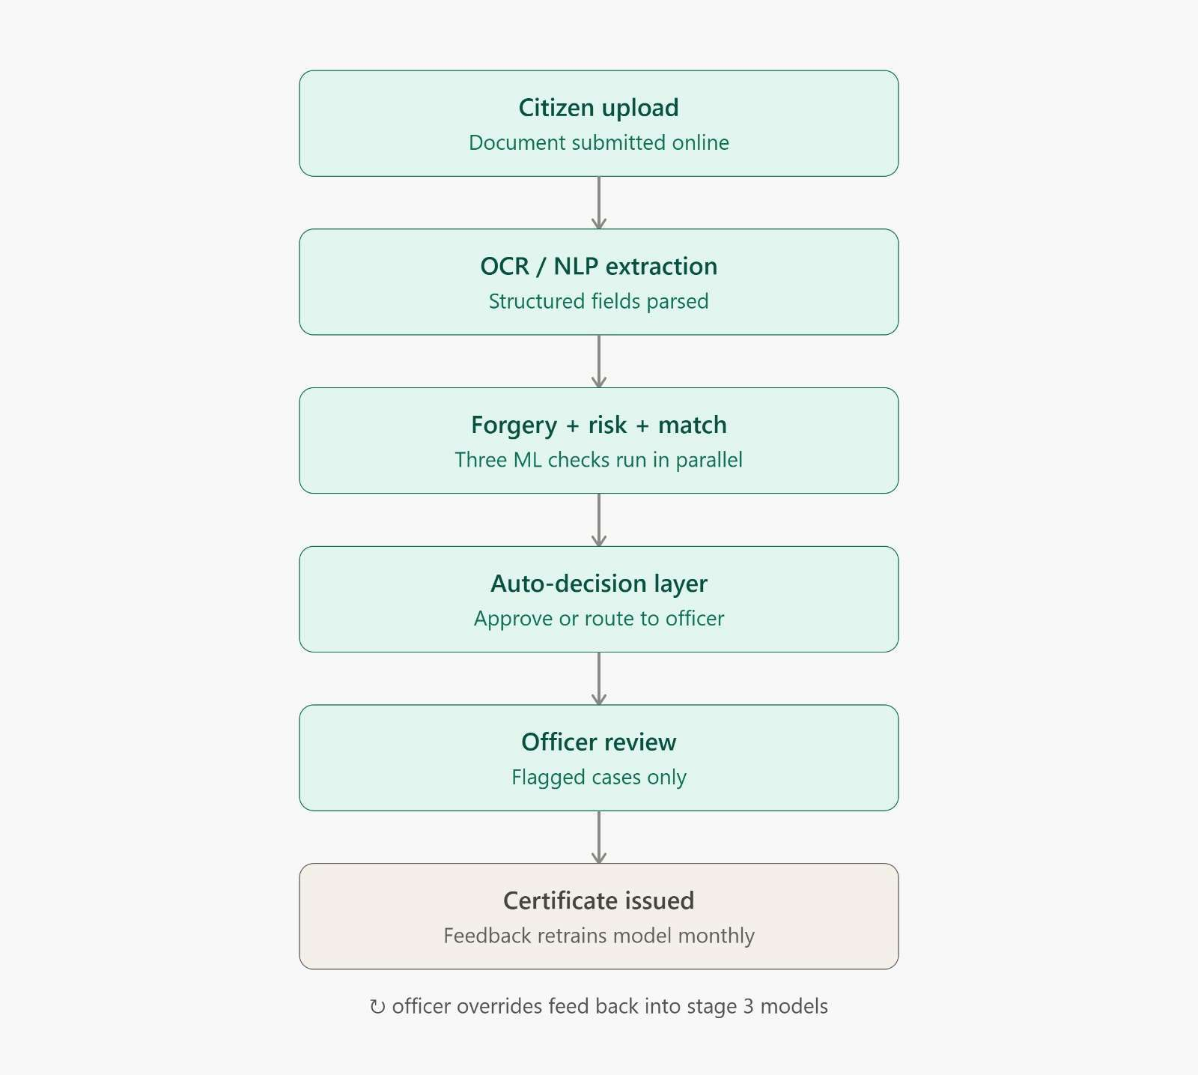
FEASIBILITY AND VIABILITY
Feasibility
• The technology is ready: The AI tools needed to spot fraud and unusual patterns already exist and are widely used by banks today.
• Getting good data is hard: The AI is only as smart as the information it gets, so forcing all local government offices to upload clean, digital records will be a major challenge.
Viability
• It saves a lot of money: The system will easily pay for itself by stopping wasted funds, fake projects, and contractor corruption.
• People will fight it: Corrupt officials or dishonest contractors who make money off the current broken system will strongly resist using this AI
@SIH Idea submission- Template
4
Notes:
Feasibility & Viability: Technology is proven, data noise handled via OpenCV preprocessing, saves public funds, empowers caseworkers via Human-in-the-Loop Cockpit.

Slide 5
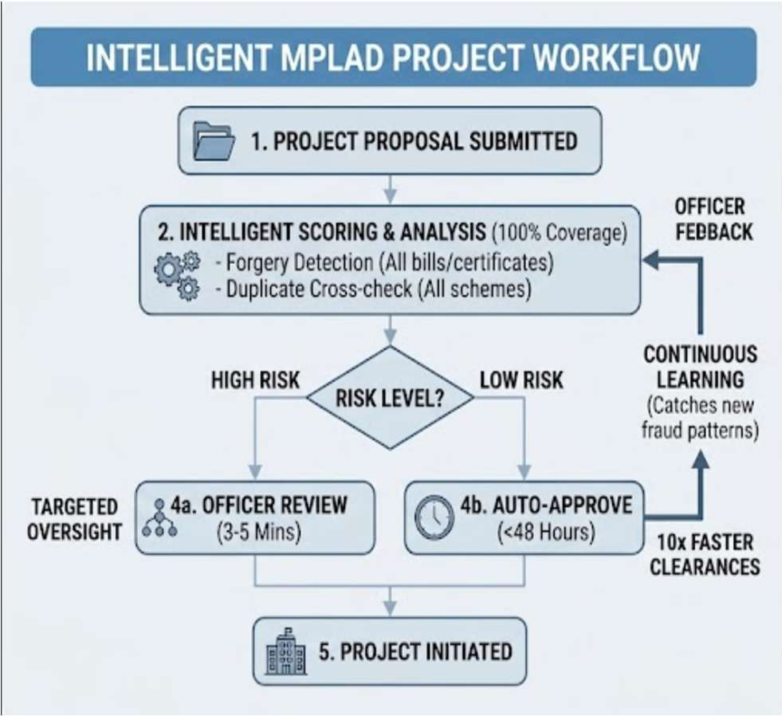
IMPACT AND BENEFITS
• 10x Faster Clearances:
Auto-approves low-risk projects in under 48 hours instead of taking 15–30 days.
• Targeted Officer Review:
Uses risk scoring so officials only spend 3–5 minutes reviewing high -risk files.
• Total Forgery Detection:
Scans every single bill and certificate for tampering, leaving no blind spots.
• Prevents Duplicate Funding:
Cross-checks department data to stop the same work from being billed under multiple schemes.
• Continuous Learning:
Updates automatically from officer feedback to catch new fraud patterns.
@SIH Idea submission- Template
5
Notes:
Impact & Benefits: 10x faster clearances, 3-5 minute targeted officer reviews, 100% forgery detection, duplicate funding prevention, continuous active learning.

Slide 6
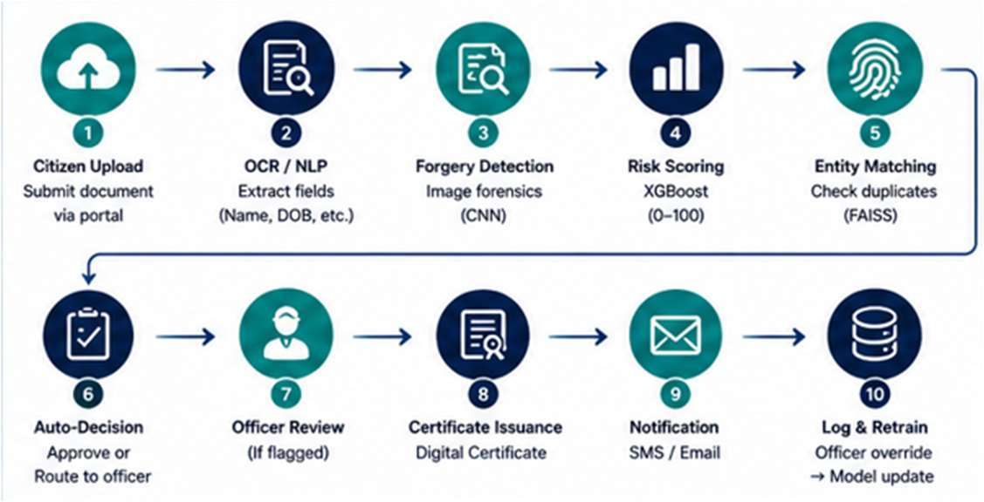
RESEARCH AND REFERENCES
Policy & government frameworks (2 sources)
• Right to Public Services (RTS) Act — turnaround benchmarks
• MeitY Digital India / e-Governance AI adoption guidelines
Technical research (2 sources)
• CNN-based document forgery detection (ELA methods)
• SHAP — SHapley Additive exPlanations, explainability framework
END TO END WORKFLOW
@SIH Idea submission- Template
6
Notes:
Research & References: RTS Act, DPDP Act 2023, MeitY guidelines, CNN ELA, and SHAP explainability. Live demo: https://printed-blind-lil-arch.trycloudflare.com

