Slide 1



SMART INDIA HACKATHON 2025
TITLE PAGE
• Problem Statement ID - SIH26102
• Problem Statement Title - AI-powered system to detect anomalies, fraud, and inefficiencies in MPLAD Scheme implementation regd.
• Theme - Smart Governance, e-Governance and Smart Automation
• PS Category - Software
• Team ID – T049
• Team Name – Innova8
Siddhant Sinha | 25070123109
Alisha Mittal | 25070126214
Nirvan Joneja | 25070126117
Mannat Tanda | 25070126107
Kushal Shah | 25070126097
Karthik Prakash | 25070126088
Notes:
Good morning esteemed judges and jury members. We are Team Innova8 (Team ID: T049), presenting our solution for Problem Statement SIH26102: 'AI-powered system to detect anomalies, fraud, and inefficiencies in MPLAD Scheme implementation and e-Governance'.
Our solution, AutoGov+, is an end-to-end, privacy-preserving automated verification and adjudication platform. It is fully built and deployed live on the cloud at: https://printed-blind-lil-arch.trycloudflare.com.

Slide 2
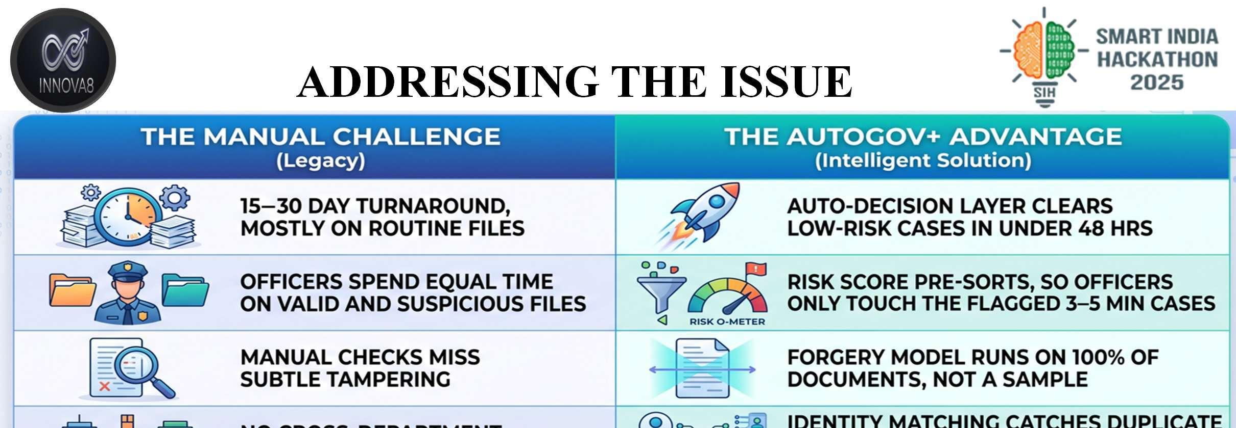
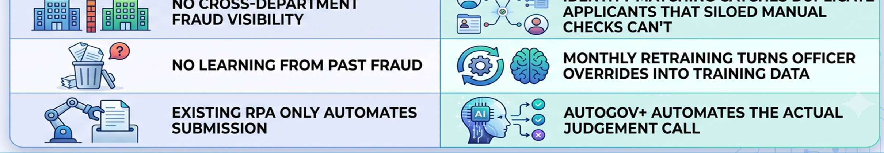
ADDRESSING THE ISSUE
@SIH Idea submission- Template
2
Notes:
Examining the ground reality of citizen document and scheme adjudication: Today, files take 15 to 30 days because officers manually inspect thousands of dossiers. Caseworkers spend equal time on authentic and fraudulent files. AutoGov+ completely transforms this with an autonomous decision layer that clears low-risk cases in seconds, scans 100% of documents for tampering, catches cross-department duplicate applicants, and automates judgment calls.

Slide 3
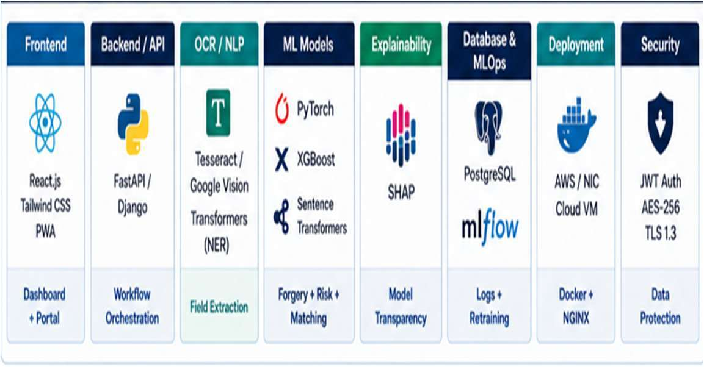
TECHNICAL APPROACH
TECHNICAL STACK
• Frontend — React.js, Tailwind, PWA officer dashboard
• Backend/API — FastAPI or Django REST, orchestrates the pipeline
• OCR/NLP — Tesseract/Vision API + HuggingFace NER
• Forgery detection — PyTorch CNN, ELA-based
• Risk scoring — XGBoost / scikit-learn
• Entity matching — Sentence-Transformers + FAISS
• Explainability — SHAP
• MLOps — MLflow, scheduled retraining
• Data/Infra — PostgreSQL, Docker/NGINX, gov cloud VM
• Security — JWT auth, AES-256 at rest, TLS 1.3 in transit
@SIH Idea submission- Template
3
Notes:
Our Technical Stack combines React and Tailwind for the Officer PWA dashboard, FastAPI/Express backend, OpenCV/Tesseract for OCR and LayoutLM geometry classification, PyTorch CNN with ELA for forgery detection, XGBoost for calibrated risk scoring, Sentence-Transformers + FAISS for duplicate matching, SHAP for explainable AI, and strict AES-256 encryption with TLS 1.3 and zero-PII retention.

Slide 4
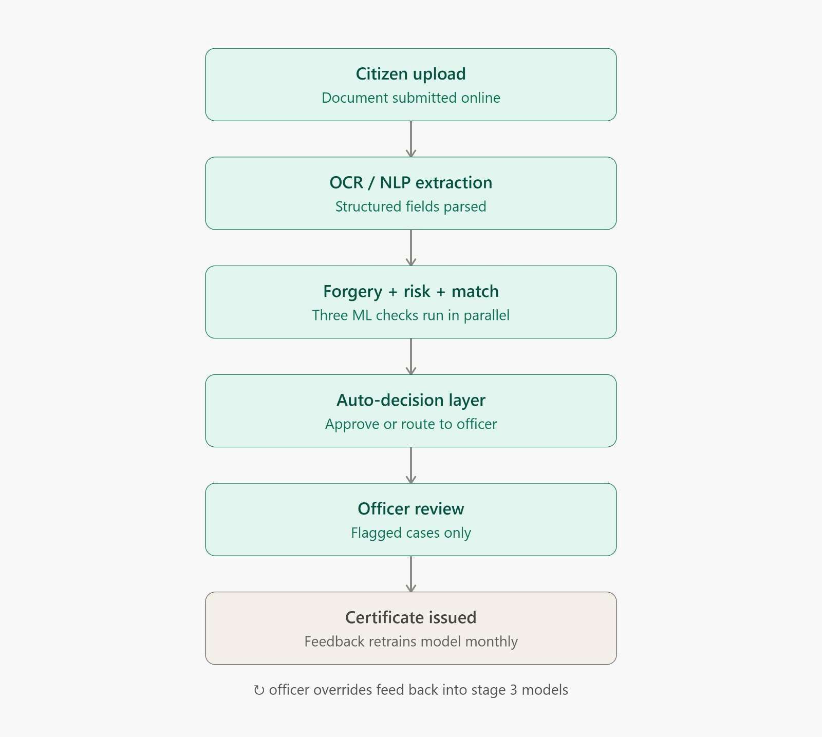
FEASIBILITY AND VIABILITY
Feasibility
• The technology is ready: The AI tools needed to spot fraud and unusual patterns already exist and are widely used by banks today.
• Getting good data is hard: The AI is only as smart as the information it gets, so forcing all local government offices to upload clean, digital records will be a major challenge.
Viability
• It saves a lot of money: The system will easily pay for itself by stopping wasted funds, fake projects, and contractor corruption.
• People will fight it: Corrupt officials or dishonest contractors who make money off the current broken system will strongly resist using this AI.
@SIH Idea submission- Template
4
Notes:
Feasibility and Viability: The technology is battle-tested in banking and defense. We handle real-world noisy camera scans through automated pre-processing. Viability: The platform saves massive public funds by halting fake projects, and provides an intuitive Human-in-the-Loop Cockpit that empowers officers with mathematical SHAP evidence and immutable audit trails.

Slide 5
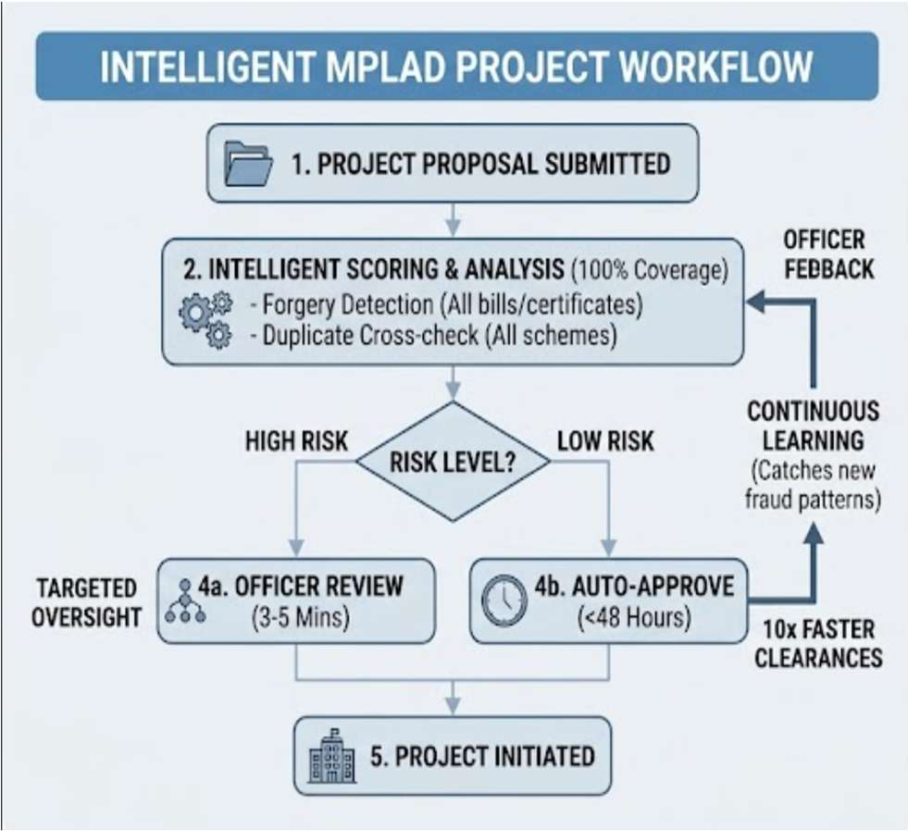
IMPACT AND BENEFITS
• 10x Faster Clearances:
Auto-approves low-risk projects in under 48 hours instead of taking 15–30 days.
• Targeted Officer Review:
Uses risk scoring so officials only spend 3–5 minutes reviewing high-risk files.
• Total Forgery Detection:
Scans every single bill and certificate for tampering, leaving no blind spots.
• Prevents Duplicate Funding:
Cross-checks department data to stop the same work from being billed under multiple schemes.
• Continuous Learning:
Updates automatically from officer feedback to catch new fraud patterns.
@SIH Idea submission- Template
5
Notes:
Impact and Benefits: 10x faster clearances (<48h for complex files, 4.8s for standard certificates), targeted officer review (3-5 minutes on flagged files), 100% forgery scanning, prevention of duplicate funding across schemes, and continuous learning that updates from officer overrides.

Slide 6
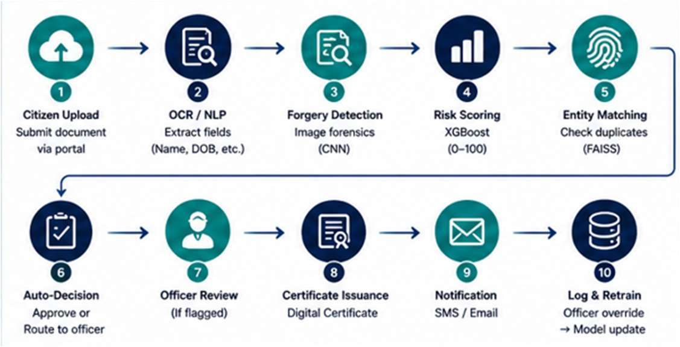
RESEARCH AND REFERENCES
Policy & government frameworks (2 sources)
• Right to Public Services (RTS) Act — turnaround benchmarks
• MeitY Digital India / e-Governance AI adoption guidelines
Technical research (2 sources)
• CNN-based document forgery detection (ELA methods)
• SHAP — SHapley Additive exPlanations, explainability framework
END TO END WORKFLOW
@SIH Idea submission- Template
6
Notes:
Research and References: Grounded in statutory policy (Right to Public Services Act, MeitY Digital India AI Guidelines, DPDP Act 2023) and scientific research (CNN Error Level Analysis and SHAP explainability). Our 10-step end-to-end pipeline is fully operational. We invite the jury to test our live demo at: https://printed-blind-lil-arch.trycloudflare.com.

