Slide 1
CANTEEN MANAGEMENT SYSTEM
-Kushal Kiran Timilsina
-Bibash limbu

Slide 2
Introduction
Canteen Management system is a Canteen based system which stores the records of the food order by the student and generate bill of each student.
In this system we have admin & salesman, where admin manages student, food, salesman whereas salesman take order from students on spot.

Slide 3
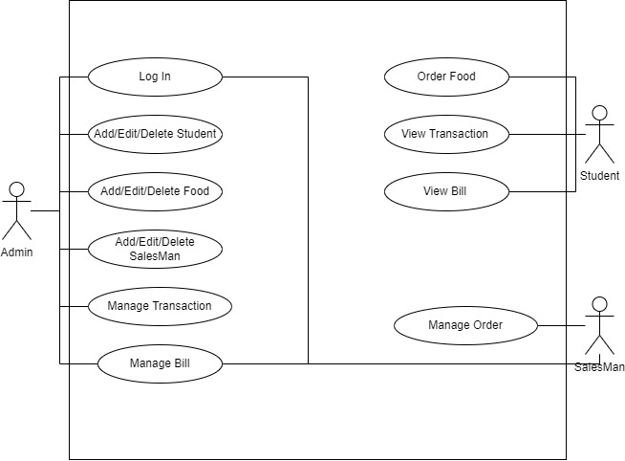

Slide 4
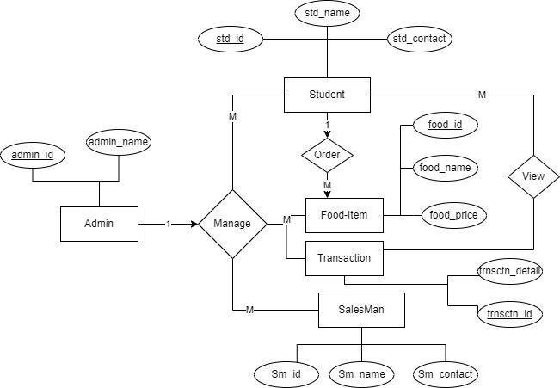
ER DIAGRAM

Slide 5
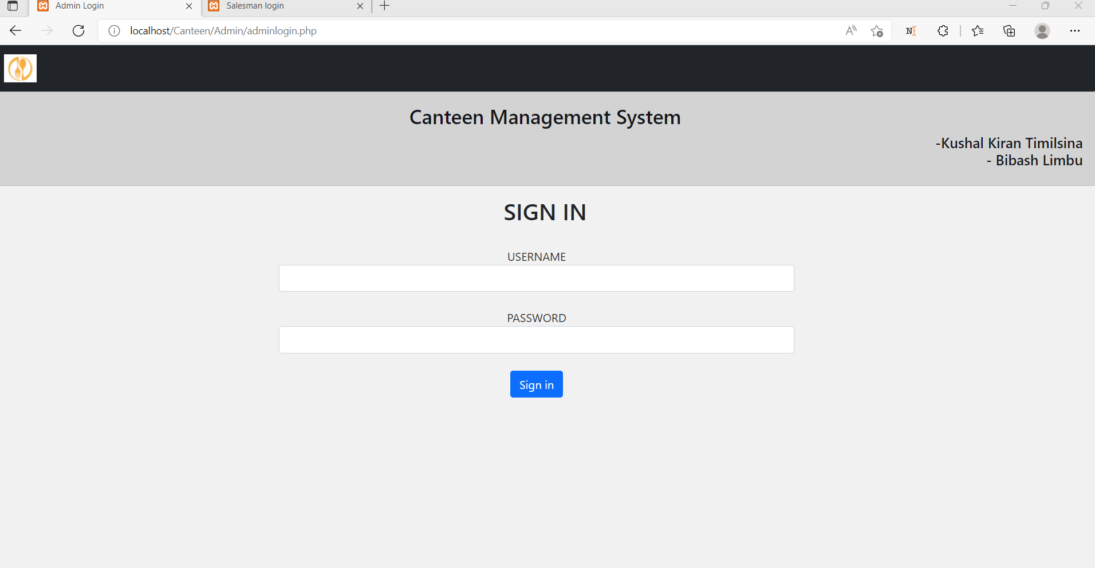
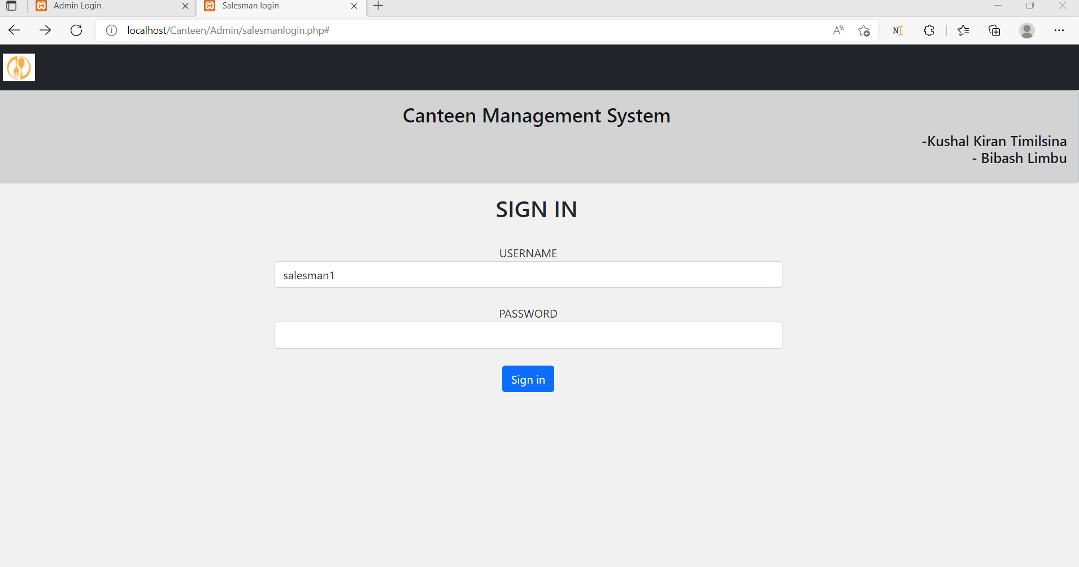
Login for Canteen Management System
Admin Login
Salesman Login

Slide 6

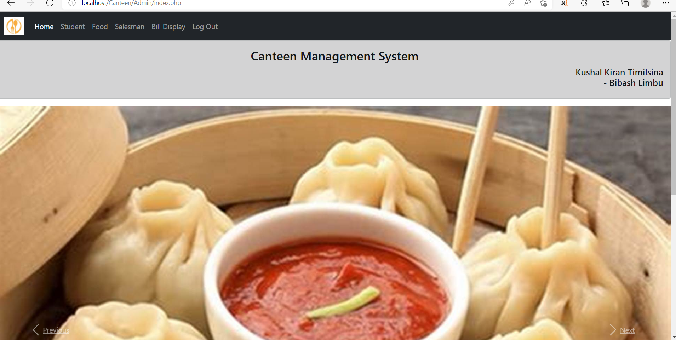
ADMIN
HOME
STUDENT
FOOD
SALESMAN
BILL DISPLAY
LOG OUT

Slide 7
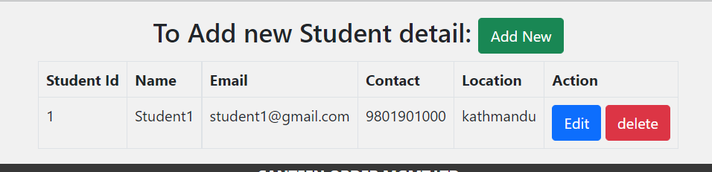
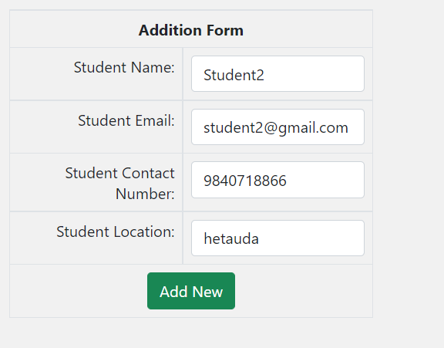
STUDENT
VIEW STUDENT DETAIL
ADD STUDENT DETAIL
EDIT STUDENT DETAIL
DELETE STUDENT DETAIL

Slide 8
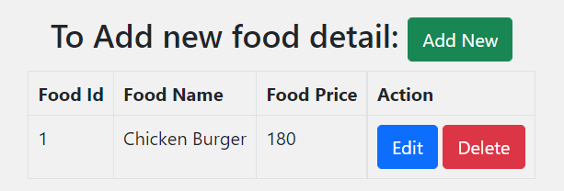
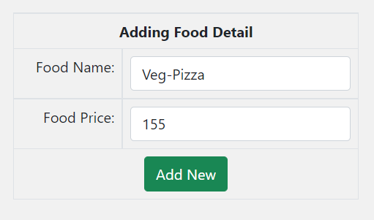
FOOD
VIEW FOOD DETAIL
ADD FOOD DETAIL
EDIT FOOD DETAIL
DELETE FOOD DETAIL

Slide 9
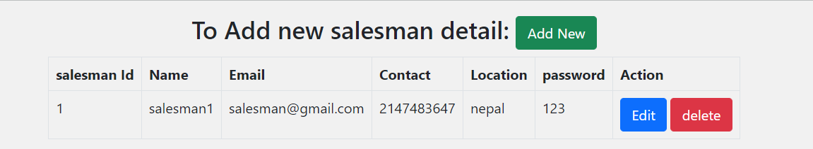
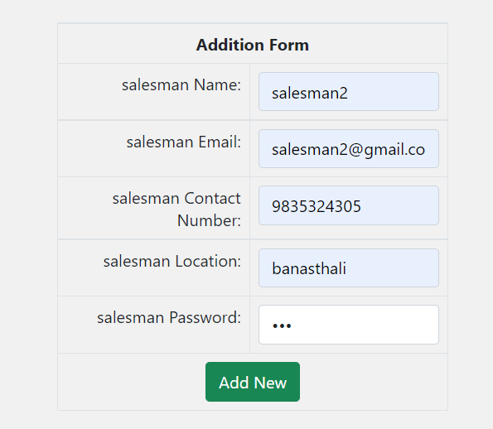
SALESMAN
VIEW SALESMAN DETAIL
ADD SALESMAN DETAIL
EDIT SALESMAN DETAIL
DELETE SALESMAN DETAIL

Slide 10
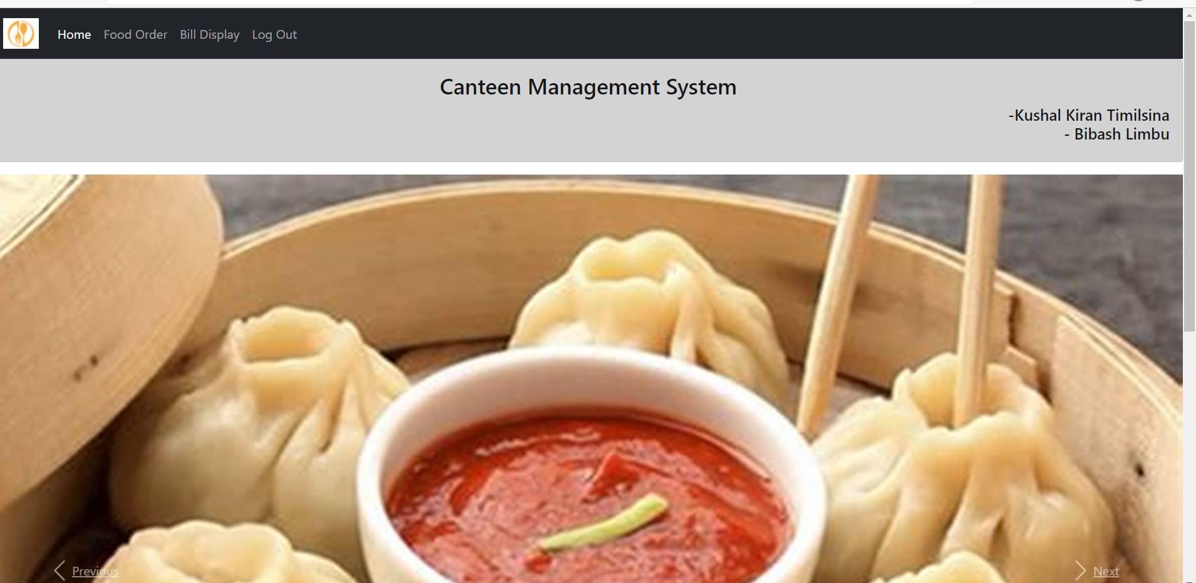
SALESMAN
HOME
FOOD ORDER
BILL DISPLAY
LOG OUT

Slide 11
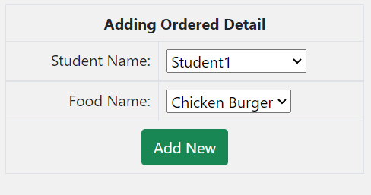
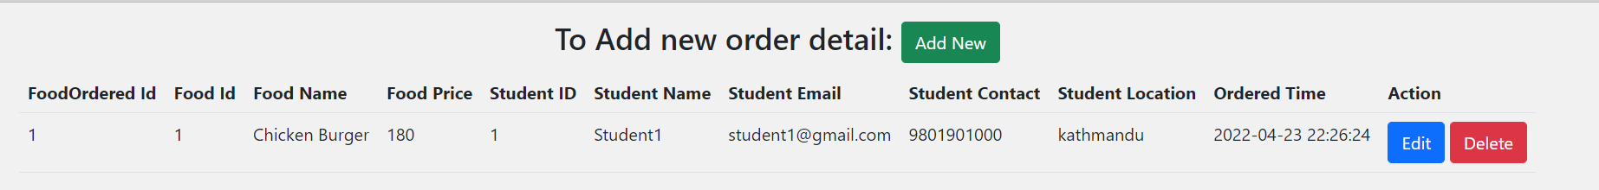
FOOD ORDER
TAKE ORDER
EDIT FOOD ORDER RECORD
DELETE FOOD ORDER RECORD

Slide 12
COMPLETED
LOG IN TO THE SYSTEM
ADD/EDIT/VIEW/DELETE STUDENT DETAIL
ADD/EDIT/VIEW/DELETE FOOD DETAIL
ADD/EDIT/VIEW/DELETE SALESMAN DETAIL
TAKE ORDER
EDIT/DELETE ORDER DETAIL
LOG OUT

Slide 13
TO BE COMPLETED
GENERATE BILL

Slide 14
Thank you!
Thank you!

