Slide 1
StudyTrack
M1
M2
M3
M4
M5
M6
M7
M8
M9
M10
Final DevOps project – Session 21
A study log shipped end to end: FastAPI + PostgreSQL + React → tests → Docker → GitHub Actions → GHCR → Terraform → Kubernetes/Helm → Argo CD → Prometheus/Grafana
Kushal Talati · 24BCS10123 · github.com/kushaltalati/devops-heros
Notes:
Hi, I am Kushal Talati, 24BCS10123. StudyTrack is my final project: my own application (a study log), taken through every DevOps layer the course covered. Everything in this deck was really run; the raw logs and screenshots are in the repo under docs/outputs and screenshots.

Slide 2
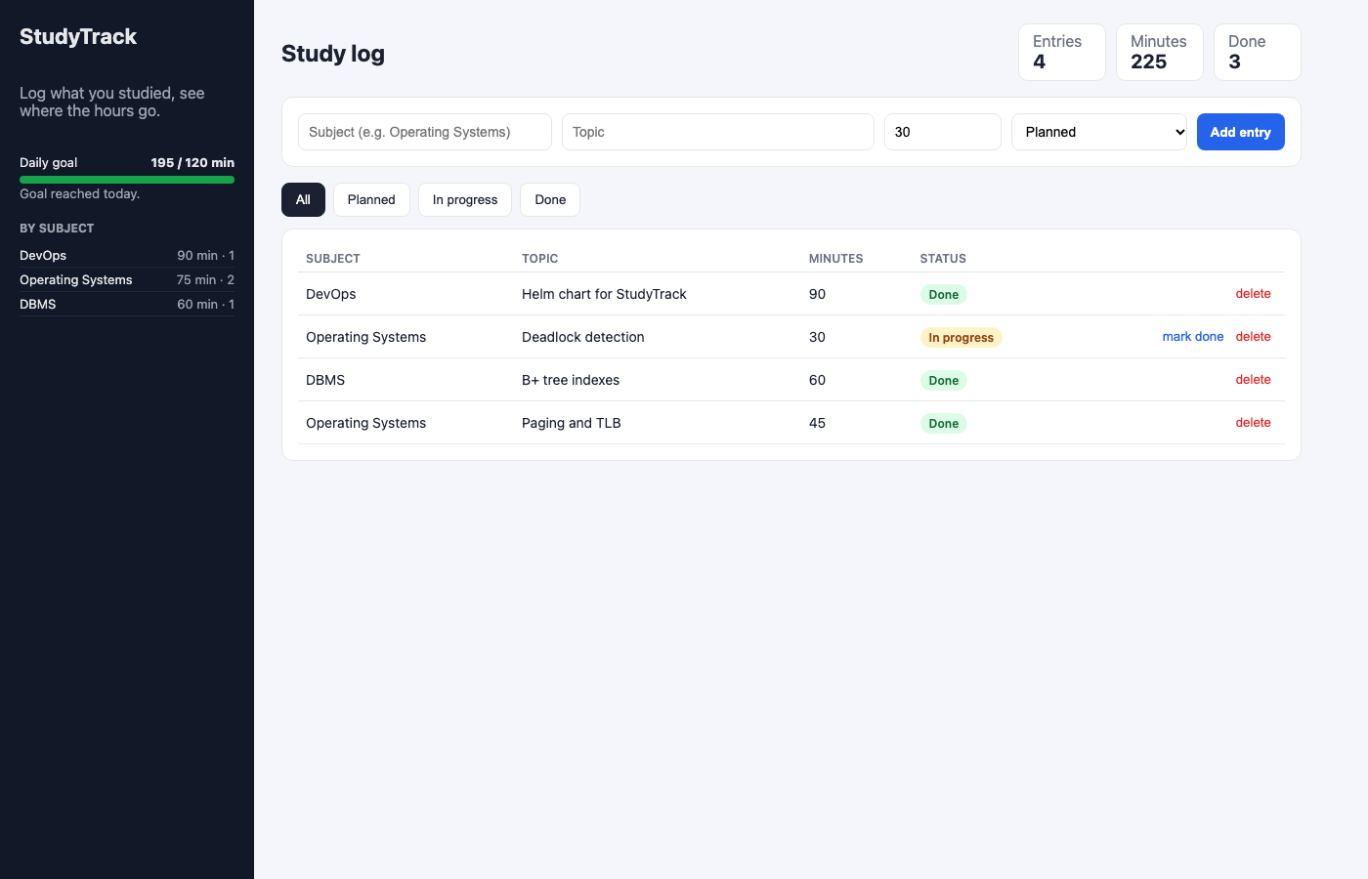
StudyTrack: a study log with a daily goal
Record blocks of study time – subject, topic, minutes, status – mark them done, and watch the dashboard: total minutes, progress against a daily goal, per-subject breakdown.
Same shape as the course's TaskBoard reference (FastAPI + PostgreSQL + React, one resource with full CRUD) – but my own domain, code and schema.
7
11
2
REST endpoints
pytest cases, 93% cov
images, both non-root
Frontend via docker compose on localhost:3000 – sidebar goal bar, KPI cards, add form, status filters, entries table.
Notes:
The app itself is deliberately small so the DevOps layer is the point. One table, study_entries, seven endpoints, a React dashboard. The screenshot is the compose stack running locally.

Slide 3
Architecture: CI builds, GitOps deploys
git push
capstone branch
GitHub Actions gates
pytest · bandit/semgrep · pip-audit/npm audit · gitleaks · helm lint
build + push
GHCR sha-<7> amd64+arm64
trivy gate
HIGH/CRITICAL ⇒ fail
deploy job
bump image.tag, commit
kind cluster kushal-lab · namespace studytrack
Argo CD
auto-sync · self-heal · prune
frontend ×2
nginx-unprivileged :8080
ServiceMonitor
/metrics every 15s
Prometheus
3 alert rules
/
The runner never gets a kubeconfig. It changes one line in git; Argo CD does the apply.
Ingress
studytrack.local
backend 2…6 (HPA 50% CPU)
uvicorn · startup/ready/live probes
postgres + PVC 1Gi
Secret · ConfigMap
Grafana
8-panel dashboard
/api
Terraform (VPC · 2 public subnets · IGW · SG · S3 · EKS module) ran against LocalStack – see M7.
Notes:
Read left to right along the top: a push runs the gates, builds both images for amd64 and arm64, Trivy can fail the pipeline, and the last job only edits image.tag in values.yaml and commits. Argo CD watches that path and syncs the cluster. The cluster is the same kind cluster I used from session 9 onwards.

Slide 4
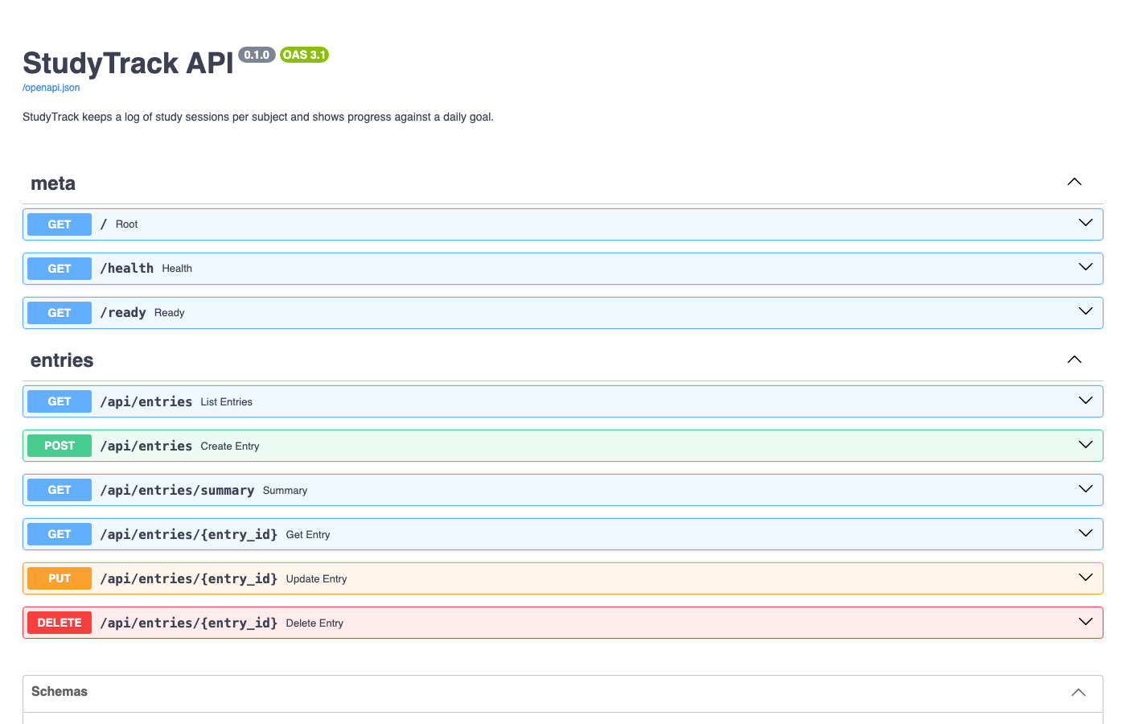
M1 Application and API
GET | /health | liveness – process answers
GET | /ready | readiness – SELECT 1, 503 if DB down
GET | /metrics | Prometheus text format
GET | /api/entries | list · ?subject= ?status_filter=
GET | /api/entries/summary | totals, goal, by_status, by_subject
POST | /api/entries | 201 · pydantic: minutes 1..600
PUT | /api/entries/{id} | partial update · 422 / 404
DELETE | /api/entries/{id} | 204
12-factor config: DATABASE_URL, APP_ENV, DAILY_GOAL_MINUTES, CORS_ORIGINS are env vars – exactly what the ConfigMap and Secret inject. Alembic migration 0001 runs from the entrypoint before uvicorn, so a fresh DB is ready on first boot.
FastAPI Swagger at /docs – the demo creates, updates and deletes an entry from here.
Notes:
Seven endpoints, one table. The readiness endpoint really touches the database, which matters later in the troubleshooting scenario. Configuration is environment variables only, so the same image runs under compose and under Kubernetes.

Slide 5
M2 + M4 Tests gate the build; images run non-root
M2
11 pytest cases over 7 endpoints
M4
Two Dockerfiles, two non-root users
SQLite in-memory via conftest.py – no PostgreSQL needed on the runner
Covers validation (422), not-found (404), filters and the summary maths
pytest -v --cov=app → 11 passed, main.py 93% covered, 0.37s
First job of the pipeline; every other job needs: test – a red test means no image is ever built or pushed
backend: python:3.12-slim, uid 10001, HEALTHCHECK /health, entrypoint = migrate then uvicorn
frontend: node:24-alpine builds dist/ → nginxinc/nginx-unprivileged, uid 101, port 8080
docker compose: postgres:16-alpine with pg_isready healthcheck, backend waits for service_healthy
Rows survived docker compose up --build – data lives in the pgdata volume, not the container
Notes:
Tests run against SQLite in memory so the CI job is fast and needs no database service. Both images are non-root, which is why nginx listens on 8080 instead of 80. The compose volume proves the data is outside the container.

Slide 6
M5 Pipeline: 8 jobs, 4 gates, one commit back
sast bandit · semgrep
sca pip-audit · npm audit
test
pytest + cov
build-and-push
buildx + QEMU, amd64/arm64, sha-<7> + latest
image-scan ×2
trivy, exit 1 on HIGH/CRIT
deploy
image.tag → values.yaml, commit [skip ci]
secret-scan gitleaks
helm-lint lint + template
Triggers: push to the capstone / sessions branches, path-filtered to this folder, so classmates' pushes to the shared fork never run my pipeline. Never pull_request.
Why multi-arch: runners are amd64, my kind nodes are arm64 – the first amd64-only image would have died with exec format error.
Run history: YAML parse error → blocked by SCA → trivy action unresolvable (swapped for docker run aquasec/trivy) → green run 37665794354 with sha-ada2a45 live.
Notes:
The shape is a fan-out and fan-in: tests first, four independent gates, then one build, Trivy per image, and the deploy job that only edits git. Every red run in the history taught me something, and the green run is linked in the README.

Slide 7
M6 Gates only matter if they can say no
10
42 → 0
0
known CVEs in starlette 0.50.0 – pip-audit blocked the run, nothing was built
trivy findings on the first frontend image (alpine 3.21) → base image bump
HIGH/CRITICAL left on both final images (debian 13.7 · alpine 3.24.2)
What runs, and where
The fix was never an ignore
SAST – bandit -ll, semgrep p/python + p/security-audit on backend/app
SCA – pip-audit --strict, npm audit --omit=dev --audit-level=high
Secrets – gitleaks over history and tree, .gitleaks.toml allow-lists lab placeholders
Images – trivy twice: full report that never fails, then the gate with --ignore-unfixed
SCA block → upgrade FastAPI/Starlette to the patched release and drop a library, not add an exception
Trivy block → bump the nginx base image; the Debian python image was already clean
--ignore-unfixed because a CVE with no patched package yet can only be documented, not fixed
Notes:
This is the slide I care about most. The SCA gate really fired on starlette, and Trivy really forced a base image bump. Both would have shipped silently without the pipeline.

Slide 8
M7 Terraform: 12 resources applied and destroyed
aws_vpc.main | 10.42.0.0/16, DNS support + hostnames
aws_subnet.public[0..1] | 10.42.1.0/24 (a), 10.42.2.0/24 (b), EKS/ELB tags
aws_internet_gateway.main | + route table: 0.0.0.0/0 → igw, 2 associations
aws_security_group.web | 80/443 in, all out
aws_s3_bucket.backups | versioning on, public access blocked, force_destroy
module.eks (create_eks ? 1 : 0) | IAM roles, aws_eks_cluster, aws_eks_node_group
Where it ran, honestly
The AWS key on this laptop is invalid (InvalidClientTokenId) and I did not want a paid account for an assignment
Same code, one variable flipped → LocalStack 4.0.3 on localhost:4566
init · fmt -check · validate · plan (12 to add) · apply · output · aws ec2/s3 verify · destroy (12 destroyed) · state list empty
EKS: planned, not applied
terraform output → vpc_id = vpc-98e2ca57 · public_subnet_ids = [subnet-0fe094cb, subnet-291d6d0a] · backup_bucket = studytrack-24bcs10123-backups-dev
LocalStack free has no EKS API; a real control plane costs money the moment it exists – so create_eks defaults to false
Saying "planned, not applied" is better than a screenshot I do not have.
Notes:
Infrastructure code must be portable to be testable. The whole apply and destroy cycle ran against LocalStack with one variable, and the EKS module is planned with create_eks=true but not applied, and I say so.

Slide 9
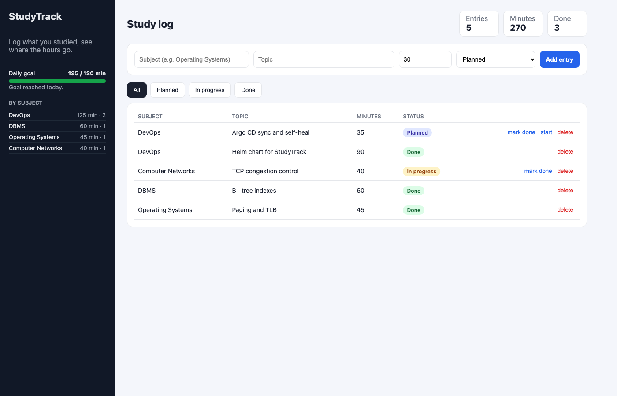
M8 Kubernetes + Helm: 5 pods, Ingress, HPA 2 → 6
http://studytrack.local through ingress-nginx: / → frontend, /api → backend
Replicas: 2 → 6 within one HPA sync period (SuccessfulRescale, cpu above target), back to 2 after a 60 s stabilisation window.
helm upgrade --install studytrack helm/studytrack → REVISION 1, deployed
ConfigMap · Secret · PVC + postgres · backend/frontend Deployments with startup/readiness/liveness probes · 3 ClusterIP Services · Ingress · HPA · ServiceMonitor — values.yaml + values-dev + values-prod
Notes:
Left: the app served through the Ingress hostname. Right: the HPA load test – CPU per pod went from 4 percent of request to over 460 percent, the HPA scaled from two to six pods in one sync period, and scaled back after the load stopped. The chart has the real numbers from the kubectl get hpa watch.

Slide 10
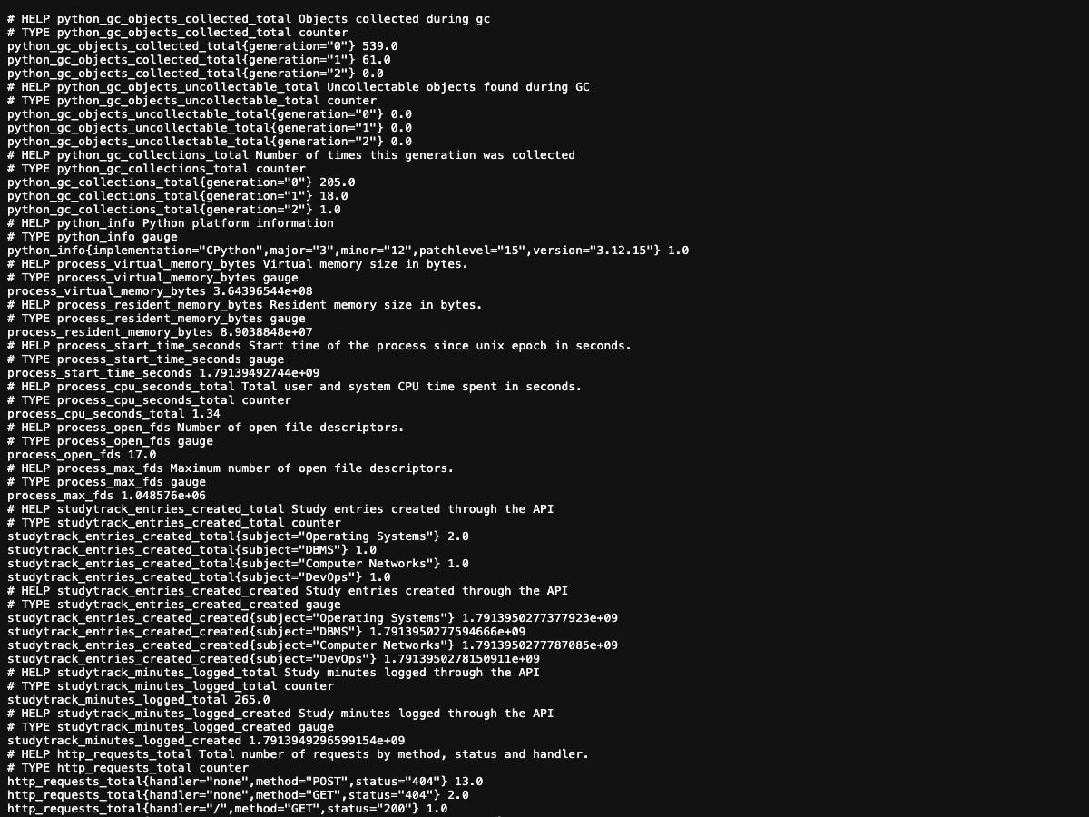
M9 Observability: metrics → Prometheus → Grafana
38.9
198 ms
2 / 2
req/s on /api/entries/summary during load
p95 latency (histogram_quantile 0.95)
backend scrape targets health=up
Three alert rules (PrometheusRule)
backend target down · 5xx ratio above 5% · p95 above 500 ms – all inactive / health=ok while the app is healthy
/metrics: http_requests_total, duration histogram, studytrack_entries_created_total{subject}, studytrack_minutes_logged_total
Grafana dashboard uid studytrack, 8 panels, imported via API
targets up · req/s · p95 · minutes logged · req/s by handler · status codes · CPU vs request · HPA replicas – panels return live data
Notes:
The backend exposes application and business metrics; the ServiceMonitor is part of the Helm chart so kube-prometheus-stack picks the pods up automatically. The numbers are from a 70 second load test; the Grafana dashboard JSON is in the repo.

Slide 11
M10 Commit → pipeline → rollout, already run once
1
2
3
4
5
commit ada2a45
run 37665794354 green
deploy commits 58f742e
Argo CD history id 1
both Deployments rolled
entrypoint.sh retries alembic while postgres starts
tests, 4 gates, 2 multi-arch images, trivy clean
tag: sha-ada2a45 written into values.yaml [skip ci]
deployedAt 18:23:41Z, revision 58f742e – picked up automatically
ScalingReplicaSet events, new entrypoint log line, data intact (PVC)
Self-heal, observed
Why GitOps here
kubectl scale deploy studytrack-frontend --replicas=5 was reverted to the 2 replicas in git within about 2 minutes, without me doing anything
prune deletes what git deleted; the git log is the deployment history
CI cannot reach a kind cluster on my laptop – and the runner should not hold a kubeconfig anyway
The pipeline changes one line in git; Argo CD, which already has cluster access, does the apply
Notes:
This is the M10 live demo flow, and it already ran for real: my commit, the green pipeline, the deploy commit the pipeline wrote, Argo CD picking it up, and both Deployments on the new image with the data intact. In the demo I will repeat the same loop live.

Slide 12
Failure simulation: three manifests, one method
Symptom | How I found it | Root cause → fix
Pod ErrImagePull → ImagePullBackOff, 0/1 | describe pod → events: manifest unknown from ghcr.io; logs empty | Tag does-not-exist is not in the registry → kubectl set image …:sha-da417a0
curl http://broken-service:8080 from a pod → exit 000 | get endpointslices → none; describe svc → selector app=label-that-does-not-exist | Selector matches no pod → patch the selector; endpoints appear
Pod Running but 0/1, never Ready, no restarts | describe → Readiness probe failed: 503; /health 200 but /ready says database down; env DATABASE_URL host no-such-db | Wrong DB host in ConfigMap → fix the value, rollout restart
get → describe (events) → logs → exec → find the root cause → change one thing → verify. Scenario 3 taught me most: a pod can be alive and useless at the same time, and the Service correctly ignores it because readiness checks the database, not just the process.
Notes:
Two scenarios from the course and one of my own. In the demo I break the image tag live and fix it. The method never changes: get, describe, logs, exec, one change, verify.

Slide 13
What I understood
1
Gates only matter if they can say no
2
CI builds, GitOps deploys
3
Readiness ≠ liveness
SCA and Trivy each blocked a run; the fix was an upgrade, not an ignore.
The runner never holds a kubeconfig. One line in git; Argo CD applies, heals drift, prunes.
/health = restart me? /ready = send me traffic? Scenario 3 is a pod that is alive and useless.
4
Tags are deployments
5
Non-root and multi-arch are not details
6
Portable infra is testable infra
latest says nothing; sha-ada2a45 says which commit is running – HPA, Argo and rollouts become reproducible.
uid 10001 / 101, nginx on 8080; amd64 runner, arm64 nodes.
Same Terraform, one variable → LocalStack; EKS planned, not applied, and said so.
Notes:
Six things I would not have understood from slides alone. Each one came from something that actually broke or actually blocked.

Slide 14
Live demo – in this order
1
App + API
2
Git → CI
3
Images
create an entry in the UI, CRUD it in Swagger, select it in psql
small commit, push, watch the Actions run and the gates
GHCR multi-arch manifest, Trivy on both images
4
Terraform
5
Kubernetes
6
Observe + heal
init · validate · plan against LocalStack
pods, svc, helm list, Ingress hostname, HPA
Prometheus targets, Grafana, break an image tag, fix it, Argo CD self-heal
Repo: github.com/kushaltalati/devops-heros → session21-python/kushal-24bcs10123 Green run: actions/runs/37665794354
Notes:
Demo order. Everything runs on the same kind cluster the earlier sessions used; the raw logs under docs/outputs back every step. Thank you – questions welcome.

