Slide 1
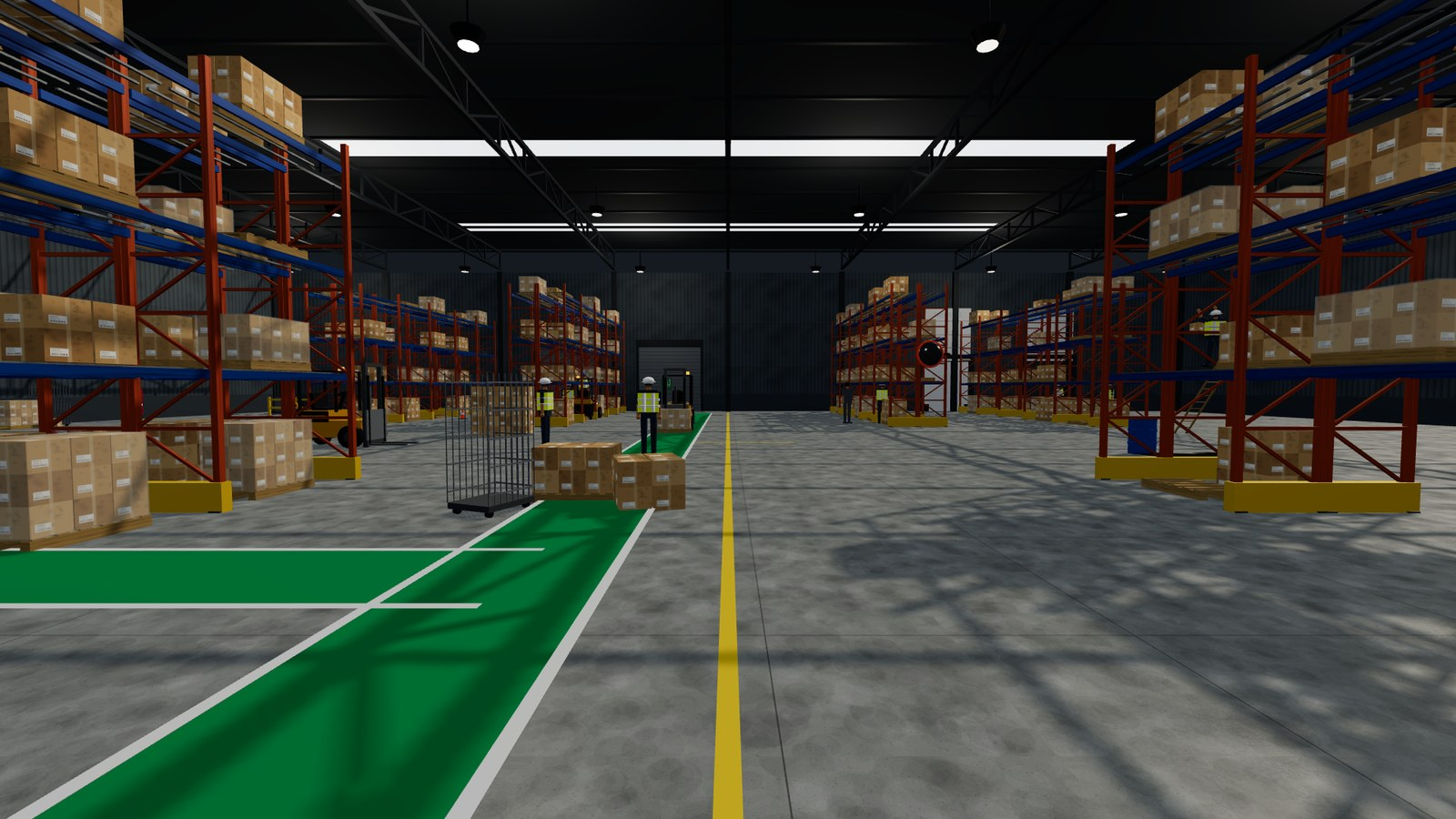
BEAT THE HAZARD
A 3D interactive health & safety training game for
warehouse forklift and pedestrian safety
The Code Crafters
HAZARDS
SITES
TESTS
FRAME RATE
15
3
266
60
Built by Kushal Neupane
Notes:
[0:00 – 0:30] Open on the screenshot: "this is the actual game, running." One-line pitch: we put the trainee INSIDE the warehouse instead of showing them slides about it. Do not linger — the four numbers do the work. Move on within 30 seconds.

Slide 2
THE PROBLEM
Safety training tests recall.
The job needs noticing.
1
2
3
Slides, then a quiz
The real skill is visual
That gap is where people get hurt
Most warehouse e-learning is a slideshow and a multiple-choice test. It checks whether you can repeat a rule.
On the floor nobody labels the hazard. You have to notice one upright is not vertical, or a carton overhangs a beam.
Forklift and pedestrian incidents are among the most serious in warehousing — and they are spotted, or missed, by eye.
A trainee can score full marks on the quiz and still walk past a blocked fire exit.
Notes:
[0:30 – 2:00] 90 seconds, no more. The amber line at the bottom is the one that lands — read it out. Then ask the room: how would you test whether someone would NOTICE a hazard? That question sets up the next two slides.

Slide 3
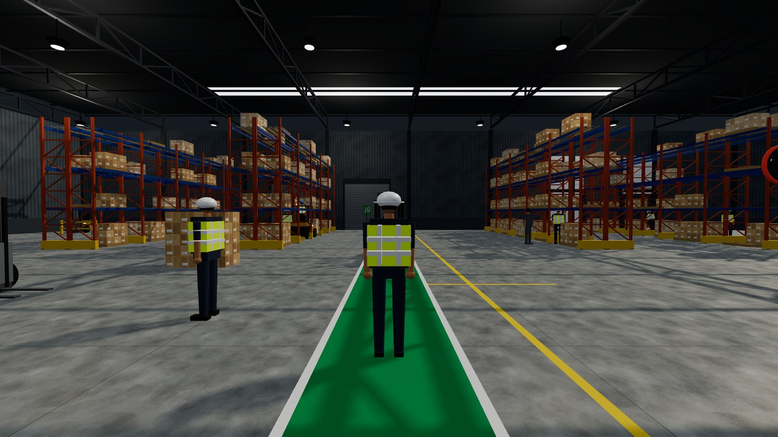
WHAT WE BUILT
Put them in the building
A browser-based 3D warehouse the trainee walks around in first person.
Every hazard is real geometry, at real scale
Inspect it from any angle, at your own eye level
Train Mode teaches it; Test Mode measures whether it stuck
Runs in any modern browser — no install, no headset
Works completely offline
Recognising a hazard is a spatial skill.
So we made the training spatial.
Notes:
[2:00 – 3:00] The pitch slide. Emphasise "no install, no headset" — it runs on the laptops they already have, and offline, which matters on a warehouse floor with bad wifi. Point at the image while you say it.

Slide 4
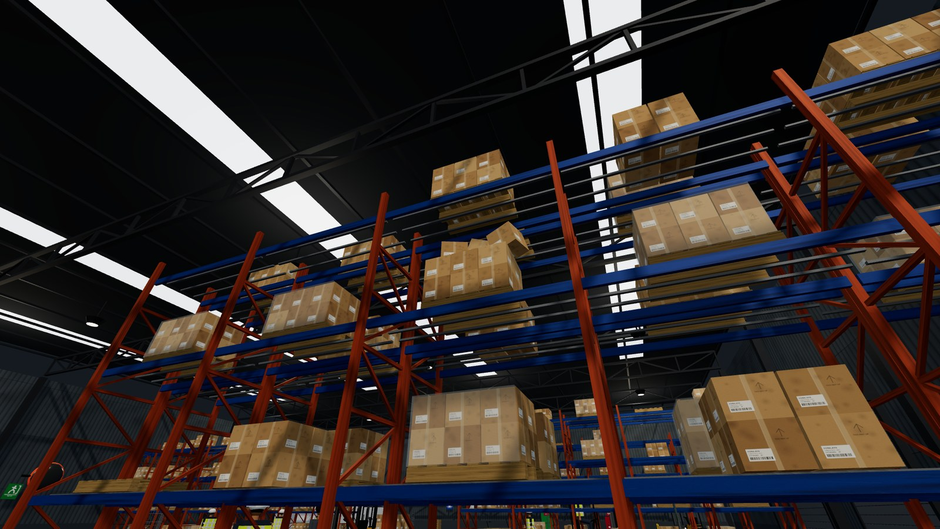
THE RULE EVERYTHING IS BUILT ON
A hazard is never an icon
✕
What most tools do
✓
What we do
Why it matters
A red marker floating over a photo, labelled "FALLING BOXES". The answer is given away — the trainee only has to click it.
A rack bay where most cartons sit square — one is displaced, one is tilted, one overhangs the beam and falls. You judge it by looking.
If the hazard is a marker, you are training people to spot markers.
If the hazard is the warehouse itself, you are training people to spot hazards.
Real screenshot — the unstable pallet sits among correctly stacked ones. No label, no marker.
Notes:
[3:00 – 5:00] THE most important slide — give it two full minutes. Do not just describe it: point at the screenshot and ask the room to find the bad pallet themselves. That few seconds of searching IS the product. Then read the amber column on the right.

Slide 5
COVERAGE
15 hazard scenarios, every one physically modelled
1
MAJOR
2
MAJOR
3
MAJOR
4
MAJOR
5
MINOR
Forklift on a walkway
Reversing blind spot
Falling boxes
Damaged racking
Unmarked spill
6
MINOR
7
MAJOR
8
MINOR
9
MINOR
10
MAJOR
Blocked walkway
Blocked fire exit
Blocked extinguisher
Worker without PPE
Open dock edge
11
MINOR
12
MINOR
13
MINOR
14
MAJOR
15
MAJOR
Trailing cable
Broken pallet
Over-height stack
Unsafe ladder
Blind corner
8 major · 7 minor Each carries a description, why it is dangerous, the correct control, and its teaching text.
Notes:
[5:00 – 6:00] Do NOT read fifteen names aloud. Say: "these are the fifteen the brief asked for, and every one is geometry you can walk up to." Then pick two — falling boxes and blind corner — and describe how each is staged. Red are major: worth three times a minor one.

Slide 6
WHAT MAKES IT TEACH
We also build the things that look wrong
but are actually right
Real hazard spotting is discrimination, not detection. A trainee who flags everything has learned nothing — so the warehouse is seeded with correctly-controlled lookalikes. Flagging one is scored wrong, and the game explains why it is fine.
“
This spill is already being managed — it is signed and coned off, which is exactly the correct control. The hazard is an UNMARKED spill.
HAZARD
CORRECTLY CONTROLLED — a wrong answer
Unmarked spill on the floor
→
A spill that IS coned and signed
Rack upright bent by an impact
→
A rack with a green inspection tag
Open dock door, no barrier
→
A dock sealed by a parked trailer
Forklift in the pedestrian lane
→
A truck parked in its charging bay
Actual feedback when a trainee flags a decoy
Notes:
[6:00 – 7:30] This is the slide that separates us from a click-the-hotspot trainer. The line to use: "we teach them what GOOD looks like, not just what bad looks like." Mention decoy count scales with difficulty: 0 on Simple, 12 on Hard.

Slide 7
HOW A SESSION RUNS
Learn it, then prove it
1
TRAIN MODE
2
TEST MODE
Teaches. Optional — never a gate.
Evaluates. Open from the start.
No clock at all — the trainee sets the pace
A guide arrow and distance point to the nearest hazard
Its location is named: “Aisle B, south end — at eye level”
A column of light marks the spot, visible through racking
Each find opens a card: what it is, why, and the control
Five minutes on the clock, whatever the difficulty
No guide and no locations — you find them by looking
Wrong flags break your combo and return a safety tip
Decoys punish spraying flags at everything
Full breakdown with personalised coaching
Observe
→
Find
→
Flag
→
Validate
→
Result
Notes:
[7:30 – 8:30] Train Mode has no clock: an arrow, a distance and a named location lead the trainee to the nearest hazard, and a column of light marks the spot. It is optional — an experienced operative can go straight to Test Mode, which is five minutes with no guide and no locations. The strip along the bottom is the Test Mode loop.

Slide 8
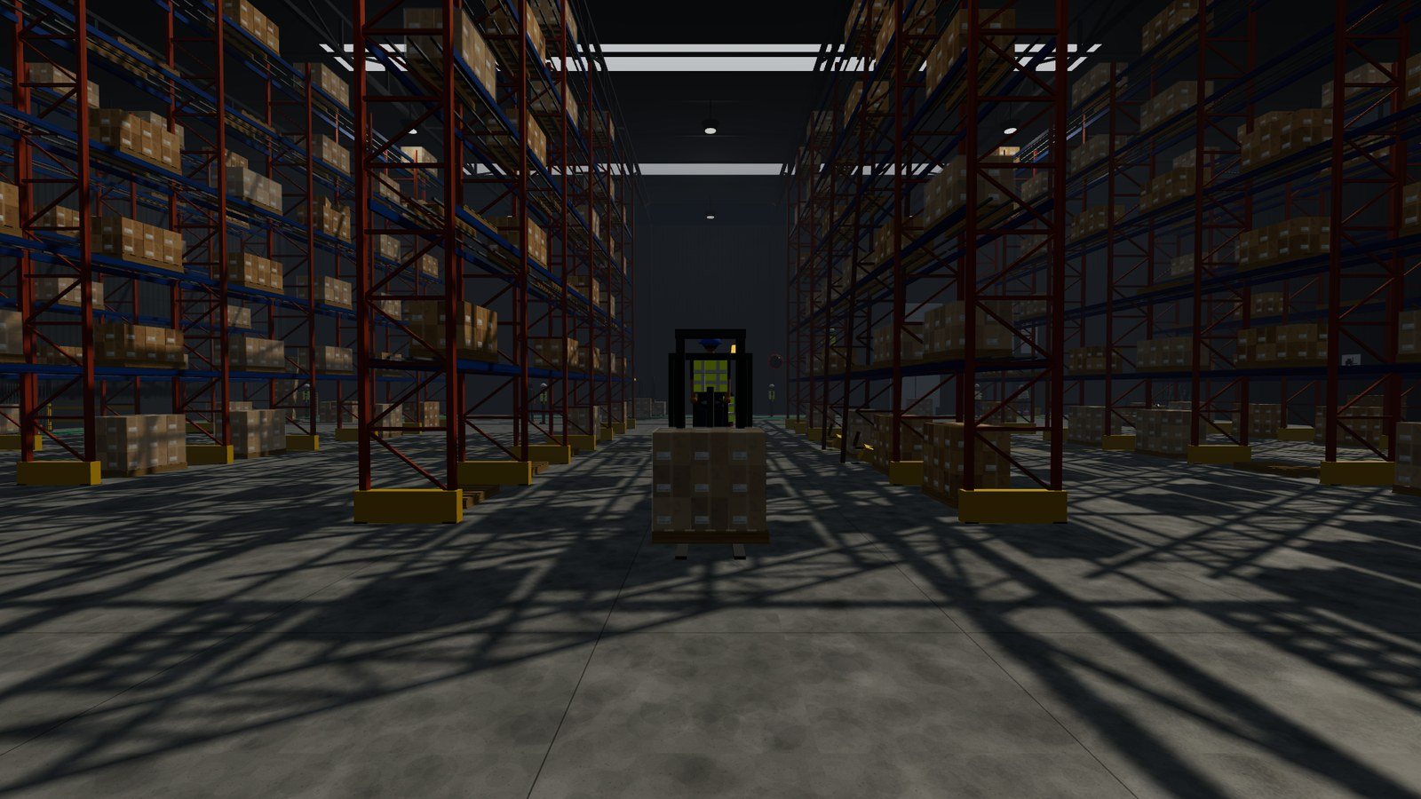
DIFFICULTY
Three difficulties that change the game,
not the label
 | SIMPLE | MID | HARD
Test length | 5:00 | 5:00 | 5:00
Fast bonus if found within | 45 s | 30 s | 19 s
Score multiplier | ×1.0 | ×1.25 | ×1.6
Hazards highlighted | Yes | No | No
Hazard count shown | Yes | Yes | No
Decoys to reject | 0 | 6 | 12
Moving hazards | No | Yes | Yes
Ambient light | 0.85 | 0.60 | 0.40
Aim tolerance | 1.35 | 1.00 | 0.80
On Hard
The building is genuinely darker and hazier
Forklifts patrol; cartons actually fall
Twelve safe lookalikes to reject
You are not told how many hazards exist
A tighter reticle — aim has to be deliberate
Background: the High-Bay Annexe on Hard — five levels, narrow aisles, reduced lighting. Not a filter: that is the scene.
Notes:
[8:30 – 9:30] The point: difficulty is not a number we multiply the score by. EIGHT separate things change, including the lighting in the building. The background image IS Hard difficulty — that is what the trainee actually sees.

Slide 9
MEASUREMENT
Scoring rewards the judgement that matters
 | FAST | SLOW
Major hazard | +15 | +7
Minor hazard | +5 | +2
Wrong flag | 0 + a safety tip
COMBO
3 correct in a row → +3 on every find
Broken by a wrong flag. Spraying flags becomes a losing strategy.
RANKS
Safety Champion
50+
A major hazard is worth three times a minor one, deliberately. A trainee who prioritises vehicles, racking and edges over housekeeping is prioritising correctly — and the score should say so.
Getting There
30 – 49
Needs Practice
Below 30
Every value here lives in one configuration file — a safety officer can retune the thresholds to their own standard without touching game code.
Notes:
[9:30 – 10:15] Quick slide. The last line is the client-facing point: THEY can retune it. Also mention the results screen writes coaching based on how they actually played, e.g. "you missed 3 major hazards — those are the ones that kill".

Slide 10
ADDED AFTER PLAYTESTING
Knowing what to look for is not enough —
you need to know where
A 62-metre building is a lot of floor. Every hazard now reports its position using the same aisle letters and dock numbers that are stencilled on the floor in-world.
Where it shows up
The Train Mode panel, naming the next hazard
The feedback card when you find one
Beside every hazard you missed, on the results screen
📍 Aisle C, north end — high up
Falling boxes, on a level-3 beam
📍 Dock door 3
Person on an unguarded dock edge
📍 Run B, south end — at floor level
Unmarked spill in a dark aisle
Turn it off in Settings if you want the search to stay unaided.
📍 Outbound bay 4
Broken pallet still carrying a load
Notes:
[10:15 – 11:00] Frame this as a playtest finding, not a feature we planned: "we could find the hazards because we built them — a new trainee could not." It shows the process, which is what a tutor wants to hear.

Slide 11
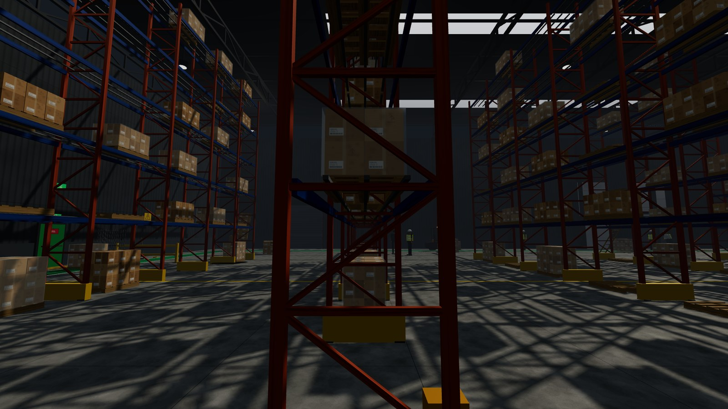
CONTENT
Three warehouses, three risk profiles
01
02
03
GENERAL STORAGE
CROSS-DOCK
NARROW AISLE · LOW LIGHT
Main Storage Hall
Loading & Dispatch Bay
High-Bay Annexe
Four racking runs, a central pedestrian spine, an active forklift aisle.
Six dock doors and constant vehicle movement. Dock edges and marshalling.
Five levels, poor light, heavy congestion. The hard site.
15 hazards
62×44 m
12 hazards
70×30 m
15 hazards
54×40 m
All three share one prop and scenario library — environments 2 and 3 are about 250 lines each, not copies of the application. A fourth site is one file plus one line.
Notes:
[11:00 – 12:00] The closing line is the commercial point: adding a site is cheap because the hazard library is shared. If they ask "could you build OUR warehouse?" — yes, and this is why that is not a rewrite.

Slide 12
ACCESS
Four ways in, plus a second factor
🔐
🔵
👤
🔢
Passkey
Google / Facebook
Name only
Authenticator app
Fingerprint, face or device PIN — or your phone. Nothing typed.
One free Client ID and the button goes live. No secret needed.
The original zero-friction path. Still the default.
A 6-digit code as a second step. Real RFC 6238.
Built properly, proven properly
And stated honestly
TOTP checked against the official RFC 4226 and 6238 vectors
QR encoder written from scratch — the offline build needs no CDN
Every QR decoded back by an independent decoder, 100 random secrets
The game has no backend, so passkeys and 2FA are a local device gate — not server-verified identity. GitHub cannot work in a browser at all: its exchange needs a client secret. So its button is visibly disabled and says why, rather than failing silently.
Notes:
[12:00 – 13:30] Two beats. First: it is real — official test vectors, QR built from scratch. Second, and more important for credibility: we say what it does NOT do. No backend means these are local gates. GitHub is disabled ON PURPOSE with the reason shown. A safety product that overstates its own security teaches the wrong lesson.

Slide 13
UNDER THE HOOD
How it is built
Three.js
Vite
Vanilla JS
3D RENDERING
BUILD & DEV SERVER
NO FRAMEWORK
Direct control of the scene graph and the frame loop.
Instant reload, ES-module output, almost no config.
A canvas game owns its own loop; a virtual DOM would fight it.
Vitest
Custom
Procedural
TESTING
COLLISION
ALL ART & AUDIO
Gameplay logic is pure, so it tests in Node with no browser.
~60 lines. A physics engine is 500 kB for a flat floor.
Every mesh, texture and sound generated in code.
Zero third-party assets. No downloaded models, stock textures, sound files or web fonts — which means no licences to track and nothing to attribute. It also keeps the whole game to one 828 kB file.
Notes:
[13:30 – 14:15] Keep it brisk — this is credibility, not the story. The line that matters is the box at the bottom: everything is generated in code, so there is no licensing overhead and the whole game fits in one file.

Slide 14
ENGINEERING HIGHLIGHT
A believable warehouse needs thousands of boxes
Drawn naively, Environment 1 was 9,587 draw calls per frame. Unusable on any machine.
→
BEFORE
AFTER
9,587
994
individual meshes, one draw call each
objects in 74 merged batches — same picture
Static geometry is merged by material at load. Anything animated — forklifts, workers, the falling carton — is excluded so it still moves.
FRAME RATE
DRAW CALLS
TRIANGLES
BUNDLE (GZIP)
60 fps
1,520
272k
183 kB
Notes:
[14:15 – 15:15] For a technical audience this is the strongest story in the deck: a real problem, measured, and solved with a specific named technique. Say the number out loud — nine and a half thousand down to under a thousand.

Slide 15
QUALITY
Proven, not assumed
AUTOMATED TESTS
PASSING
HAZARDS REACHABLE
CONSOLE ERRORS
266
100%
42/42
0
What the tests lock down
And a robot that plays the game
Scoring, combo, ranks — the exact rules from the brief
The reaction clock, including its warning bands
All 15 hazards present, with complete teaching text
Difficulty genuinely differs — not just a label
Profile progression, gates and every achievement
TOTP against the official RFC test vectors
A harness walks the player to 24 vantage points around every hazard, aims the camera and tries a real flag. It reports anything unreachable.
Main Storage Hall — Mid
15 / 15
Loading & Dispatch — Mid
12 / 12
High-Bay Annexe — Hard
15 / 15
Notes:
[15:15 – 16:15] The right-hand box is the one to dwell on: we did not just unit-test the maths, we wrote something that plays the game and proves every hazard can actually be found. That is what caught the biggest bug — next slide.

Slide 16
WHAT WE TRIED, AND WHAT BROKE
The bugs are the interesting part
Every one of these looked fine on screen. They were only found by driving the real game — unit tests could not have caught any of them.
Hazards could not be clicked
A wall in every warehouse
Proxies never had their world matrix updated, so for raycasting they all sat at the origin. 14 of 15 unflaggable — and the 15th was a false positive.
The spawn angle faced a blank wall, with the whole building behind the player.
Invisible interface
The timer blamed the wrong hazard
The DOM helper did not parse "#id", so the HUD had no CSS applied at all.
On expiry it penalised an arbitrary hazard the player was nowhere near.
Settings that did nothing
A QR nothing could scan
"Invert look" and "Reduce motion" were saved but never applied.
Format bits were written transposed. The matrix looked perfect; no scanner could read it.
All nine found and fixed. This is why we tested by playing it, not by reading it.
Notes:
[16:15 – 17:15] Do not rush past this and do not apologise for it — a tutor or client rates a team that finds its own bugs far above one that claims it had none. The strongest example is the first: fourteen of fifteen hazards were unclickable and it LOOKED fine.

Slide 17
BEING STRAIGHT WITH YOU
What it does not do yet
Not photorealistic
No VR
Stylised procedural geometry, built for believable scale and hazard readability — not a rendered CAD walkthrough.
No headset was available to test on. Shipping untested VR and calling it done would be dishonest.
Social login unconfigured
Limited device testing
Google and Facebook work the moment you add a free Client ID. GitHub needs a small server, and says so.
Touch controls are built and the layout is responsive, but untested on a real phone. Chromium only so far.
All of this is written into the repository documentation — found by us, not discovered later by you.
Notes:
[17:15 – 18:00] Present this confidently, do not apologise through it. Stating limits clearly is what makes every other claim in the deck believable. If asked "why no VR?": we had no headset to test on, and untested VR is worse than no VR.

Slide 18
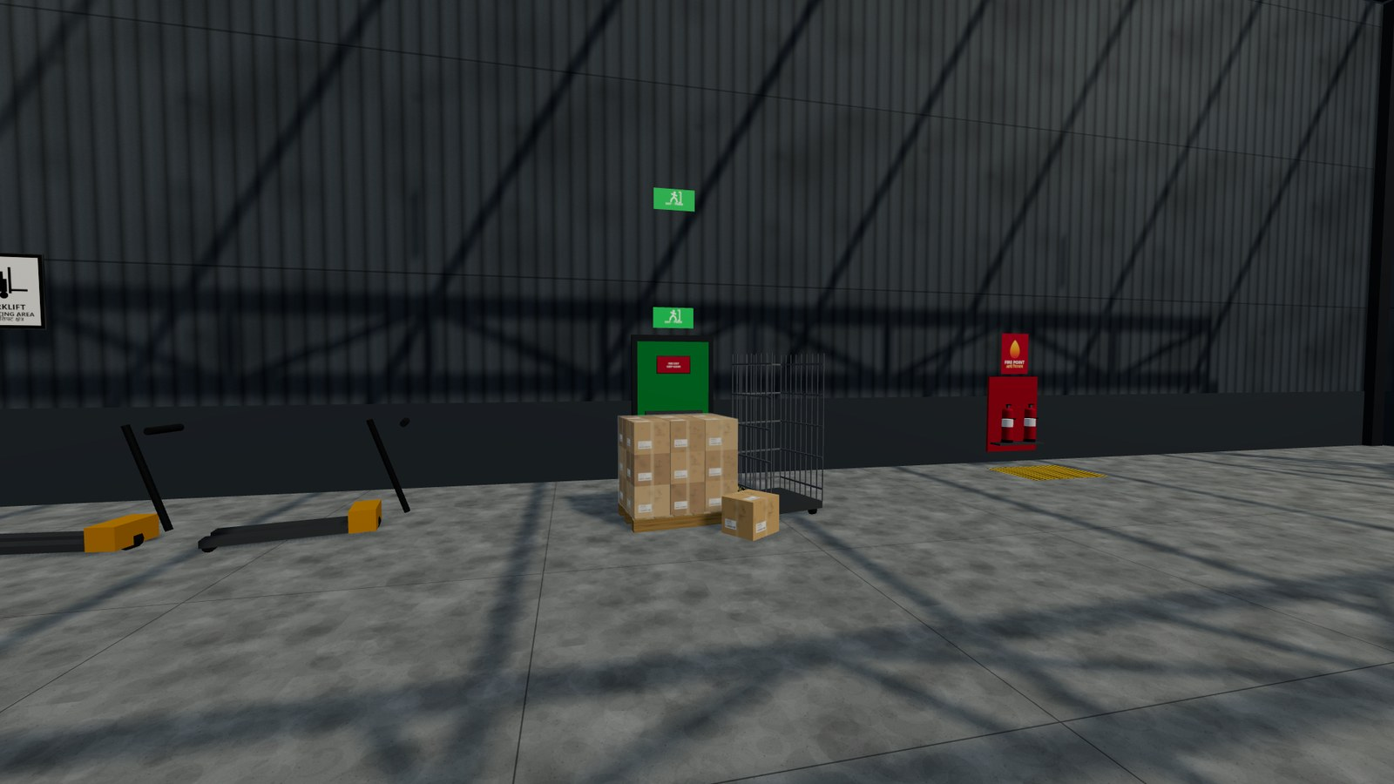
Thank you
Live demo — and then your questions.
Two-minute demo route
Play it yourself
1
Walk the Main Storage Hall
kushalthewave.github.io/interprize-project
2
Find the falling boxes
Download it, or install it as an app —
3
Flag a decoy on purpose — watch it teach
both play with no internet.
4
Show the results screen
Also ships as one 828 kB file that runs offline.
BEAT THE HAZARD · The Code Crafters · Built by Kushal Neupane
Notes:
[18:00 – 20:00] Two minutes. Have the game ALREADY LOADED in another window — do not load it in front of them. Follow the four steps on the left and resist exploring. Step 3 is the one that sells it: flag the coned-off spill on purpose and let the game explain why that is a wrong answer. Finish on the results screen and take questions.

