Slide 1


Bellabeat Insights
Fitbit User Activity & Sleep Analysis
Identifying user behavior trends to support Bellabeat's marketing and wellness strategy.
Presented by - Kushal Verma
Last update : 10 June 2016

Slide 2

Objectives
Understand activity habits
Understand Sleep habits
Identifying behavior patterns
Generate actionable recommendations

Slide 3




3
DATA Overview
Data characteristics:
30 Fitbit users collected
Final dataset: 24 users
410 observations
Metrics Included:
Daily Steps
Sleep Duration
Sedentary Time
Active Minutes
Tools Used:
Cleaning - Python
Transforming - Python
Analysis - Python
Visualization - Tableau

Slide 4

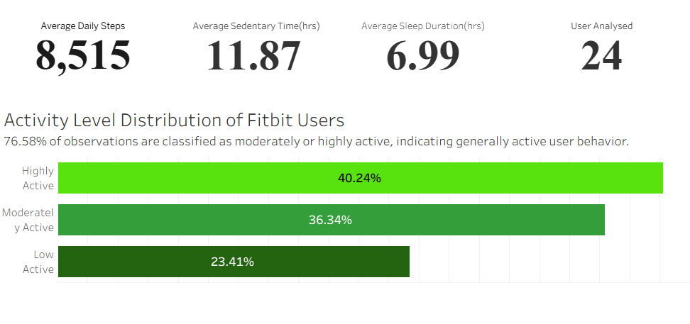
4
User Overview
Key Findings
Average Daily Steps: 8,515
Average Sleep Duration: 6.99 hrs
Average Sedentary Time: 11.87 hrs
76.58% of observations are moderately or highly active
Insight
Most users maintain active lifestyles but spend substantial time sedentary.

Slide 5
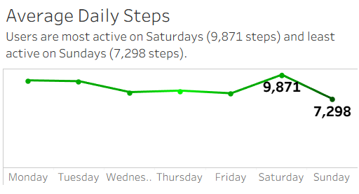


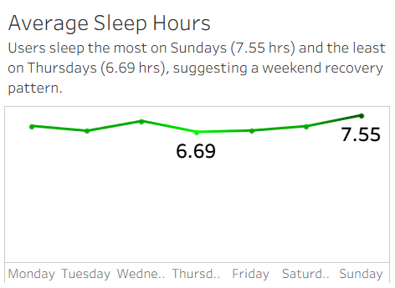
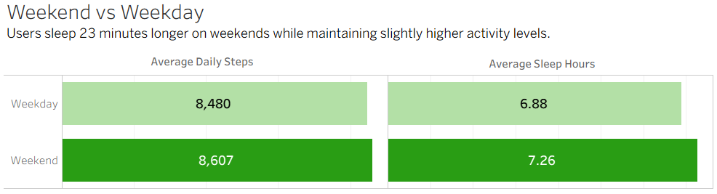
5
Weekly behaviour analysis
Key Findings
Highest activity on Saturday (9,871 steps)
Highest sleep duration on Sunday (7.55 hrs)
Weekend sleep increases by ~23 minutes
Insight
Users demonstrate a clear weekend recovery pattern.

Slide 6
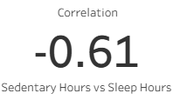
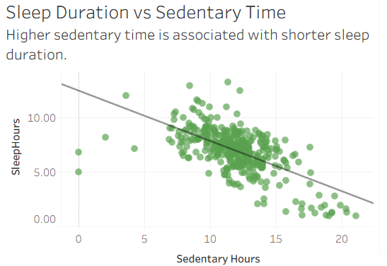
Activity & Sleep Relationship
6
Key Findings
Correlation between sedentary hours and sleep duration:
r = -0.61
Higher sedentary time is associated with shorter sleep duration
Insight
Sedentary behavior is the strongest sleep-related factor identified.

Slide 7

7
Key Insights
Insight 1
76.58% of observations belong to moderately or highly active users.
Insight 2
Users follow a consistent weekend recovery pattern.
Insight 3
Sedentary behavior has the strongest relationship with sleep duration.
Insight 4
Average sleep duration is 6.99 hours, slightly below the recommended level.

Slide 8

8
Recommendations
Reduce Sedentary Behavior
Inactivity alerts
Movement reminders
Daily movement goals
Engage Low-Activity Users
Personalized challenges
Goal tracking
Motivational notifications
Leverage Weekend Recovery
Weekend wellness insights
Sleep coaching
Recovery-focused recommendations

Slide 9
9
Conclusion
Most Fitbit users maintain active lifestyles and demonstrate consistent weekly wellness patterns. However, prolonged sedentary behavior is associated with reduced sleep duration and represents the strongest opportunity for intervention. Bellabeat can improve user wellness and engagement through inactivity reduction strategies, personalized engagement programs, and recovery-focused features.

Slide 10

Thank You!

