Slide 1
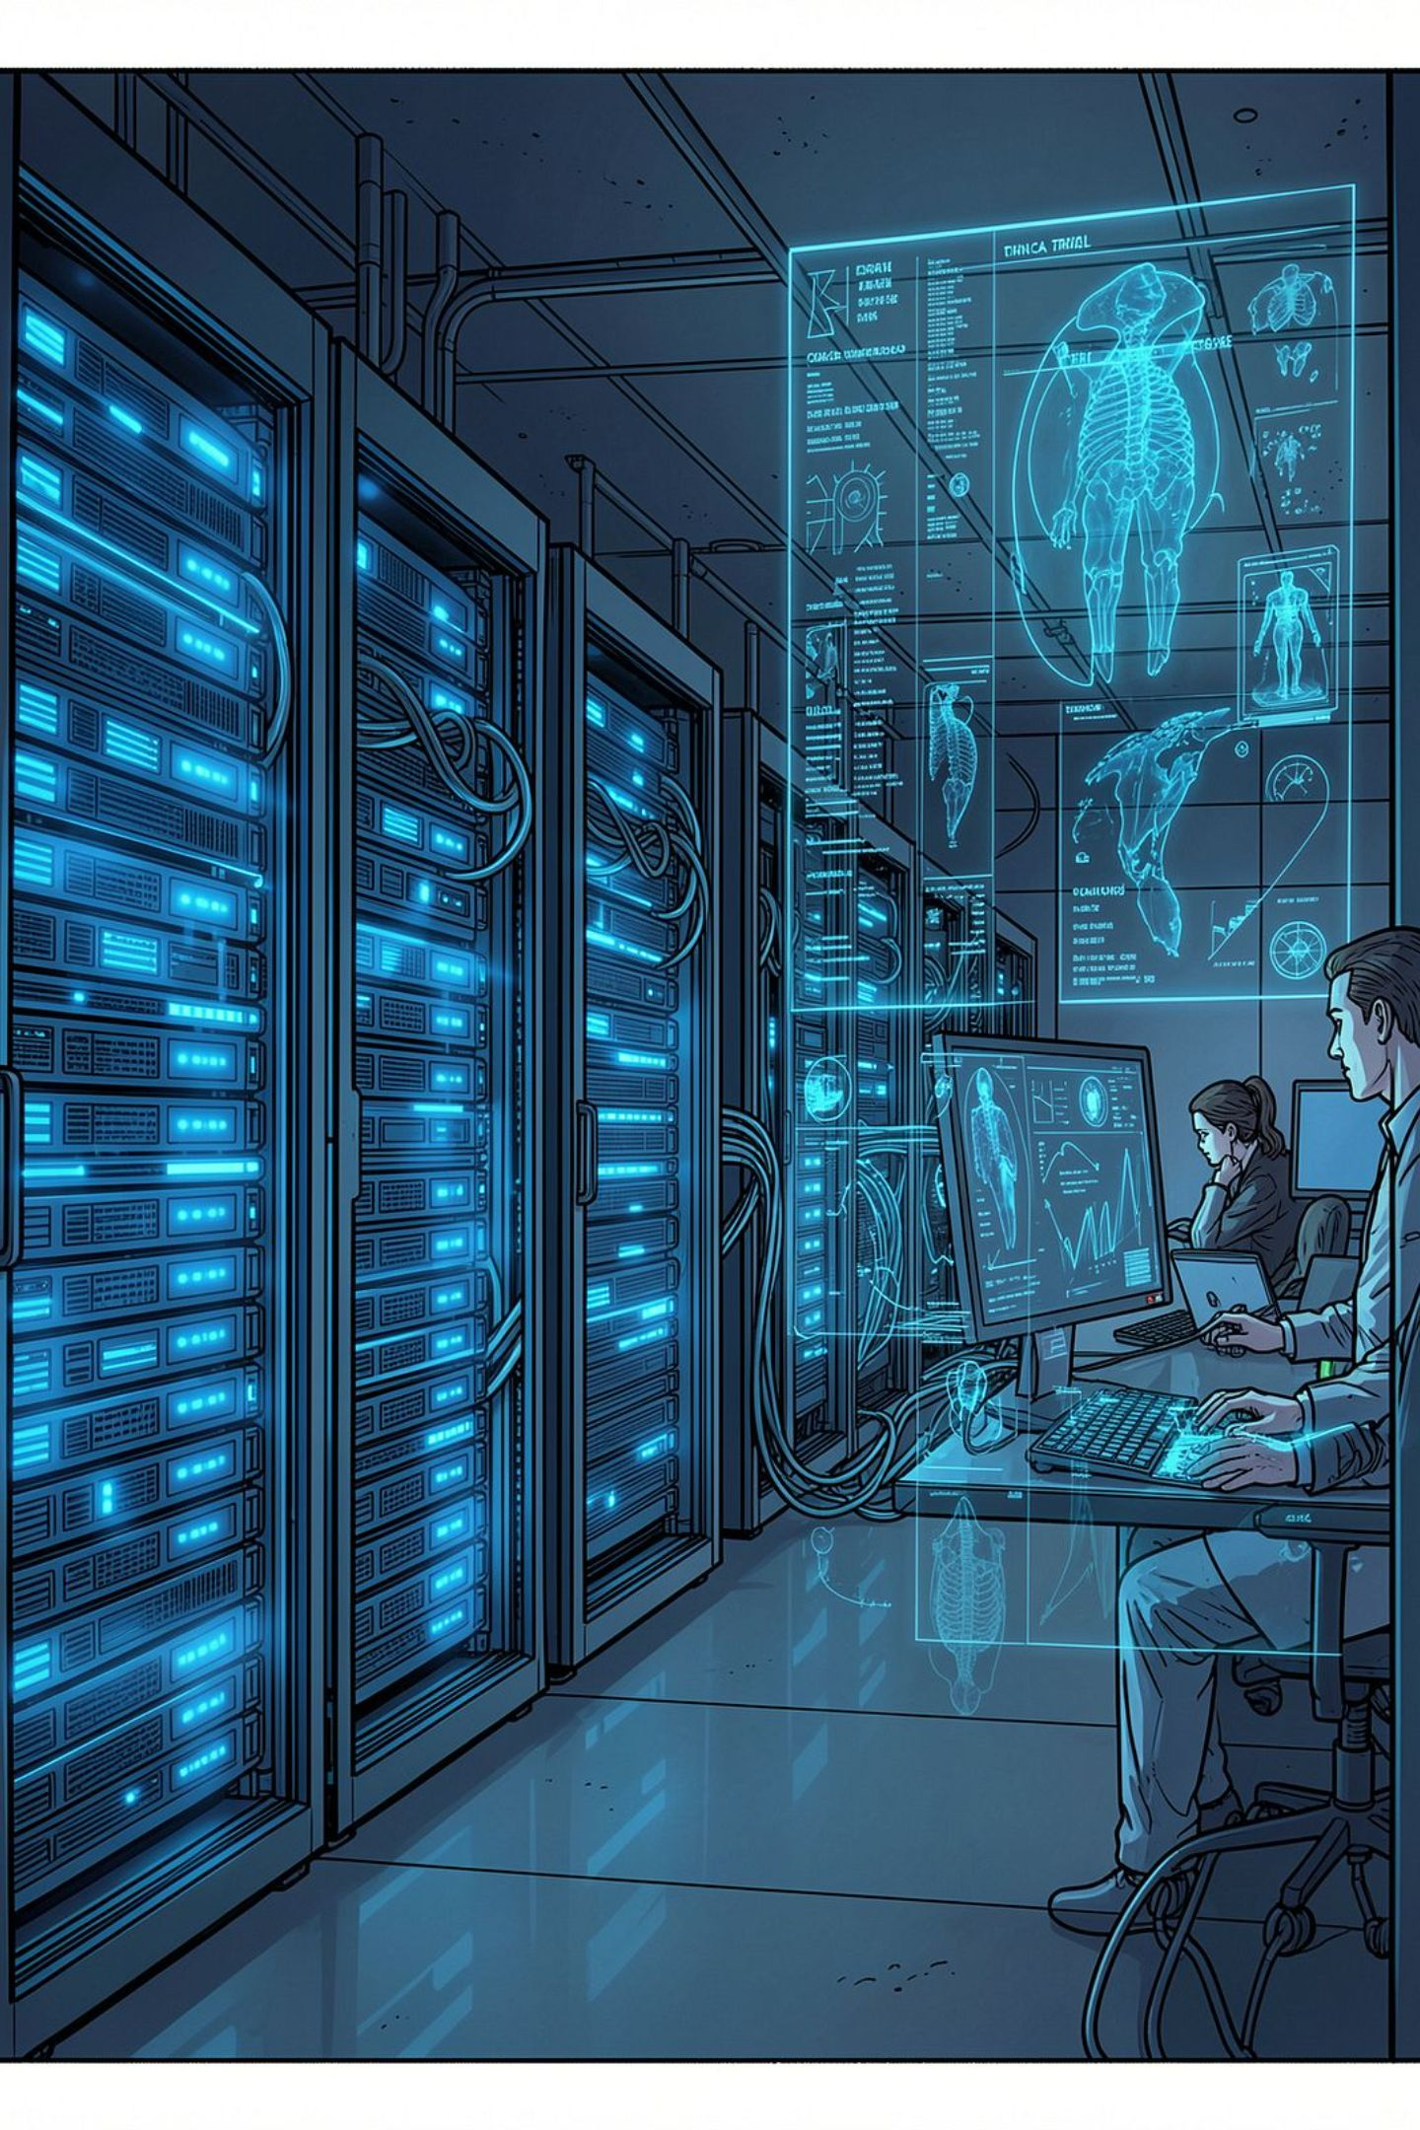
ClinGuard AI
Autonomous Clinical Trial Protocol Compliance
Deterministic Risk Scoring & Automated CAPA Generation
TEAM AUTOGEN
TRACK: AI
IBM BOB HACKATHON
Kushal Vaghela (Lead) · Jemeet Shahi · Raj Panchigar · Darsh Boghara

Slide 2

The Problem: Undetected Deviations Cost Millions
5K+
Patient Visits
Across a single major Phase II/III trial
200+
Active Sites
No real-time risk visibility for managers
$50–100M
Cost of Delay
Per FDA submission rejection
12mo
Approval Delay
From a single rejected submission
Protocol deviations — missed visits, wrong dosing, banned co-medications — go undetected until FDA audit. Risk managers lack real-time site-level visibility.

Slide 3




IBM BOB HACKATHON · PROBLEM STATEMENT
The Challenge We Took On
Compare patient records against protocol specifications, classify deviations by ICH E6 GCP severity, score site-level risk, and generate CAPA-ready reports with mitigations.
Detect
Classify
Rule-based deviation identification across all patient records
ICH E6(R2) Major / Minor / Administrative severity
Score
Report
7-factor transparent site risk score (0–100)
Automated CAPA generation with clinical mitigations

Slide 4
Our Solution: ClinGuard AI
An autonomous compliance and Risk-Based Monitoring platform — with a strict, auditable boundary between deterministic logic and generative AI.
Deterministic Deviation Detection
Hybrid Severity Classification
7-Factor Site Risk Scoring
ICH E6(R2) rules + AI rationale for edge cases
Transparent 0–100 composite score
Rule-based evaluation with full evidence trails
Automated CAPA Generation
MCP Server
Clustered deviations → signed PDF reports
4 tools for zero-hallucination AI querying

Slide 5
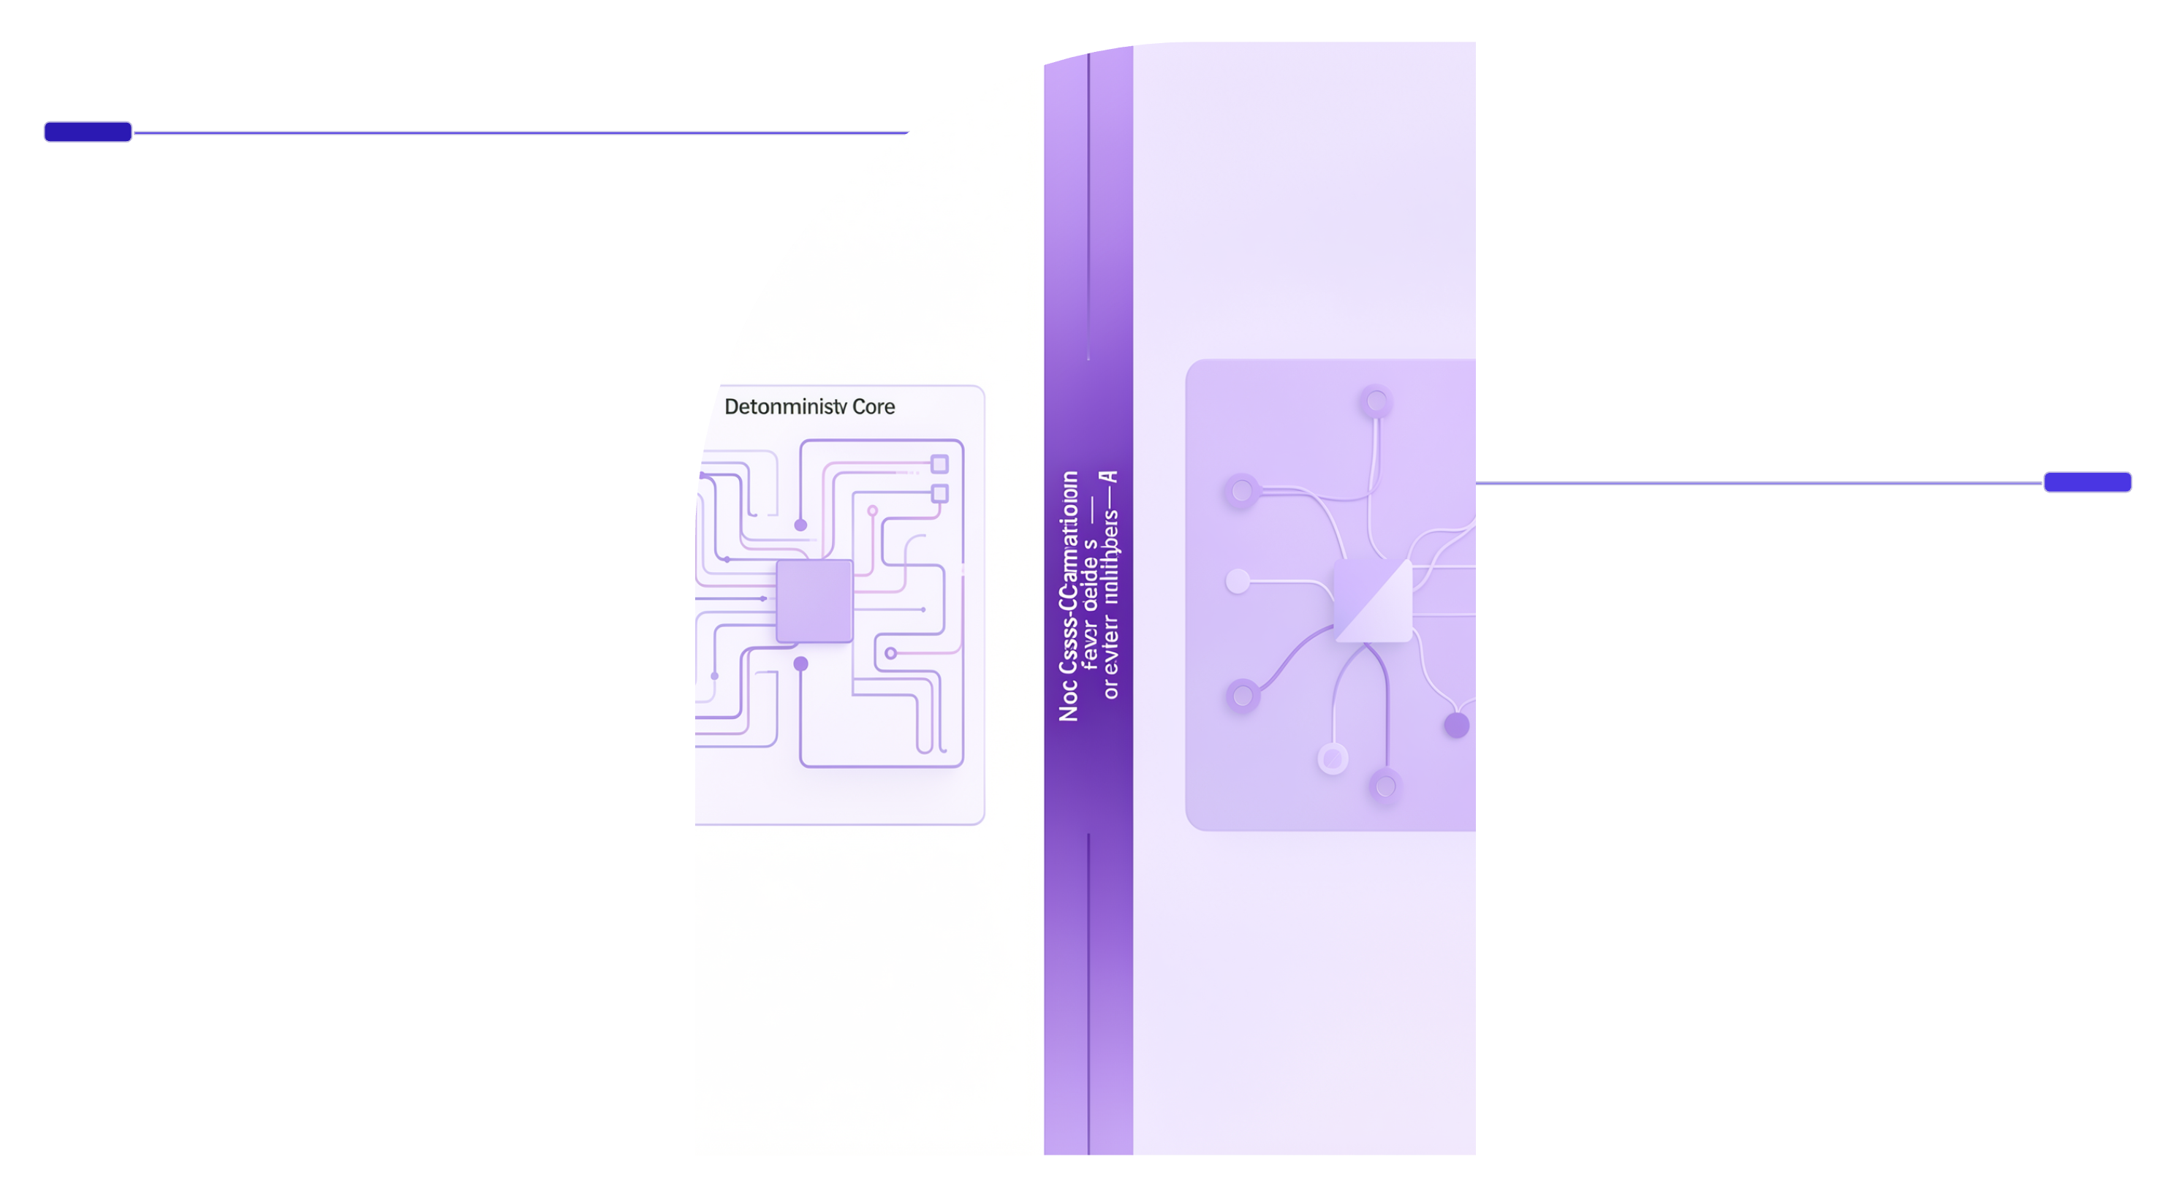
Architecture Philosophy: Zero Hallucination Compliance Core
ClinGuard AI enforces a strict two-lane separation: the deterministic engine owns all compliance-critical facts, while generative AI is confined to drafting clinical language — never deciding outcomes.
Deterministic Core
Deviation detection, severity classification, site risk scoring, evidence trails, CAPA logic. 107 tests passing.
Generative Layer
Clinical rationale drafting and narrative language only — no factual decisions.
This boundary ensures every compliance-critical number, score, and flag is reproducible, auditable, and traceable — with zero generative hallucination on regulatory decisions.

Slide 6
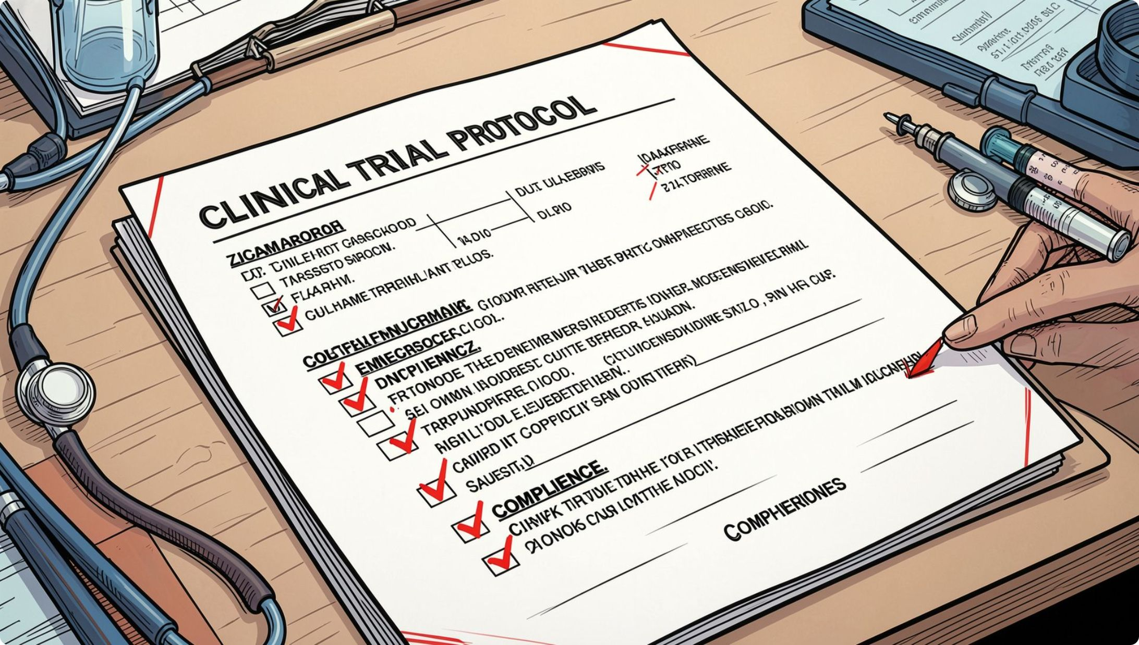

Feature Deep-Dive 1: Deviation Detection Engine
Rule-Based Evaluation Across 5 Domains
Visit windows — detects out-of-schedule visits against protocol-defined intervals
Weight-adjusted dosing — flags dose discrepancies outside ±10% thresholds
Banned CYP3A4 inhibitors — cross-references co-medication lists against exclusion criteria
Eligibility & lab criteria — validates inclusion/exclusion parameters per protocol spec
Missing signatures — identifies unsigned CRFs and consent forms
Every flagged deviation includes a full, timestamped evidence trail — field-level before/after values, rule ID, and protocol clause reference.

Slide 7
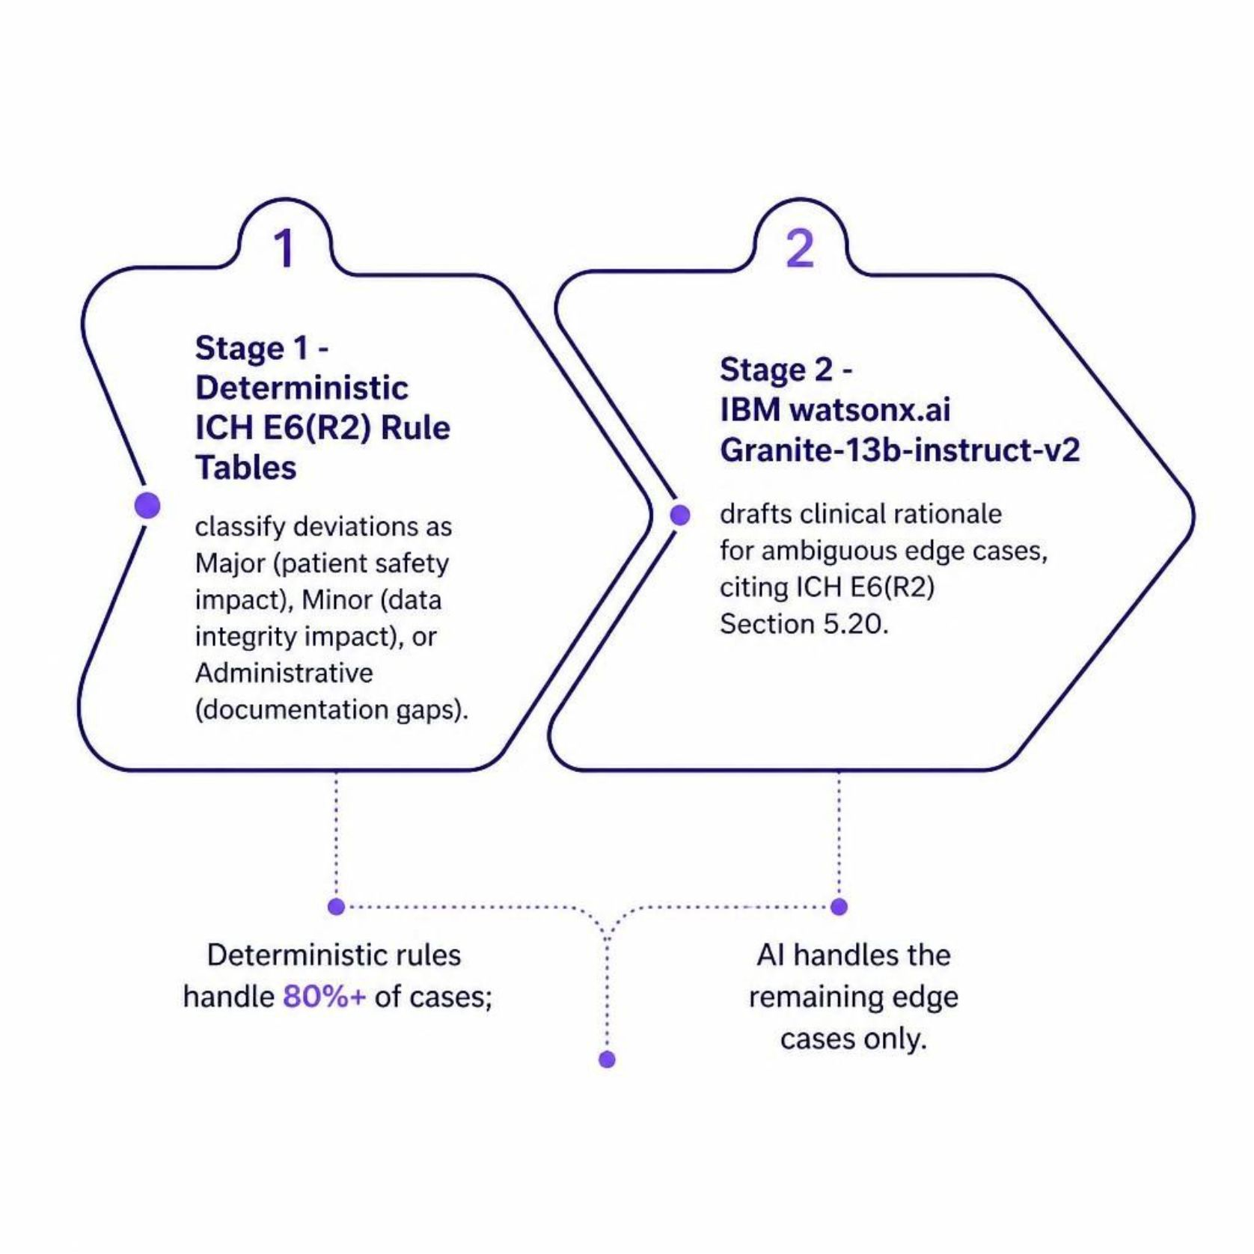

Feature Deep-Dive 2: Hybrid Severity Classification
Deterministic First. Generative Only When Needed.
ICH E6(R2) rule tables handle the majority of classifications automatically — Major, Minor, or Administrative — with zero ambiguity.
For edge cases where protocol language is ambiguous, IBM watsonx.ai Granite-13b-instruct-v2 drafts clinical rationale, always citing ICH E6(R2) Section 5.20.
The AI layer never overrides deterministic classification — it only augments narrative justification for human reviewer sign-off.

Slide 8
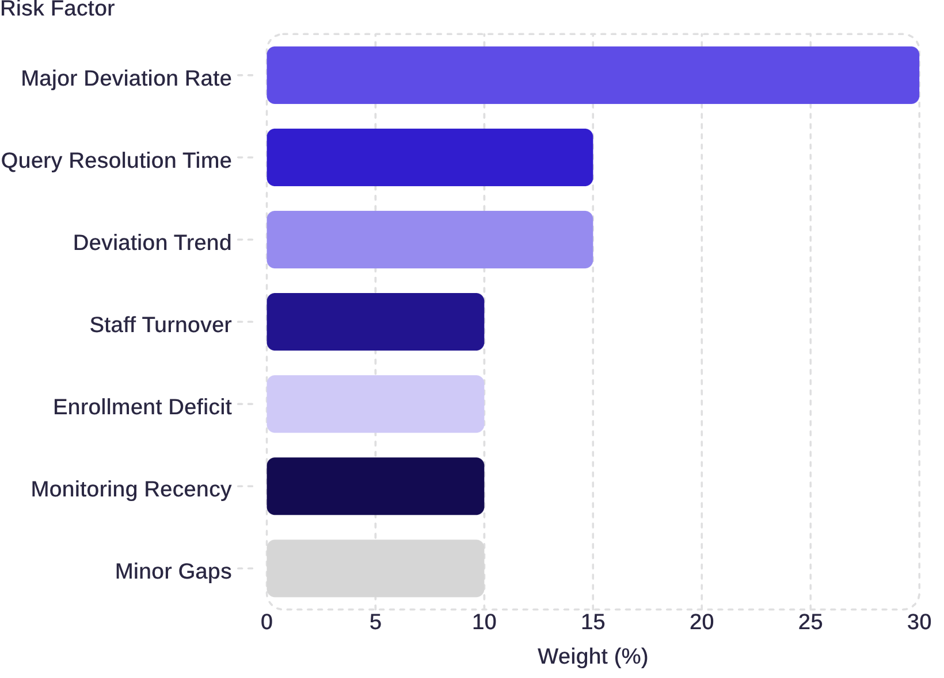
Feature Deep-Dive 3: 7-Factor Site Risk Scoring
Fully Transparent. Fully Auditable. Not a Black Box.
Each site receives a composite risk score from 0 to 100, computed from 7 weighted factors. Risk managers can drill into any factor's contribution.
30% — Major Deviation Rate (primary driver)
15% — Query Resolution Time & Deviation Trend
40% — Staff Turnover, Enrollment, Monitoring, Minor Gaps
Scores update in real-time as new data flows in — enabling proactive site intervention before FDA audit.

Slide 9
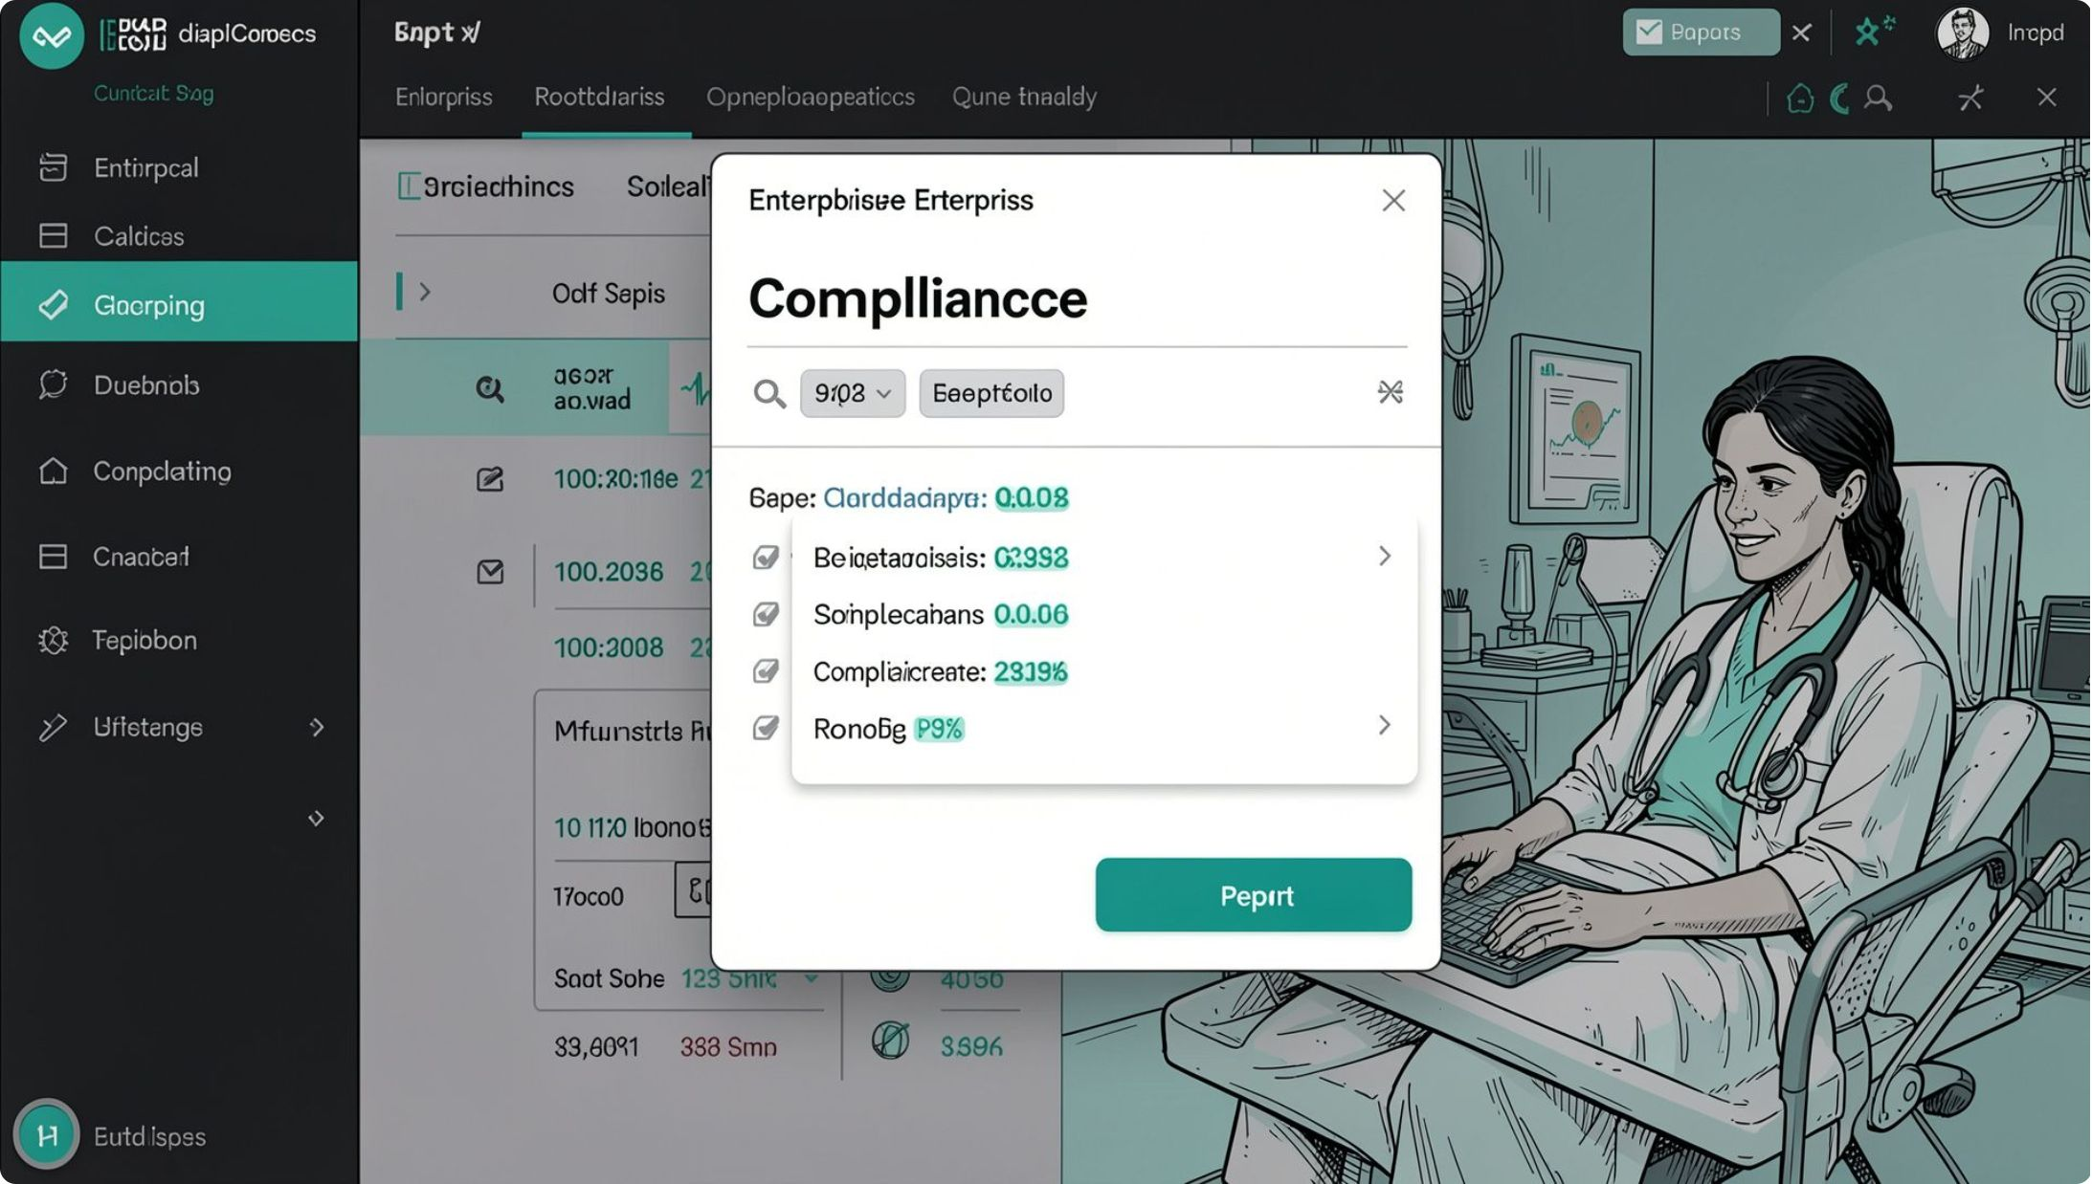
Automated CAPA Reports + MCP Assistant
CAPA Generation Engine
Clusters repeat deviations within 30-day windows into structured Corrective and Preventive Action plans. Exports to Markdown and signed PDF via fpdf2.
Model Context Protocol (MCP) Server
Exposes 4 JSON-RPC tools for zero-hallucination AI assistant integration:
run_deviation_detection
get_site_risk_scores
get_deviations
generate_or_fetch_capa

Slide 10
Tech Stack, Demo & What We're Proud Of
Technology Stack
Live Demo
Backend
Dashboard walkthrough: Risk Heatmap View, Deviations View, Chat Panel, and CAPA Export Modal.
Python 3.11+, FastAPI, SQLAlchemy, PostgreSQL/SQLite
📱 Scan QR or visit: [Demo Link Placeholder]
Frontend
React 18, Vite, TailwindCSS, TypeScript 5.0+
What We're Most Proud Of
AI Layer
Strict deterministic/generative boundary — zero hallucination on compliance-critical numbers
107/107 pytest cases passing — full deterministic coverage
IBM watsonx.ai Granite-13b-instruct-v2
Infrastructure
Known Limitations
MCP Server, fpdf2, pytest (107/107 tests passing)
Watsonx.ai requires live API credentials (graceful template fallback if absent)
Currently runs on synthetic Phase II/III data — HL7 FHIR / CDISC ODM integration is the next milestone
Team AutoGen: Kushal Vaghela (Lead) · Jemeet Shahi · Raj Panchigar · Darsh Boghara

