Slide 1



KB141 - Research Portal
SMART INDIA HACKATHON 2020
Prepared by- Team Envyus :-
Kushan Mehta (Team Leader)
Mitanshu Bhatt
Nitasha Gupta
Jay Mistry
Fenil Kaneria
Megha Sankhlecha

Slide 2
Problem Statement
Design State Research Portal, a single point securely hosted solution to seamlessly integrate search and manage all the research activities.

Slide 3
Problem Description
The act of research sets the course for the development of any product or service. Without comprehensive research, all stages that follow in research activities could be greatly affected and time consuming. In this context, a single State research portal is needed to be designed in a manner that it can serve as a one-stop solution pertaining to one’s research needs.
Few of the areas to be incorporated are as given below:
1. Great User Experience
2. Discovery engine for access to information
3. Uploading Research & Authentication

Slide 4
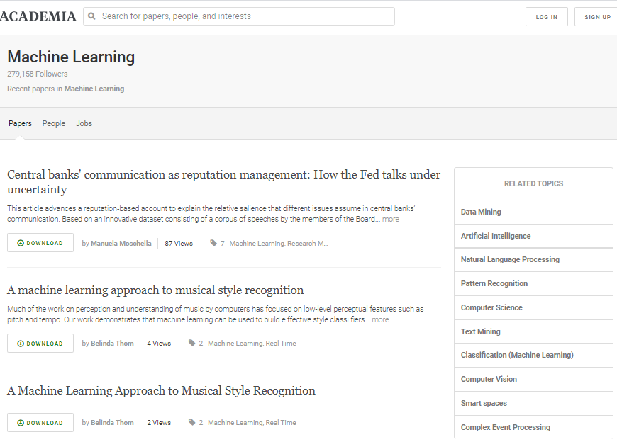

Slide 5
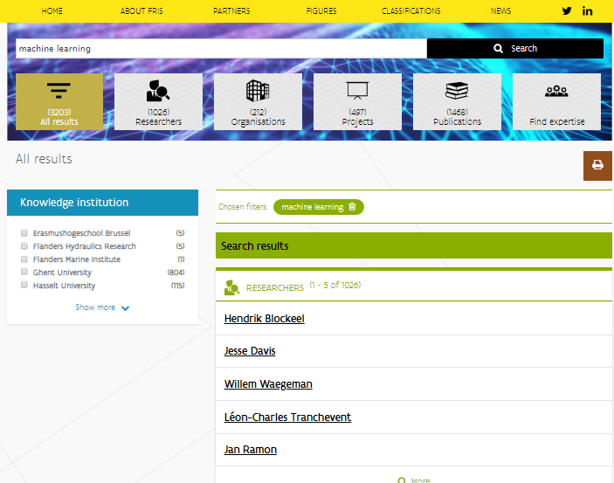

Slide 6
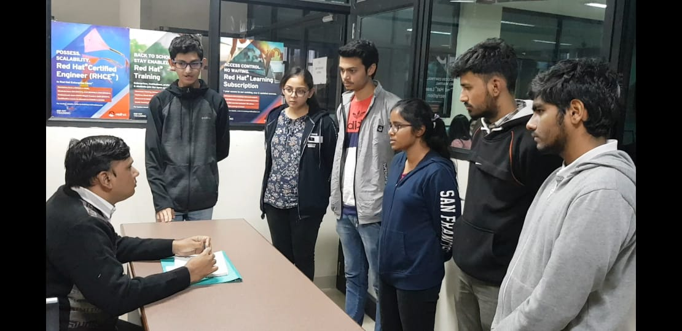
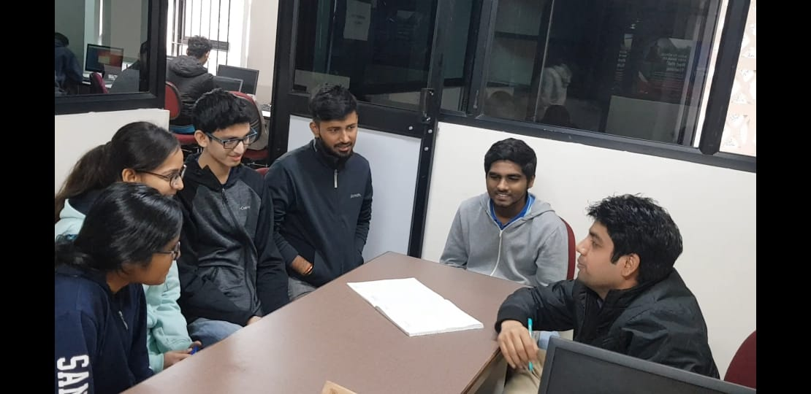
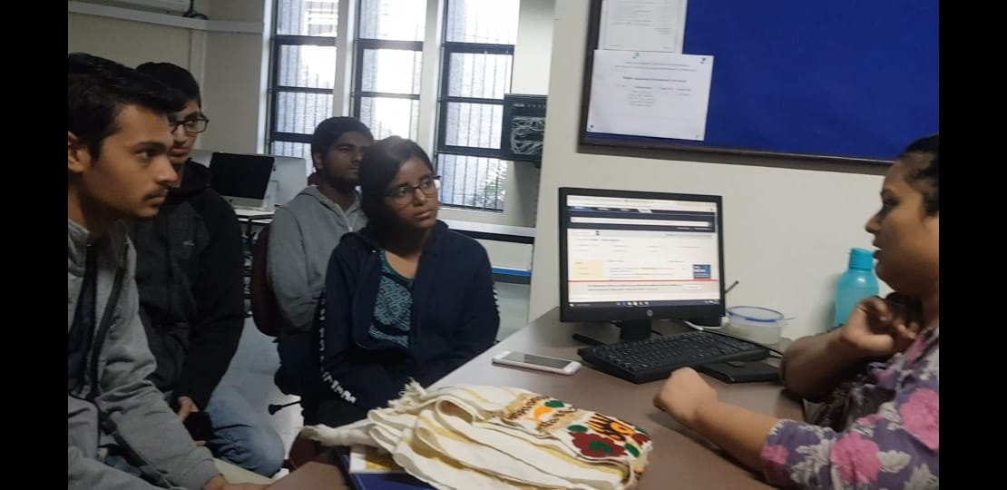
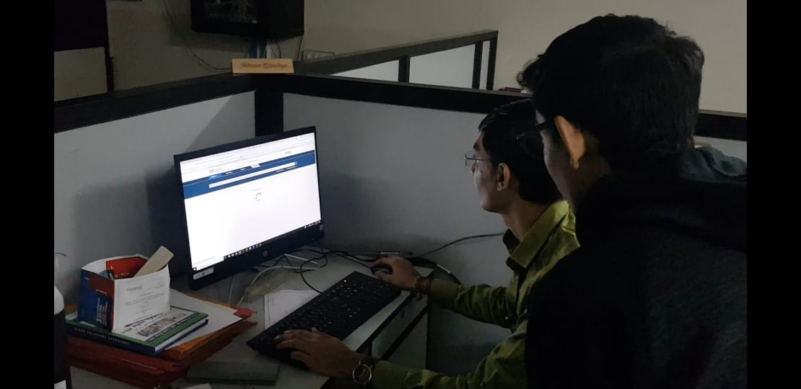
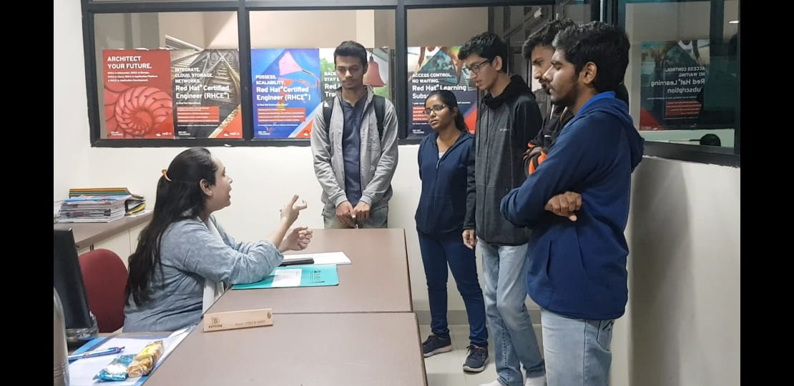
Screenshots (Interview)

Slide 7
Consolidated List of Requirements
One stop portal to explore all available research papers of concerned topic
Good user-experience platform for easy and clutter-free navigation.
Mobile free with add-to-watchlist feature
Fast searching
Have less but valid filters for searching
Upload mechanism should be less burdening
Should provide brief about each research paper before opening
Should have one click authentication mechanism
Should be secured

Slide 8
Proposed Solution
Develop a modern web application built on top of best user experience (UX) practices also optimized for mobile, to help ease the process for navigation to desired information
Provide services such as uploading research where a user would be able to create their profile and add details pertaining to their research background, also allowing categorization university/college and department/areas of study wise
A discovery service will be integrated into the portal which considers various approaches on how the metadata can be best used around searching and retrieving search results.

Slide 9
Continue..
Seamless and intuitive integration of various other research platform services is to be done for the purpose of developing the discovery tool so as to fetch and provide access to data from standard sources such as IEEE, Elsevier, Springer, ACM and other journals
Robust search & discovery engine developed specifically for the purpose, incorporating various NLP techniques for the improvement of precision & accuracy of the search results procured.
Rich filters such as filtering by year of publication, type, affiliation, author etc. which would help to zero-down on the perfect reference for the user’s research needs.

Slide 10
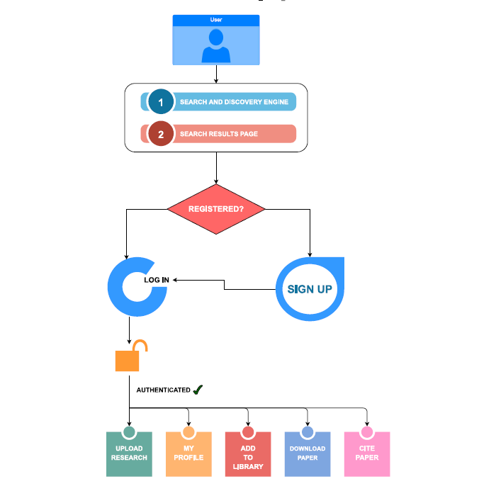
FLOWCHART

Slide 11
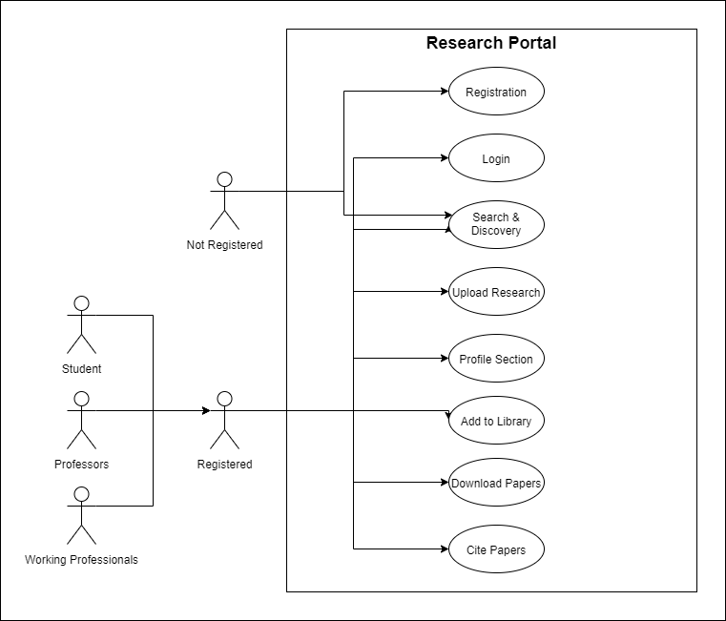
USE CASE DIAGRAM

Slide 12
Technology Stack
ElasticSearch (Built on top of Apache Lucene Engine)
Scalable Model built around search & discovery
Natural Language Processing (NLP)
Flask Microframework
ReactJS
MySQL
Python
Microservices driven architecture

Slide 13
Hardware/Software Requirements
Any platform with access to browser including mobile devices

Slide 14
Work done
Analysis & Requirement Gathering
  Interviews
  Surveying (Existing portals)
  Brainstorming
Technical work
  System Architecture design
  User Experience design
  API implementation of various journals
  ~180 Million (179372373) Research Corpus mined and being processed
  Real-time Search & Discovery Engine built upon ElasticSearch (Lucene Engine)

Slide 15
Work in Progress
Apply advanced NLP techniques to improve the search results and ranking algorithm by weighted modelling techniques
Microservices implementation for layered architectural approach
UI enhancements
Scale the model
Seamless official platform(s) integration

Slide 16
Work Distribution
Kushan Mehta - System architecture & Design, Search & Discovery Engine
Mitanshu Bhatt - Backend
Nitasha Gupta - Backend and database design
Fenil Kaneria - Frontend
Jay Mistry - Frontend
Megha Sankhlecha - Frontend & Search & Discovery Engine

Slide 17
Implementation

Slide 18
Thank You

