Slide 1
Introduction to Classification
Chathura Rajapakse

Slide 2
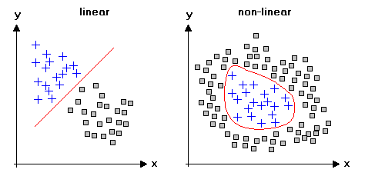
Predicting a categorical variable

Slide 3
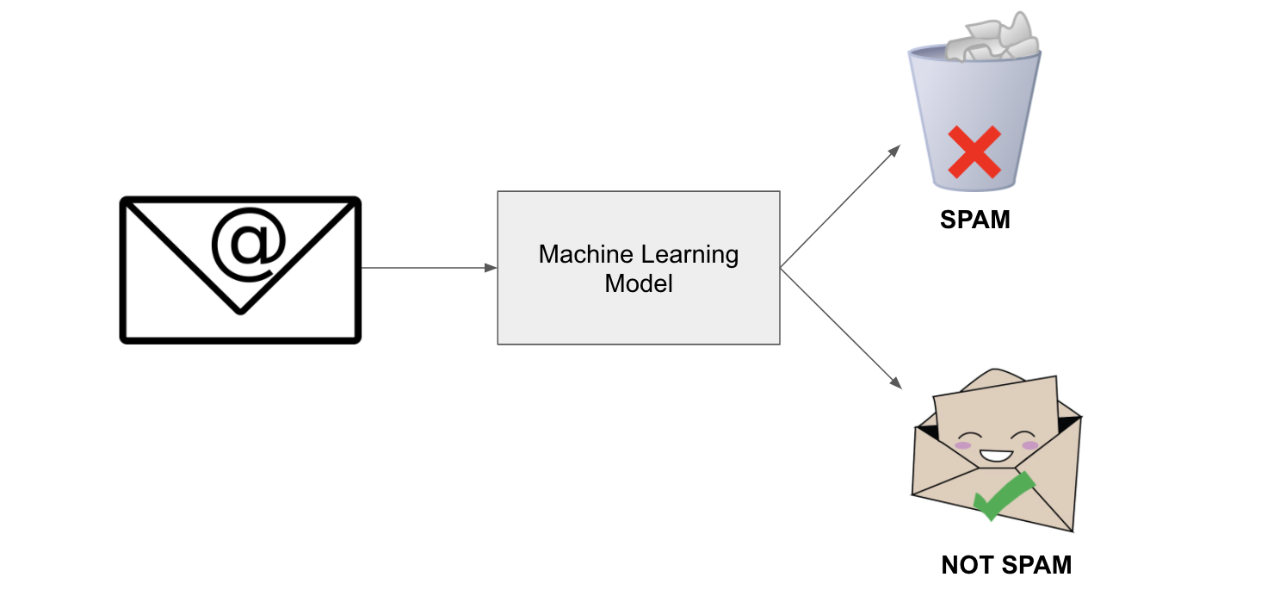
What is a classifier?
https://miro.medium.com/max/2988/1*El5bBBkaDoaVtpQbOZRIFw.png

Slide 4
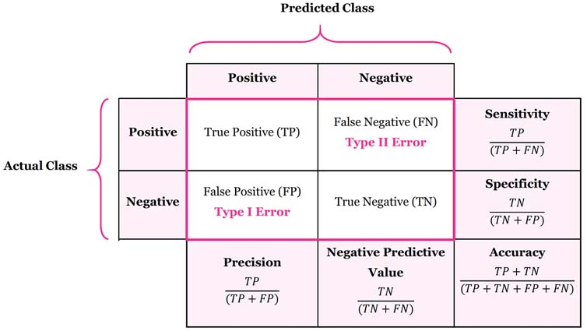
Confusion matrix
Evaluating a classifier’s performance

Slide 5
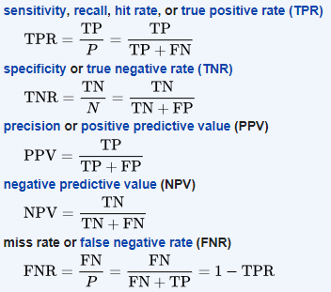
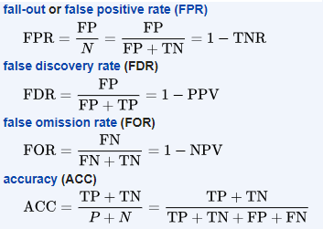
Matrices to evaluate the confusion
Extra reading: https://machinelearningmastery.com/confusion-matrix-machine-learning/

Slide 6
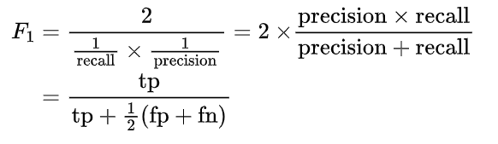

F1-Score
Combines Precision and Recall to get the harmonic mean of the two
Can give importance to Precision or Recall through adjusted F2 score

Slide 7
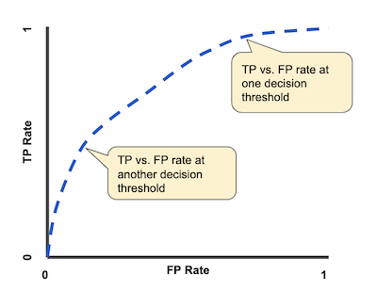
ROC – Receiver Operating Characteristic Curve
You can compare the ‘AUC’ of ROC of two classification methods to decide which one is better
FP rate can be replaced by precision to avoid imbalance

Slide 8
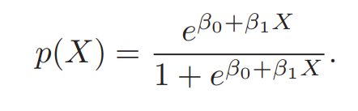
What is logistic regression?
Fitting data to a function that gives outcomes (Y) only between 0 and 1 for all values of X
Use the logistic function
Produces an S - curve

Slide 9

Cost Function
Enables the estimation of parameters
Mean squared error (MSE)
Entropy based cost function

Slide 10
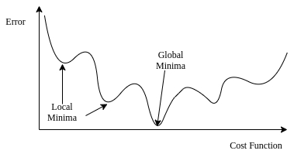
Parameter estimation
Minimizing the cost function
Gradient descent

Slide 11
How are predictions made?
Parameters estimated from the maximum likelihood method
Prediction

Slide 12
Naïve Bayes Classifier
Based on Bayes theorem
Assume independence between predictors
Knowing the value of one attribute does not tell us anything about another
Simple but surprisingly powerful classification model
Bayes theorem provides a way of predicting a hypothesis (h) given data (d)
In classification, the hypothesis (h) is the class to assign given a new data instance (d).

Slide 13
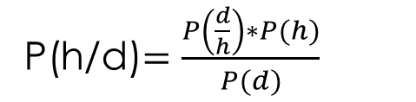
Bayesian Equation
P(h/d)$=\frac{P\left(\frac{d}{h}\right)∗P(h)}{P(d)}$
P(h/d) = probability of hypothesis h given the data d (posterior probability)
P(d/h) = probability of data d given that the hypothesis h was true
P(h) = probability of hypothesis h being true (regardless of the data) – Prior probability
P(d) = probability of the data (regardless of the hypothesis)

Slide 14
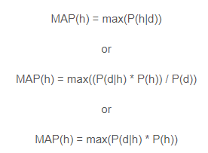
Using the Bayes’ Theorm
Number of different hypothesis could be evaluated based on the posterior probability
The maximum probable hypothesis (maximum a posteriori – MAP) hypothesis will be selected
This is a normalizing term (a constant) used to compute the probability. Hence could be dropped when we are interested in the most probable hypothesis

Slide 15
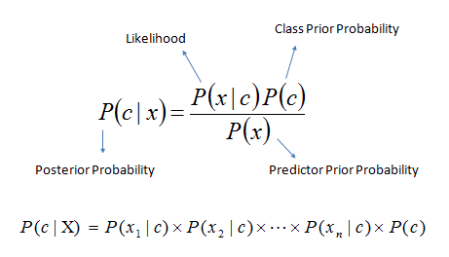

Naïve Bayes Classifier

Slide 16
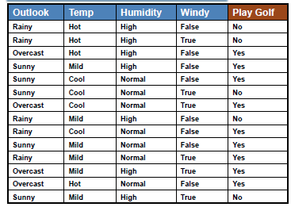
Naïve Bayes Classifier Example
Step 1: Calculating prior probabilities of classes (hypothesizes)
Prior Probabilities of classes:
P(Yes) = 9/14
P(No) = 5/14

Slide 17
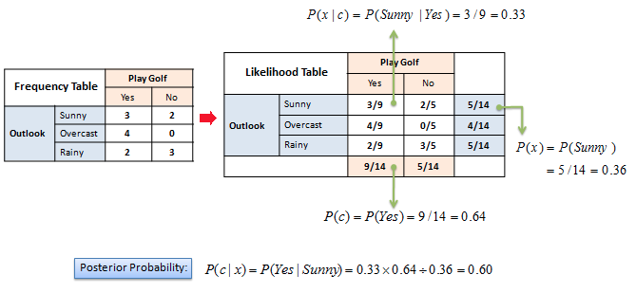
Naïve Bayes Classifier Example
Step 2: Building frequency tables for each attribute and thereby
building the likelihood tables

Slide 18
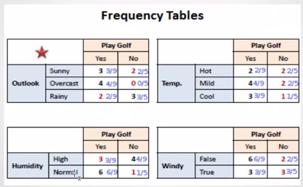
Naïve Bayes Classifier Example
Step 2: Building frequency tables for each attribute and thereby building
the likelihood tables

Slide 19
Step 3: Take the conditions of the given day
Example:
Outlook = Rainy
Temp = Mild
Humidity = Normal
Windy = True
Likelihood of Yes = P(Yes/X) = P(Outlook = Rainy/Yes) x P(Temp = Mild/Yes) x
P(Humidity = Normal/Yes) x P(Windy = True/Yes) x P(Yes)
= 2/9 x 3/9 x 6/9 x 3/9 x 9/14 = 0.014109347
Likelihood of No = P(No/X) = P(Outlook = Rainy/No) x P(Temp = Mild/No) x
P(Humidity = Normal/No) x P(Windy = True/No) x P(No)
= 3/5 x 2/5 x 1/5 x 3/5 x 5/14 = 0.010285714
From Normalization:
P(Yes) = 0.014109347/(0.014109347 + 0.010285714) = 0.58
P(No) = 0.010285714/(0.014109347 + 0.010285714) = 0.42

Slide 20
Naïve Bayes Classifier Example
How to handle instances with 0?
Add 1 to all occurrences
Numerical predictors need to be transformed to categorical counterparts

Slide 21
References
shorturl.at/ctDKN
https://manisha-sirsat.blogspot.com/2019/04/confusion-matrix.html
https://stats.stackexchange.com/questions/285545/can-we-make-the-machine-learn-gates-or-and-xor-etc/506332

