Slide 1

SMART INDIA HACKATHON 2026
Problem Statement ID – SIH26047
Problem Statement Title - Patient Case Taking Software
Theme- MedTech / BioTech / HealthTech
PS Category- Software
Team ID-
Team Name - matriX

Slide 2
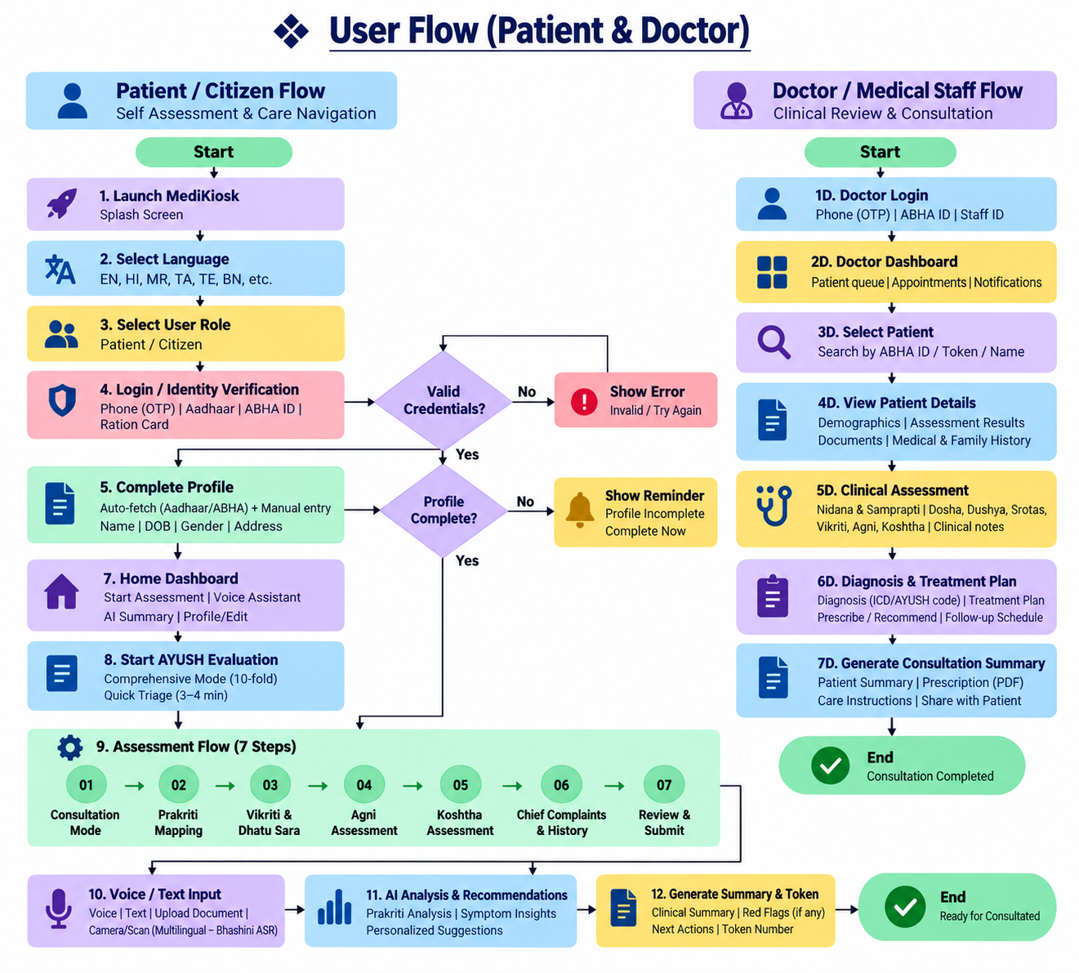
matriX
MEDIKIOSK
User Flow (Patient & Doctor)
Patient / Citizen Flow
Start
Launch MediKiosk Splash Screen
Select Language EN, HI, MR, TA, TE, BN, etc.
Select User Role Patient / Citizen
Login / Identity Verification OTP / Aadhaar / ABHA ID / Ration Card
Complete Profile Auto-fetch (Aadhaar/ABHA) + Manual entry Name / Gender / DOB / Address
Valid Credentials?
No: Show Error — Invalid / Try Again
Yes: Continue
Profile Complete?
No: Show Reminder — Profile Incomplete / Complete Now
Yes: Continue
Home Dashboard Start Assessment / Voice Assistant AI Summary / Profile / Edit
Start AYUSH Evaluation Comprehensive Mode (10-fold) Quick Triage (3–4 min)
Assessment Flow (7 Steps)
01 Consultation Mode
02 Prakriti Mapping
03 Vikriti & Dhatu Sara
04 Agni Assessment
05 Koshtha Assessment
06 Chief Complaints & History
07 Review & Submit
Voice / Text Input Voice/Text / Upload Document / Camera Scan (Multilingual – Bhashini ASR)
AI Analysis & Recommendations Prakriti Analysis | Symptom Insights Personalized Suggestions
Generate Summary & Token Clinical Summary | Red Flags (if any) Next Actions | Token Number
End — Ready for ConsultationDoctor / Medical Staff Flow
Start
Doctor Login Phone (OTP) | ABHA ID | Staff ID
Doctor Dashboard Patient queue | Appointments | Notifications
Select Patient Search by ABHA ID / Token / Name
View Patient Details Demographics | Assessments Documents | Medical & Family History
Clinical Assessment Nidana & Samprapti | Dosha, Srotas, Vikriti, Agni, Koshtha | Clinical notes
Diagnosis & Treatment Plan Diagnosis (ICD/AYUSH code) | Treatment Plan Prescribe / Recommend | Follow-up Schedule
Generate Consultation Summary Patient Summary | Prescription (PDF) Care Instructions | Share with Patient
PROPOSED SOLUTION
Unified Clinical Intake: Multimodal (voice, touch, document) capture in one platform for structured pre-consultation history, enabling faster EMR (Electronic Medical Record)-ready patient onboarding.
AI History Engine: Multilingual conversational AI (NLP – Natural Language Processing) dynamically asks adaptive clinical follow-up questions and structures responses, using a rule-based clinical decision support (CDS) engine to flag emergency symptoms (e.g., chest pain, breathlessness) for immediate triage.
Comprehensive Health History: Centralized, longitudinal EHR (Electronic Health Record) of past illnesses, treatments, surgeries, medications, and family history — ensuring continuity of care before consultation.
Medical Document Intelligence: OCR (Optical Character Recognition) + NLP-based extraction from prescriptions, lab reports, and discharge summaries, auto-building a chronological health timeline.
Clinical Summary & Red-Flag Detection: Generates a physician-ready summary via automated triage protocols, flagging emergency symptoms or critical information instantly.
AYUSH Support: Dedicated Dashavidha Pariksha module — Prakriti, Vikriti, Agni, Koshtha assessment plus Nidana and Samprapti documentation — mapped to NAMASTE and ICD-11 TM2 terminology for standardized diagnosis coding.
ABDM/FHIR Integration: Consent-based interoperability with ABHA, ABDM, and hospital HIS/EMR systems using FHIR/HL7 standards, aligned with India's Digital Public Infrastructure (DPI).
Secure & Inclusive Design: RBAC (Role-Based Access Control), end-to-end encryption, and DPDP Act–compliant consent management, with multilingual voice guidance for elderly and low-literacy accessibility.
2

Slide 3
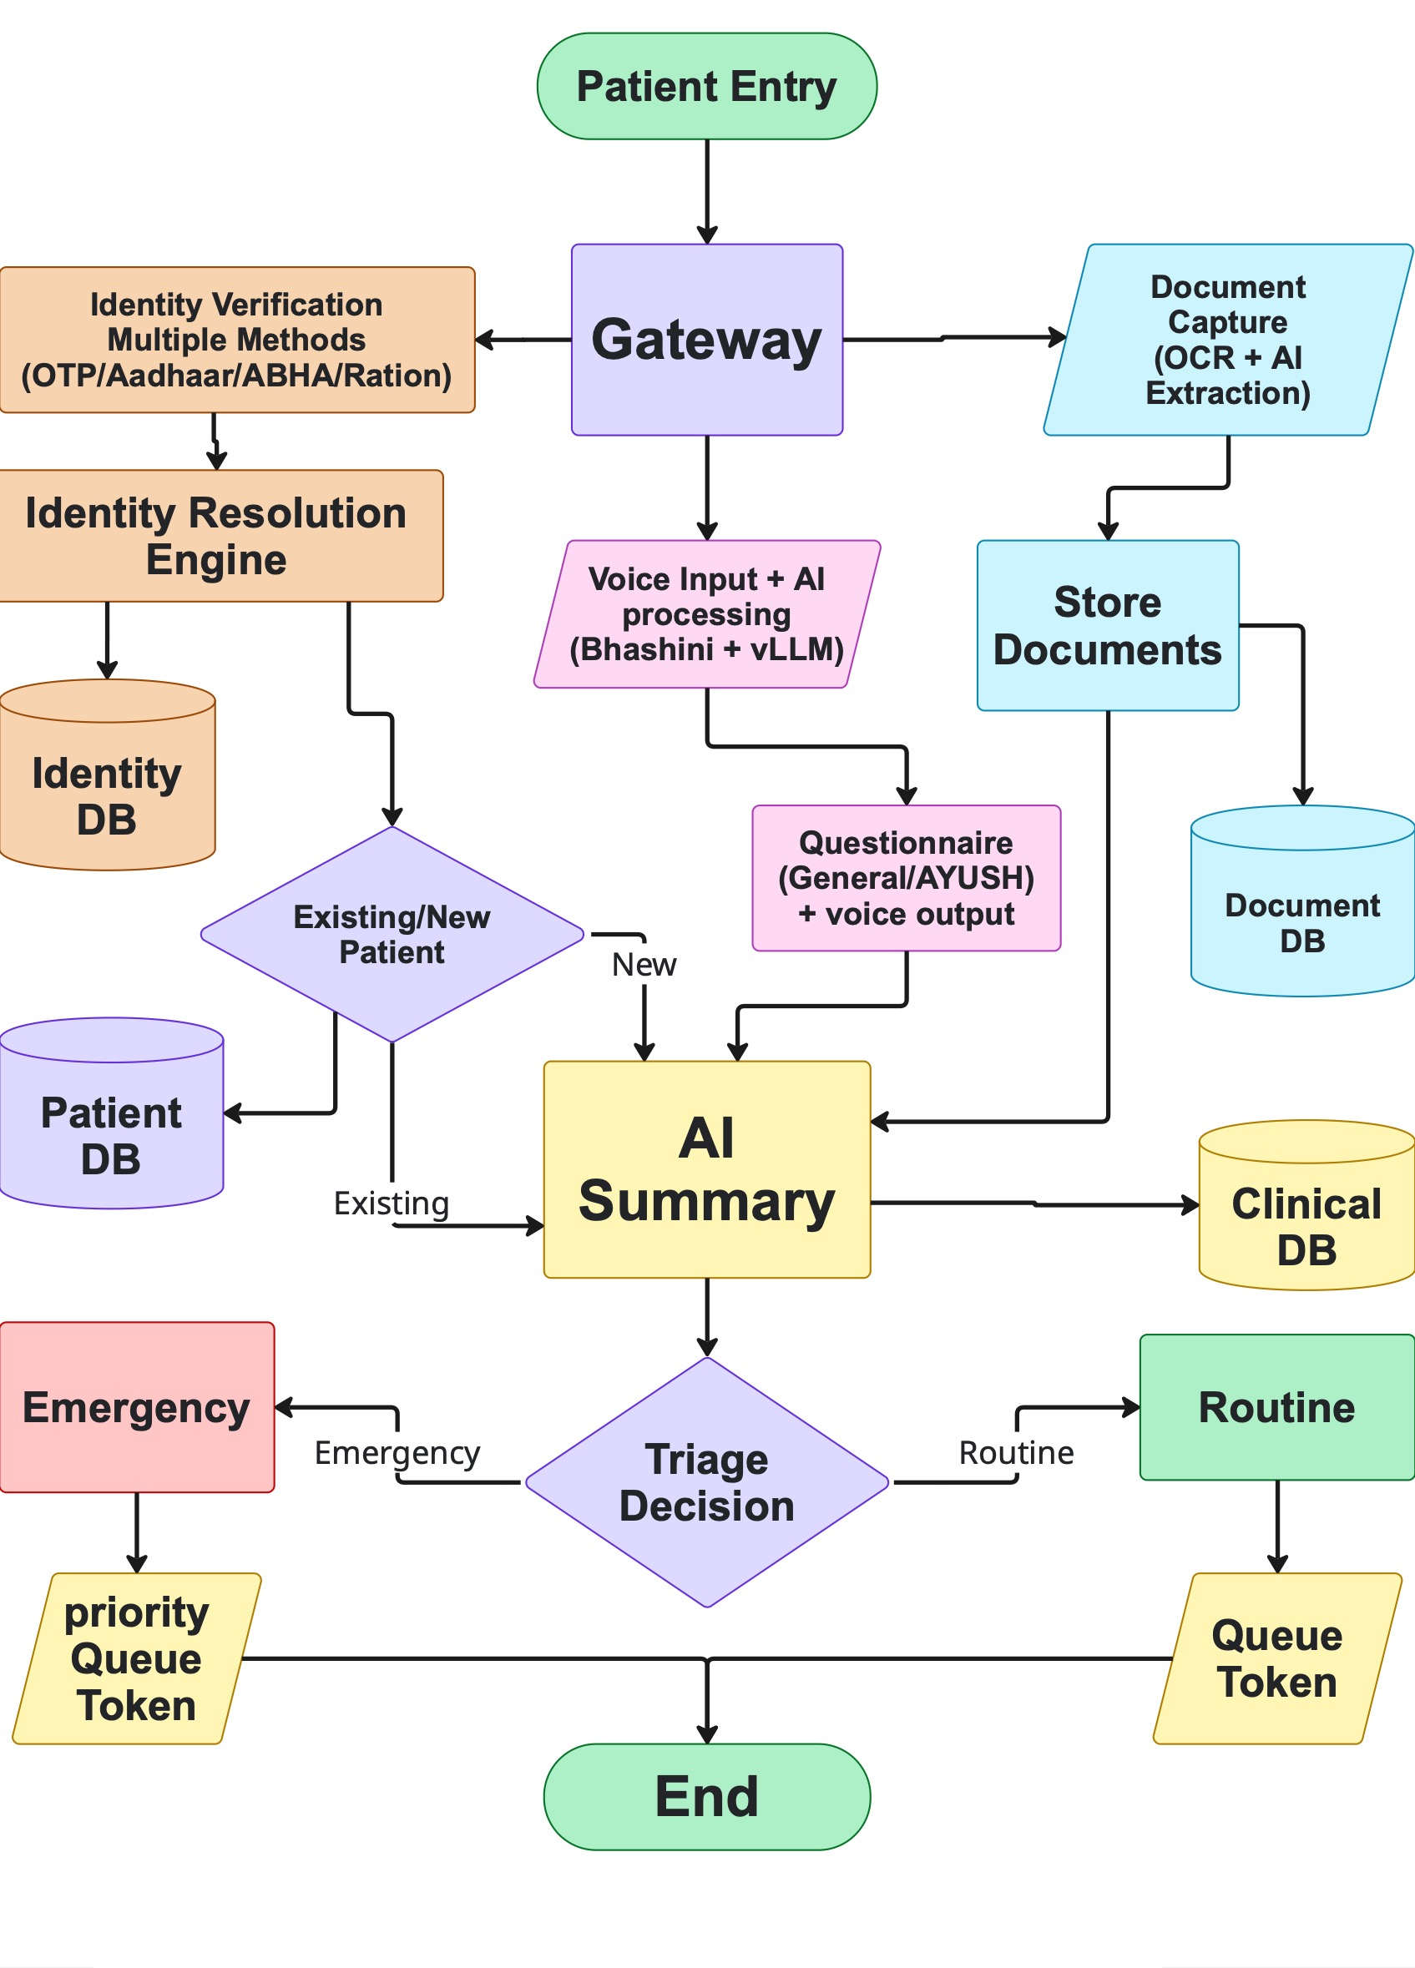
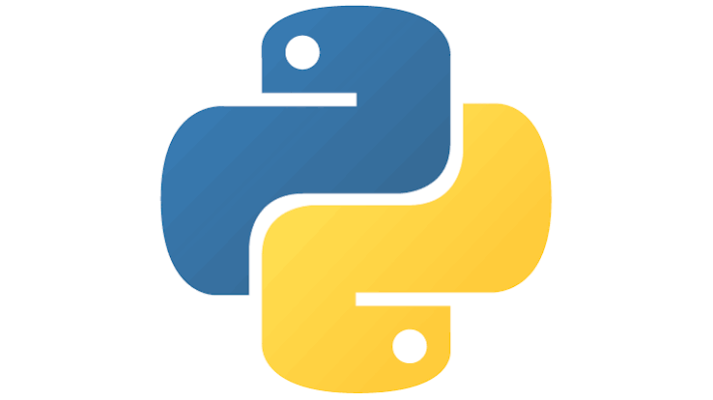


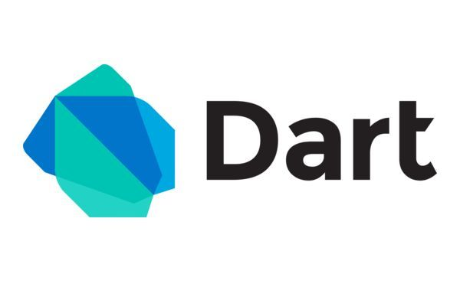
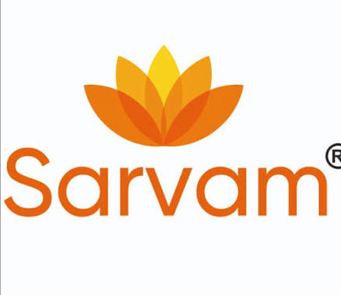
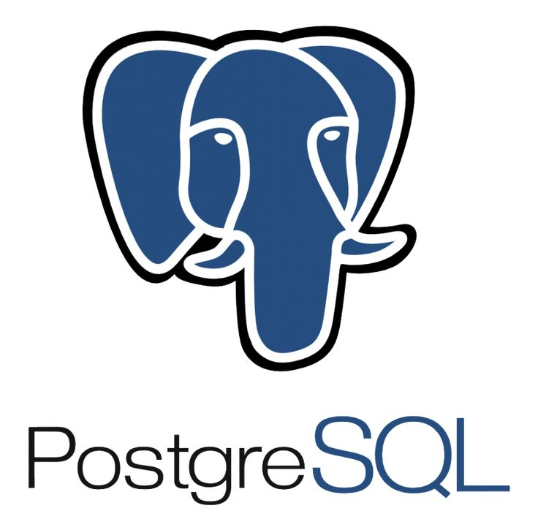




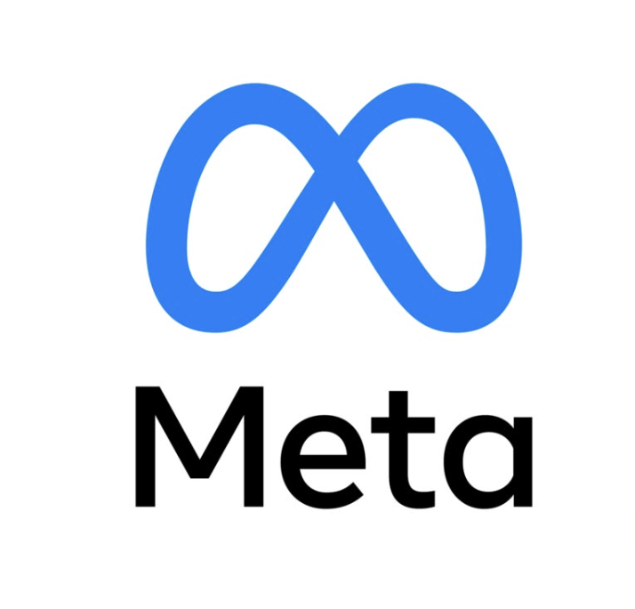
TECHNICAL APPROACH
matriX
Technology Stack:
Backend Architecture
Patient Entry
Gateway
Identity Verification (Multiple Methods: OTP/Aadhaar/ABHA/Ration)
Document Capture (OCR + AI Extraction)
Voice Input + AI Processing (Bhashini + VLLM)
Identity Resolution Engine
Identity DB
Store Documents
Document DB
Existing/New Patient
Existing → Patient DB
New
Questionnaire
(General/AYUSH) + voice output
AI Summary
Triage Decision
Emergency → Emergency → Priority Queue Token
Routine → Routine → Queue Token
End
Frontend: Flutter, Dart
Backend / API: Python, FastAPI
Database: Postgres, Redis, Google Cloud
AI/ML : vllm, Transformers, Torch, OpenCV-python, Pyaudio, PaddleOCR
Deployment : App release on Play store and App store
API services : Bhashini API, vLLM inference API, MSG91/Twillio, ABDM API, API setu, UIDAI ASA,AUA API
Add Ons : IndicWhisper, IndicTrans2, IndicTTS, Sarvam-2B/llama-3, OpenCV, paddelOCR/tesseract, Ctranslate2, PyAudio, WebRTC VAD, Pydantic, HashiCorp Vault/KMS
Figure of BACKEND ARCHITECHTURE FLOWCHART
Python
Flutter
PostgreSQL
Google Cloud
Frappe
Redis
Aadhaar
Meta
Twilio
Sarvam AI
Dart
Flutter
Google cloud
PostgreSQL
FastAPI
Meta
Dart
Reddis

Slide 4
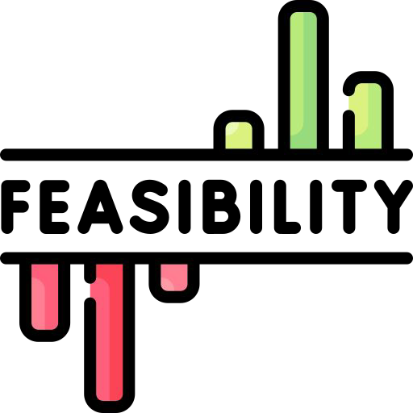
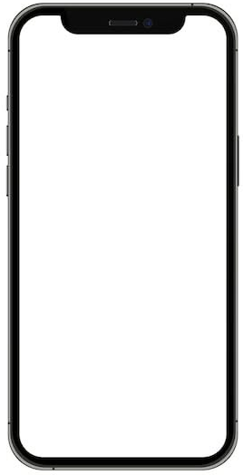
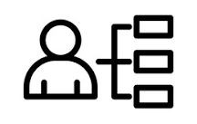
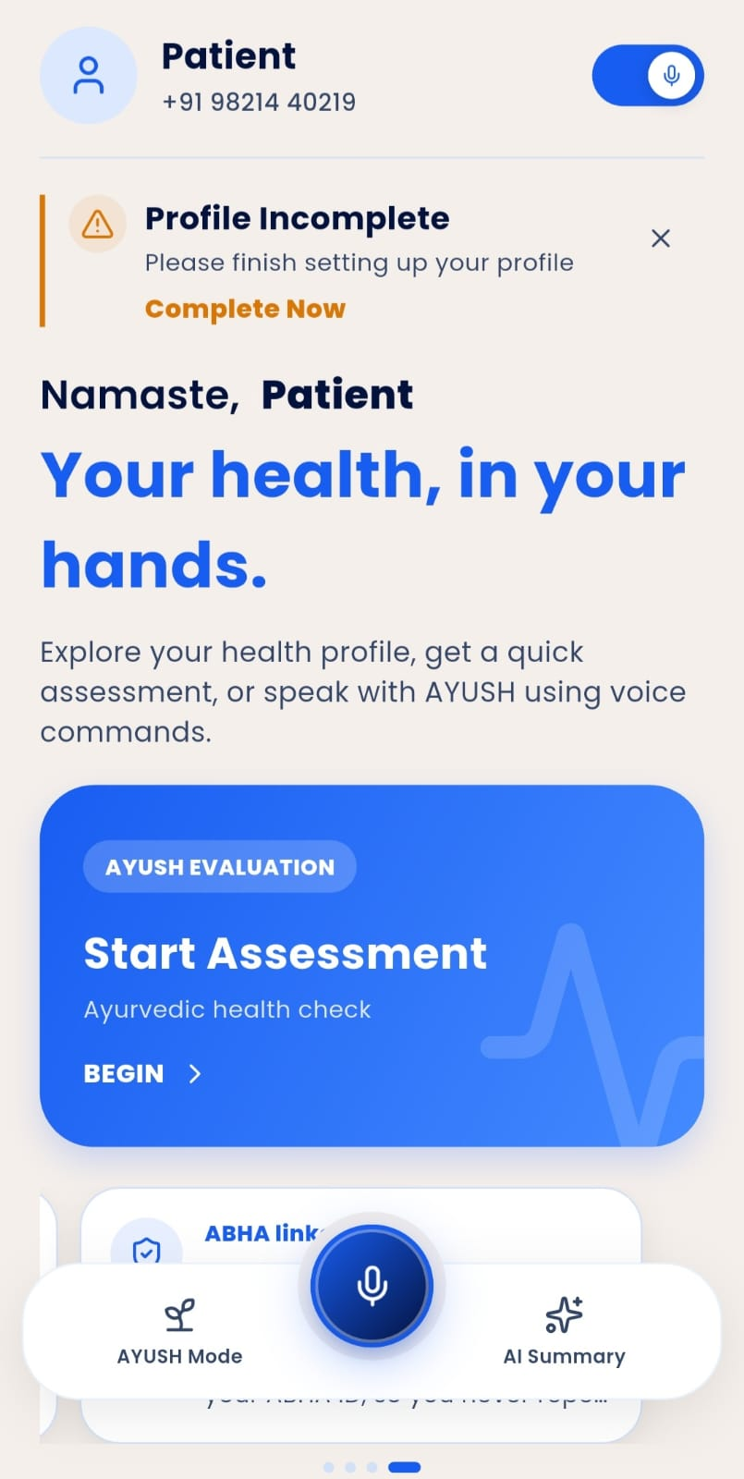

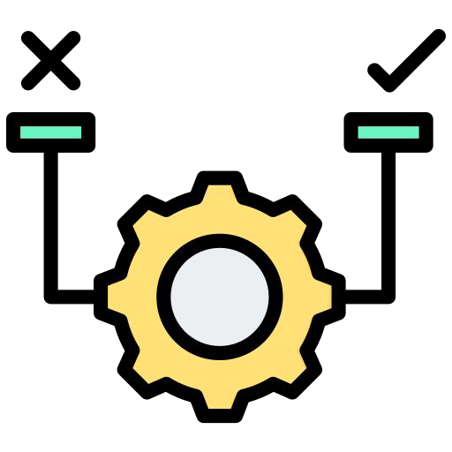

FEASIBILITY AND VIABILITY
matriX
Feasibility :
Proven Multi-Engine Stack: Integrates Indian-language ASR (Bhashini), specialized medical OCR (Tesseract), and local LLMs (Llama 3 via Ollama) into a single multimodal voice/touch interface.
National Interoperability: Uses open FHIR APIs and ABDM/ABHA gateways to pull past health profiles and push standardized clinical intake summaries.
Flexible Deployment: Supports hybrid cloud and edge on-premises instances to maintain uptime in low-connectivity government hospital environments.
Use Cases:
Lobby Clinical Triage: Gathers structured chief complaints, HPI, and specialized AYUSH assessments (Dashavidha Pariksha) while patients wait.
Paper Record Digitization: Scans, dates, and organizes scattered physical prescriptions and lab reports, flagging abnormal values chronologically.
Physician Summary Generation: Delivers an editable, pre-consultation draft summary directly to the doctor's screen alongside a physical OPD routing slip.
Business Potential:
Private Healthcare SaaS: Tiered subscription licensing for private hospital chains, corporate polyclinics, and high-volume outpatient facilities.
Diagnostic & Telehealth Expansion: Strategic integration with diagnostic lab networks for report aggregation and digital tele-triage intake.
Growing Digital Health Market: Integrate with ABDM/FHIR and expand across India’s digital healthcare ecosystem.
Viability :
Time & Workload Compression: Cuts doctor documentation time by over 60%, directly resolving the critical 2-to-5-minute OPD consultation bottleneck.
Modular Integration: Plugs smoothly into existing Hospital Information Systems (HIS) with zero disruption to current doctor diagnostic authority.
Universal Usability: Icon-driven visual navigation paired with voice-guided prompts ensures effortless self-service for elderly and low-literacy patients.
Challenges :
Handwritten Record Degradation: Addressed via multi-pass confidence scoring that flags low-certainty medication names for physician confirmation.
Multilingual & Voice Accuracy: Handling different Indian languages, accents, pronunciation, and medical terminology accurately during voice-based interaction.

Slide 5
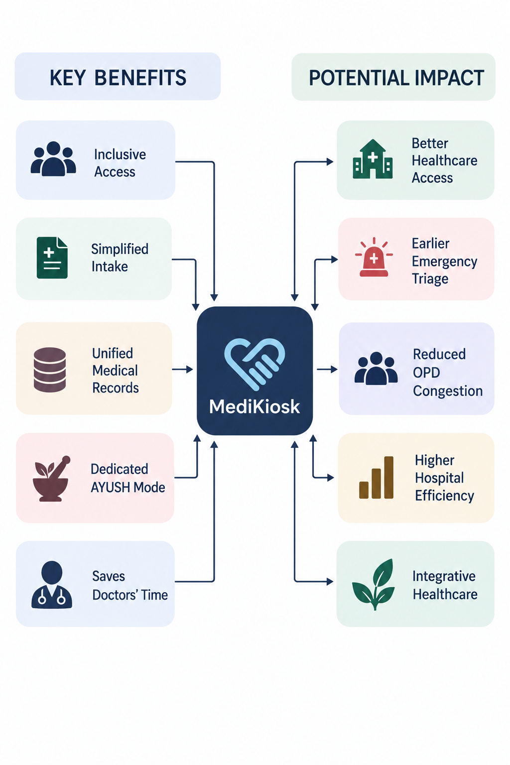
IMPACT AND BENEFITS
matriX
KEY BENEFITS
Inclusive Access
Simplified Intake
Unified Medical Records
Dedicated AYUSH Mode
Saves Doctors' Time
MediKiosk
POTENTIAL IMPACT
Better Healthcare Access
Earlier Emergency Triage
Reduced OPD Congestion
Higher Hospital Efficiency
Integrative Healthcare
❖ Potential Impact on the Target Audience :
1. Bridging the Digital Healthcare Gap: Five login paths (phone, Aadhaar, ABHA, QR, ration card) exclude no one. Voice-first, multilingual design works for elderly and first-time patients.
2. Complete, Multi-Mode History Capture: Voice, touch, document scan, and guided questioning in one intake. Cuts the risk of missed allergies, medications, or comorbidities.
3. Fragmented Records Become One Timeline: prescriptions and lab reports digitized into one chronological history.
4. Catches Emergencies Before the Queue Does: Red-flag detection flags chest pain and stroke symptoms for immediate triage. Incomplete profile alerts stop doctors working from a half-finished history.
5. Doctors Get Their Time Back: History is pre-structured before the patient enters the room. Frees consultation time for examination, diagnosis, and counselling.
Benefits of the Solution :
Social Elderly, rural, low literacy, multilingual inclusion. Early emergency detection. Real world fit: India's aging population, first time OPD patients with no digital ID.
Economical Reduced staff workload. Fewer redundant tests. Higher OPD throughput. Real world fit: 4,000 to 10,000 patient/day govt hospitals.
Technological AI, ASR, OCR, NLP/LLMs on ABDM/FHIR. AYUSH Dashavidha Pariksha digitization. Real world fit: aligns with Ayushman Bharat Digital Mission rollout.

Slide 6


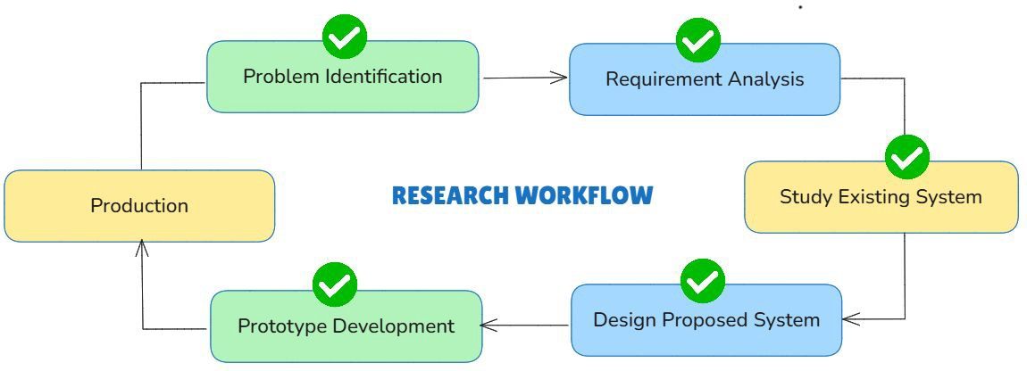

RESEARCH AND REFERENCES
matriX
Research & References
https://ahmis.ayush.gov.in/ayush_health_facilities
https://abdm.gov.in/
https://www.researchgate.net/publication/370852465_Santarpanotha_Nidana_Questionnaire_Evaluating_and_Designing
https://pmc.ncbi.nlm.nih.gov/articles/PMC5871217/
Existing Systems :
MediBuddy
AYUSH Grid
Practo
Ada health (Germany)
Market Research
Features | Medikiosk | Medibuddy | Ayush Grid | Practo
Multilingual voice-based intake |  |  |  | Partial
AI-guided adaptive history-taking
Dedicated Ayush Mode
OCR-based document digitization
ABHA/ABDM integration |  | Partial |  | Partial
Assisted mode for rural users
Rule-based red flag/emergency detection
Live Demo :

