Slide 1
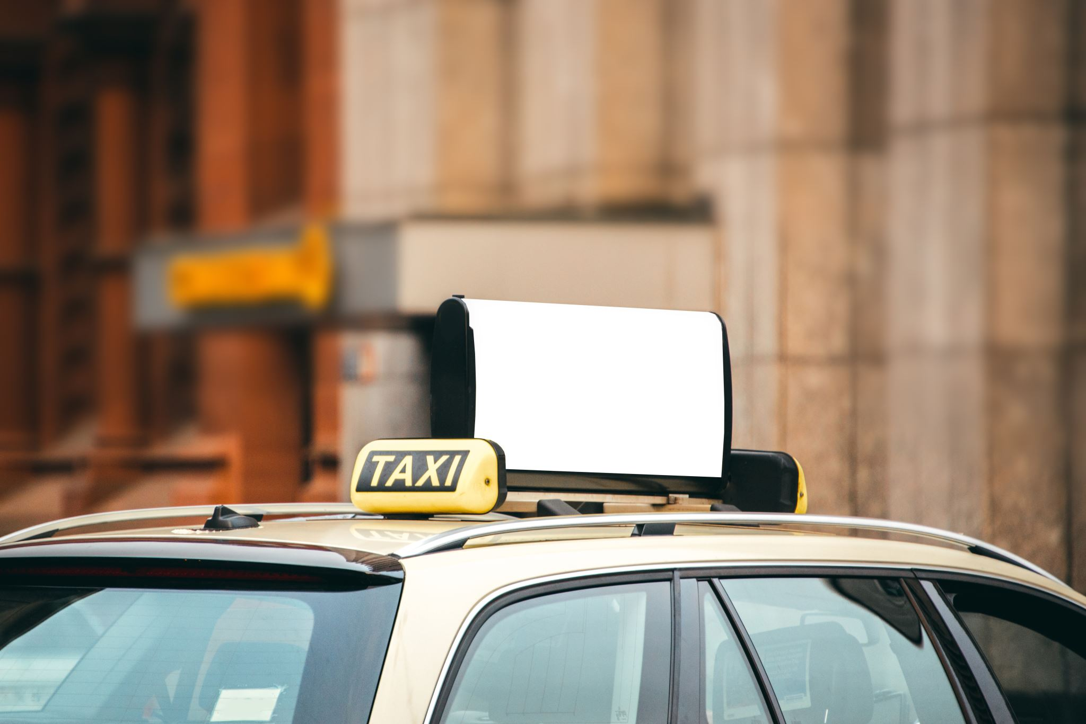
Data Analysis of Cab Services in NYC
Submitted by: Kushan Pathak
Ruid: 205002805

Slide 2
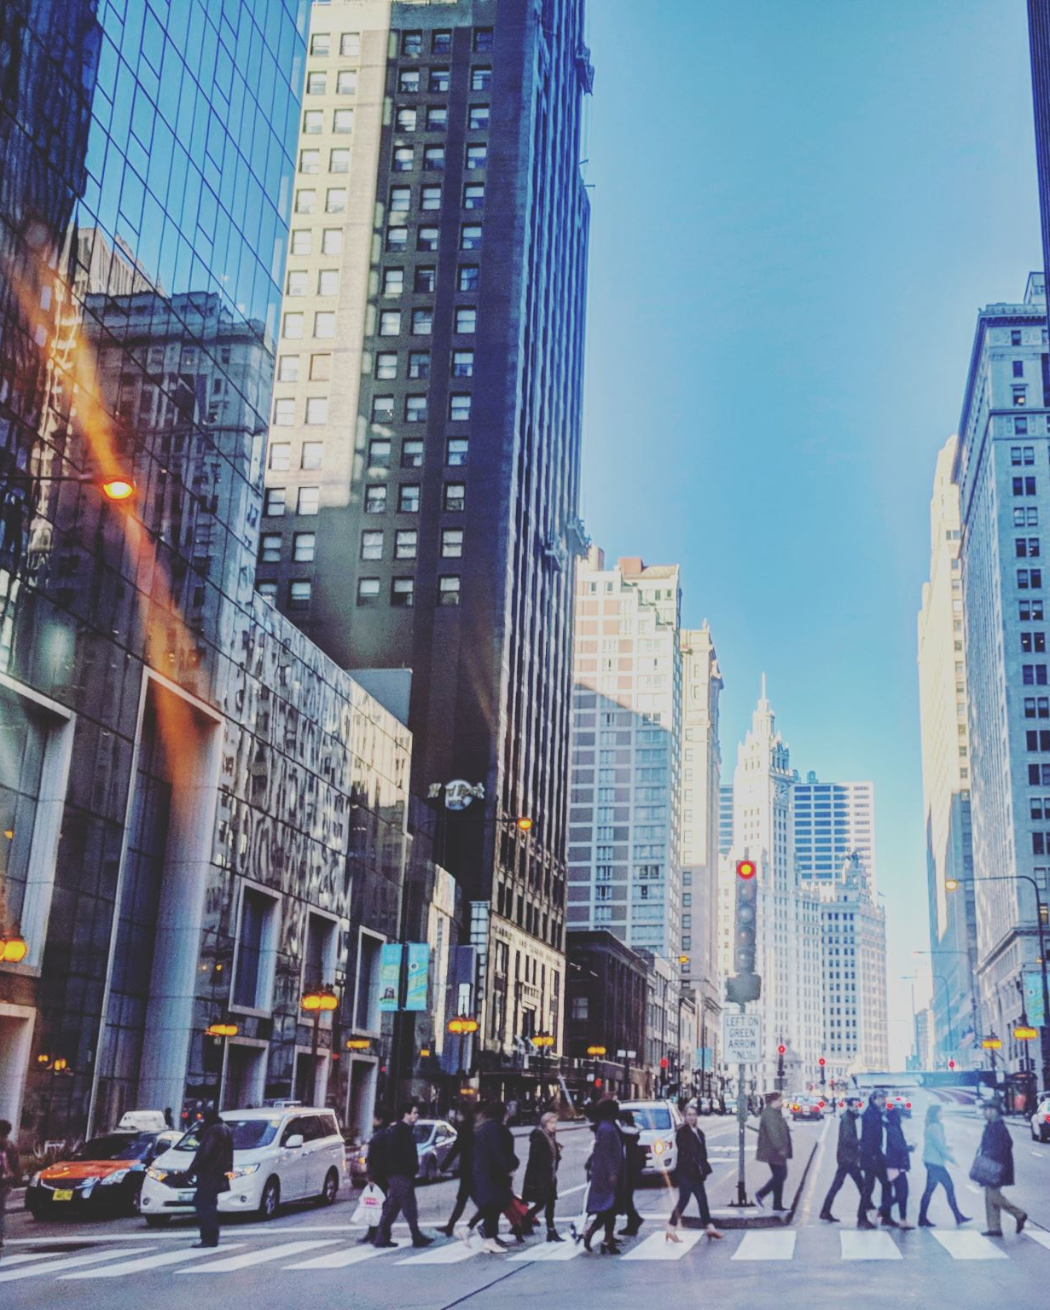
Introduction
New York City is one of the busiest cities in the world. The city has around 50,00 cab drivers driving these cabs around the city.
Three major cab services of the city are Uber,Lyft and Yellow cabs.
There are several factors that can cause the increase in fare such as weather, time and days.
It’s important for the passenger to know which cab service is cheaper and reliable to travel so that they choose their desired cab service.

Slide 3
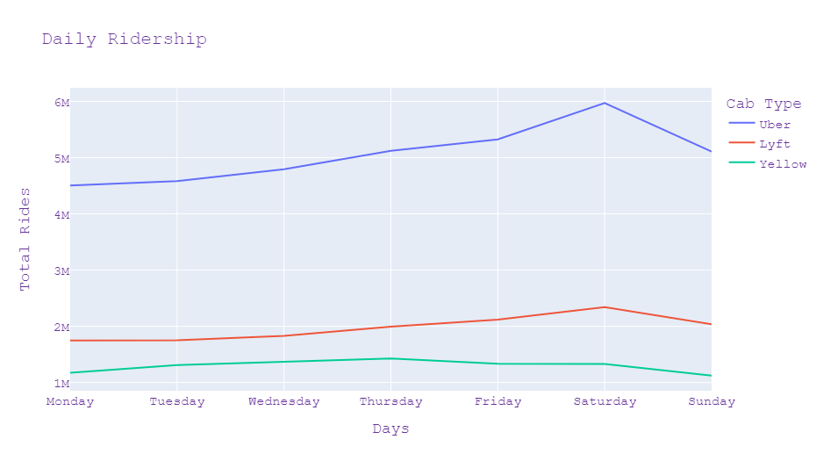
Daily Ridership
Uber has the highest ridership among other cab services.
Saturday has the highest ridership among all the other days for Uber and Lyft.
Yellow cabs have their peak ridership on Thursday.

Slide 4
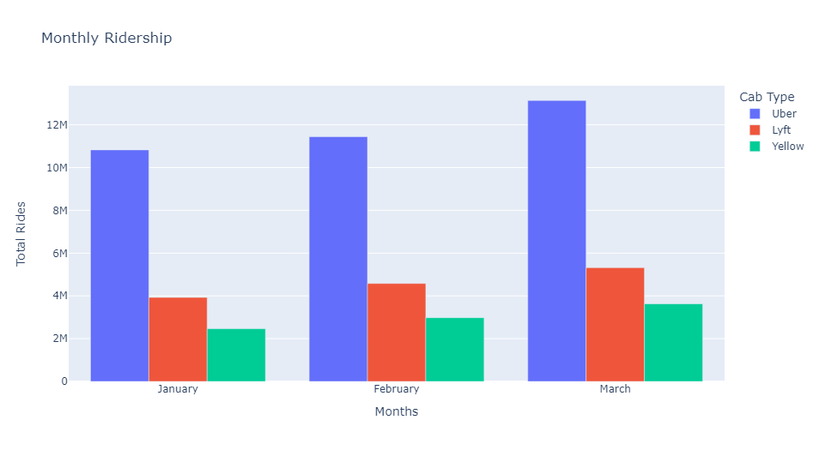
Monthly Ridership
Uber has the highest ridership among other cab services for the first three months.
Uber ridership is almost double the ridership of Lyft and approximately three times the ridership of yellow cabs.
The ridership is increasing gradually for every month.

Slide 5
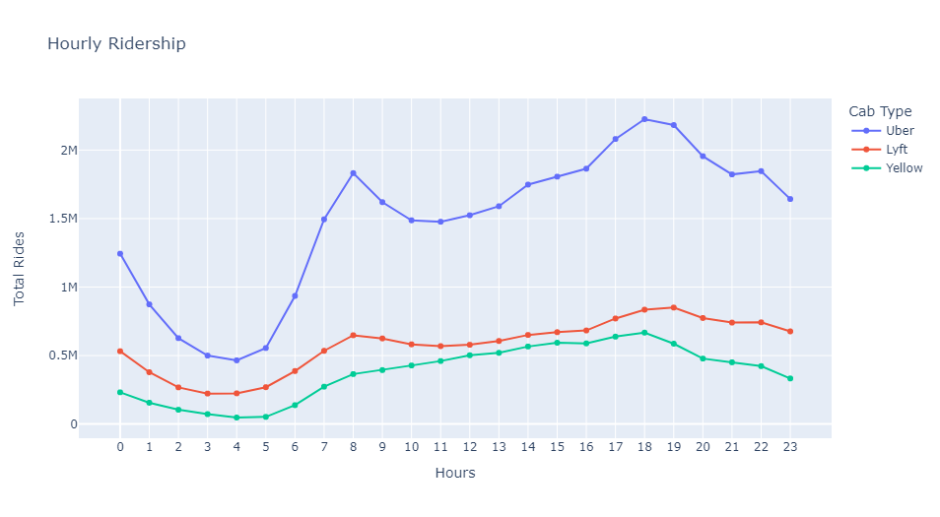
Average Hourly Ridership
Cabs booking is higher than it’s average between 4pm and 7pm and 6am and 9 am
After 7pm in the evening and from midnight to 5am the cab booking sees some dip.

Slide 6
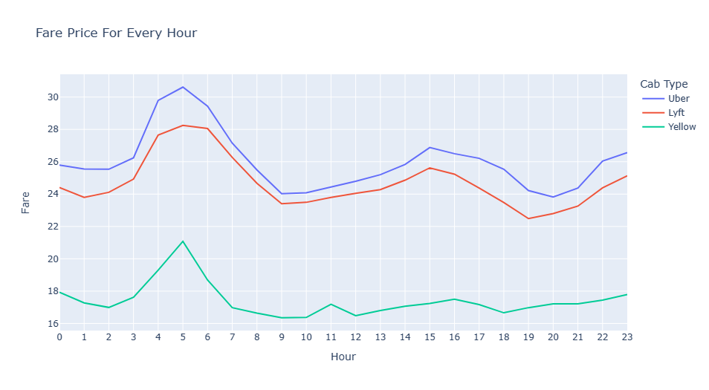
Hourly Fare Collection
The fare increases in the early morning between 3 am to 5am and between 3pm and 7pm and is at it’s peak at 5am in the morning.
We can see the dip in fare after 6am for all the cab services.
Fare increase is also seen between 10pm and 11 pm.

Slide 7
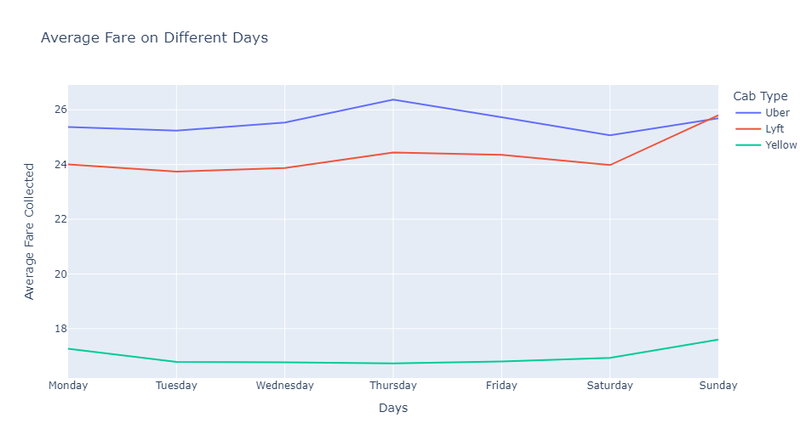
Weekly Fare Distribution
The average fare charged is generally stable on all days except some increase is seen on the Thursdays and slight increase during weekends.

Slide 8
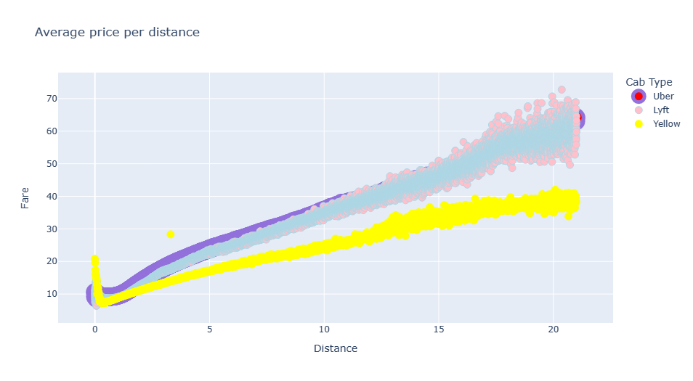
Average Fare per Distance
Uber and Lyft have higher fares for every mile covered than the yellow cabs.
We can see that short distance rides up to 5 miles have almost similar fare across all the cab services.
Lyft fare is higher when the distance covered is between 15 and 20 miles.

Slide 9
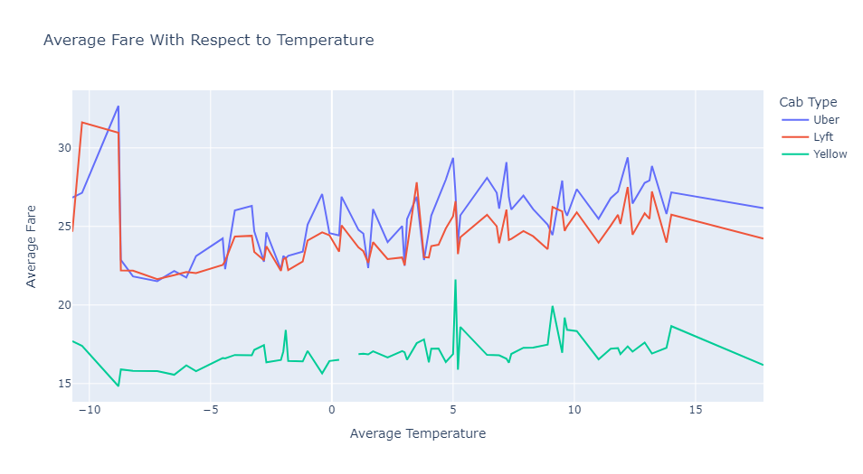
Average Fare With Temperature
The average price increases substantially with a decrease in temperature.
Uber and Lyft have higher fluctuation with respect to temperature then the yellow cabs
Yellow cabs are not much affected by the temperature drop.

Slide 10
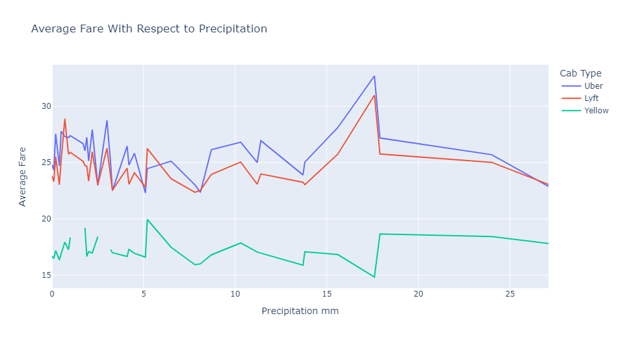
Average Fare With Rainfall
The average price for all the cab services increases when the rainfall is between 15-20mm.
Uber and Lyft have higher fares with respect to rainfall.
Yellow cab’s fare doesn’t see much hike in average fare due to rainfall.

Slide 11
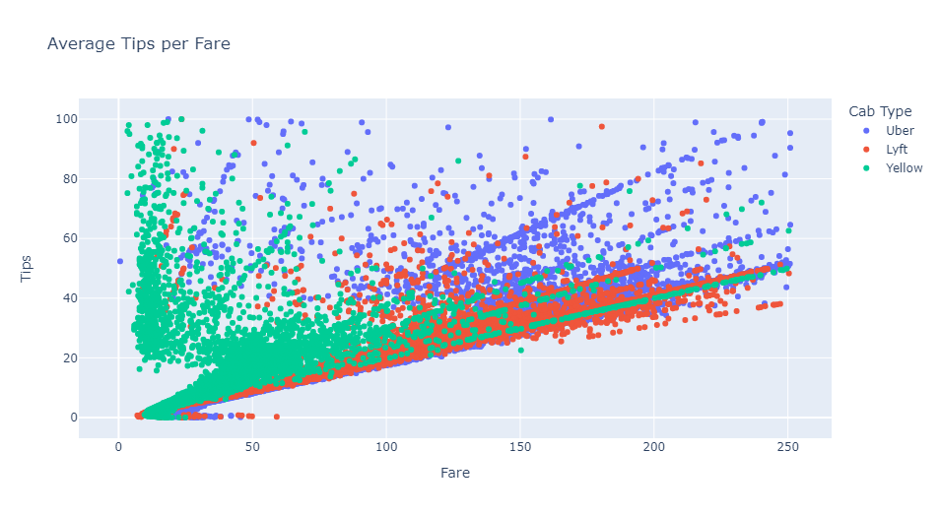
Average Tips per Fare
The tips collection is somewhat proportional to fare charged by the cabs.
The customer tips about 20% on an average for the total amount charged for their ride.

Slide 12
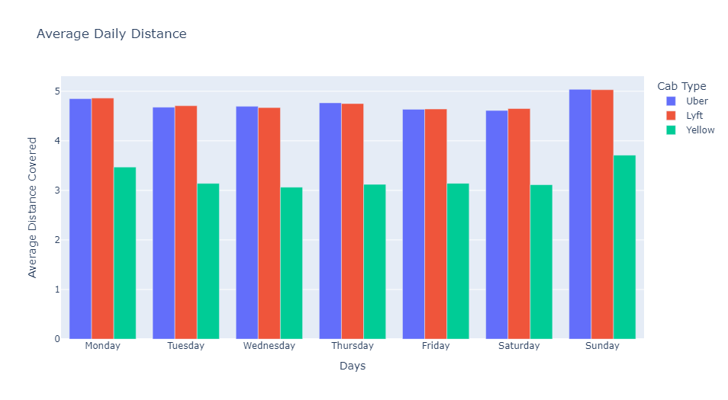
Daily Distance Covered by the cabs
The average distance covered by every cab service on a Sunday is highest compared to all the other days.
Uber and Lyft are covering more distance than the yellow cabs.

Slide 13
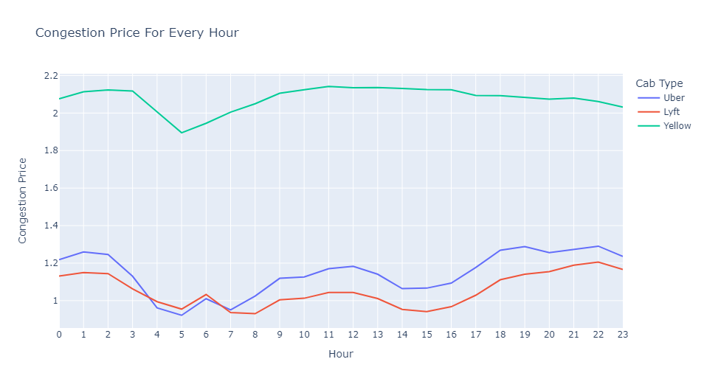
Hourly Congestion Charges
The average congestion charges charged by the yellow cabs are the highest.
The average congestion charges vary for both the Uber and Lyft and are high from 8 am to 1 pm and from 6pm to 8pm in the evening.

Slide 14
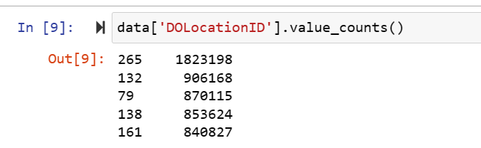
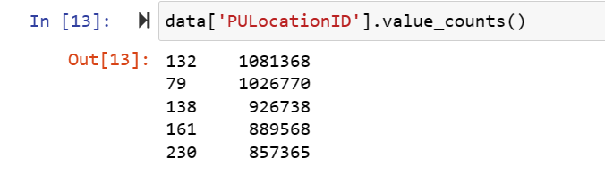
Taxi zones with most pickups and Dropoffs
Most of the pickups and drop-offs take place in the airport zones that is JFK airport and laguardia airport.
Manhattan borough has the highest pickups and drop offs apart from the airport zones in New York.
Staten Island borough has the least pickups and drop-off among all the other boroughs of New York.

Slide 15
Conclusion
From the above research we can conclude the Uber fare is the highest among all other cab services for these three months of 2022.
The ridership is highest in Uber followed by Lyft and yellow cabs.
The distance covered is also higher in Uber and Lyft than yellow cabs.
Weather does play a role in fare increase for Uber and Lyft whereas the yellow cab doesn't see much fare difference during the weather change.
A passenger on an average tips 20% of the total amount charged.

Slide 16

Thank You!

