Slide 1
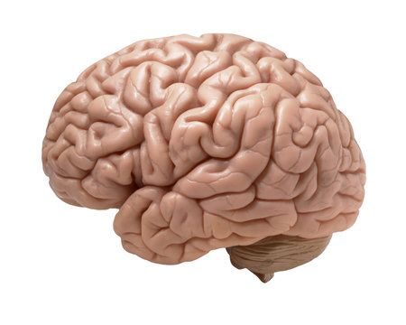
Machine learning for brain tumor classification
Kunal Sharma
Roel D’Haese
Stephan Krushev

Slide 2
Outline
Introduction to the topic
Baseline CNN model
Baseline DNN model
XCEPTION + DNN: best of two worlds
Transfer learning
Summary

Slide 3
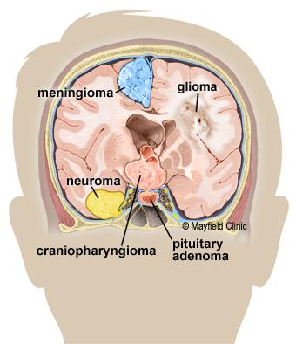
Detecting brain tumour through visual segmentation of deformities
Brain has symmetry on left-right
Cancer tissue growth leads to increase in pressure
leading to deformation s
3 types of brain tumors make up 80% of the brain
tumors: meningioma, glioma, pituitary
Notes:
confirmation with other techniques histopathologogy looking for specific biomarkers. difficult to get biopsy sample as invasive
CT scan detecting hyperdense regions, radioactive tracing through PET scan for cancer grade and aggressiveness

Slide 4
Overview
 | Meningioma | Glioma | Pituitary
Location | Protective membrane (outside the brain) | Glial cells (inside the brain) | Pituitary gland (base of the brain, one location)
B/M | Benign | Somewhat benign or malignant | Mostly benign, rarely malignant
Priority | Meningiomas are difficult to distinguish from other cancer types due to colocation, lowest priority | Includes GBM a aggressive, high-grade malignant (aka brain cancer), highest priority for precision and recall (sensitivity). | Easy to detect due to known location, low priority

Slide 5
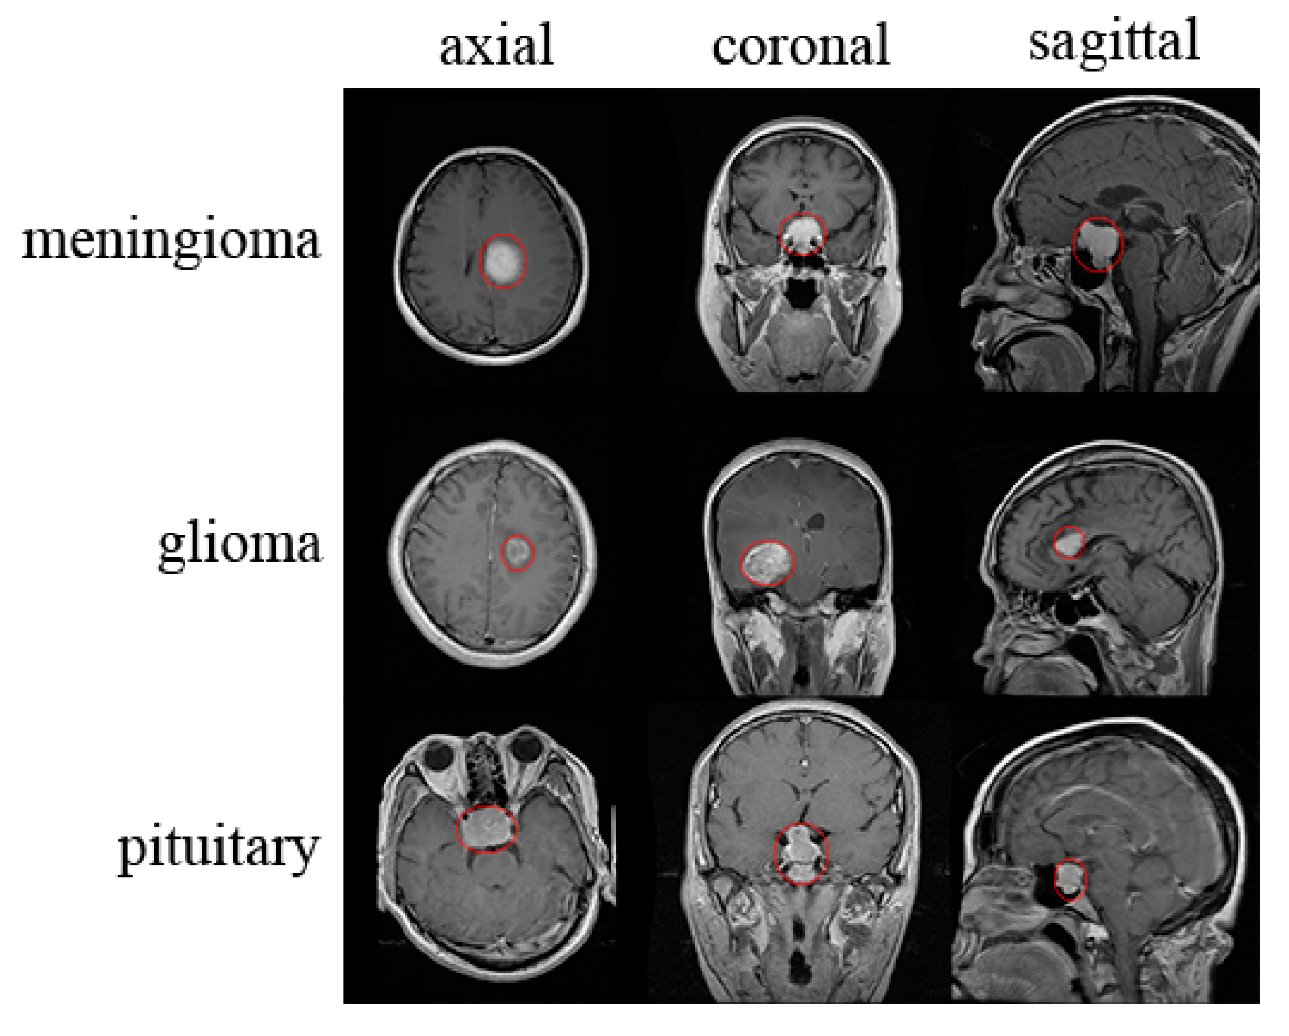
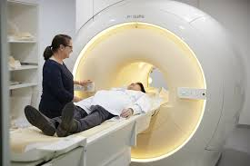
How the images are made
Magnetic resonance imaging (MRI)
Radio waves and magnetic field
Interact with hydrogen atoms
Creates cross-sectional images

Slide 6
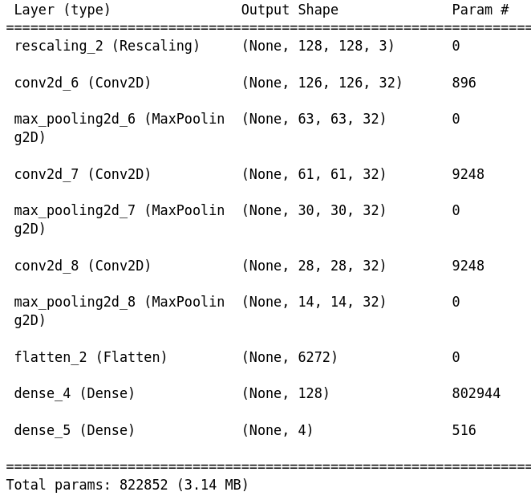
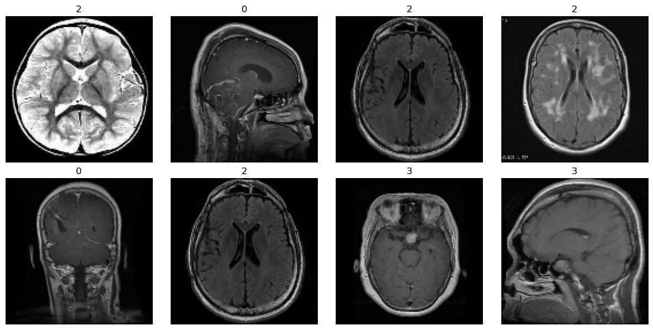
A simple CNN model
4 different angles of scan
4 different classes:
glioma, meningioma,
notumor, pituitary
Simple CNN model with max
pooling.
approx. 5000 training images, 1300 test.

Slide 7
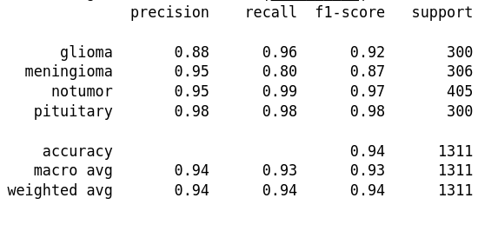
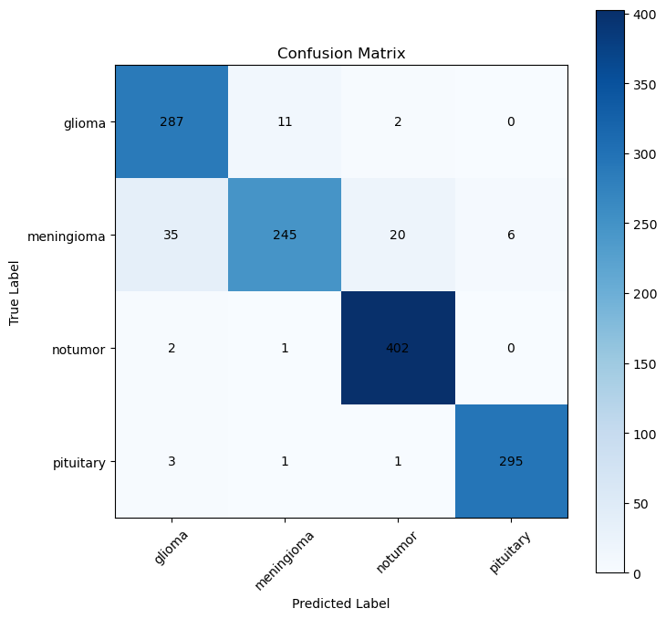
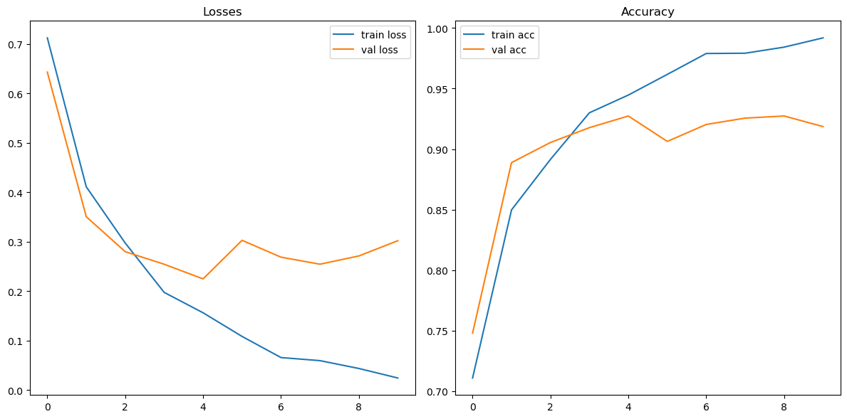
Baseline results

Slide 8
Increasing number and depth of CNN layers improved performance metrics
Recall
Weighted F1 score
CNN_1Layer | 0.8464
CNN_2Layer | 0.8431
CNN_3Layer | 0.8889
CNN_4Layer | 0.915
CNN_3Layer_Deeper | 0.9052
CNN_4Layer_Deeper | 0.9150
CNN_1Layer | 0.9293
CNN_2Layer | 0.9198
CNN_3Layer | 0.9471
CNN_4Layer | 0.9503
CNN_3LayerDeeper | 0.9608
CNN_4LayerDeeper | 0.9462
Increasing CNN layers (1 to 3) and deeper (32 to 64) increased recall by 5% and precision by 4%

Slide 9
Flipping left and right improved performance
Recall
CNN_3Layer_Deeper | 0.9052
FLIP LEFT RIGHT | 0.9444
FLIP UP DOWN | 0.8529
ROTATION | 0.9216
BRIGHTNESS | 0.8954
CROP | 0.768
Flipping up and down reduced performance, structural asymmetry in top and bottom of brain
Flipping left and right improved f1 by 0.5 % and recall by 3.5%

Slide 10
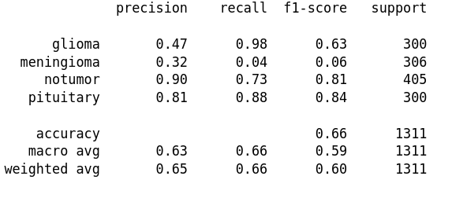
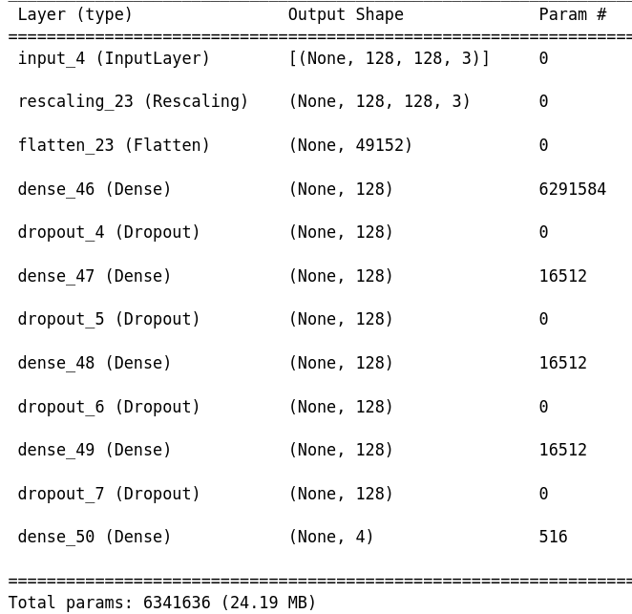
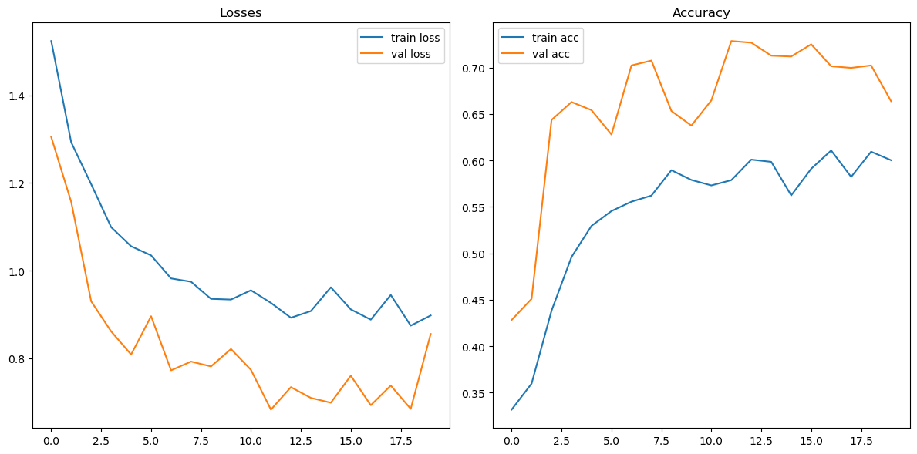
A simple DNN model

Slide 11
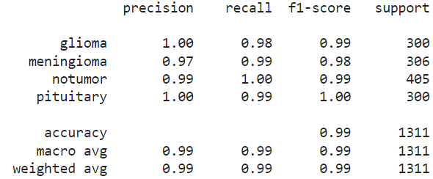
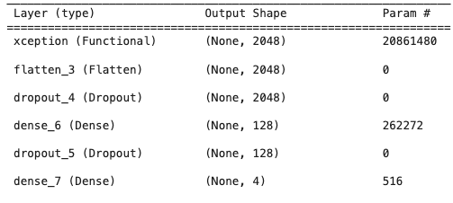
XCEPTION + DNN
Lack of fine tuning on pretrained weights led to worst performance
Training all layers led to further 4.5 % improvement
Notes:
why XceptionNet performs better than traditional CNNs:
Depthwise Separable Convolutions: XceptionNet uses this approach to reduce redundancy in feature learning by separating spatial and cross-channel correlations, leading to more efficient use of parameters.
Efficiency: With fewer parameters, XceptionNet achieves better computational efficiency while maintaining expressive power in feature representation.
Less Overfitting: The reduced parameter count helps mitigate overfitting, especially useful for small datasets, resulting in improved generalization to unseen data.
Transfer Learning: Pre-trained on large datasets like ImageNet, XceptionNet leverages learned features, enhancing its ability to adapt to specific tasks through fine-tuning.
Adaptive Receptive Field: Utilizing inception modules, XceptionNet captures features at various scales effectively, enabling it to learn hierarchical representations of complex patterns in data.

Slide 12
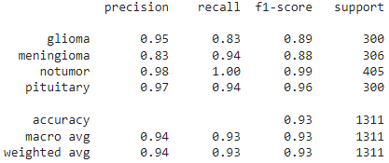
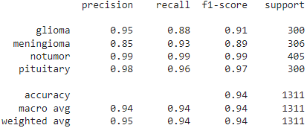
Transfer learning - Without augmentation
ResNet50
VGG16

Slide 13
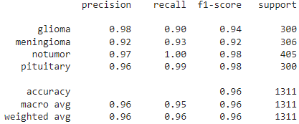
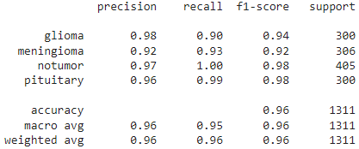
Transfer learning - With augmentation
ResNet50
VGG16

Slide 14
Summary
Recall is a good metric for clinician to not miss out on positive cases
Improved performance by going deeper, layers, data augmentation
Xception + DNN outperforms CNN-3layer by 4.5%
Detect 98/100 cases for meningioma and glioma
Xception + DNN is good enough to be used in production
Notes:
Future test and comparison with Unet, Densenet
- We were able to identify XXX type of tumour with 96 cases out 100 correctly with the XXX model.
- The XXX model outperofrms other models by XX% with utilising data augmented

Slide 15
Questions?

