Slide 1
Predicting IMDB Rating and Spoilers Detection of Movies using Machine Learning and Deep Learning
Name and Reg No.: Kush desai(20mcb1002)
Titar raginee(20mcb1004)
Raviraj patil(20mcb1016)
Subject: NoSQL Databases(CSE6006)
Guide: Dr. A. Bhuvaneswari,

Slide 2
Introduction:
Objective and goal : Study the different machine learning and Deep Learning models for predicting Movies’ Imdb ratings.
Problem Statement: Predicting IMDb Rating of Movies by Machine Learning and Deep Learning Methods.
Motivation:
(a)Can you utilize the metadata to identify the imdb rating?
(b) Apart from deriving imdb scores, the metadata available can be used for other tasks as well like spoiler detection etc.
Challenges:
(a) Handle large dataset.
(b) predict that which movie is in which genre.
(c) Deal with the spoilers.

Slide 3
Literature Survey:
Paper No | Methodology | Results
1. | Word2vec + Linear SVM, Bag of Words + Random Forest, Word2vec+Random Forest, (Word2vec+Bag of Words) + Random Forest approaches used for feature vectors and introduced three unique classification strategies. | the (Word2vec+Bag of Words) + Random Forest model has given the maximum accuracy of 84.14 percent.
2 | Author has used Bi-LSTM network and RNN-s. In this study, they perform movie genre classification from plot summaries using BiLSTM network. | Instead of using whole plot summary as input, divide it into its sentences and train the network using those sentences.
3 | The text blob tool in python is used to correct misspelled words in user text. Author used RNN, Naïve Bayes and LSTM for classification. | TF IDF Representation Of a review performed better than Bag of words. NAVIE BAYES performed well in machine learning algorithms and LSTM in deep learning algorithms in the context of the text
4 | Data collected from two platforms, Wikipedia and IMDb. Author used various classification algorithms like Random forest , Naïve Bayes etc. to predict movie ratings. To make the data set a balanced one, SMOTE is applied afterwards. Thus, the accuracies increase | Random forest, J48 and bagging gives same classification accuracy.

Slide 4
Paper No | Methodology | Results
5 | Author proposed a classification scheme of pre-release movie popularity based on inherent attributes using C4.S and PART classifier algorithm and defined the relation between attributes of post release movies using correlation coefficient. | movie popularity classified with 77% accuracy. The classification accuracy of both the decision tree and rules showed the dominance of director rank together with budget.
6 | Author performed analysis of movie reviews using a combination of deep learning techniques, LSTM and CNN. CNN is a commonly used deep learning method used for feature learning. LSTM is a unique sort of RNN, which is equipped for adapting long term conditions. Proposed model allowed remembering of information over a much longer period | LSTM–CNN provided better accuracy with an overall accuracy of 79% with compare to CNN-LSTM.
7 | Author used Linear Regression, Factorization Machines techniques in order to predict movie success by predicting IMDb ratings for newly released movies using social media data and compare it to current studies. Developed a framework in order to gather the movie data from different sources including social media. | Factorization Machines approach is used to predict movie success by predicting IMDb ratings for newly released movies by combining movie metadata with social media data.
8 | Author proposed method to unveil the important factors influencing the score of IMDb Movie Data. Author used SVM, Adaboost, Random forest classified to predict the movie score. | Random Forest represented the movie features more accurately. The success percentage for all models are better in comparison to the previous studies. The results obtained are better than that of some standard libraries and similar studies.

Slide 5
Paper No | Methodology | Results
9 | Author designed and implemented a tool to extract the IMDb dataset files and import them into a database. This tool uses document oriented data structures, and allows others to augment the code to change structures based on their needs. Finally, a web interface to perform queries against the import data to validate the import process was also developed. | delivered a website which performs various queries on some of the data collections, which validates the imported data.
10 | Author did a case study for the visualization and analysis of large and complex temporal multivariate networks derived from the Internet Movie Database (IMDB).Author integrated network analysis methods with visualization in order to address scalability and complexity issues. He applied island analysis for a specific time slice in order to identify important and meaningful subgraphs. Further, a temporal Kevin Bacon graph and a temporal two mode network are extracted in order to provide insight and knowledge on the evolution. | Shown some patterns in the evolution. Visualization with galaxy of movies is shown in the network of specific time slice.

Slide 6
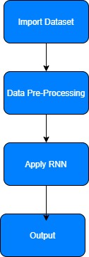
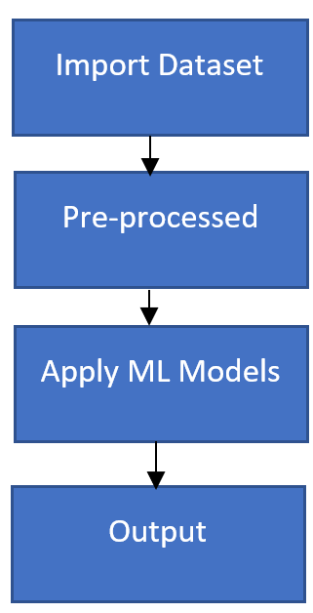
Flow Diagram:
IMDB Rating Prediction
Spoiler Detection

Slide 7
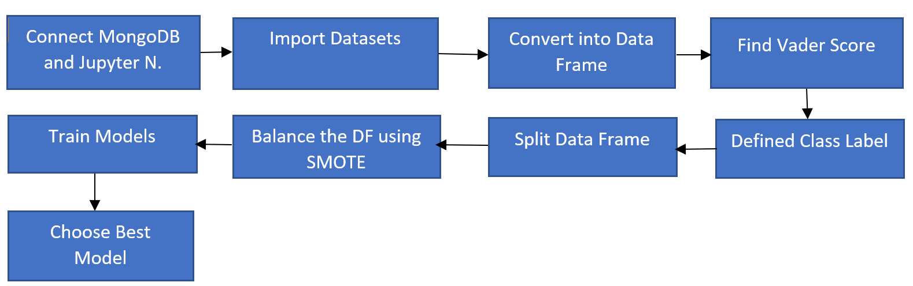
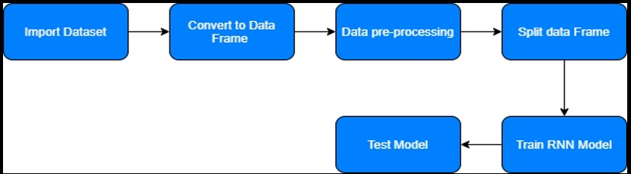
Proposed Work:
IMDB Rating Prediction
Spoiler Detection

Slide 8
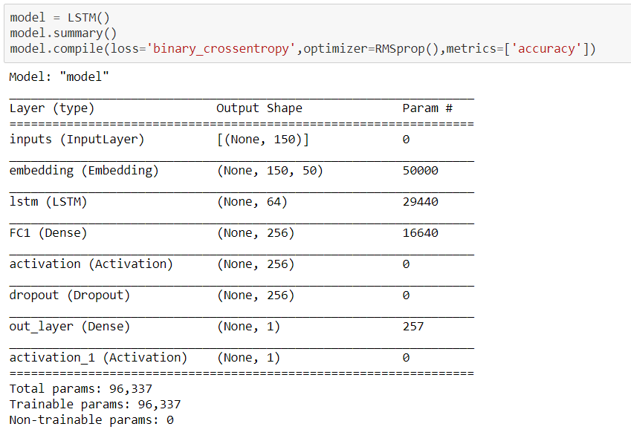
Spoiler Detection : RNN Model

Slide 9
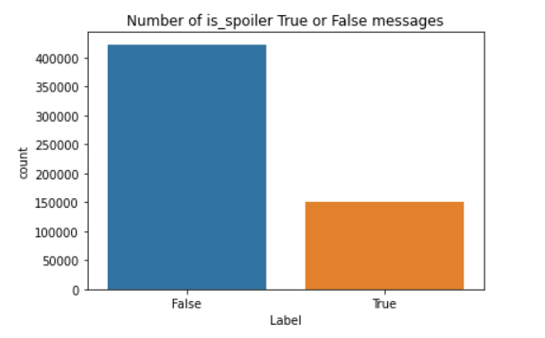
Count of Spoilers in the dataset

Slide 10
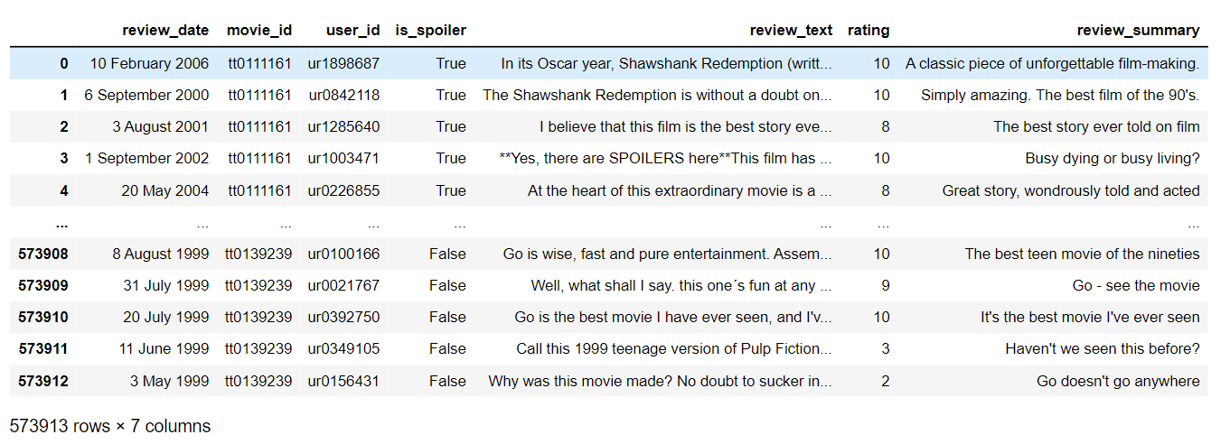
Dataset:

Slide 11
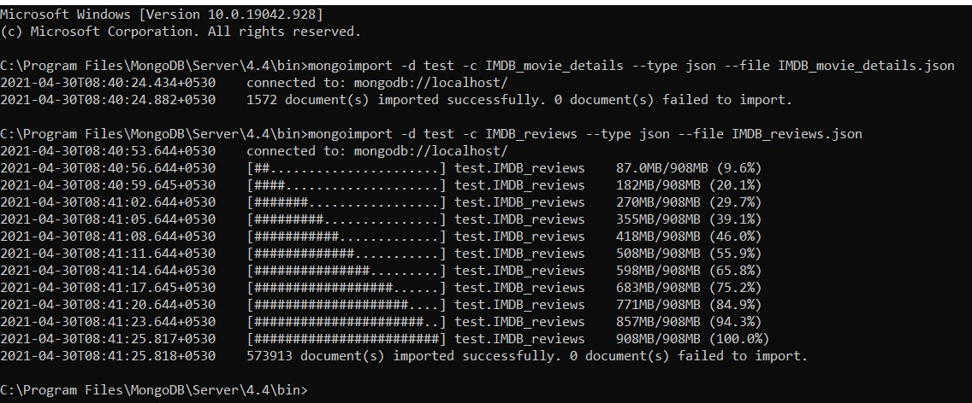
Imported Datasets into MongoDB

Slide 12
Visualization:
Distribution of ratings in dataset:

Slide 13
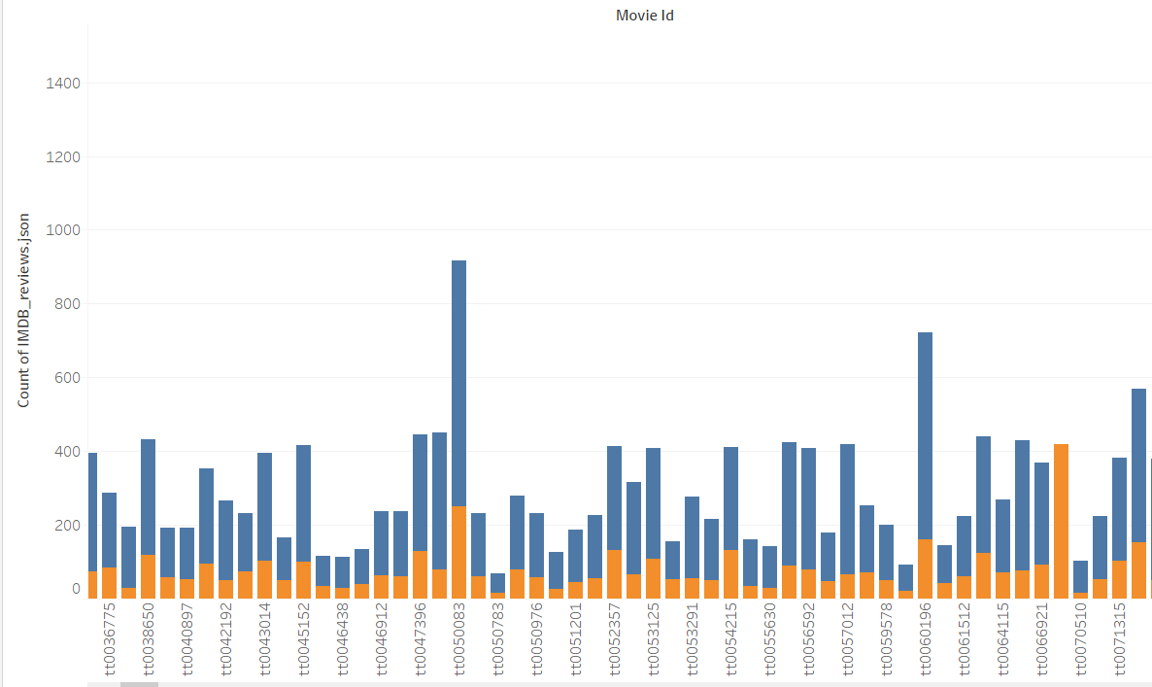

Slide 14
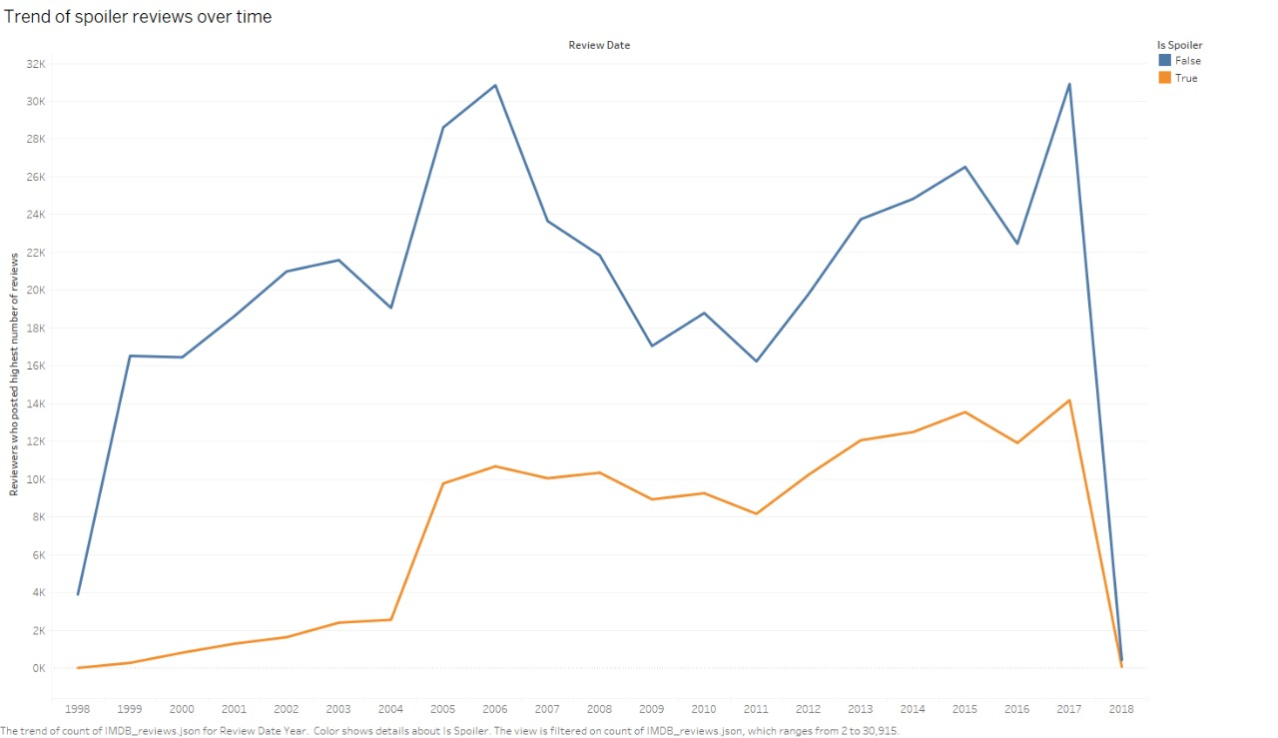
Trend Of Spoiler reviews over time:

Slide 15
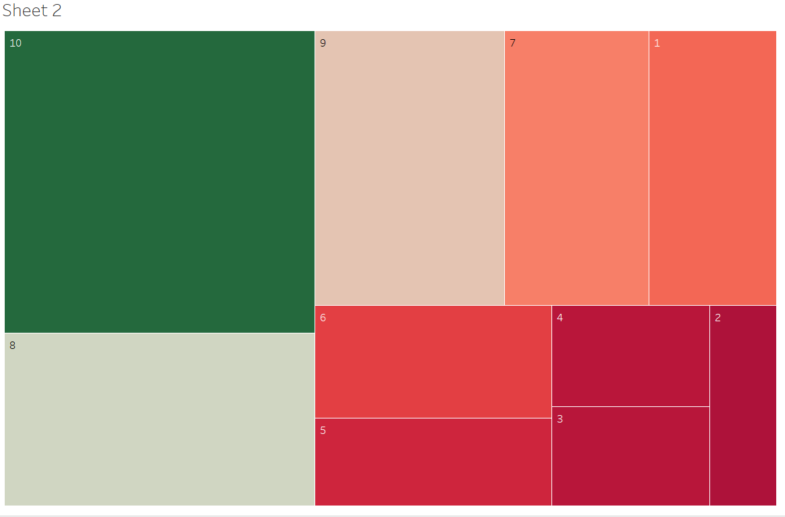
Heatmap of movies which contains highest to lowest number of ratings

Slide 16
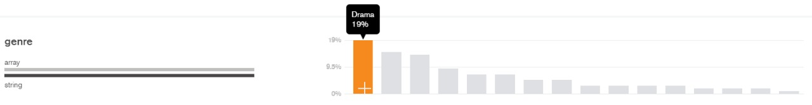
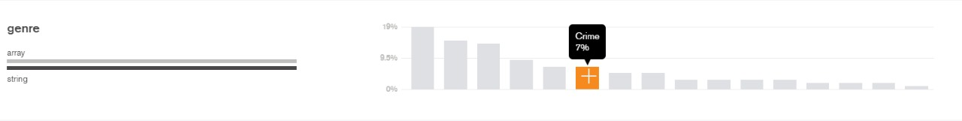
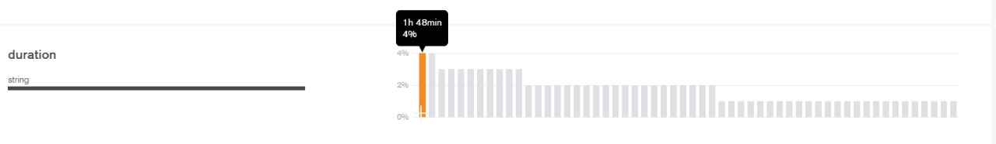
Visualization in mongo dB with movies genre and Its duration:

Slide 17
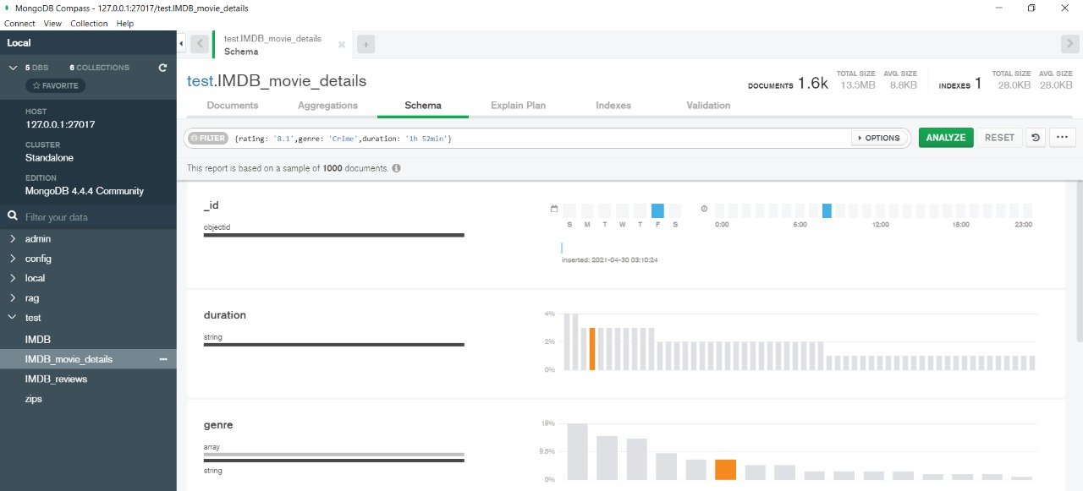

Slide 18
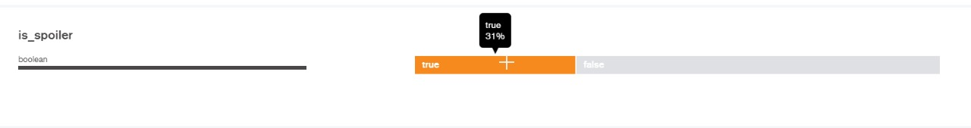
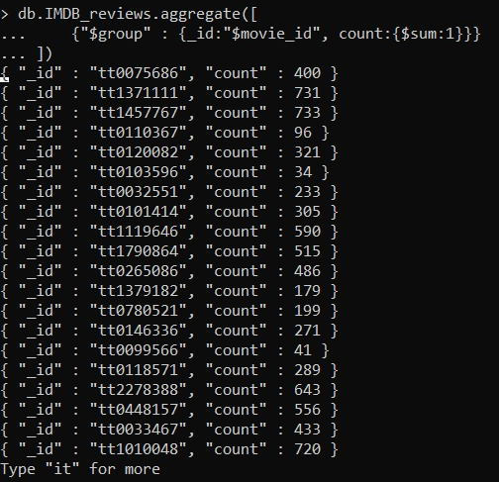

Slide 19
Results & Discussion
Model | Accuracy % | Precision Score | Recall Score | F1 Score
K Nearest Neighbour Classifier | 55 | 0.43 | 0.48 | 0.42
XGB Classifier | 66 | 0.48 | 0.51 | 0.48
Random Forest Classifier | 73 | 0.41 | 0.40 | 0.40

Slide 20
Conclusion:
Random Forest Classifier gave good accuracy(73%) compared to KNN and XGBoost.
RNN model for spoiler detection gave 76% accuracy.
XGB classifier achieved best Precision, Recall and F1 Score

Slide 21
Team Member Contribution:
Raginee(20MCB1004)
Carried out preprocessing on dataset, Design model to predict the IMDB rating
Trained model for predicting IMDB movie ratings and noted the optimal parameters and observations.
Kush(20MCB1002)
Done literature survey. Performed different visualization for IMDB rating prediction and spoiler detection on various platforms(MongoDB and Jupyter Notebook).
Designed report and presentation.
Raviraj(20MCB1016)
Research on the specific dataset , Designed optimal deep learning model for spoiled detection.
Carried out intense research on LSTM for spoiler detection and also helped in designing the report.

Slide 22
Thank You

