Slide 1
Yelp: are you a 5-star restaurant?
A project on sentimental analysis

Slide 2
Menu
Appetizers
Introduction
Exploration of Data
Bag of Words model
Entrée
Application of different classification algorithms:
Naïve Bayes
Maximum Entropy
Support Vector Machines
Dessert
Problems and Challenges
Comparison and Conclusions

Slide 3
Introduction
Sentiment analysis is an automated mining of user generated opinionated text data such as reviews, comments and feedback
The goal of our project was to use this technique
to classify text reviews into a star rating from 1 to 5
Using a number of classification algorithms, we measured the performances of each classier by testing them on the test dataset.
This idea can be extended to many applications that are only text-based and don't provide a rating, such as a review article in an online newspaper for a movie, or YouTube videos where the viewers' comments can be considered to be the text reviews for the video or a simple web page with a recipe and a comment section
We used the Python library scikit-learn for splitting the data into training and test sets, classifying the text data, and evaluating the classier

Slide 4
Exploration of data
The dataset which we used for this project has been obtained from Yelp
Since this dataset was very big with data from over 150,000 businesses, we only focused on reviews for Mexican restaurants
Here, the attribute “review-id" is unique in order to differentiate the reviews from one another, attribute “text" is the textual review for the restaurant with “business-id", and the attribute “star" is the numeric rating for that Mexican restaurant left by the same customer who left the text review

Slide 5
Exploration of Data
Upon further exploration of the data, we got this Word Cloud from approximately 27,000 text reviews for Mexican restaurants on Yelp:
For our data pre-processing, we removed all the punctuations and all the spaces from the review texts, converted all text to lower case, and removed stop words, i.e., words that are frequently used but don’t carry much meaning, such as “the", “a", “of", “for", “in“ etc.
From the Word Cloud, we noticed that overall the reviews had more positive words than negative

Slide 6
Bag of words model
In order to extract features from the text reviews, we used the Bag of Words model
The Bag of Words model is generally used to represent a given sentence in a list of words
The different types of this model that we used for this project are:
Unigram Model: The whole sentence is divided into its individual number of words which are used as features
Bigram Model: Instead of working with single words, it uses a combination of two words to create the feature vectors
Unigram + Bigram Model: Uses a combination of the above two

Slide 7
Bag of Words MODEL
Consider this review :
“Did not enjoy the bright fun Mexican décor! The food was not delicious and not reasonably priced! And the margaritas were not delicious”
Since this review has a lot of positive words, it’s possible that using just a unigram model would result in a positive rating by a classifier even though we can see that the reviewer has left a negative review
To avoid this issue, we used the unigrams + bigrams model during the classification process

Slide 8

Application of different algorithms
After observing the dataset, we considered various classification techniques that could be applied to this dataset to predict the outcomes with acceptable accuracy.
Eventually, we settled on the following methods to implement in Python and compare their results:
Naïve Bayes Classifier
Maximum Entropy Text Classifier
Support Vector Machines
For each of the classifications, we are used a 70/30 split to divide our dataset into training and test sets as well as the unigram + bigram model for feature selection

Slide 9

NAÏVE BAYES
This classifier works on the Bayes theorem of probability to predict the class of unknown data set
Bayes Theorem:
P(C|x) = P(x|C)P(C) / P(x)
where C is a class and x is a set of observations
This model is a lot simpler than the other classifiers
Since we are using the Bag of Words model for feature extraction, the denominator P(x), so we eliminated the denominator

Slide 10
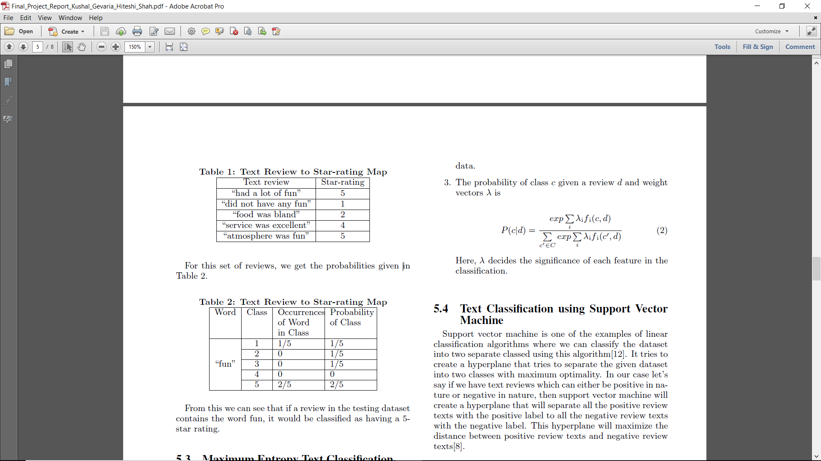
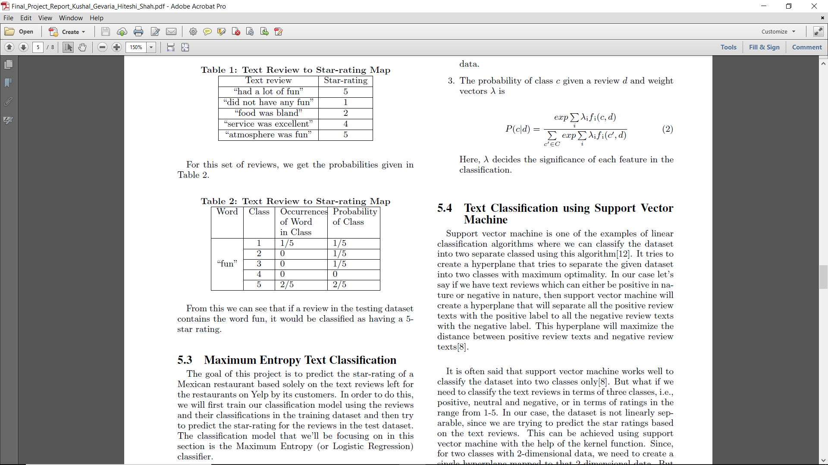

NAÏVE BAYES
Here, we first counted the number of occurrences of each word in each of the reviews that belongs to a particular class
Once we had the word counts, we just had to compute the probability of each class as well as the probabilities of each of the words belonging to each class and multiply them to get the probability of the class being predicted
The class with the highest probability for a word was the class (or star rating) that we applied to the word
Consider the example on the right:

Slide 11
Maximum Entropy
Unlike the Naive Bayes Classier, Maximum Entropy does not assume that the features are conditionally independent
It uses gradient descent to calculate the weights of each of the vectors
For this classifier, we first figured out the relevant features. using Stop-words Removal and the Bag of Words model

Slide 12
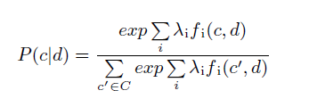
Maximum entropy
For each word w and class c ∈ C, we define a joint feature f(w, c) = N where N is the number of times that w occurs in a review in class c
Through iteration, we assign a weight to each joint feature so as to maximize the log-likelihood of the training data
The probability of class c given a review d and weight vectors λ is
Here, λ decides the significance of each
feature in the classification.
Here, we calculated the weights of each of the features
These weights are initially zero for all the features, and the values are computed using the gradient descent algorithm
Once we had the values for these weights, we computed the probability for each class and the class with the maximum probability is chosen for the current text review
The algorithm is on the right:

Slide 13
Support Vector Machines
Support Vector Machine is a supervised classification algorithm where we can classify the dataset into two classes
It tries to create a hyperplane that separates the given dataset into two classes with maximum optimality using the bag of words feature in our case
It only works for two classes and also the data should be linearly separable.
What if we want to classify in terms of more than two classes, like star ratings from 1-5, or 3 classes like “positive”, “neutral”, “negative”?
Solution is Multi-Class Support Vector Machine

Slide 14
Support Vector Machines
In Multi-Class SVM, each class is considered as one separate class and compared against the union of other classes.
This method is called as one v/s all.
For e.g., text reviews with class “positive” is compared against union of text reviews with class “negative” and class “neutral”. Which means we create a hyperplane that separates positive text reviews from other type of text reviews (negative and neutral text reviews)
Similar process is repeated for all the classes.
And it uses Kernel trick used to make the data linearly separable by mapping the feature onto higher dimension and creating hyperplane.

Slide 15
Problems and challenges
Lots of cleaning required like getting rid of articles, prepositions, stop words and special characters that does not provide any information about the nature of the text.
Problems with class values 1-5(Star ratings) – Classification algorithms did not work well to classify dataset into 5 classes since there is no direct correlation between text reviews with rating 4 and text reviews with rating 5.
For example, there are some customers who give 5 as star rating to the restaurant with a text review which does not contain words that justify the rating given.
It is very hard to identify such cases and classify the dataset into classes like 4 and 5, or 1 and 2 which are very closely related to each other based on the text reviews.
So, we clubbed classes 4 and 5 as “positive” class, class 3 as “neutral” and classes 1 and 2 as “negative” class which resulted in better classification accuracy.
SARCASM! Customers giving 1-2 star ratings with sarcastic comments which is an outlier. Need an application of sarcasm detection to remove such outliers.

Slide 16
Conclusion
After analyzing the results of each of the classifiers, we came to the conclusion that while the Naïve Bayes Classifier and the Support Vector Machines model went back and forth at giving the best prediction both types of class labels, the SVM model came up top as the winner with 85% total accuracy with the Naïve Bayes Classifier as a close second (82%) and the Maximum Entropy Classifier coming in last with a poor accuracy of 64%:

Slide 17
THANK YOU
Presentation by:
Hiteshi Shah
Kushal Gevaria

