Slide 1
ORDER DELAY ANALYSIS & PROCESS IMPROVEMENT
Prepared by: Kush Gautam
Date: August- 2025

Slide 2
Why This Project?
Frequent delivery delays impacting customer satisfaction.
Increased cancellations and returns.
Main causes suspected: courier delays, stock shortages, incorrect addresses.

Slide 3
Data Summary Dataset Used: Order_Delay_Dataset.csv
Order ID | OrderDate | DeliveryDate | DelayDays | Region | ReasonForDelay | ProductCategory
1001 | 11-07-2025 | 13-07-2025 | 0 | North | On Time | Home Appliances
1002 | 16-06-2025 | 19-06-2025 | 1 | South | Courier Delay | Groceries
1003 | 06-06-2025 | 12-06-2025 | 4 | West | Courier Delay | Electronics
1004 | 06-06-2025 | 09-06-2025 | 1 | South | Operational Issue | Groceries
1005 | 02-06-2025 | 08-06-2025 | 4 | South | Operational Issue | Books

Slide 4
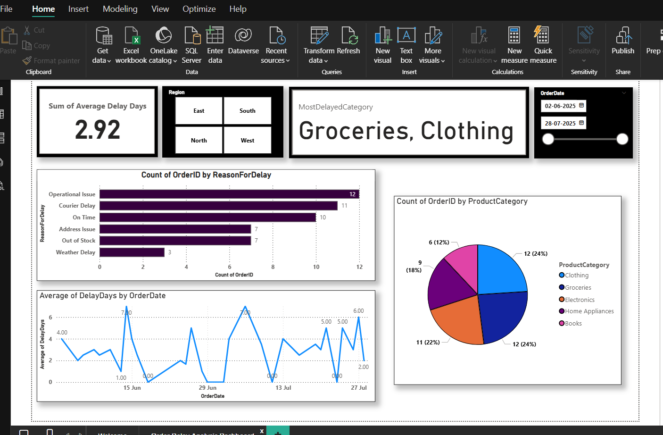
Power BI Insights

Slide 5
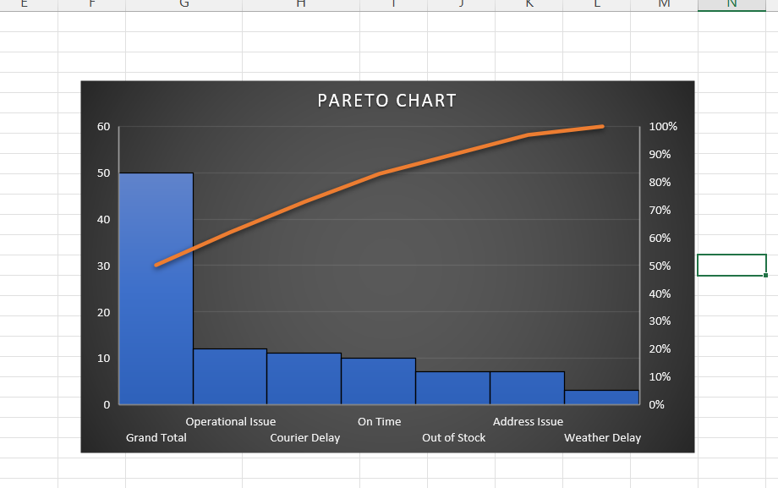
Root Cause Analysis

Slide 6
Root Cause Analysis
80% of delays come from top 2–3 reasons.
Courier delays are the largest contributor (~42%).
Stock shortage is second (~35%).

Slide 7
Recommendations
Issue | Root Cause | Recommendation
Courier Delay | Single courier, low capacity | Partner with additional courier
Stock Shortage | Poor inventory forecasting | Maintain buffer stock
Address Errors | Incorrect data entry | Implement auto-validation

Slide 8
Expected Outcomes
Targets:
Reduce courier delays by 25–30%.
Cut stock-related delays by 20%.
Lower average delay days from 2.4 → 1.5 days.
Improve customer satisfaction by 15%.

Slide 9
Conclusion
Content:
Implement recommendations in 3 months.
Monitor KPIs via Power BI dashboard.
Conduct quarterly reviews.
Continuous improvement cycle.

