Slide 1

Project Presentation
FLIGHT CANCELLATION AND DELAY DATA ANALYSIS
Project By:
KUSHI N
AF0377854
Guide:
SIVAKUMAR SELVAM

Slide 2

INTRODUCTION
The analysis of flight cancellation and delay data is crucial for enhancing the efficiency and reliability of air travel. This study aims to delve into the patterns and factors contributing to flight disruptions, providing valuable insights for airlines, passengers. By examining historical data, we can identify trends, common causes, and potential areas for improvement. Such an analysis not only helps in understanding the operational challenges faced by airlines but also aids in developing strategies to minimize delays and cancellations, ultimately improving the overall travel experience for passengers.

Slide 3
DESCRIPTION OF DATASETS
YEAR :Year of the Flight Trip
MONTH : Month of the Flight Trip
DAY : Day of the Flight Trip
DAY_OF_WEEK : Day of week of the Flight Trip
AIRLINE : Airline Identifier
FLIGHT_NUMBER : Flight Identifier
ORIGIN_AIRPORT : Starting Airport
DESTINATION_AIRPORT : Destination Airport
SCHEDULED_DEPARTURE : Planned Departure Time
DEPARTURE_TIME : WHEEL_OFF - TAXI_OUT
DEPARTURE_DELAY : Total Delay on Departure
TAXI_OUT : The time duration elapsed between departure from the origin airport gate and wheels off
WHEELS_OFF : The time point that the aircraft's wheels leave the ground
SCHEDULED_TIME : Planned time amount needed for the flight trip
ELAPSED_TIME : AIR_TIME+TAXI_IN+TAXI_OUT
AIR_TIME : The time duration between wheels_off and wheels_on time

Slide 4
DESCRIPTION OF DATASETS
DISTANCE : Distance between two airports
WHEELS_ON : The time point that the aircraft's wheels touch on the ground
TAXI_IN : The time duration elapsed between wheels-on and gate arrival at the destination airport
SCHEDULED_ARRIVAL : Planned arrival time
ARRIVAL_TIME : WHEELS_ON+TAXI_IN
ARRIVAL_DELAY : ARRIVAL_TIME-SCHEDULED_ARRIVAL
DIVERTED: Aircraft landed on airport that out of schedule
CANCELLED : Flight Cancelled (1 = cancelled)
CANCELLATION_REASON: Reason for Cancellation of flight: A - Airline/Carrier; B - Weather; C - National Air System; D – Security
AIR_SYSTEM_DELAY : Delay caused by air system
SECURITY_DELAY : Delay caused by security
AIRLINE_DELAY : Delay caused by the airline
LATE_AIRCRAFT_DELAY : Delay caused by aircraft
WEATHER_DELAY : Delay caused by weather

Slide 5

HARDWARE AND SOFTWARE REQUIREMENTS
Hardware Requirements:
Hard Disk : 512GB
Ram : 8GB
Input Devices : Keyboard, Mouse.
Software Requirements:
Operating System : Windows 64-bit
Programming Language : Python
Python Libraries : Pandas, Numpy, Matplotlib, Seaborn.
IDE : Jupyter notebook

Slide 6
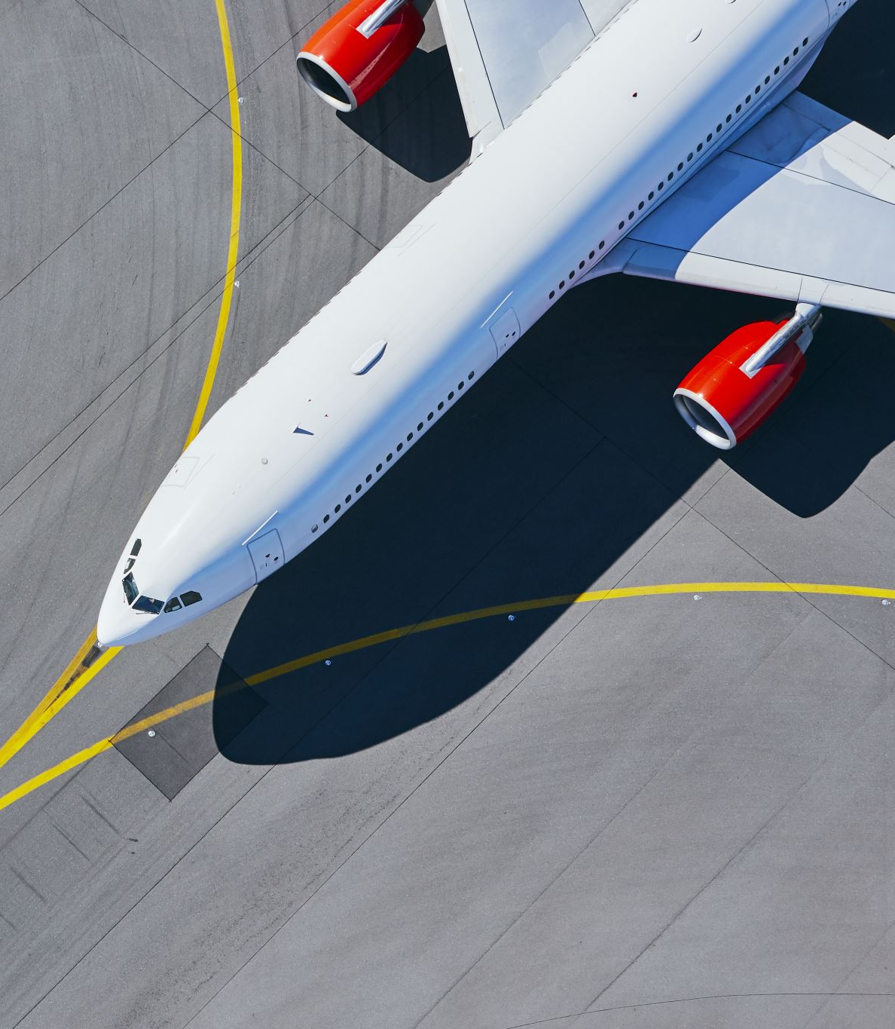
PROBLEM STATEMENT
Flight cancellations and delays disrupt travel plans, cause passenger frustration, and cost airlines significant revenue. While weather is a recognized factor, a comprehensive analysis of flight cancellation and delay data is needed to identify the underlying causes, including potential airline-controllable issues. This analysis will help develop strategies to improve on-time performance, enhance passenger satisfaction, and optimize airline operations.

Slide 7
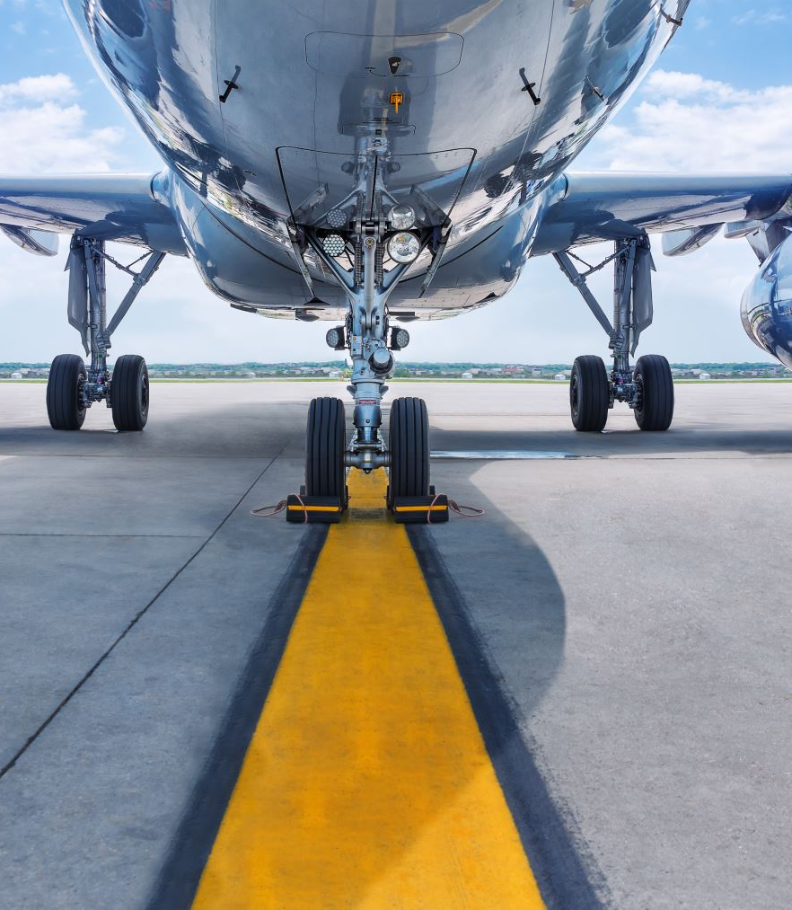
CONCLUSION
In conclusion, this analysis of flight cancellation and delay data has provided valuable insights into the factors impacting air travel punctuality. By understanding the root causes of disruptions, airlines and regulatory bodies can develop targeted strategies to minimize cancellations, reduce delays, and improve the overall air travel experience for passengers. This will not only benefit the industry economically, but also enhance customer satisfaction and ensure a more reliable air transport system.

Slide 8
Thank you

