Slide 1
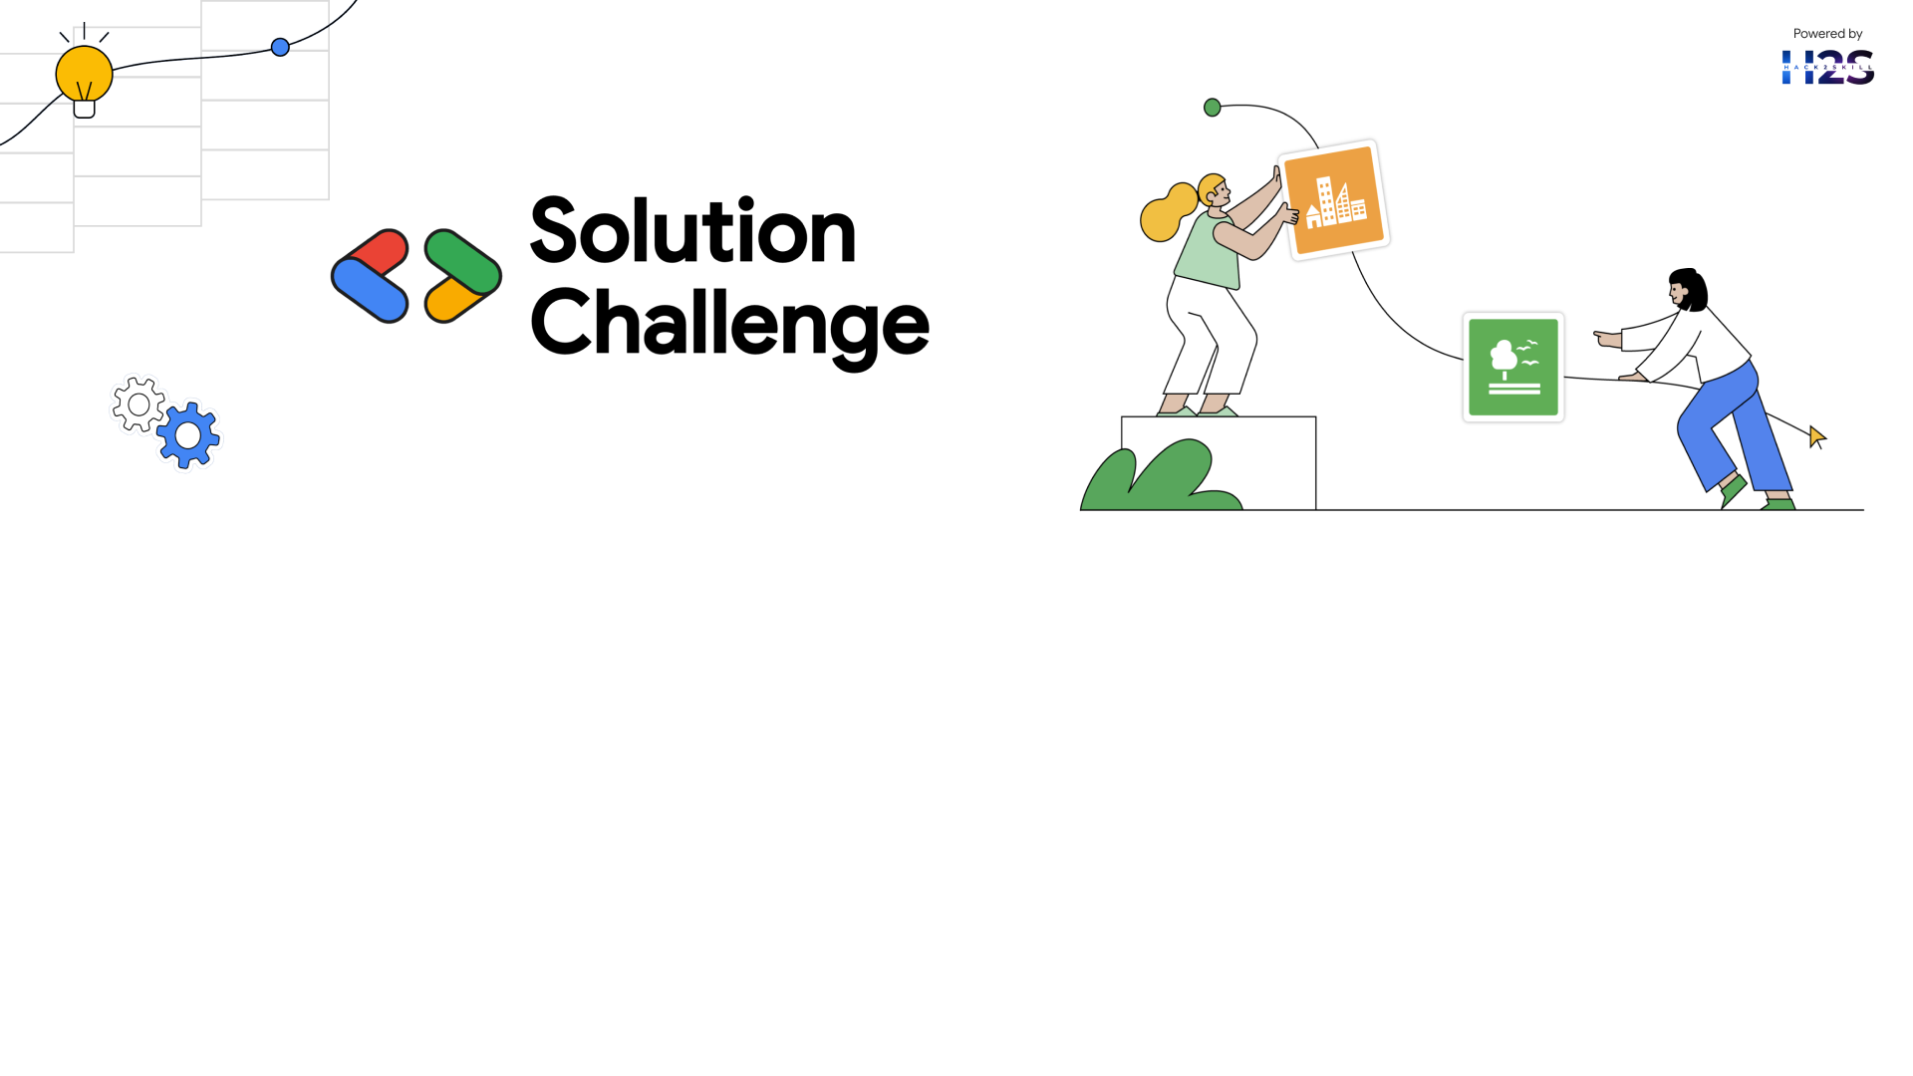
Team Details
Team name: VTechno
Team leader name: Nishika M D
Problem Statement: Despite progress, gender inequality in education and career opportunities persists. Girls, especially in underprivileged areas, lack access to mentorship, education, and career guidance.

Slide 2

AI-Powered Platform for Girl Child EmpowermentKey
Features:1. Personalized Learning: AI-driven educational content and skills training.
2. Mentorship Matching: AI-powered mentor matching for guidance and support.
3. Health and Wellness: Access to health resources, counseling, and wellness programs.
4. Career Guidance: AI-driven career assessments and job matching.
5. Community Forum: Safe online space for girls to connect, share, and learn.
Benefits:
Improved Education: Increased access to quality education and skills training
Increased Confidence: Mentorship and support to build self-esteem and confidence.
Better Health: Access to health resources and wellness programs.
Economic Empowerment: Career guidance and job matching for economic independence.
Stronger Community: Connection and support from a community of peers and mentors.
Goals:
Empower 1 million girls in the next 5 years.
Improve education and skills for 80% of users.
Increase confidence and self-esteem for 90% of users.
Impact:
Reduced gender gap in education and employment.
Improved health and wellness for girls and women.
Increased economic growth through women's empowerment.

Slide 3
Bridging the Gender Gap – Empowering the Girl Child Through Opportunities
How Is It Different Targeted Approach:
It targets rural and semi-urban regions, in contrast to the majority of urban-focused programs.- Mentorship Support: The girls are provided with female mentors in areas such as STEM, business, and leadership.- Practical Skills Training: Provides training in digital literacy, financial management, and entrepreneurship.- Community Involvement: Involves parents and local leaders to change attitudes and empower girls' development.
How Will It Fix the Problem?
Education Support: Offers scholarship, books, and online resources.-
Job Readiness: Provides coding, healthcare, and new industries' training workshops.- Entrepreneurship: Empowers small businesses through micro-loans and training.- Confidence Building: Offers self-defense training and mental health counselling.
Unique Selling Points (USP)- AI-Guidance:
Leverages technology to recommend individualized career and study directions.- Mentorship Platform: Links girls with mentors, learning materials, and employment opportunities.- Community Support: Partners with NGOs, schools, and local companies.- Progress Monitoring: Tracks impact through data to enhance the program..

Slide 4
List of Features Provided by the Solution
Customized Learning Paths: AI recommends study and career paths on the basis of strengths and interests.
Mentorship Guidance: Girls are guided by female role models in different professions.
Development of Skills: Offers digital literacy, coding, financial literacy, and entrepreneurship training
.Academic Assistance: Offers scholarships, study guides, and online learning tools
Career Readiness: Conducts workshops and internships in sectors like STEM, healthcare, and cybersecurity.
Entrepreneurship Support: Provides access to small business loans, training, and networking opportunities.
Mental Health Support: Offers counseling and workshops to build confidence and resilience.
Self-Defense Training: Provides classes to improve safety and self-confidence.
Community Participation: Organizes awareness programs in order to bring about a shift in societal attitude and elicit community support.
Progress Monitoring: Monitors progress based on data in order to better the program.

Slide 5
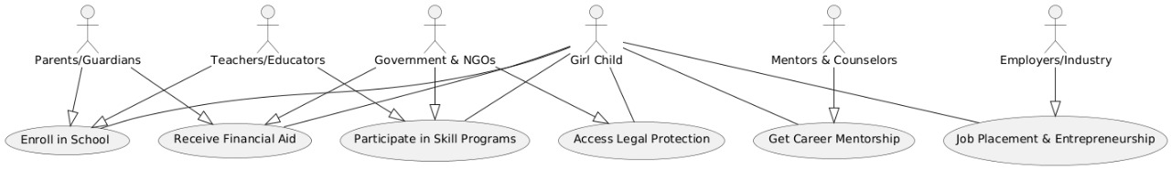

Slide 6
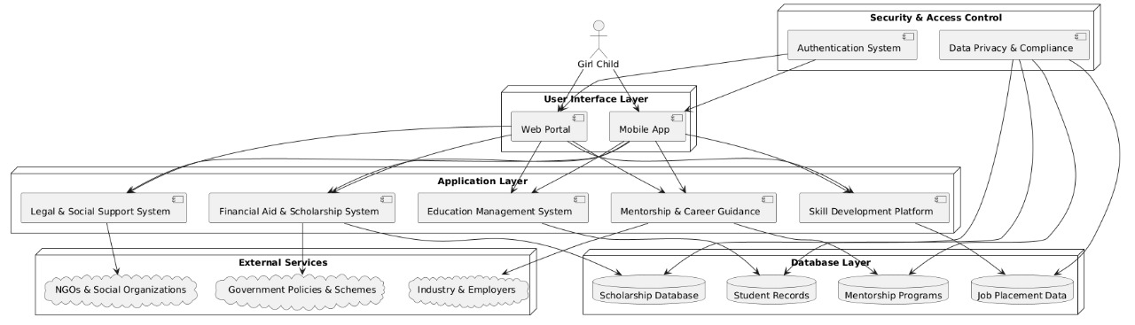

Slide 7
Frontend:React.js (for building a responsive web platform) OR Flutter/React Native (for a mobile app).
Backend:Node.js + Express (to handle API development and server-side logic)
DatabaseFirebase (for real-time data storage, user authentication, and seamless synchronization).
PostgreSQL (to manage structured data like scholarships, job listings, and user records).
AI & Google APIsGemini API – Provides AI-driven mentorship, career guidance, and learning support.
Google Vision API – Detects biases in educational content and enhances inclusivity.
Google Translate API – Supports multilingual access for a diverse audience
.Google Speech-to-Text API – Improves accessibility by converting voice inputs into text.
Google Maps API – Helps locate NGOs, women’s safety centers, and educational institutions.
Cloud & Development ToolsGoogle IDX – A cloud-based AI-powered development environment for efficient coding and collaboration.
Google Cloud Platform (GCP) – For hosting, AI model deployment, and scalable cloud storage.

Slide 8
AI-Driven GrowthIntelligent mentorship using Gemini AI for career advice & learning assistance.Bias detection using AI in learning materials to ensure diversity.
Increased FeaturesGamification – Badges, quizzes, and rewards to drive engagement.AI-powered job & scholarship matching for career growth.Community & Peer Learning – Forums & mentor-led discussion groups.
Scalability & PerformanceMicroservices Architecture – Modular, scalable, and efficient backend.Offline AI with Edge Computing – Guarantees availability without internet.Multi-Tenant Support – NGOs & institutions can build their own platforms.
Security & ComplianceData Privacy & Encryption – Safe storage of user data.Child Protection & GDPR Compliance – Ethical AI and security policies.AI Transparency – Explainable AI models to establish user trust.
Global Impact & PartnershipsLocalization & Multilingual Support – Accessing different communities.NGO & Government Collaborations – Broadening educational reach.Corporate Sponsorships & Internships – Career opportunities in the real world.

Slide 9
Snapshots of the MVP

Slide 10
