Slide 1


Case Study
A MUSIC LABEL COMPANY
Presented by: Kush Jaggi

Slide 2
INTRODUCTION
Our client, a music label company representing diverse array of artists, has provided us with a comprehensive dataset of popular songs. The goal is to make data-driven decisions to optimize song performance on streaming platforms like Spotify.
The client is particularly interested in understanding the factors influencing a song's success and aims to implement machine learning models for predicting new song release’s success, aiding strategic decision-making in promotion, release timing, and marketing budget allocation. This initiative marks a shift towards leveraging data insights for staying ahead in the dynamic music industry.

Slide 3
PROBLEM STATEMENT
A MUSIC LABEL COMPANY REPRESENTING DIVERSE RANGE OF ARTISTS.
Each popular song comprises of :
Track Details
Release Date
Streaming Metrics
Musical Attributes
Main Goal:
Optimize the performance of their songs on Spotify and other streaming platforms.
Help in song selection for promotion, release timing, and budget allocation for marketing campaigns(using machine learning)

Slide 4
DATASET
Name | Description
Track Name | Title of the song, representing its unique identifier.
Artist(s) Name | Name(s) of the artist(s) associated with the song.
Artist Count | Number of artists involved in creating the song, reflecting collaboration.
Release Time | Year, month and day when the song was officially released to the public.
Playlists | Count of Spotify, Apple and Deezer playlists that have included this song.
Charts | Count of Spotify, Apple and Deezer playlists that have included this song.
Streams | Number of times the song has been streamed on various platforms.
BPM | Tempo of the song, indicating the number of beats per minute
Key | Musical key in which the track is composed, mapped to standard Pitch Class notation.
Mode | Indicates the modality (major or minor) of the track, reflecting its melodic content.
Danceability (%) | Measure of how suitable the song is for dancing, represented as a percentage.

Slide 5
DATASET
Name | Description
Valence (%) | Reflects the musical positiveness conveyed by a song, presented as a percentage.
Energy (%) | Represents the intensity and activity of the song, presented as a percentage.
Acousticness (%) | Indicates the acoustic nature of the song, presented as a percentage.
Instrumentalness(%) | Indicates the acoustic nature of the song, presented as a percentage.
Liveness (%) | Represents the likelihood of an audience presence during a recording, presented as a percentage.
Speechiness (%) | Reflects the presence of spoken words in the song, presented as a percentage.

Slide 6
STRATEGY
HOW?
Understand the factors that contribute to a song's success
How to improve the visibility and engagement of the artist’s music.
To implement machine learning models to predict the success of new song releases.
STEPS PERFORMED :
Environment – Google Colab
Data Preprocessing
Determining correlation with streams (musical attributes, artist count, release day, release month etc)
Machine Learning Model Training w/ comparison between Linear and Random Forest Regression
Predictions based on new data
Final Recommendations

Slide 7
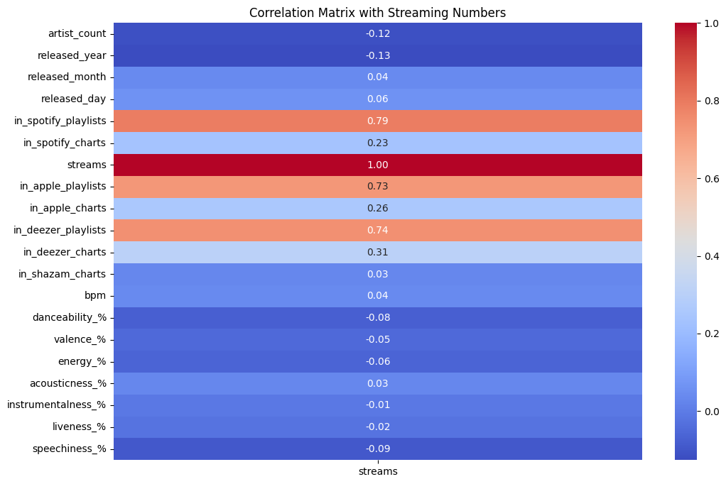
Key Attributes correlating with higher streams

Slide 8
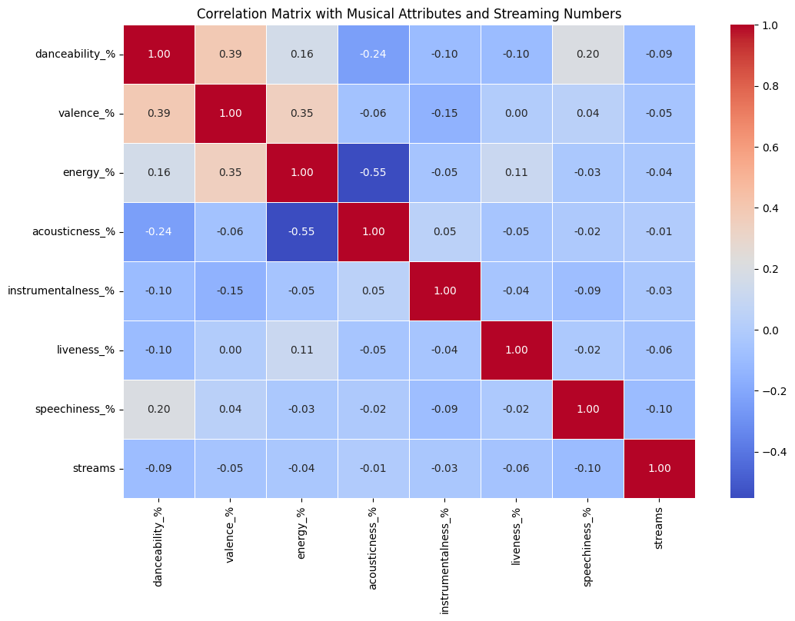
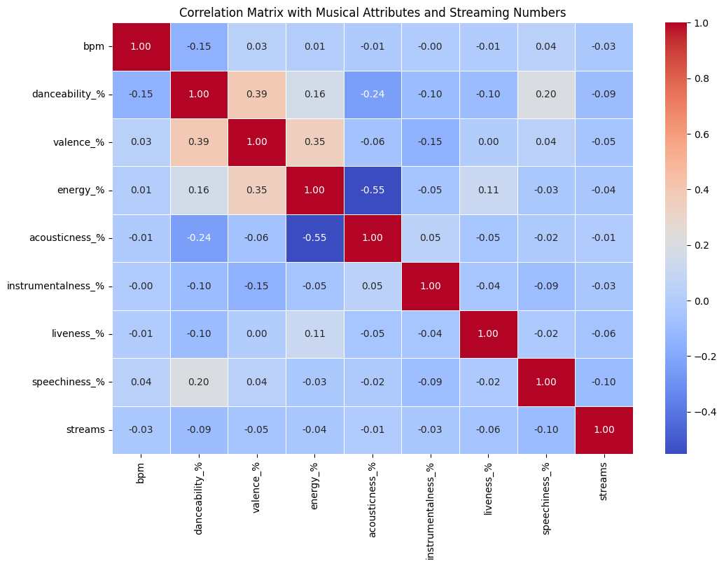

Musical Attributes correlating with higher streams

Slide 9
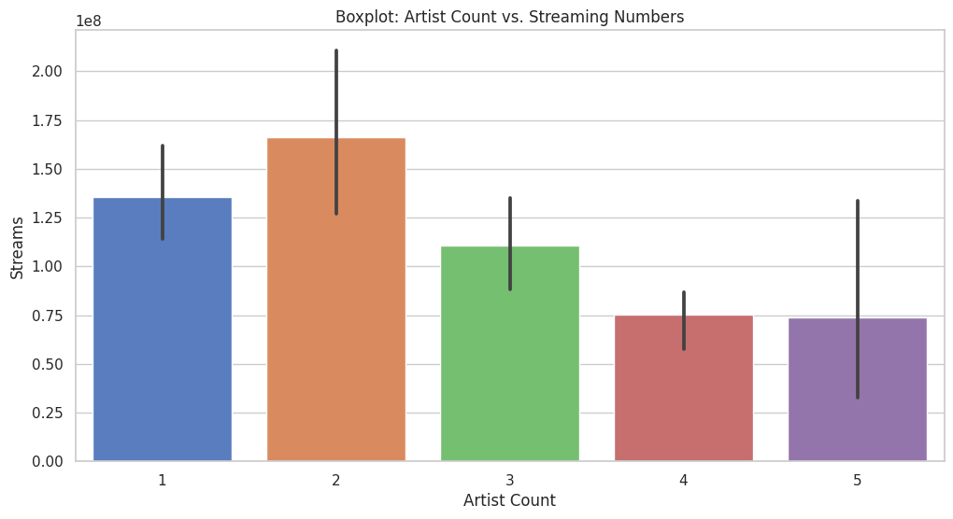
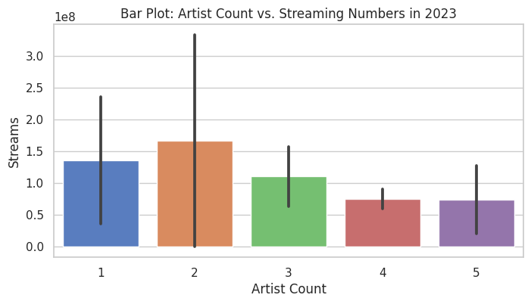
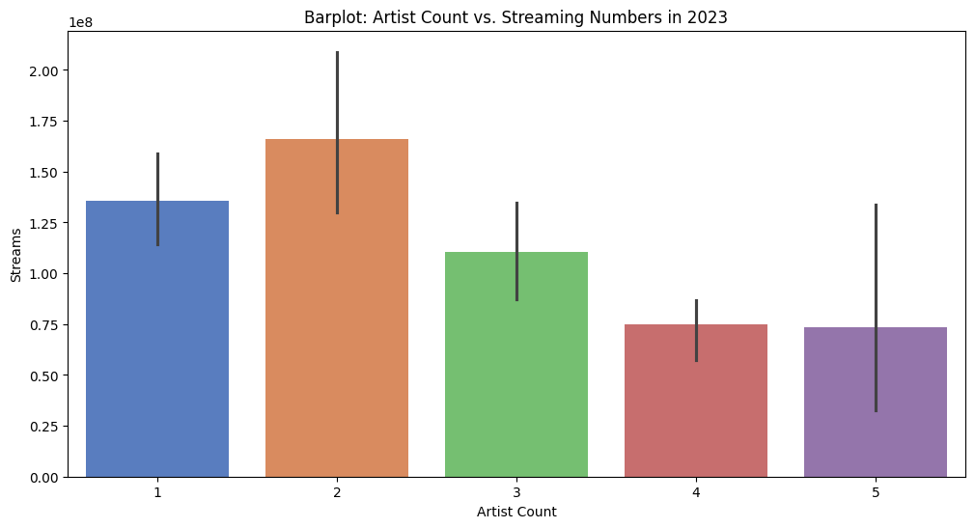
Artist Counts correlation with streams

Slide 10
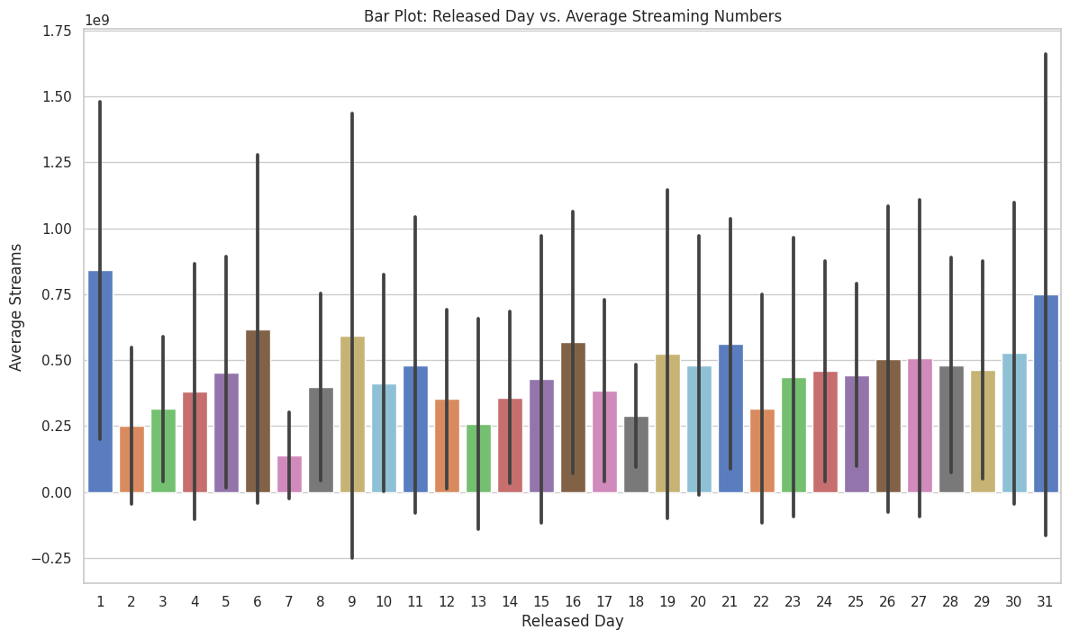
Release Day correlation with streams

Slide 11
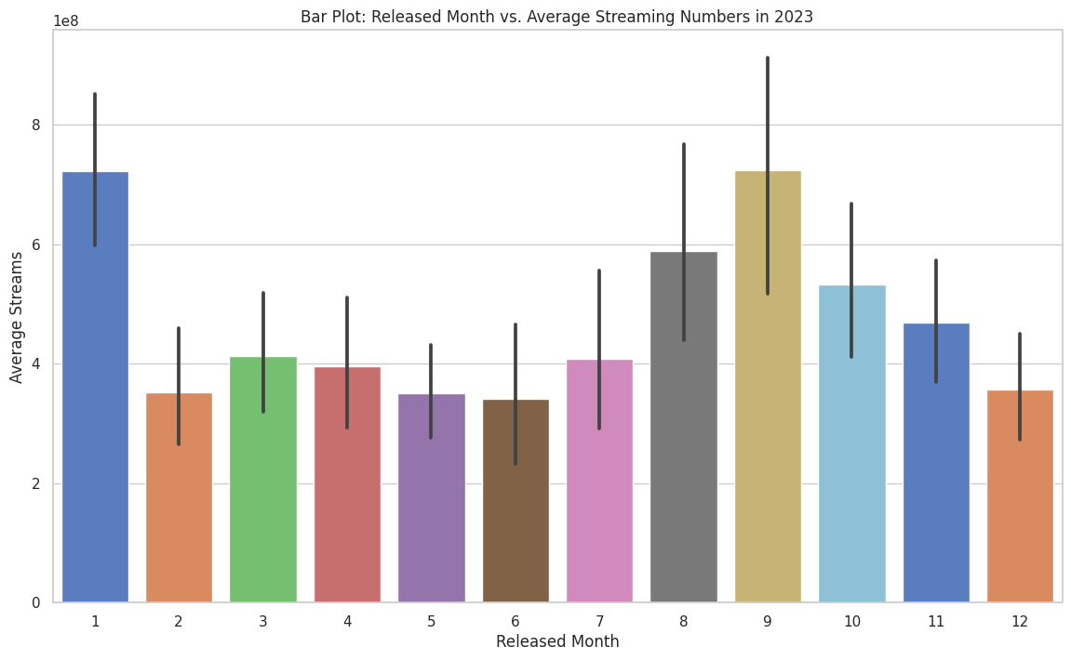
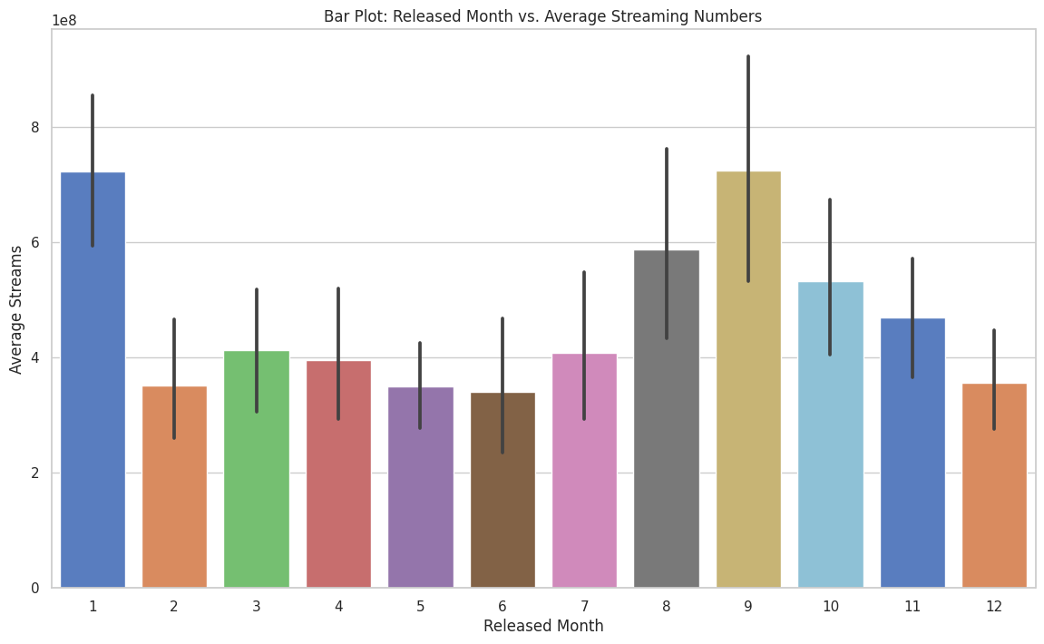
Release Month correlation with streams

Slide 12
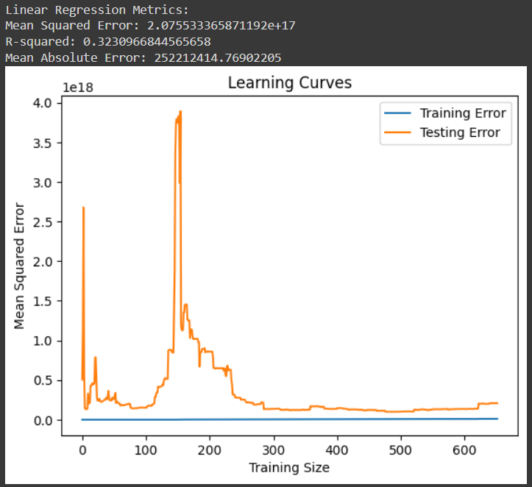
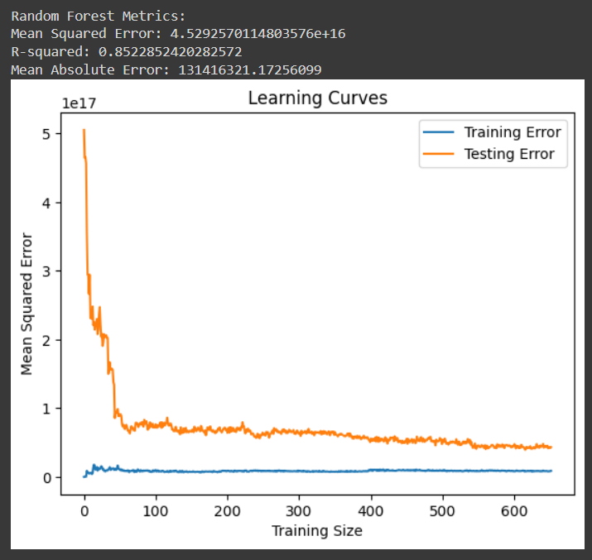

Machine Learning Model Comparison
Linear Regression
Random Forest
VS

Slide 13
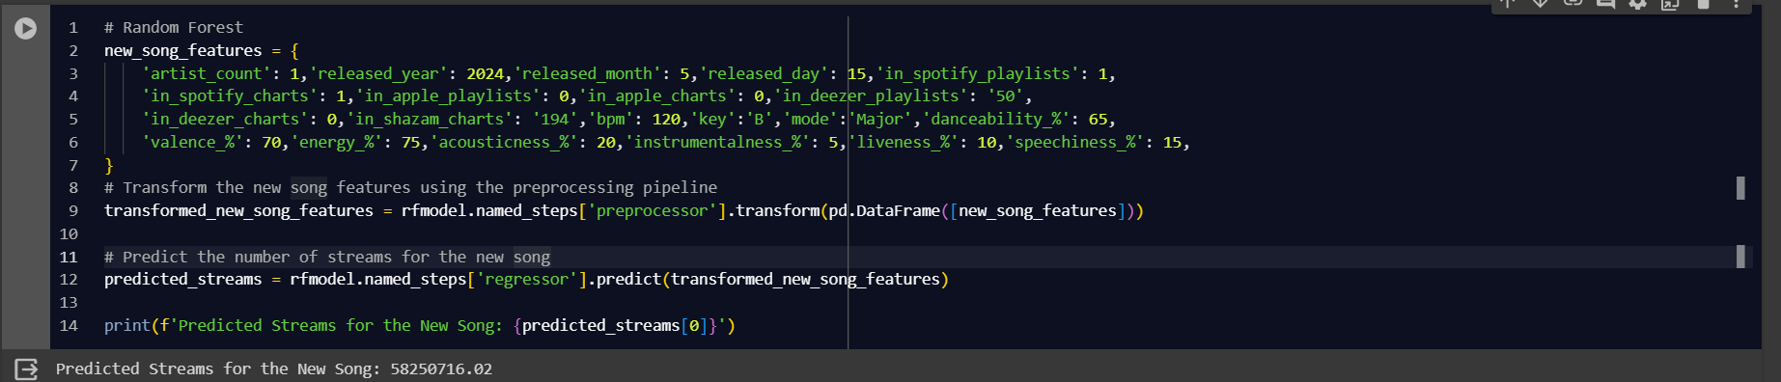
ML Model Based Prediction

Slide 14
INSIGHTS
Strong Positive Correlations: Features like ' in_spotify_playlists’,'in_apple_playlists’ and 'in_deezer_playlist' show strong positive correlations with the number of streams.
Moderate Positive Correlations: 'in_apple_charts' , 'in_spotify_charts', 'in_deezer_charts' and 'in_shazam_charts' also have positive correlations, but they are less strong compared to playlist inclusions.
Moderate Negative Correlations: 'released_month', 'valence%', 'liveness%', 'danceability%', and 'speechiness%' show moderate negative correlations with streams.
Weak Correlations: 'acousticness%', 'released_day’, 'released_month’, 'bpm', 'instrumentalness%', 'energy%’ have weak correlations with streams.
Negative Correlation: 'artist_count' has a negative correlation with streams. This indicates that songs from artists with a lower count tend to receive more streams.

Slide 15
FINAL RECOMMENDATIONS
1 or 2 artists only, with 1 being best .
Being part of inclusive playlist and important charts plays a vital role to increase visibility.
Strategic release timing is important, January and September are hot months with 1st and 31st of the month being the dates with highest grossing streams.
Sentimental music with least lyrics, having low BPM, valence and energy is trending in the market with the songs being danceable a lower priority.
More vocals and less liveliness in the music will boast the streams significantly.

Slide 16
THANK YOU!

