Slide 1

Introduction to Network Administration Day 1
IT Professional Program

Slide 2
Agenda
Welcome to Network Administration!
Course/Block Introduction
Tips for Microsoft Teams
Ch.1 Networking Basics
Lab exercises/tasks

Slide 3
Course/Block Introduction
This block (Network and Linux Administration) is 16 weeks long:
4 weeks of IT Service and Project Management
4 weeks of Network Administration (this course)
CompTIA Network+ certification available
6 weeks of Linux Administration
2 weeks of Security Fundamentals

Slide 4
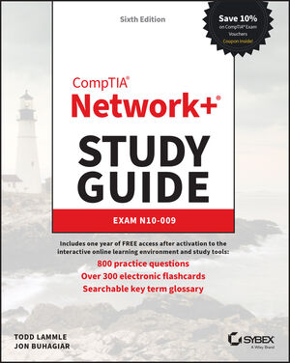
Course/Block introduction
This course (Network Administration):
Covers core network and IP theory used in IT jobs.
We apply the concepts we learn in this course throughout the remainder of the program.
Book is available in Brightspace:

Slide 5
Course/Block Introduction
Attendance:
If you cannot make it to class, please message me beforehand if possible (email or Teams) and watch the video for that day afterwards.
Marks:
CIDR Assignment = 15%
Quizzes = 15% (3 quizzes in total, each Monday)
Final Exam = 60%
Professional Performance = 10%

Slide 6
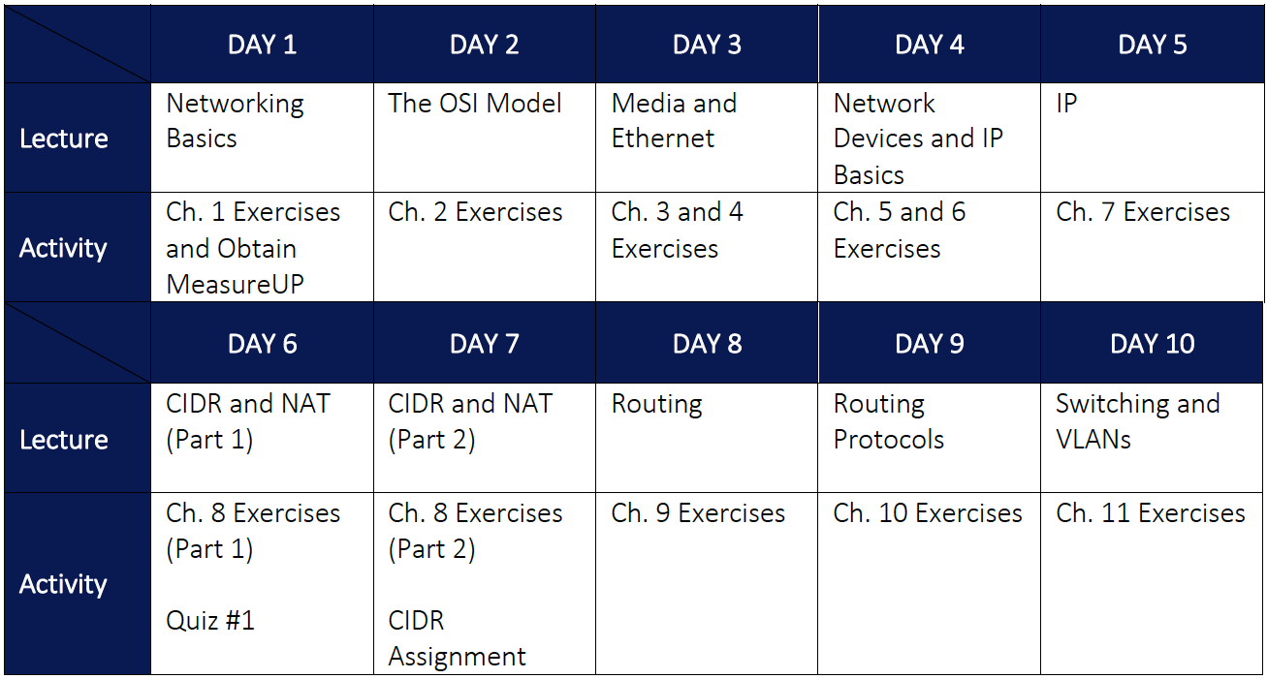

Slide 7
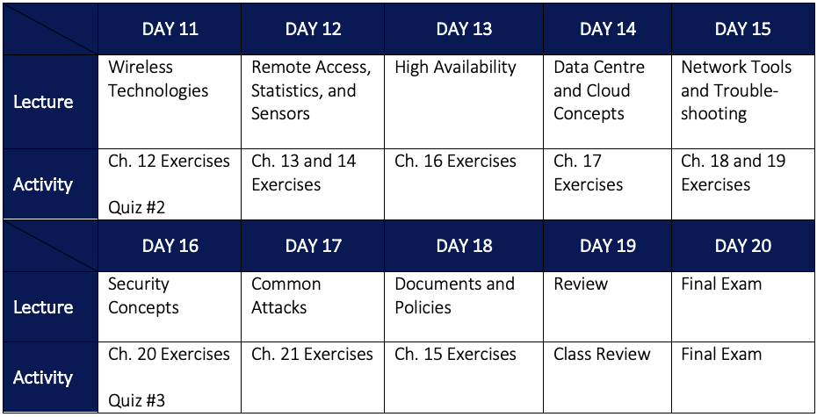

Slide 8
Tips for Microsoft Teams
The Microsoft Teams app currently uses a lot of system resources.
For better performance install Teams as a Microsoft Edge app:
Install the Microsoft Edge web browser from https://www.microsoft.com/en-us/edge
Open Microsoft Edge and log into https://teams.microsoft.com
Click ... > Apps > Install this site as an app

Slide 9
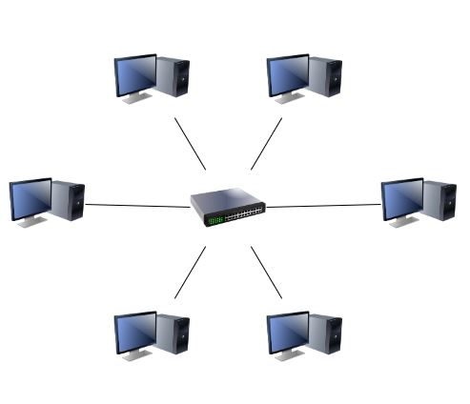
Ch.1 Networking Basics
What is a network?
2 or more computers that can communicate to each other (wired or wireless)
What creates a network (LAN or WLAN)?
A cable or wireless connection between 2 systems
A concentrator (2+ systems):
Hub (multiport repeater)
Switch
Wireless switch (WAP)

Slide 10
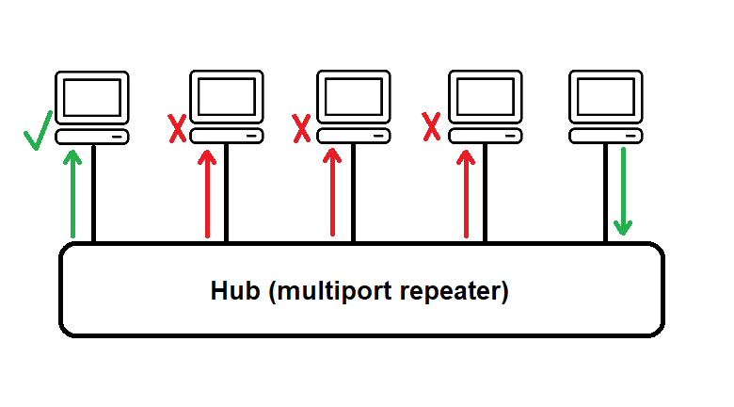
Ch.1 Networking Basics

Slide 11
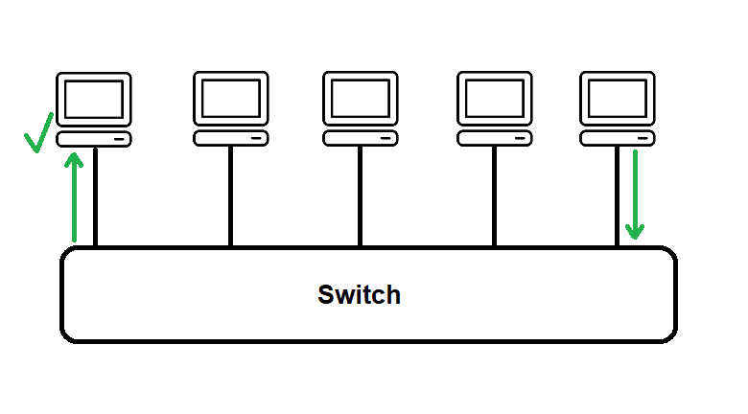
Ch.1 Networking Basics

Slide 12
Ch.1 Networking Basics
Each computer on the network is called a host
Server
Client
Network/security appliance
Printer
SAN storage device
etc.

Slide 13
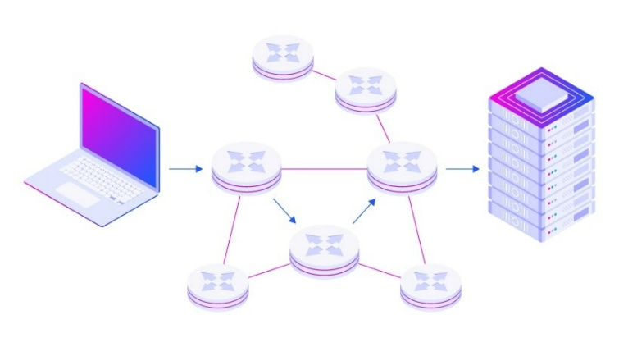
Ch.1 Networking Basics
Each LAN (or WLAN) maintains its own logical host addressing:
For LANs that use Internet Protocol (IP), each host has a unique IP address on a specific IP network
Routers connect one LAN to another (and route traffic between the associated IP networks)
The Internet is the largest interconnected network via routers at ISPs

Slide 14
Ch.1 Networking Basics
Rules of IP:
Two hosts can directly talk to each other only if they are on the same LAN
To communicate to a host on another LAN, the traffic must be passed through a router (= default gateway)
IPv4 Addressing
Each IP address has a network & host portion
Subnet mask is used to determine which portion is the network portion
e.g. 192.168.1.55
and 255.255.255.0
= host 55 on the 192.168.1 network

Slide 15
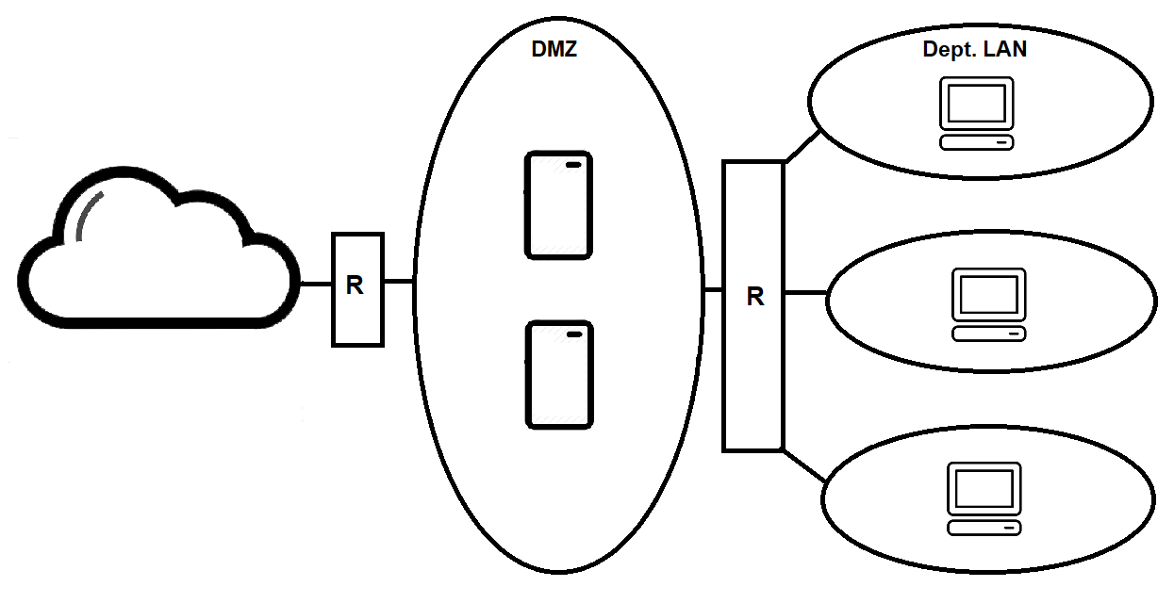
Ch.1 Networking Basics
Typical LAN layout in a company:

Slide 16
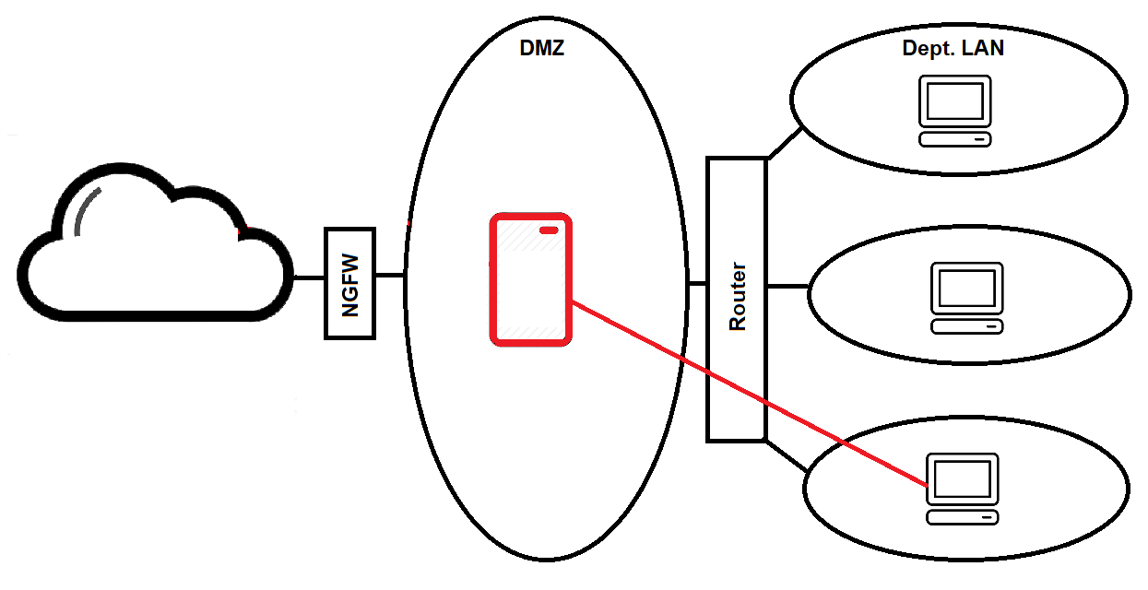
Ch.1 Networking Basics
DMZ (server closet/datacenter LAN) often called a backbone, NGFW provides modern protection:

Slide 17
Ch.1 Networking Basics
Virtualization software (=hypervisor) allows you to run multiple operating systems simultaneously on a single computer
Very commonly done on servers to allow for better hardware utilization (e.g., 20 server virtual machines on 1 physical rackmount server!)
We use it extensively on our PCs to learn IT topics in our program
IT professionals use it extensively on their PCs in a job environment to test configuration of technologies before deploying them (among other things)

Slide 18
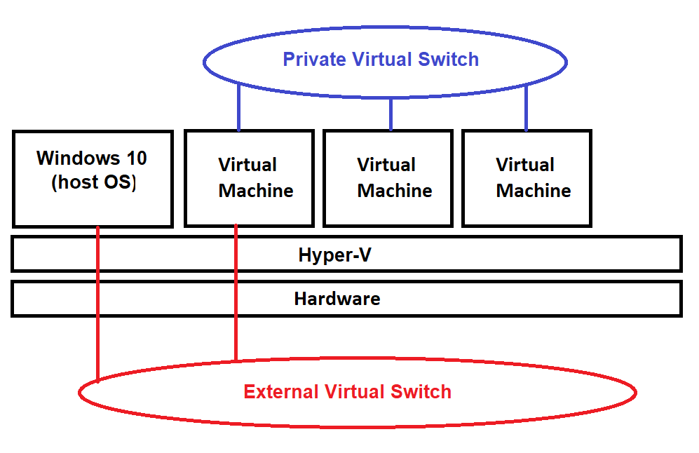
Ch.1 Networking Basics
Software defined networks (virtualization):

Slide 19
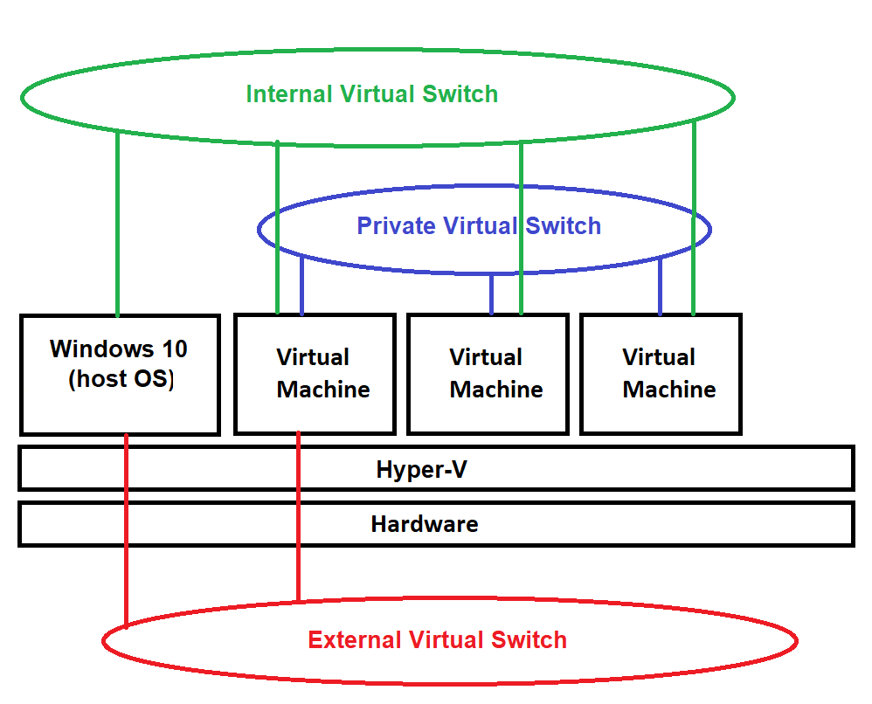
Ch.1 Networking Basics

Slide 20
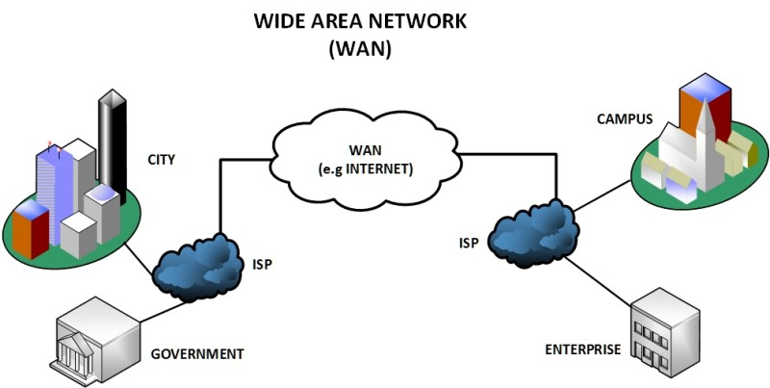
Ch.1 Networking Basics
WANs (e.g., Internet)
ISPs are connected to each other via many routed LANs (i.e., many switches/routers)!

Slide 21
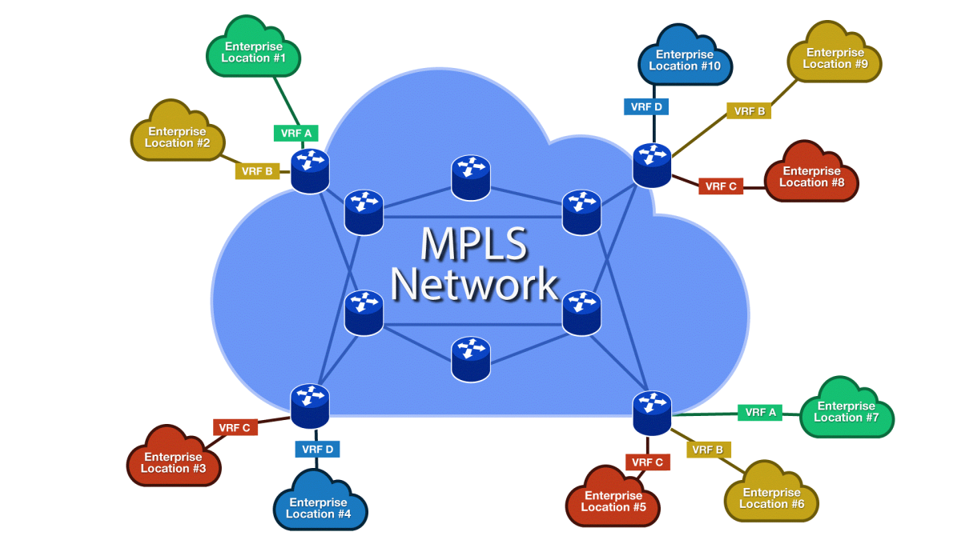
Ch.1 Networking Basics
For companies with multiple locations on the Internet, the ISP can take shortcuts that bypass routers for traffic between your locations using MPLS:

Slide 22
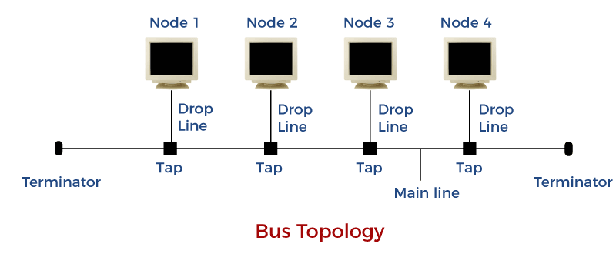
Ch.1 Networking Basics
Physical network topologies:
Bus
Ring
Mesh
Point-to-point
Point-to-multipoint
Star (hub/switch/WAP)
Hybrid

Slide 23
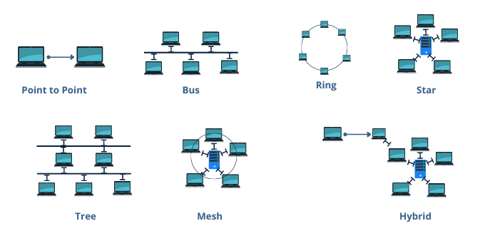
Ch.1 Networking Basics
Physical network topologies:

Slide 24
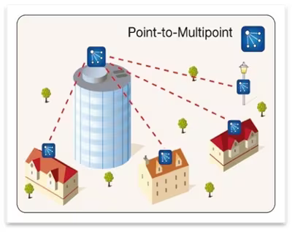
Ch.1 Networking Basics
Types of point-to-point:
Router to router
Host to host (wired/wireless)
Host to switch/hub
Point-to-multipoint often refers to wireless:

Slide 25
Ch.1 Networking Basics
Logical network terms:
Peer-to-peer network
Networked hosts that maintain their own logins (when you access a shared resource, you must log into each system using a local user account)
Client-server networks
Usually refers to corporate networks where resources are shared only on servers
Special servers provide single sign-on (SSO) services that allow users to log in once to a server and all the other servers trust you from that point onwards (e.g., Active Directory domain controller servers)

Slide 26
Lab exercises/tasks
Read Ch.1 and complete the questions at the end (answers are in Appendix B)
Install Hyper-V (if necessary) and install two Windows Server 2019 VMs (demo)
SERVER1 and SERVER2
3GB RAM (non-dynamic), Gen2, Private virtual switch
Change the time/zone, disable the firewall (all profiles), change computer names, set IPs manually:
SERVER1 = 172.16.0.1 / 255.255.0.0
SERVER2 = 172.16.0.2 / 255.255.0.0
ping 172.16.0.1 from SERVER2
ping 172.16.0.2 from SERVER1

Slide 27
Lab exercises/tasks
Change the IP of SERVER2 to:
172.17.0.2 / 255.255.0.0
ping 172.16.0.1 from SERVER2 (fail!)
ping 172.17.0.2 from SERVER1 (fail!)
Change the IP of SERVER2 back to:
172.16.0.2 / 255.255.0.0
ping 172.16.0.1 from SERVER2
ping 172.16.0.2 from SERVER1

