Slide 1
PROJECT ARTRO
Designed by :- Raghav Sethi
Kushagra Mittal
FROM :- I.K GUJRAL PUNJAB TECHNICAL UNIVERSITY , MAIN CAMPUS

Slide 2
INDEX
INTRODUCTION
MAIN COMPONENTS
WORKING
CIRCUIT DIAGRAM
APPLICATION
BIBILIOGRAPHY

Slide 3
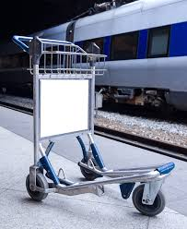
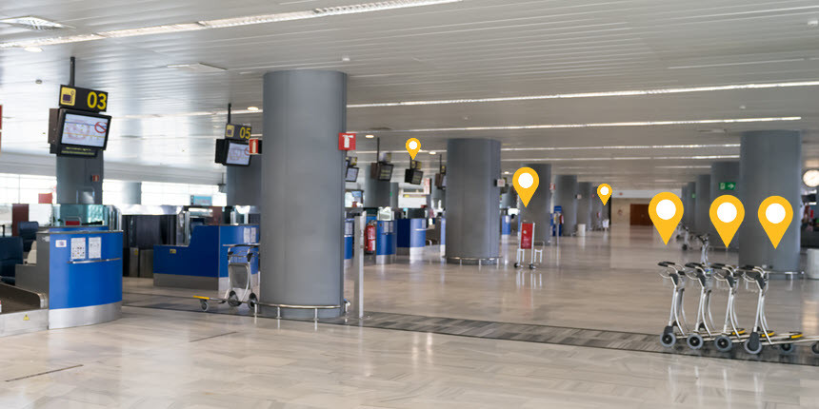
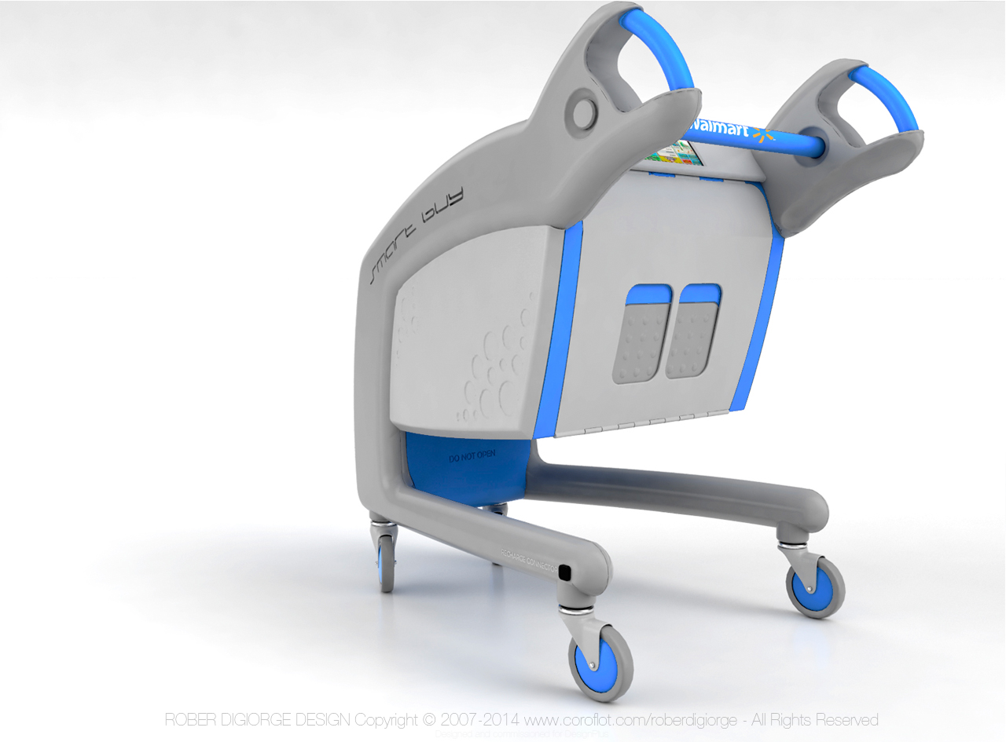
INTRODUCTION
The Artro Project is based on the autonomous trolley which is designed for human comforts , commonly we call it Smart Trolley.
The main aim of our project is to replace the manual trolley which is currently being used at Airport , shopping centre, etc.

Slide 4
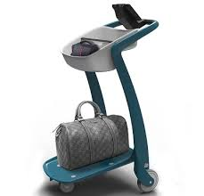
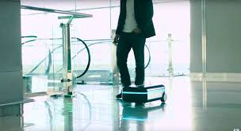
INTRODUCTION
It is very futuristic , not only because of future capabilities , but because of its dynamic design and technology used.
It will hold our luggage or items and follow us where we will approach by avoiding obstacles around us.
It is perfectly controlled through microprocessor and controller ,which is coded and then accordingly work.

Slide 5
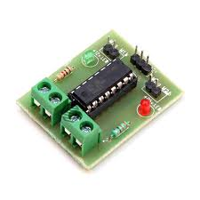
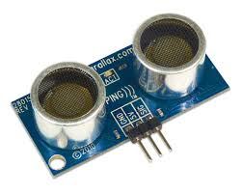
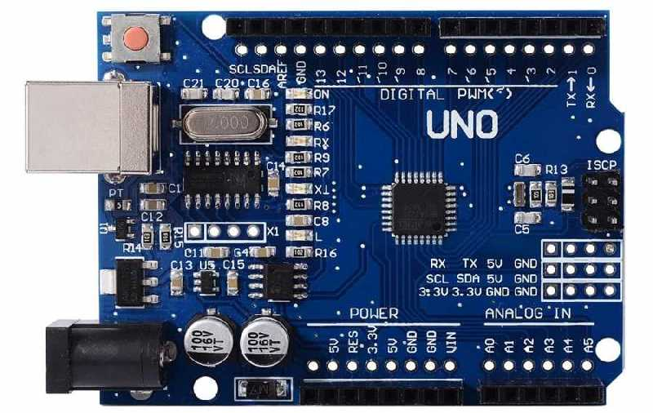
Main Components
Arduino UNO R3 ATmega328 (Microprocessor board)
Motor Driver dual H L293
Battery 12V , 1 A (for motors)
Battery 9V , (for Arduino)
Ultrasound Sensor
Motors 12V ,250 rpm, torque = 0.5 Nm

Slide 6
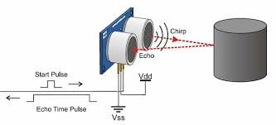
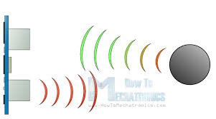
WORKING
It is autonomous trolley which is under control of human , where a person will approach it will follow .
It consist of two ultrasound sensor(L : left ,R : right) which transmits the ultrasound waves , these waves will reflected back if any object is there .
After returning back of waves , it is receive at receiver of sensor and here it calculate the distance between the object and sensor.
The main component of our project is Arduino (microprocessor board) through which we coded it.

Slide 7
WORKING
As the distance we get from both L,R sensor and distance is greater than 20 cm then it will start moving in the forward direction .
If the distance is less than 20 cm but greater than 10 cm then it will stop.
If distance is less than 10 cm then it will move backward.
If it get the distance from R sensor but not from L sensor then it will turn in right direction or it get distance from L sensor but not from R sensor then it will turn left.

Slide 8
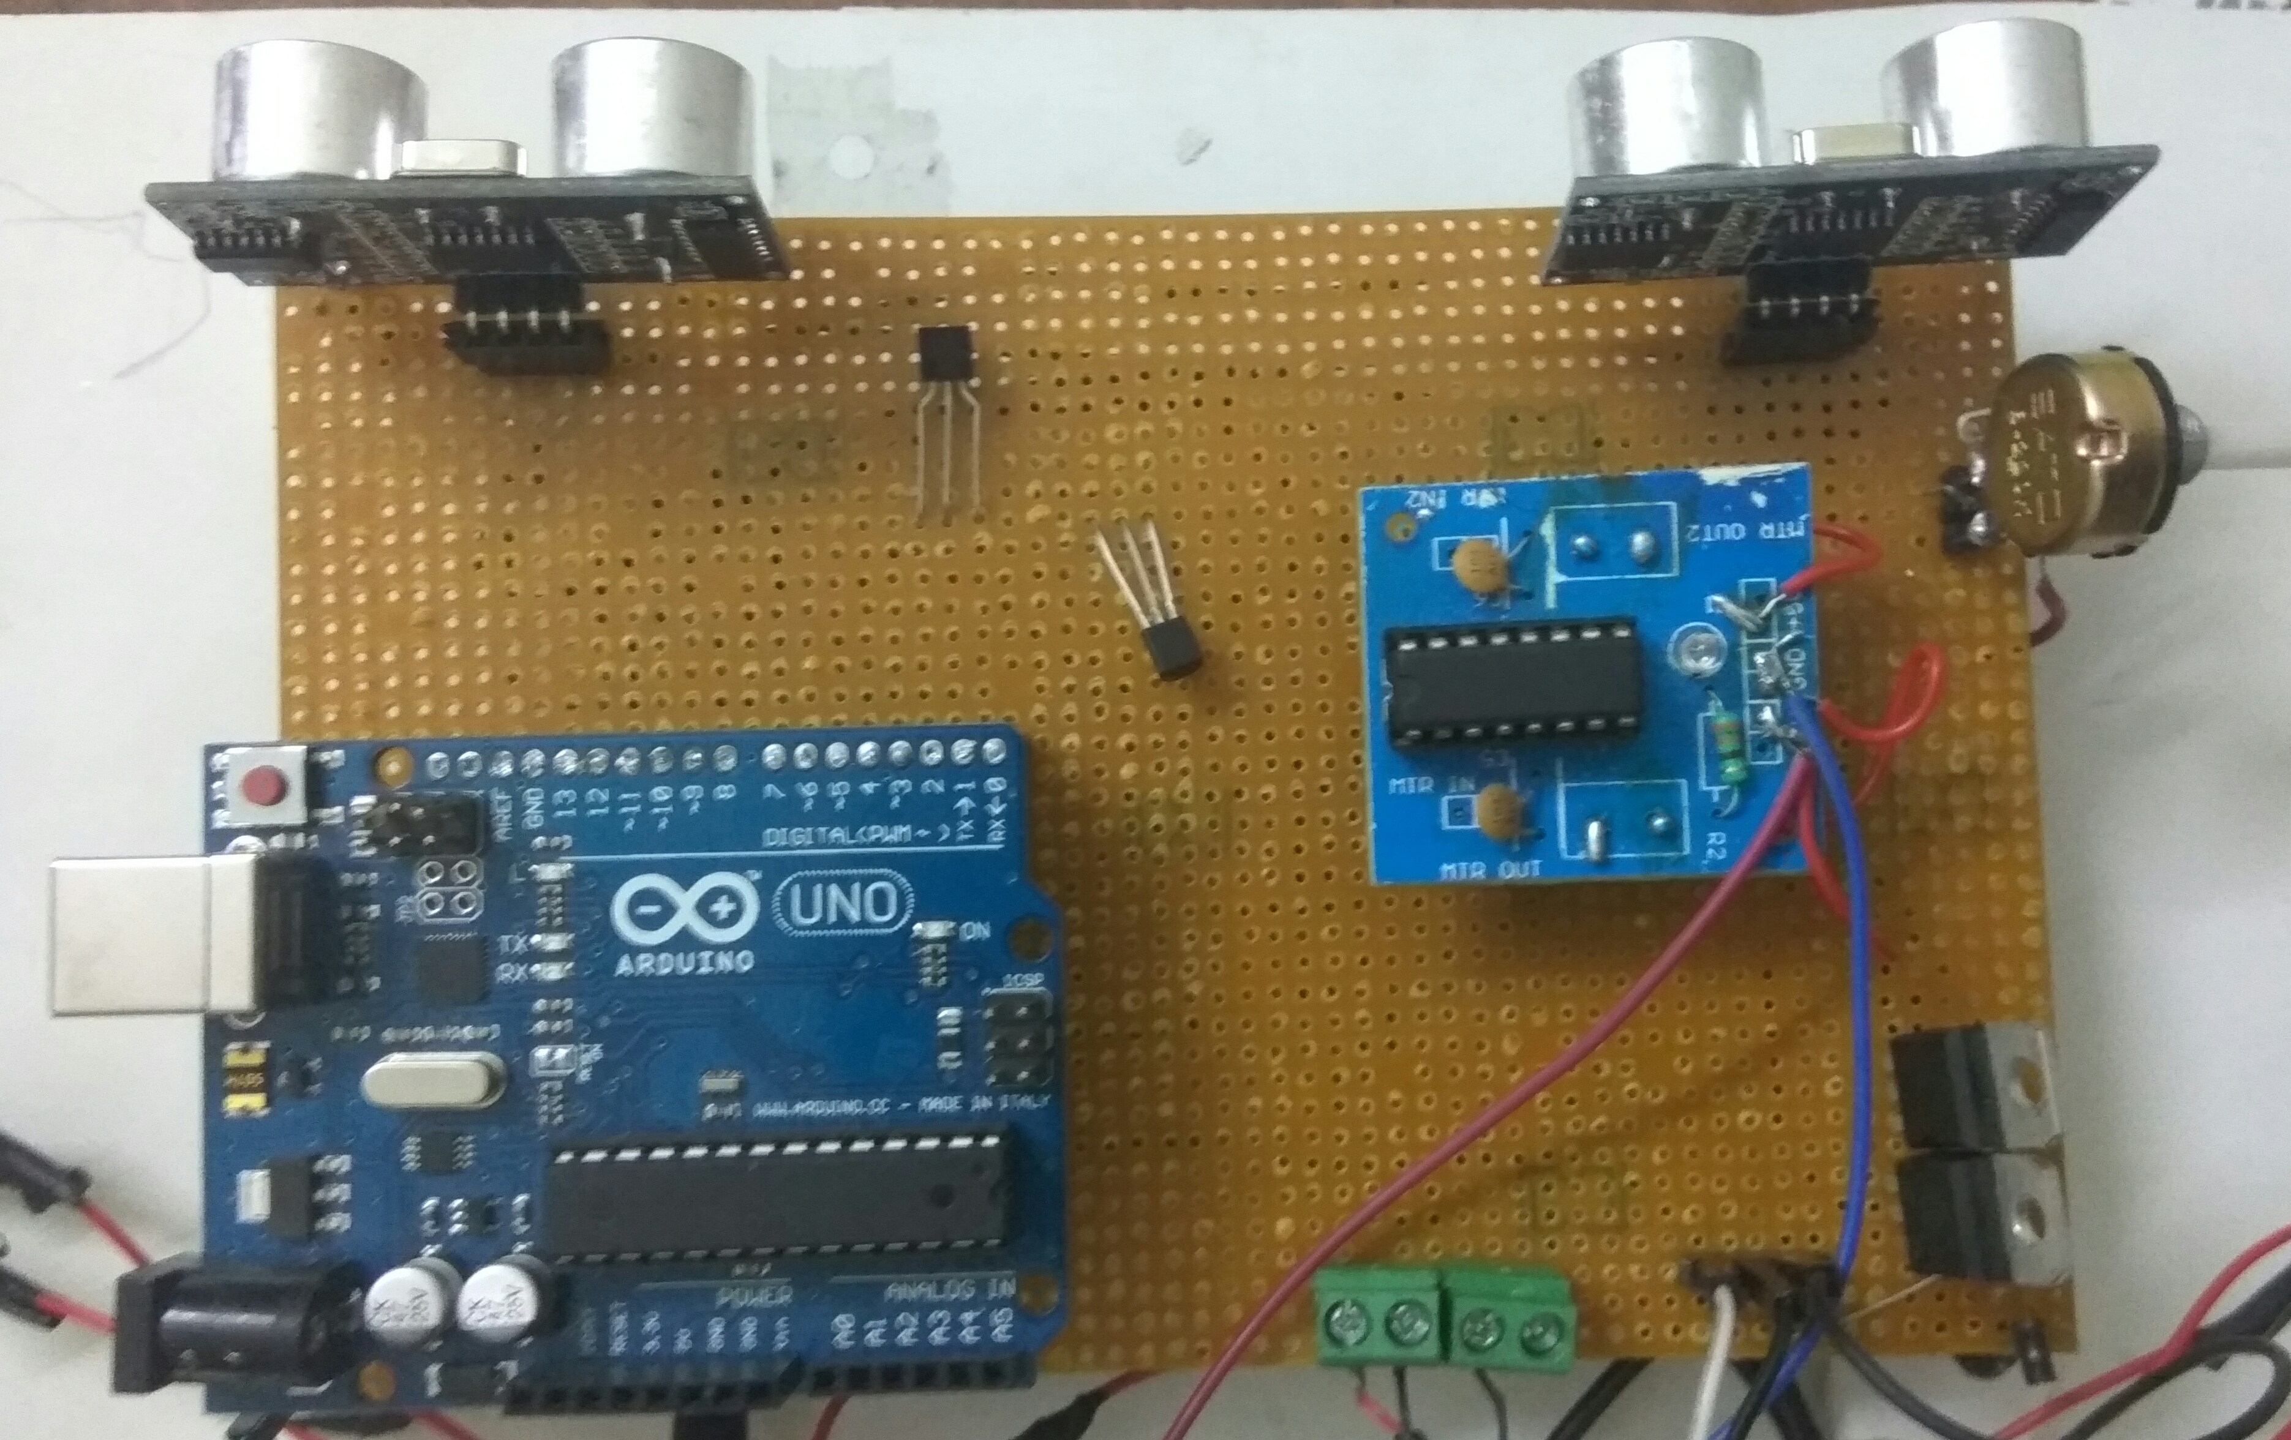
CIRCUIT DIAGRAM

Slide 9
APPLICATIONS
This can be used in airports , railway station platforms as Smart Trolley . As there we have to cover large distance with our luggage which becomes difficult to carry those. But by this it makes us more comfortable to carry our luggage.

Slide 10
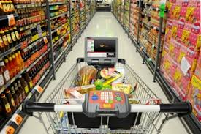
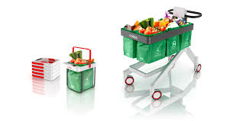
It can be used in shopping centre as shopping cart. As used keep our selected items in it , but some times it becomes difficult to carry or to move it . By this we can easily control our shopping cart .

Slide 11
BIBILIOGRAPHY

