Slide 1


Slide 2
Online Crime Reporting System
ICT GANPAT UNIVERSITY
User Experience Design & WAD Project

Slide 3
ACKNOWLEDGEMENT
User Experience Design project is a golden opportunity for learning and self-development. I consider myself very lucky and honoured to have so many wonderful people lead me through in completion of this project. First and foremost, I would like to thank Dr. Hemal Shah, Principal, ICT, and Prof. Dharmesh Darji , Head, ICT who gave us an opportunity to undertake this project. My grateful thanks to Prof. Bhavesh Jain, Prof. Javik Panchal & Prof. Tejas Kadiya for their guidance in project work Online Crime Reporting System, who despite being extraordinarily busy with academics, took time out to hear, guide and keep us on the correct path. We do not know where would have been without his help. CSE department monitored our progress and arranged all facilities to make life easier. We choose this moment to acknowledge their contribution gratefully.
20162171008 YUVRAJ JADAV
20162171009 JAY KUMAR SAPRA
20162171010 KUSHLENDRA SINGH H KUSHVANSH

Slide 4
ABSTRACT
Nowadays, much of the crimes committed were unreported to the authorities. Given this fact, the study presents the development of a Crime Management and Reporting System through online and even offline and at the same time is the active participation of the citizens. The idea draws its motivation from the inconvenience of going to the police station and personal belief of the weak investigative capabilities of the authorities to resolve petty crimes and limited spreading of crime information to the community. The project specifically looks into the crime detection and prevention. This study aims to provide an overview of the investigative process and, in doing so, identify effective and efficient approaches to the investigation and detection of the volume of crimes. The review is particularly aimed to highlight the research evidence those investigative practices and actions that are likely to lead to a positive outcome. The development of software includes the process of brainstorming and planning, requirements analysis, system analysis and designs, implementation and testing, deployment, and maintenance. The criteria of evaluation of software quality were adapted in ISO/IEC 25010:20011. This also shows that distance is also a factor that influences greatly how crimes are being handled with many crimes going unreported as a result. Crime Management and Reporting System would really help the complainant and the authority to communicate privately and easily with regards to the reported issue. In addition, it would be easier for the complainant to report a witnessed crime without the fear of getting involved in the problems because of the security that the only authorized user can see the report. Based on the findings, the researchers recommend the following for further study: widening the limit of the system by considering other cities; a generic platform for keeping human records from birth till death, deploying World Scientific News 131 (2019) 164-180 -165- this sort of platform will serve as a source of information on persons from various states within the country and even those outside. Verification using Biometric is highly recommended to enhance the security of data stored in the system. This increases the restriction on access to the system, thus unauthorized users have no access to the system. Face recognition technology can be added.
Keywords: Biometric, crime management, online, reporting system, software quality

Slide 5
Contents
01
02
03
04
05
06
INTRODUCTION
PROJECT SCOPE
SOFTWARE AND HARDWARE REQUIREMENT
PROJECT PLAN
IMPLEMENTATION DETAILS
PROCESS FLOW DIAGRAM
07
08
09
EXPECTED OUTCOMES
FUTURE WORK
CONCLUSION

Slide 6
INTRODUCTION
01
We’re all going to have to change how we think about data protection.

Slide 7
Guiding Principles
Prof. Bhavesh Jain
Prof. Javik Panchal
Prof. Tejas Kadiya
User Experience Design
Web Application Development - IBM
Web Application Development

Slide 8
PROJECT SCOPE

Slide 9
Objectives and Scope
AWARENESS
CYBER HYGIENE
Spread awareness from cyber fraud
Steps for way to use internet safely
MENTORSHIP
INVESTIGATIN
Right direction and steps will be provided
Proper report on the submitted form.

Slide 10
Scope
This website provides an architectural overview of crime management. This web site is generic. A web-based tool that enables the user to manage the crime on tasks completed as part of a project with tasks and sub-tasks. The tool includes interactivity, Functionality, Information will be stored into a database. Administrative and managerial functions will be provided including configuration projects/tasks/subtasks.

Slide 11
ADMIN FEATURE
Add/Update/Display/Delete Police Officer(Police Station)
Add/Update/Display/Delete Citizen(User)
Update/Display/Delete Complaint
View/Delete Complaints Status
View/Delete Emergency Complaint
View Query
View Feedback

Slide 12
USER FEATURE
Registration and login page
Notify to your near police station
Awareness about cyber hygiene
Complain anonymously
Add/update/delate complains
Uploading system for files like photos, pdf, etc.
Proper guidance to problem solutions
Tracking to your complain

Slide 13
TECHNICAL BACKGROUND

Slide 14
Technical Background
Technology most commonly used for better and quicker communication, which is very significant in the proposed project entitled, Crime Management and Reporting System. Online crime reporting is a convenient and presumably a good alternative way to address unreported incidents using their laptops and smartphones, individuals can file reports any time of day or night and take the time they need to report in their own words. Witnesses can use this alternative to report quality of life threats or suspicious activities that might go otherwise unreported.
In this step, the proponents will start coding using HTML, CSS and JavaScript for the graphical user interface. MySQL is used in designing a robust database and JAVA for the application logic which enables communication between the front-end and the backend of the system. And the coding and synchronizing of the software and hardware to make sure that these two components are working together. All the units developed in the implementation phase, the entire system and the hardware used by the proponents is being tested for any errors and failures.

Slide 15
USER RESEARCH

Slide 16
Privacy
Security
Trust
Privacy is one of the biggest problems in this new era.
Security is always excessive until it’s not enough.
Trust Takes Years To Build, Seconds To Break And Forever To Repair

Slide 17
Security
AUTHORITY
Top-notch security with high level of programming and more advanced and updated tools and technology.
SECURITY
ANONYMITY
PRIVACY

Slide 18
Privacy
75
48
PAGE
AUTHORITY
DOMAIN
AUTHORITY
No one can be directly get authority of any database or any protected page without login.
Domain is name has been unique and registered with our company.

Slide 19
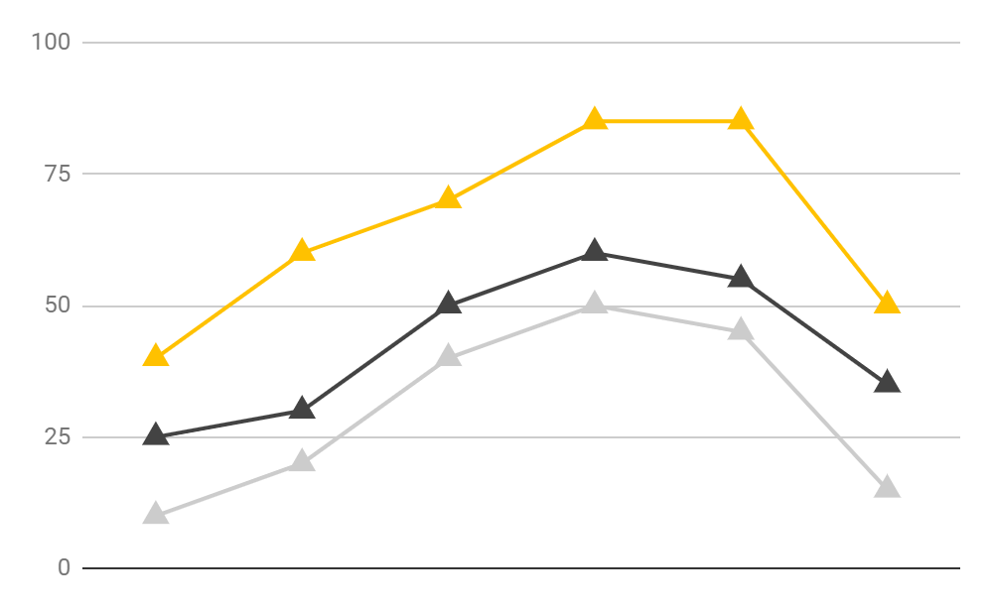
TYPES OF WEBSEITE AVAILABLE
Government
NGOs
Private
Most of the website are the government websites about more than 75%.

Slide 20
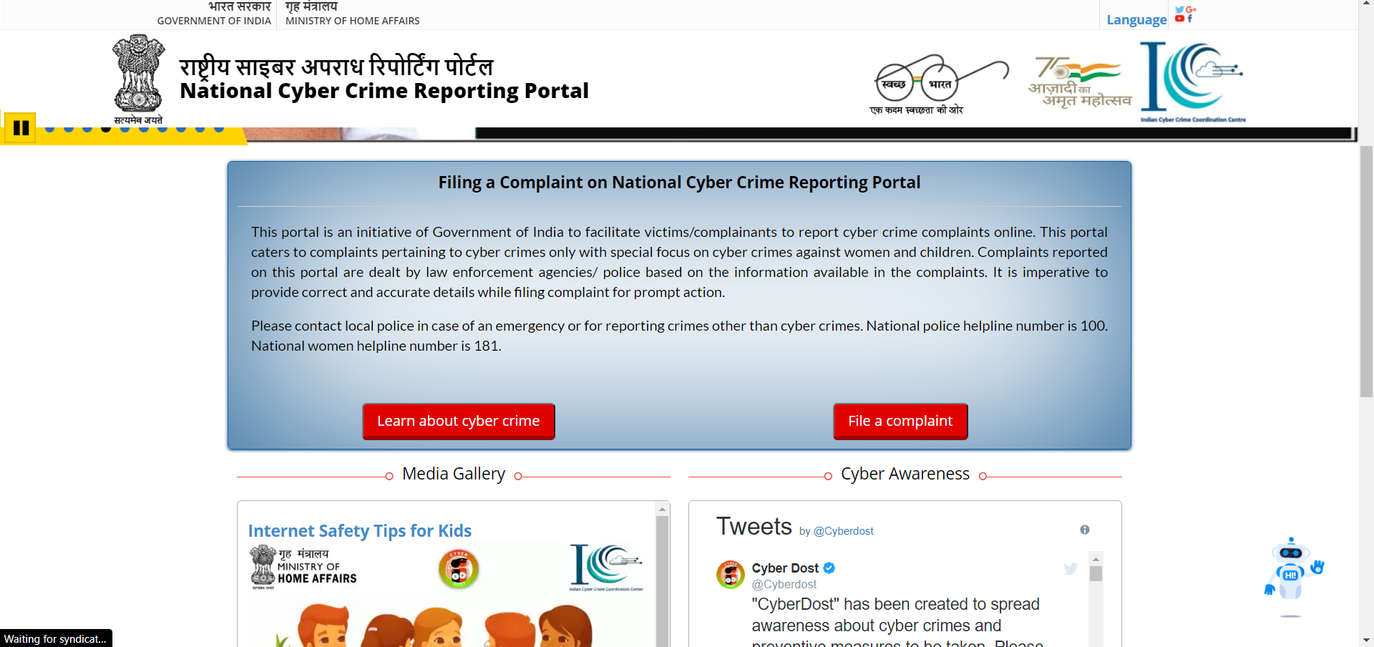
SCREENSHOTS
VENUS
Venus has a
beautiful name,
but it’s very hot

Slide 21
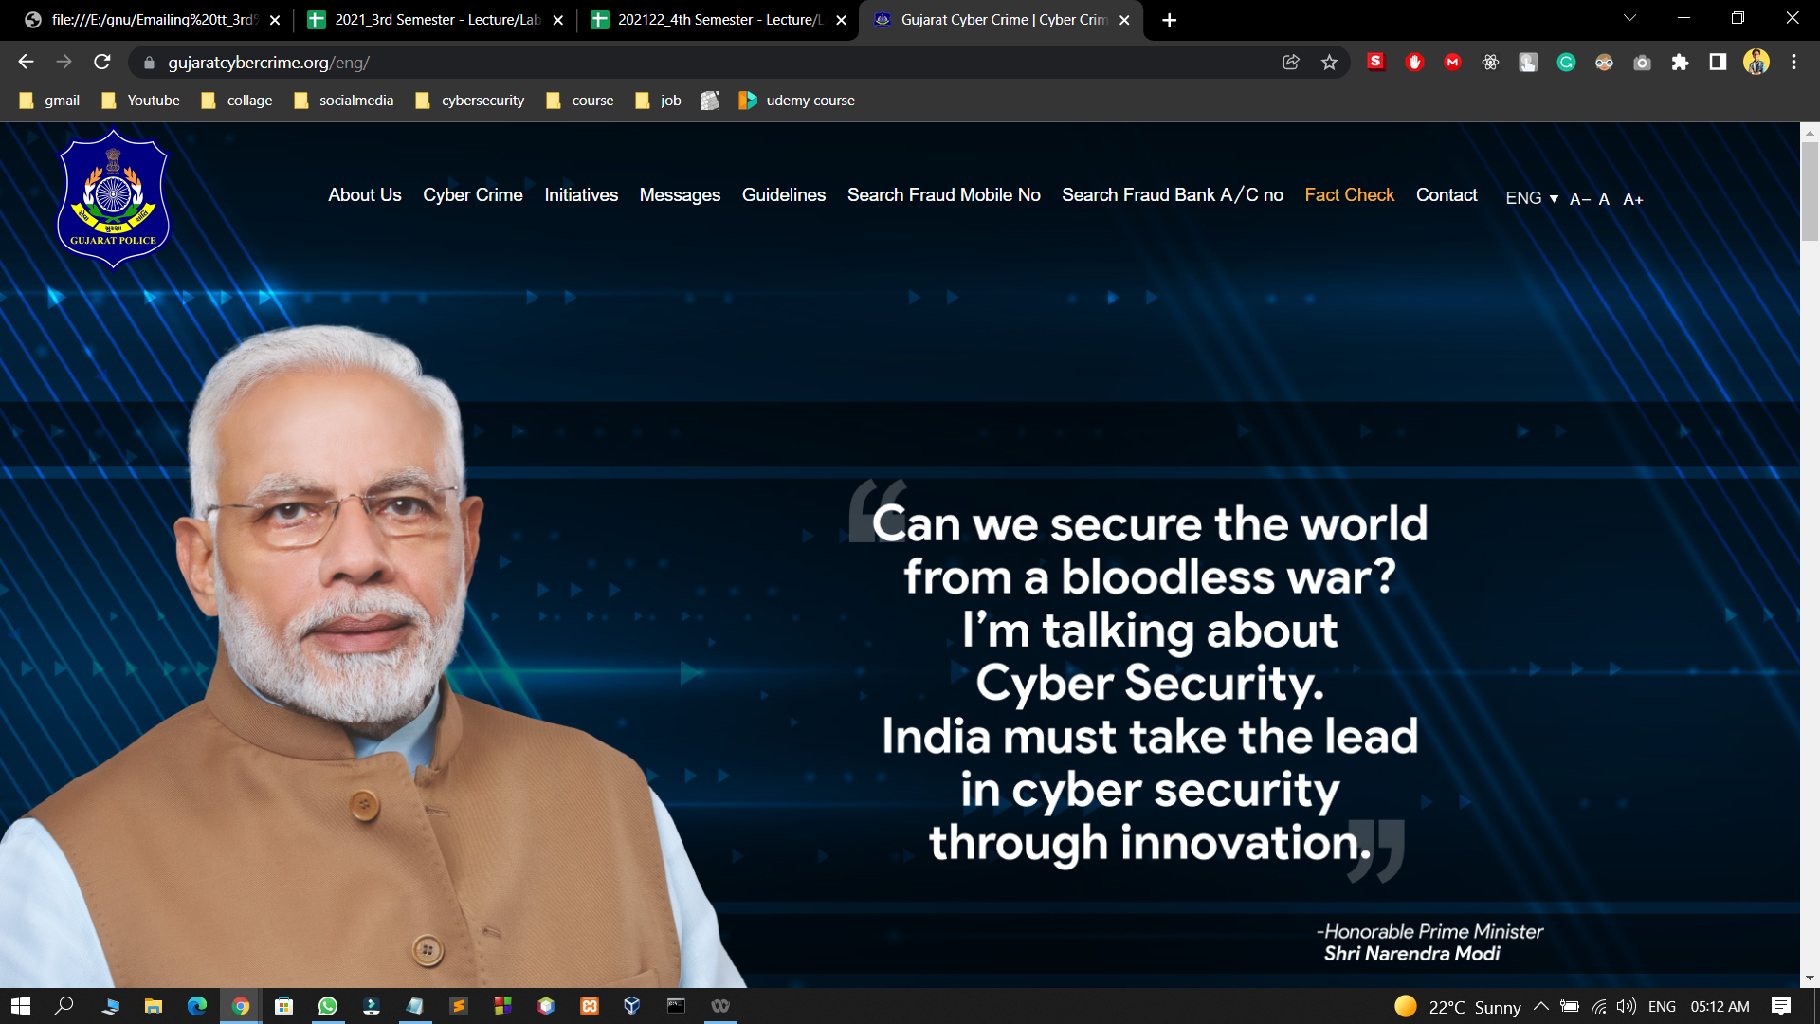
SCREENSHOTS
VENUS
Venus has a
beautiful name,
but it’s very hot

Slide 22
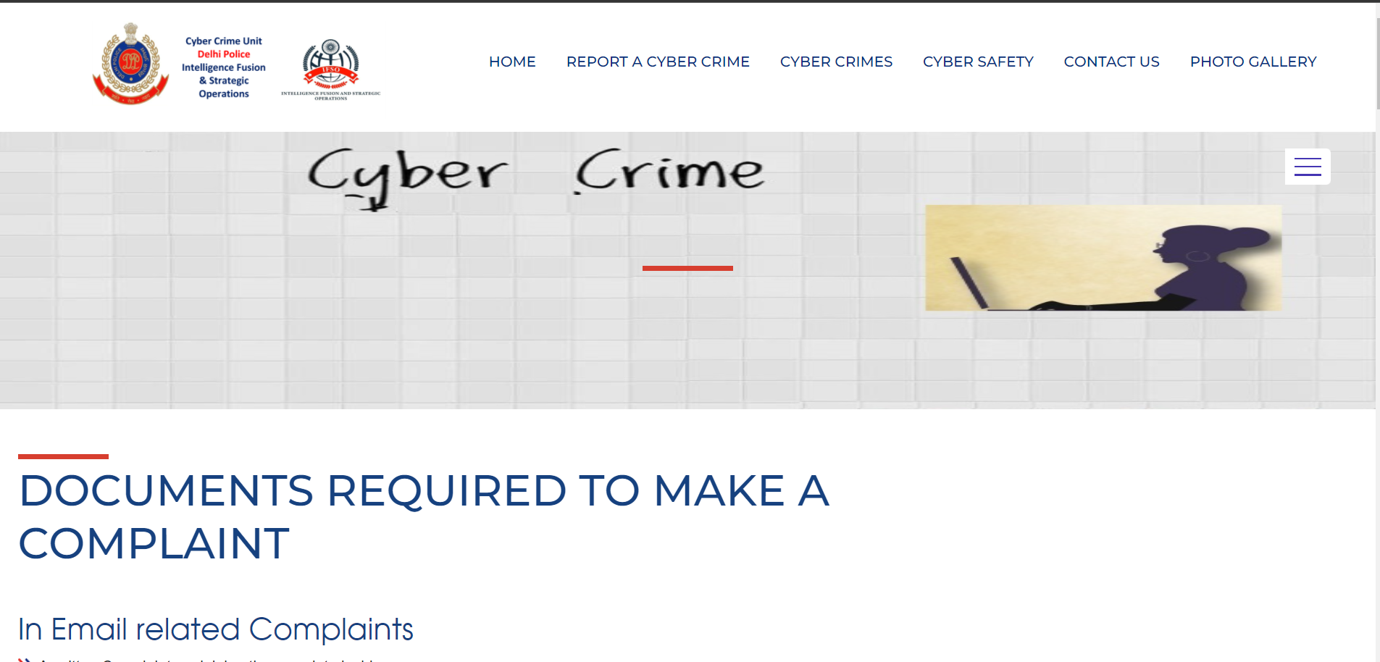
SCREENSHOTS
VENUS
Venus has a
beautiful name,
but it’s very hot

Slide 23
ADVANTAGES:-
This web application allows the user to deal with the great ease of the environment.
It allows the user to complain of his crime anytime.
It provides the functionality to complain.
It also allows the user to change the password.
The users get a reply from admin.

Slide 24
DISADVANTAGES:-
This application does not allow users to recover their passwords.
It is not going to allow users to ignore or remove their crime reports.
It would also not allow changing in their profile.
It is not fully secured as anyone can visit anyone’s profile.

Slide 25
USER PERSONA
Level of Satisfaction by Usability
Usability | Barangay Officials / Weighted Mean | Verbal Interpretation | Residents/ Weighted Mean | Verbal Interpretation
Learnability | 4.33 | Strongly Satisfied | 4.57 | Strongly Satisfied
Operability | 4.47 | Strongly Satisfied | 4.74 | Strongly Satisfied
User interface aesthetics | 4.47 | Strongly Satisfied | 4.66 | Strongly Satisfied
Overall mean | 4.42 | Strongly Satisfied | 4.65 | Strongly Satisfied

Slide 26

SOFTWARE & HARDWARE REQUIREMENT
Mainly hosted on server
anyone can be excess from anywhere with any device.

Slide 27
Dynamic Webpage
Spring MVC
Integrated Payment Gateway

Slide 28
Software Links
TOP 8 WEBS
All tools and technology which are used in this project are open source.
https://tomcat.apache.org/
https://getbootstrap.com/
https://hibernate.org/
https://www.eclipse.org/downloads/
https://www.mysql.com/
https://www.canva.com/
https://aws.amazon.com/
TOP 8 WEBSITES

Slide 29
PROJECT PLAN
Having very big community of our cyber dosts.

Slide 30
Increase Website Traffic
As much as the traffic will increase to our website more the people will believe in our initiative.
Business Logic
Secured control
Presentation logic
Pay for Service
Feedback
Database

Slide 31
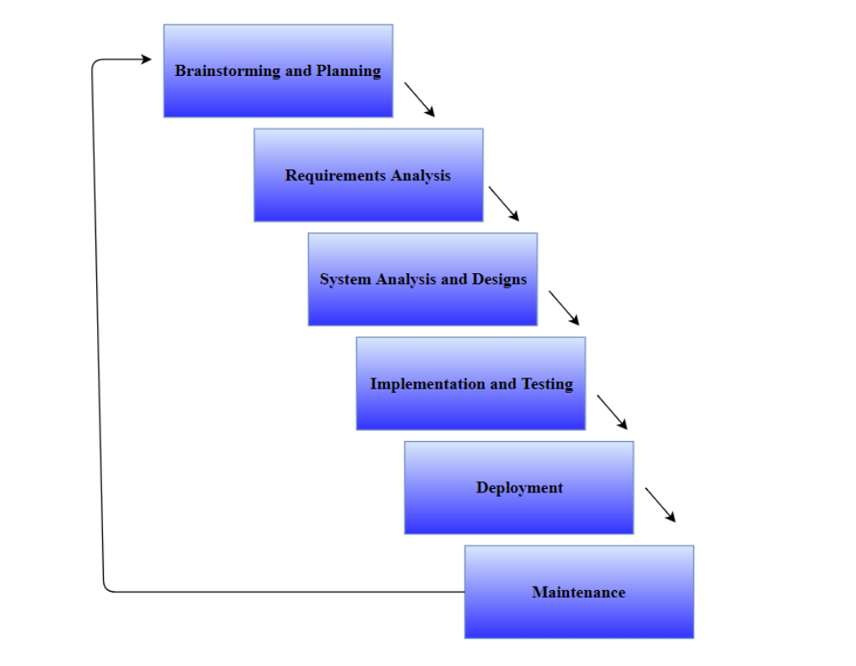
Step by Step Approach

Slide 32
MAIN FEATURES
BEST SECURITY
LOGIN AND REGISTRATION PAGE
FULLY BASED ON DATABASE
ALL TYPE OF VALDIATION
PAYMENT GATEWAY
USER AS WELL AS ADMIN PAGE

Slide 33
MAIN TARGET PEOPLE
CYBER VICTEMS
CYBER CELL OFFICERS
STUDENTS
IT PEOPLES
SECURITY PERSONALS
YOUNG ONES

Slide 34

IMPLEMENTATION DETAILS

Slide 35
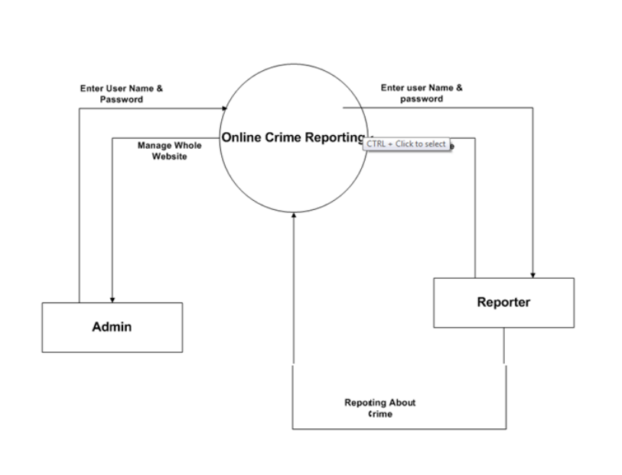
FLOW CHART

Slide 36
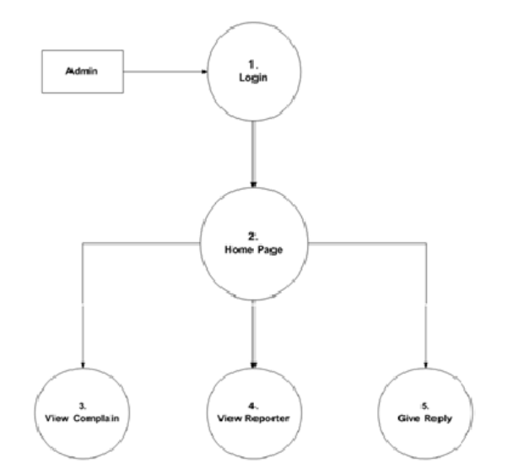
FLOW CHART

Slide 37
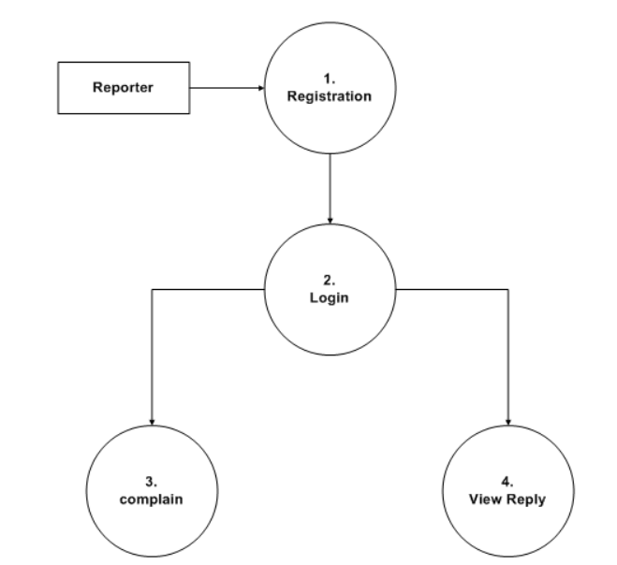
FLOW CHART

Slide 38
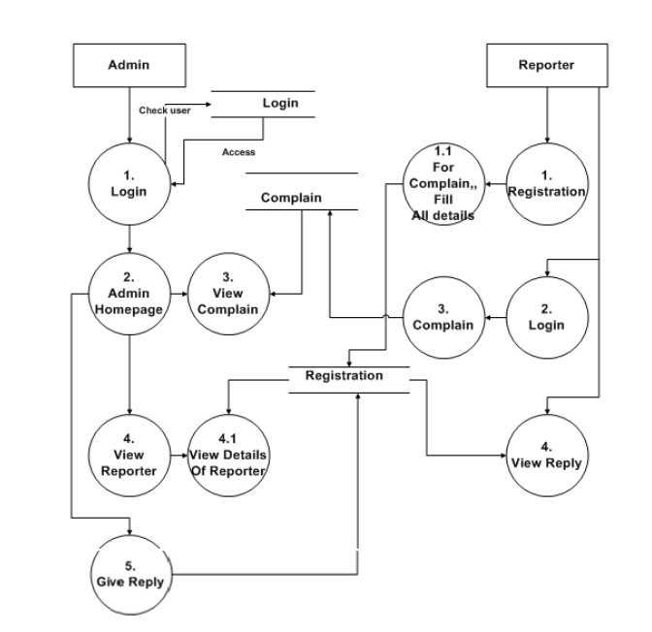
FLOW CHART

Slide 39
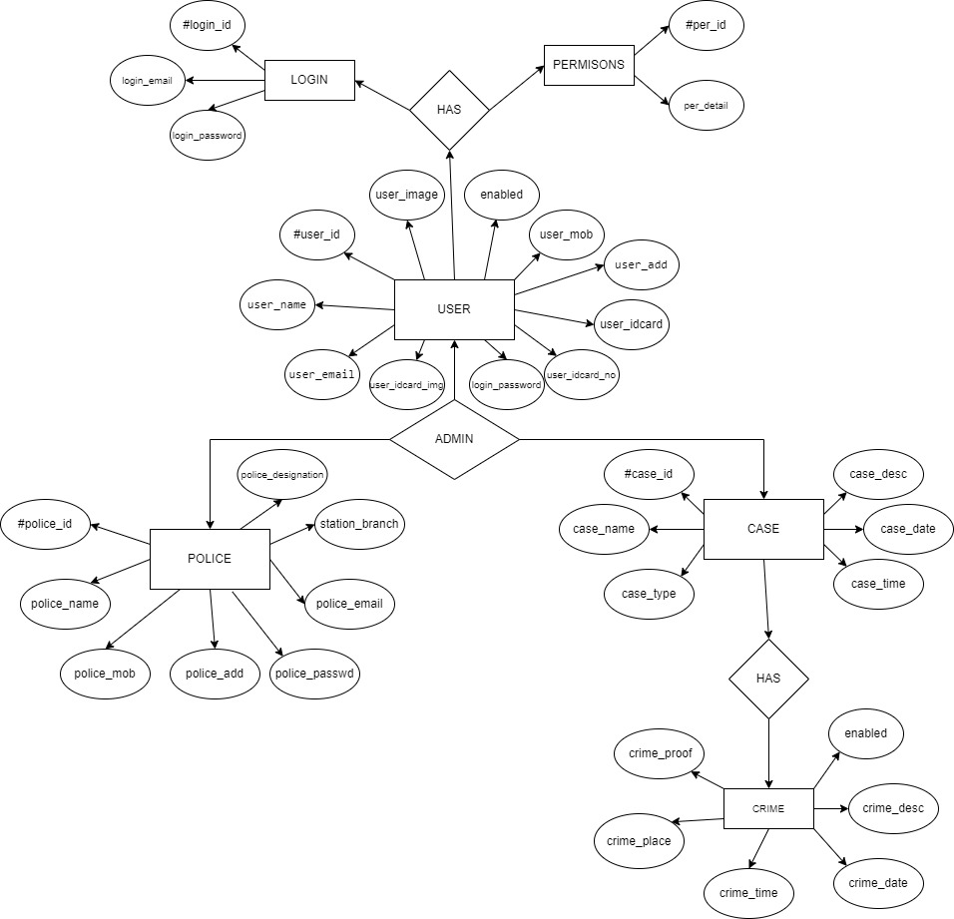

Slide 40
CONCLUSION
In the modern world, the use of computers and Mobile phones are becoming rampant. More so, recent developments in ICT Industries has revolutionized and consequently brought about a paradigm shift in the way activities are accomplished. As a result of the crime reporting system needs to embrace these new technologies. This report has presented a simple, convenient, cost-effective, but efficient online crime reporting system with a user-friendly, sensitive and intelligible web interface. Whereby it can be accessed at any time provided there is an internet connection.

Slide 41

Thanks
Do you have
any questions?
help@cyberfirstaid.in
Please keep this slide for attribution
Cyber Firstaid
Please visit once…

