Slide 1
How Sensory Modalities Affect Memory Recall Eric Huber Kush Manek Amritpal Singh

Slide 2
Project analysis slide 2
Project Introduction
Research Question: How do visual, auditory, and audiovisual stimuli affect short-term memory recall?
Objective: To determine whether different sensory modalities impact memory recall of grocery items.
Hypothesis: One sensory modality will result in better recall than the others.

Slide 3
Project analysis slide 3
Project Methodology
Design
Participants
Methods
Data Collection
Randomized Complete Block Design (RCBD)
There were a total of 10 individuals each examiner, so a total 30 individuals were interviewed
Audio
Visual
Audio-Visual
Participants recalled grocery items after exposure to different modalities.

Slide 4
Project analysis slide 4
Project Analysis
Shapiro Wilk Test
Data Merged
Homoscedasticity test for equal variances
ANOVA
Diagnostics
Initial Testing
Tukey post-hoc analysis

Slide 5
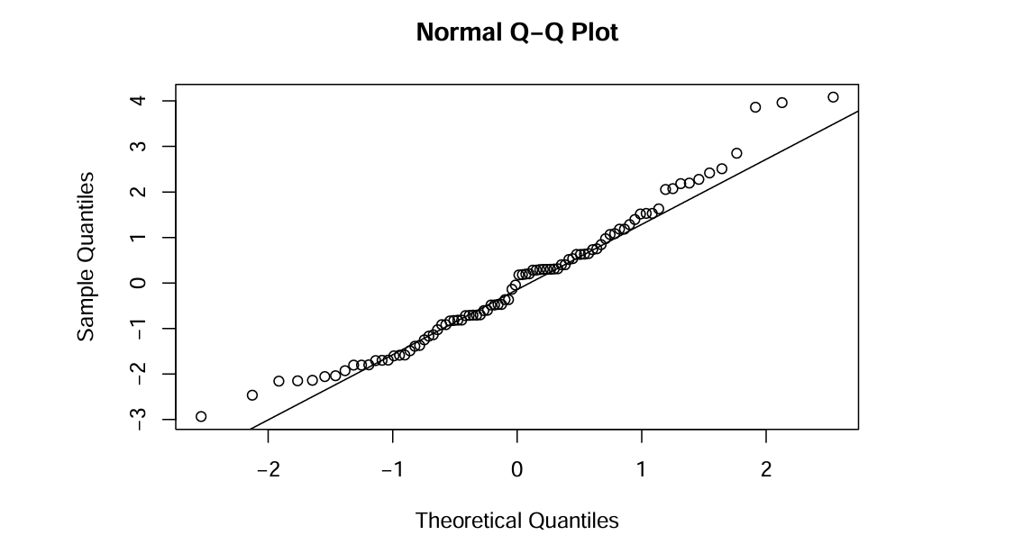
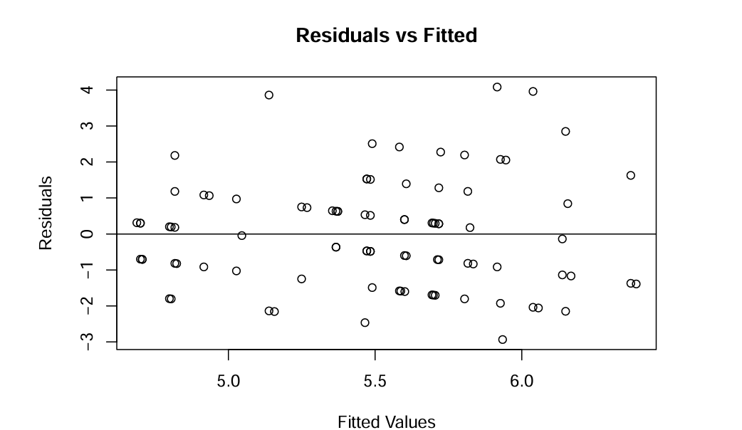
Project analysis slide 5
Project Analysis
Data from three examiners were merged and a final data set was obtained.
Randomized Block Designs were used along with Anova.
As part of the analysis model adequacy check was performed.

Slide 6
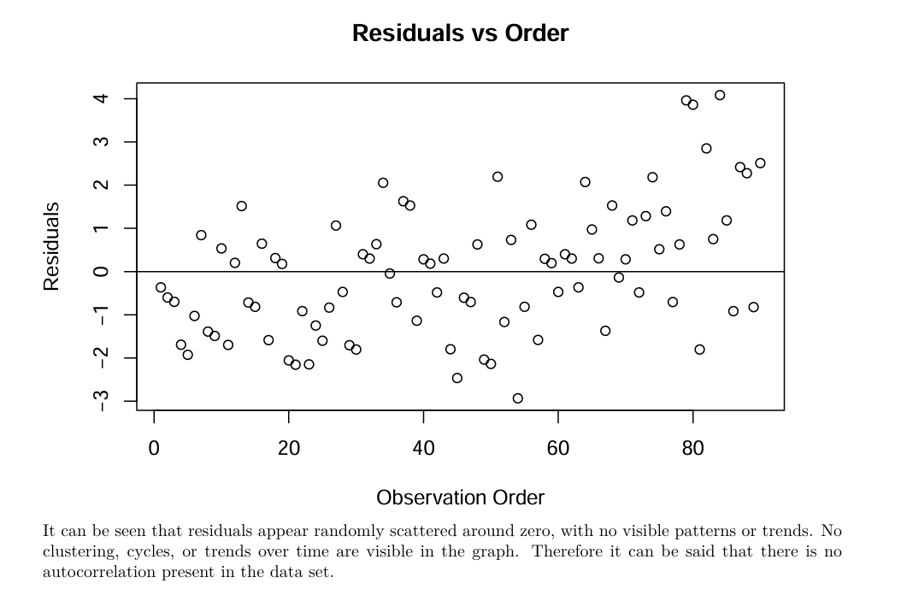
Project analysis slide 6
Project Analysis

Slide 7
Project analysis slide 8
Project Findings
Positive
NEGATIVE
STRENGTH
WEAKNESS
Variance remained stable across groups (homoscedasticity test)
Normality assumption not fully met (Shapiro-Wilk test)
Learning Opportunities
THREAT
Individual cognitive differences
Attention levels during the experiment
Sample not representative of population
Short-term recall focus

Slide 8
Project analysis slide 10
Project Conclusion
No Significant difference was discovered for different treatments
As well as the block is insignificant
This suggest it might not be appropriate to conclude that one modality is better than the other.
This could be due to the other nuisance factors which were effectively removed through randomization or otherwise accounted for.
We consider rerunning the experiment including factors including but not limited to age, sample size.

Slide 9
Thank You

