Slide 1
Advanced Database Management System
Dept. of MCA
TOPIC: Soft Skills Development Web App
Project By: Group 10
30-Ritika Joshi
32-Deepak Kamble
33-Chetna Khandagale
35-Mayuri Kulkarni
38-Kushagra Mishra
Guide Name :-
Prof. Ashutosh Kulkarni

Slide 2
INTRODUCTION
We have developed this Soft Skills Assessment System based on a problem statement from SMART UNIVERSITY – HACKATHON (Software) which is as follows:
Students in the university come from different environments. Every student has some strengths and weaknesses. Develop an application that can help the student in assessing their soft skills . The output of the system can be user centric tasks and personal feedback on their soft skills. The recommendations should be in terms of improvements required in communication skills, writing skills, technical skills, way of presentation etc. The solution should also generate an individual progress report.

Slide 3
AIM & OBJECTIVE
AIM:
The aim of this project is to develop an assessment application specifically for soft skills and provide personalized feedbacks to the users. The aim here is to eliminate the problems in the manual system and provide a simpler solution to assessing soft skills based on predefined parameters.
OBJECTIVE:
The objective of this application is to provide a simpler and convenient method of assessing soft skills and provide user specific feedbacks on their respective assigned tasks.

Slide 4
SCOPE OF THE PROJECT
The system shall have different users and different roles will be assigned with related permissions. The system shall have an administrator, faculty and students as its users. The admin would have authority to create student and faculty profiles, the admin shall also be able to view,update delete student and faculty records. The admin shall also have the ability to assign a student to faculty.
The faculty shall be able to make announcements, assign personalised tasks to student, give personalised feedback to student, grade the students presentation, communication and writing skills based on predefined criteria.
The student shall be able to view his/her assigned faculty details. The student shall also be able to view his/her assessments , tasks, and feedbacks.

Slide 5
FEASIBILITY OF THE PROJECT
Feasibility study includes consideration of all possible ways to provide a solution to the given problem. The proposed solution should satisfy all the user requirements and should be flexible enough so that future changes can be easily done based on the future upcoming requirements.
Technical Feasibility:
This project is developed using Mysql as a database and HTML 5 & CSS, Bootstrap,JS for frontend and PHP for backend. The project is developed in Microsoft Windows platform. All the resources needed for the development of the software as well as the maintenance of the same is available with the user.

Slide 6
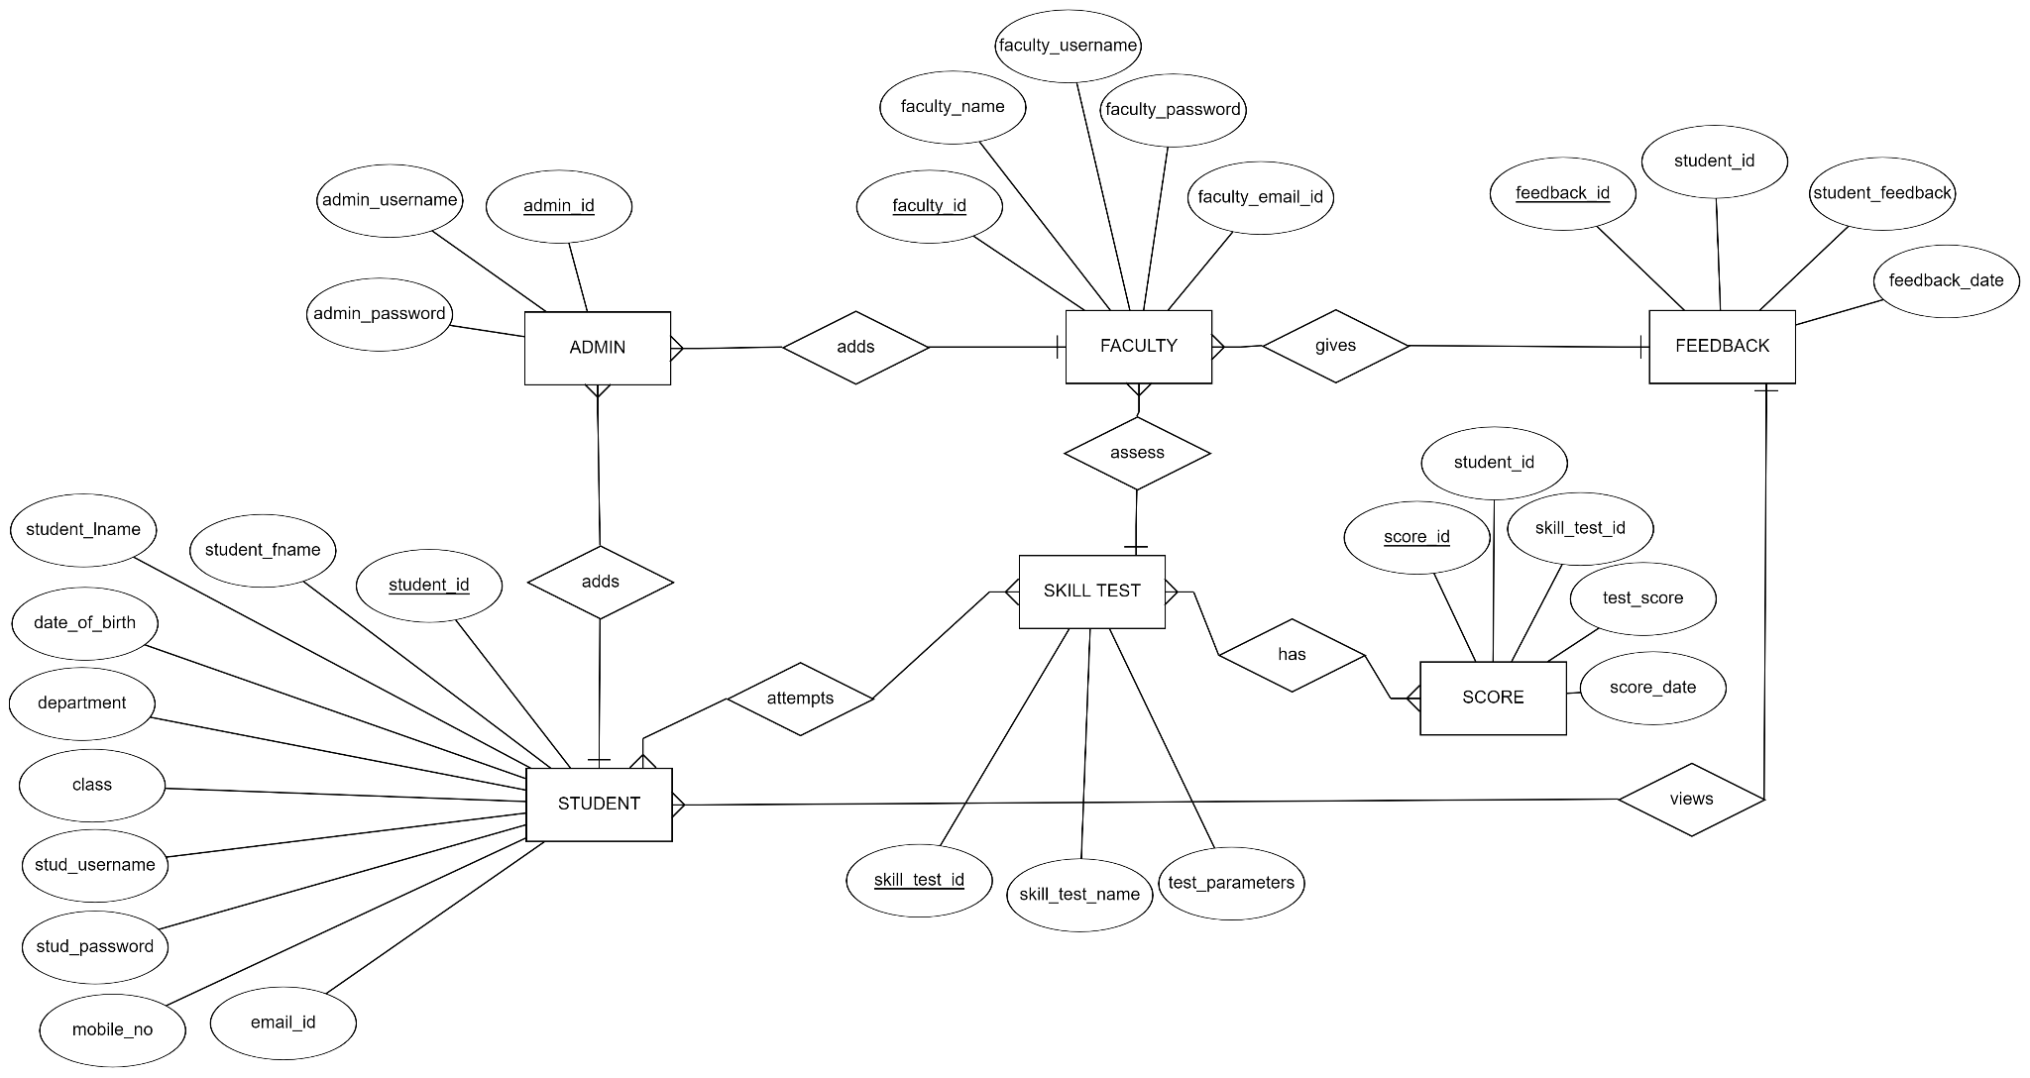
ER DIAGRAM

Slide 7
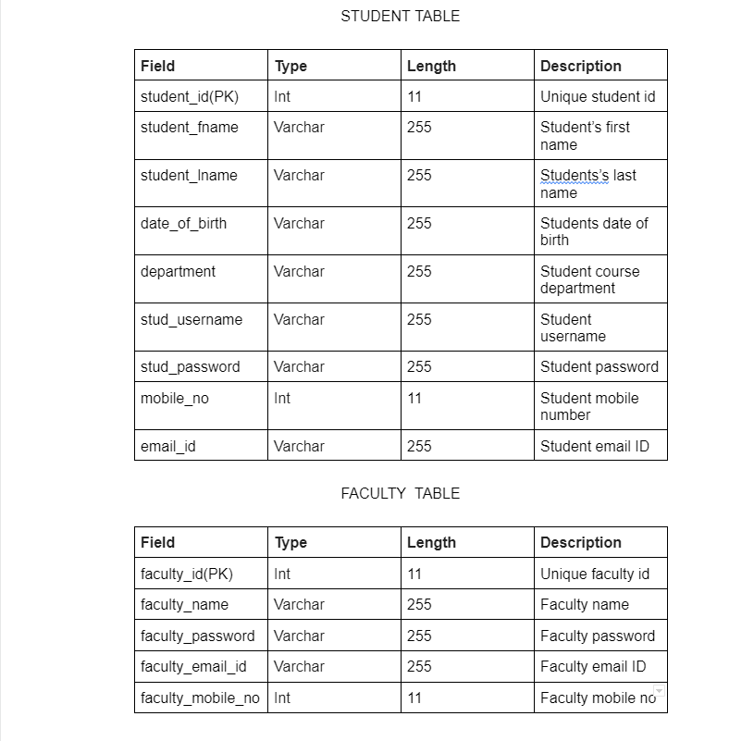
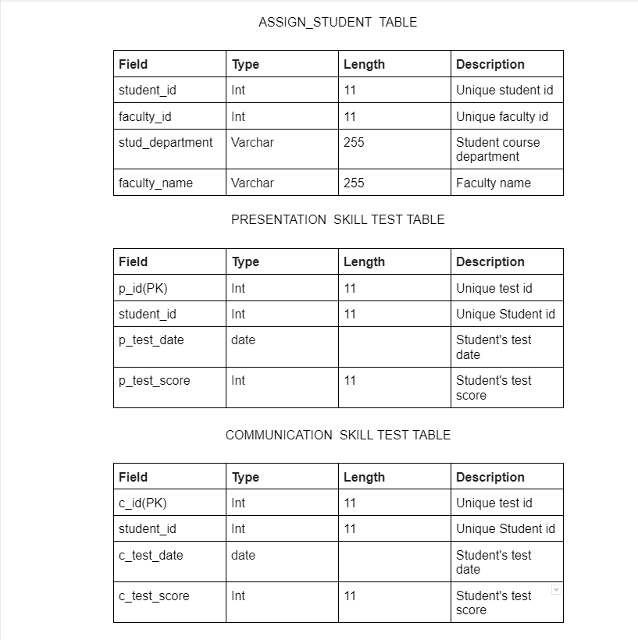
DATA DICTIONARY

Slide 8
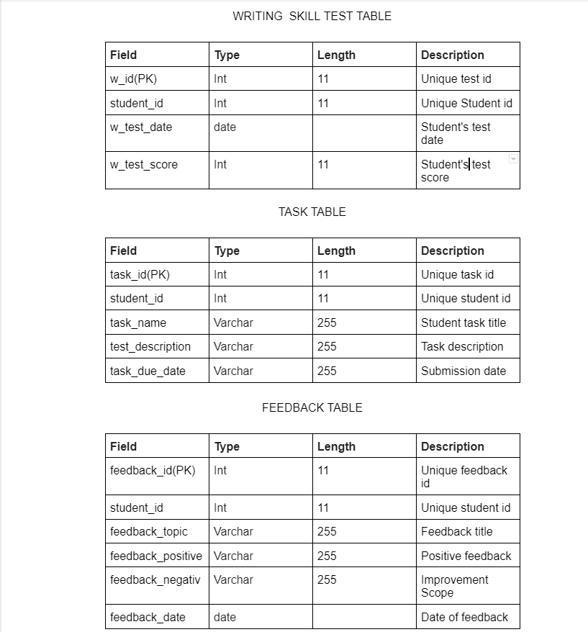
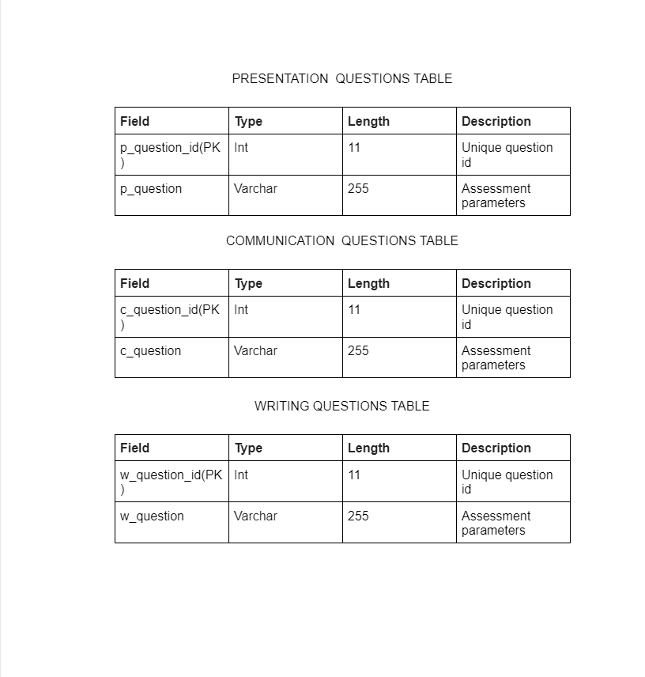
DATA DICTIONARY

Slide 9
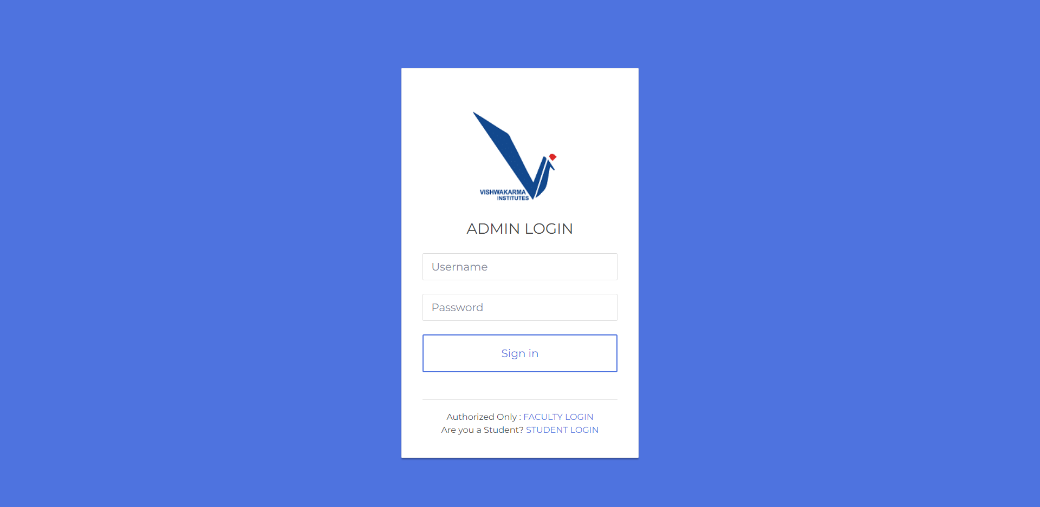
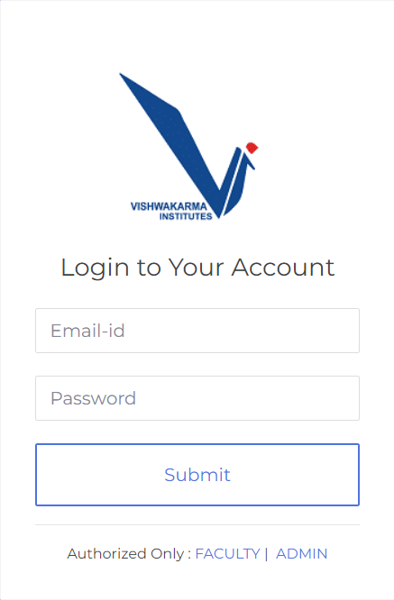
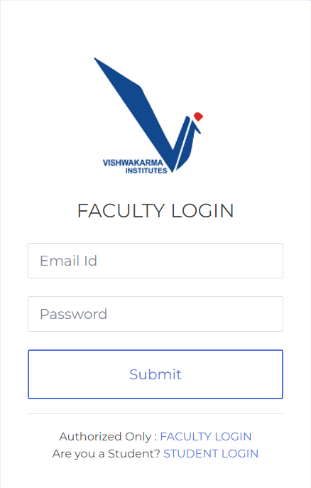
OUTPUT SCREENSHOTS
ADMIN, STUDENT, FACULTY LOGIN SCREENS RESPECTIVELY

Slide 10
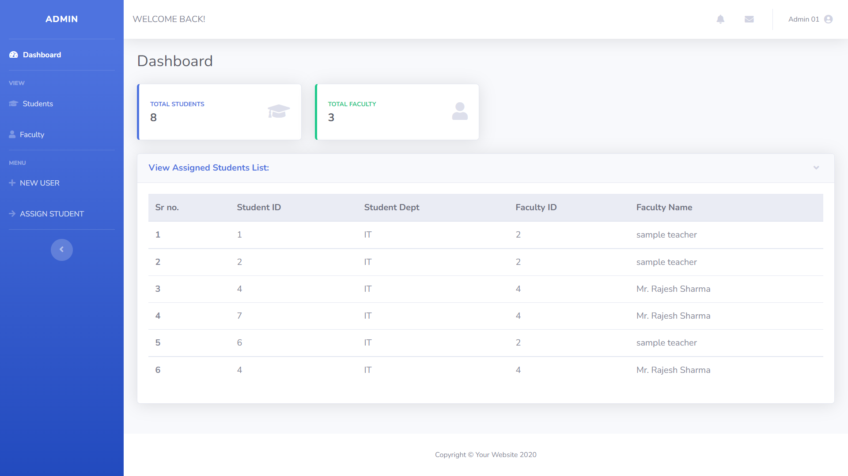
ADMIN DASHBOARD

Slide 11
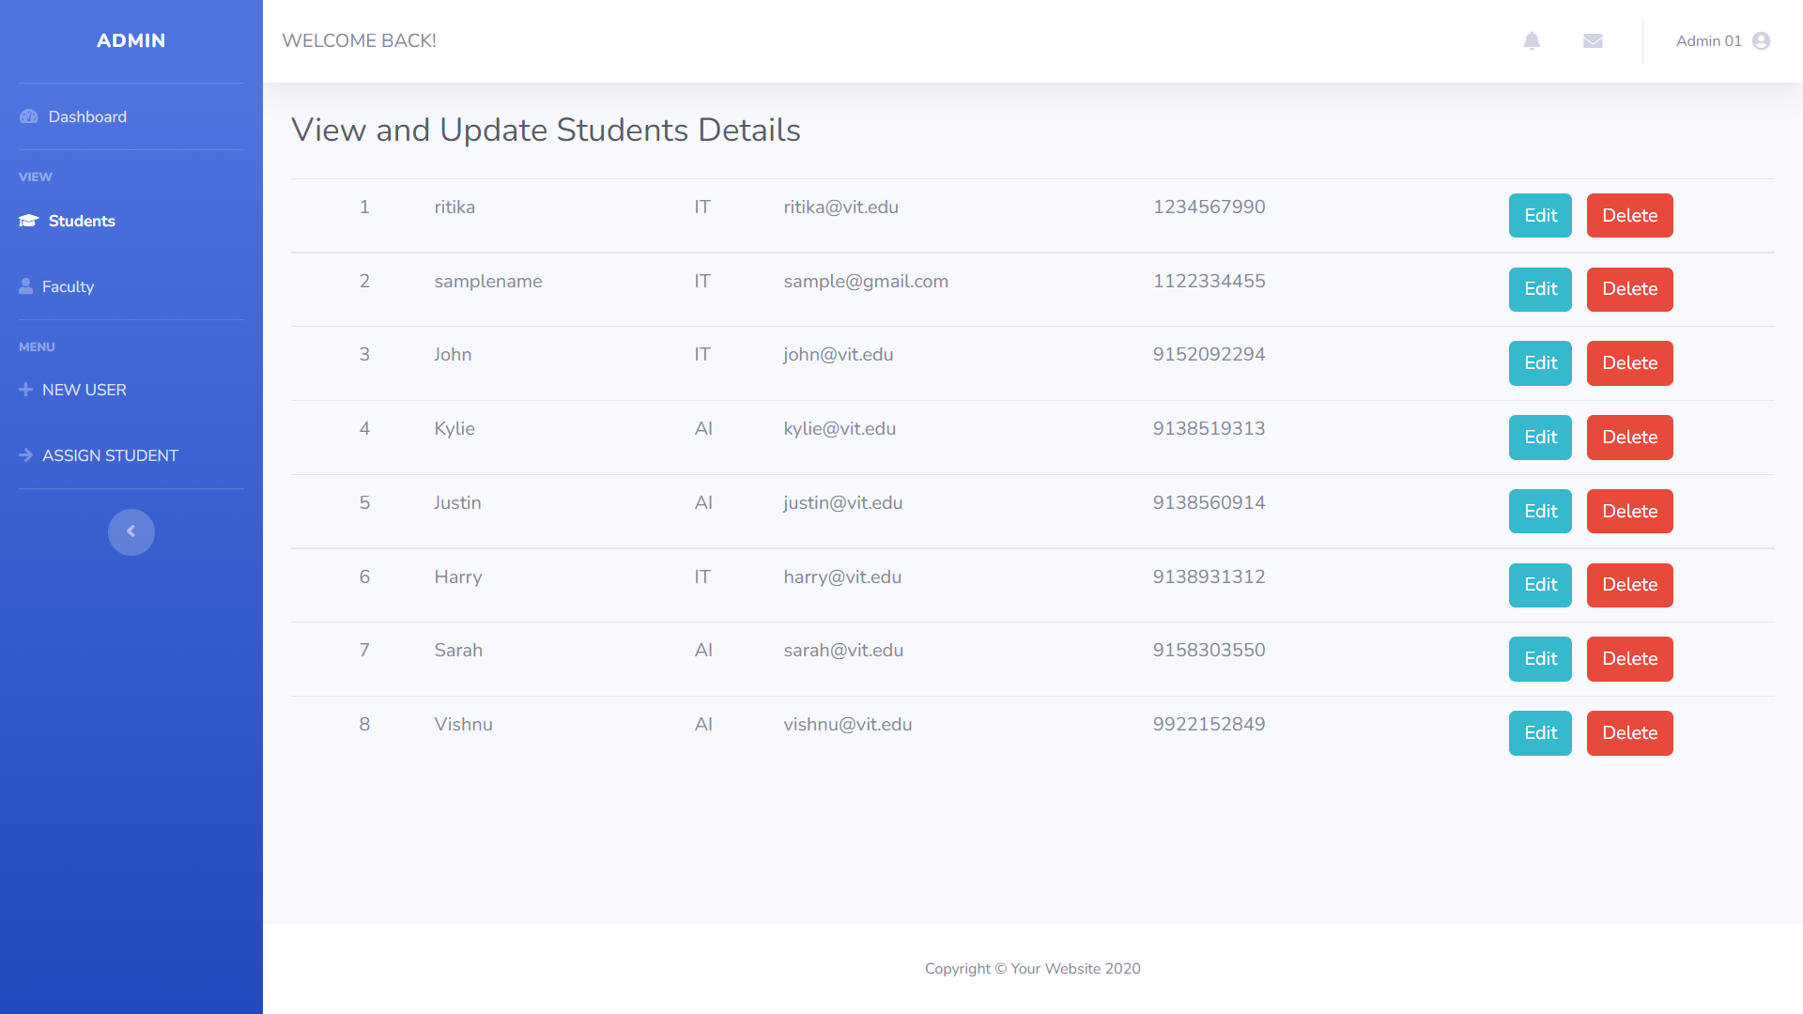
ADMIN DASHBOARD

Slide 12
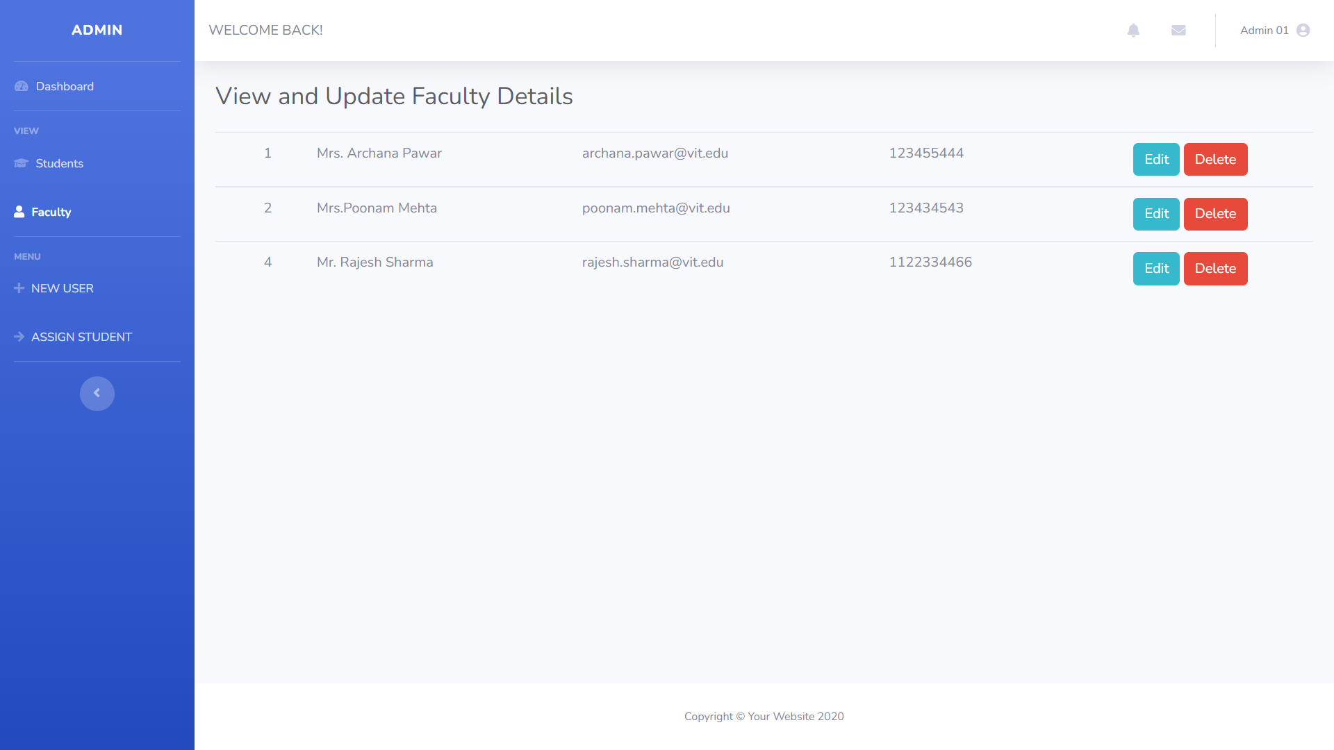
ADMIN DASHBOARD

Slide 13
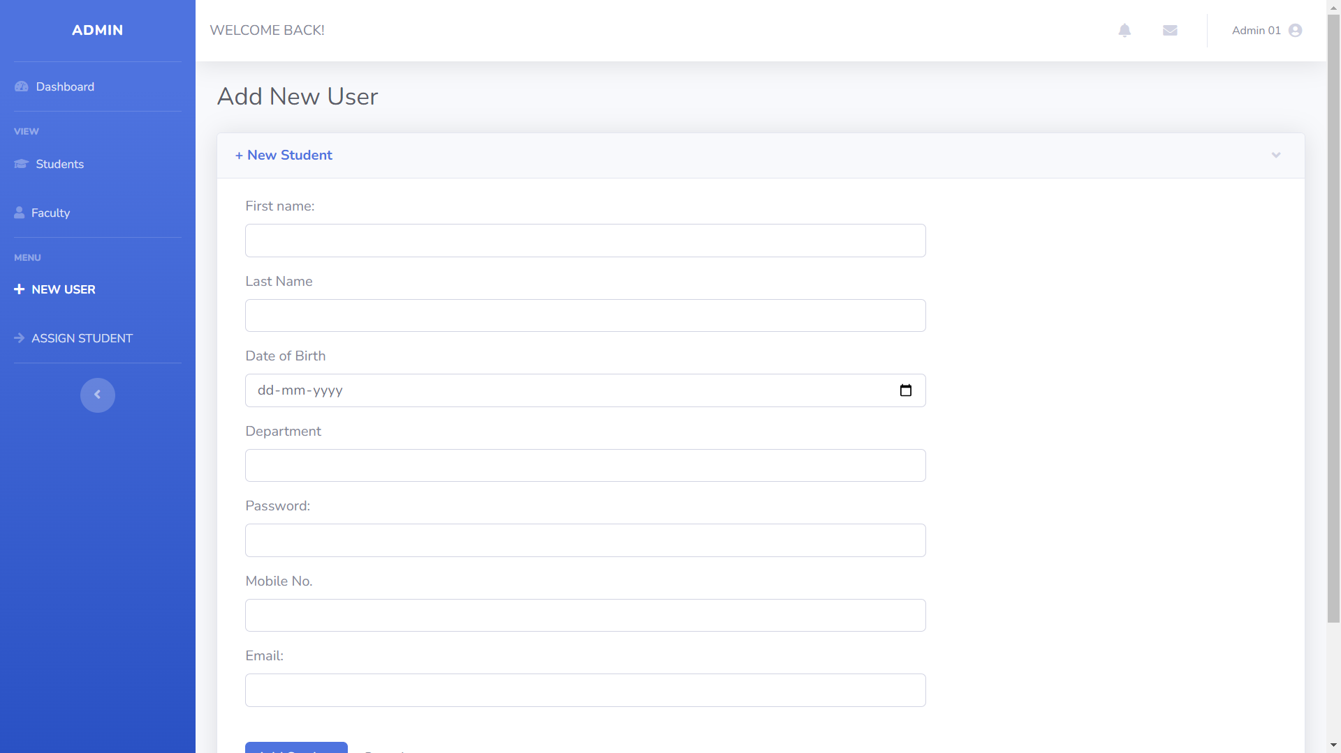
ADMIN DASHBOARD

Slide 14
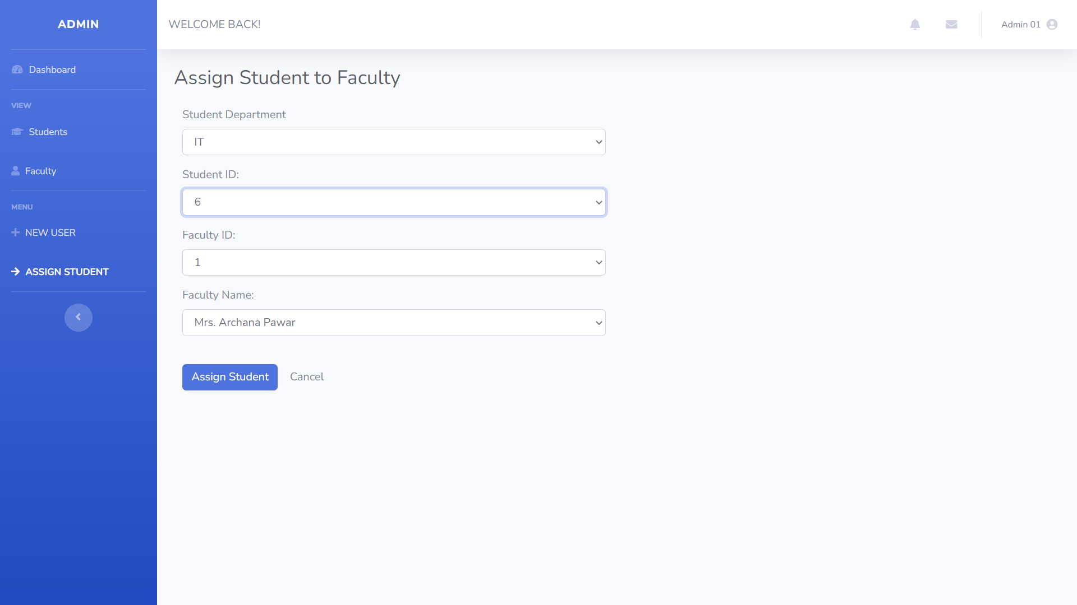
ADMIN DASHBOARD

Slide 15
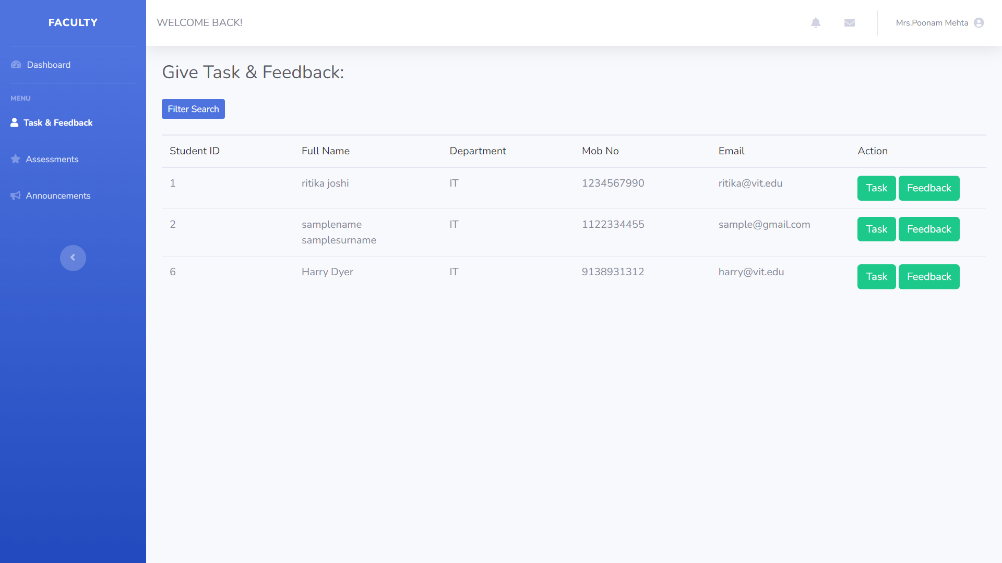
FACULTY DASHBOARD

Slide 16
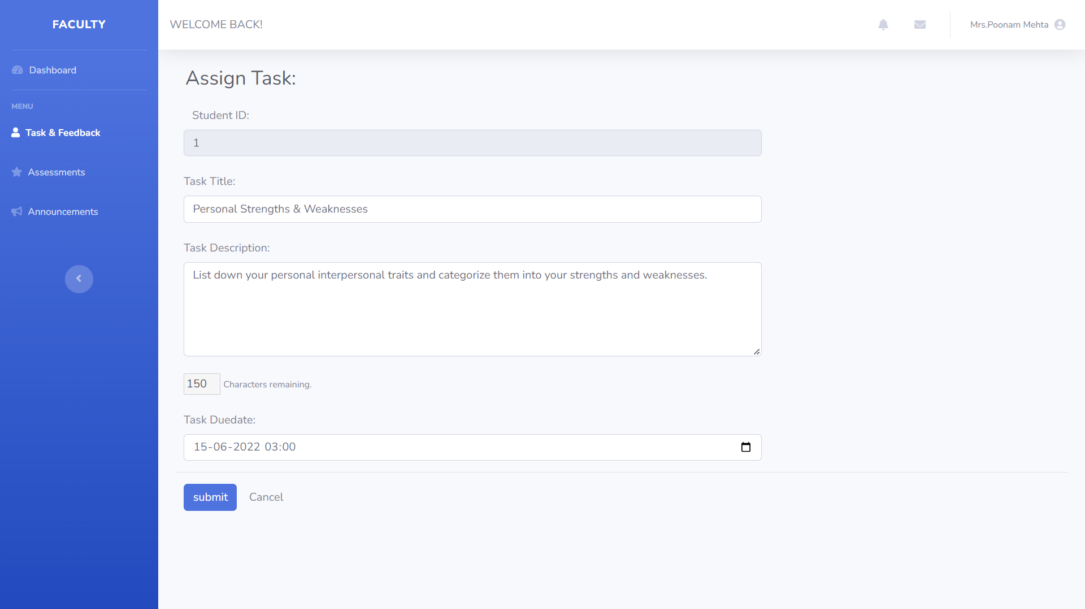
FACULTY DASHBOARD

Slide 17
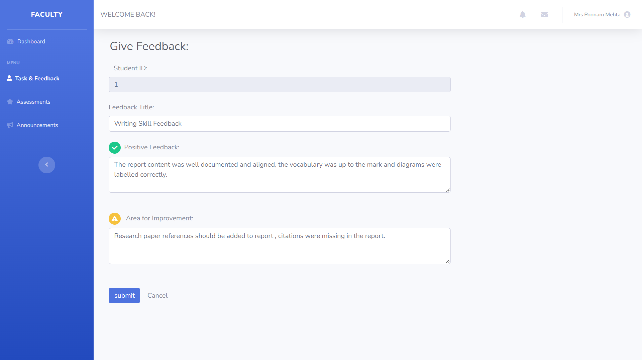
FACULTY DASHBOARD

Slide 18
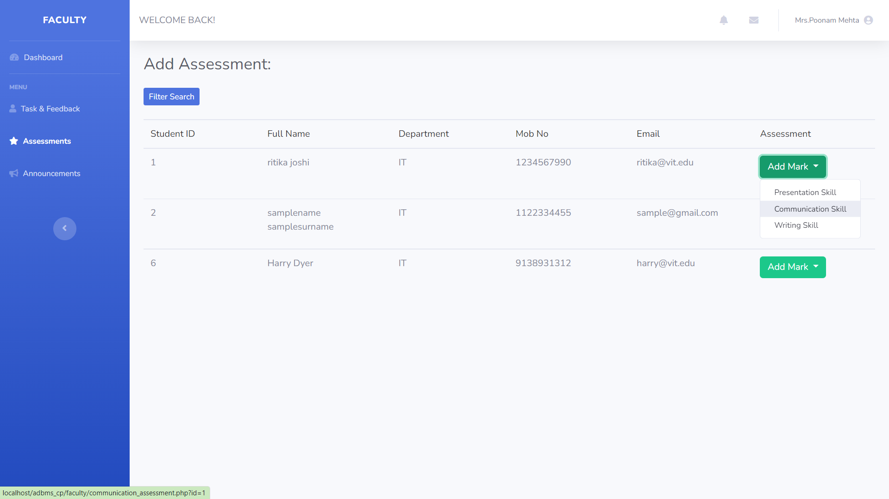
FACULTY DASHBOARD

Slide 19
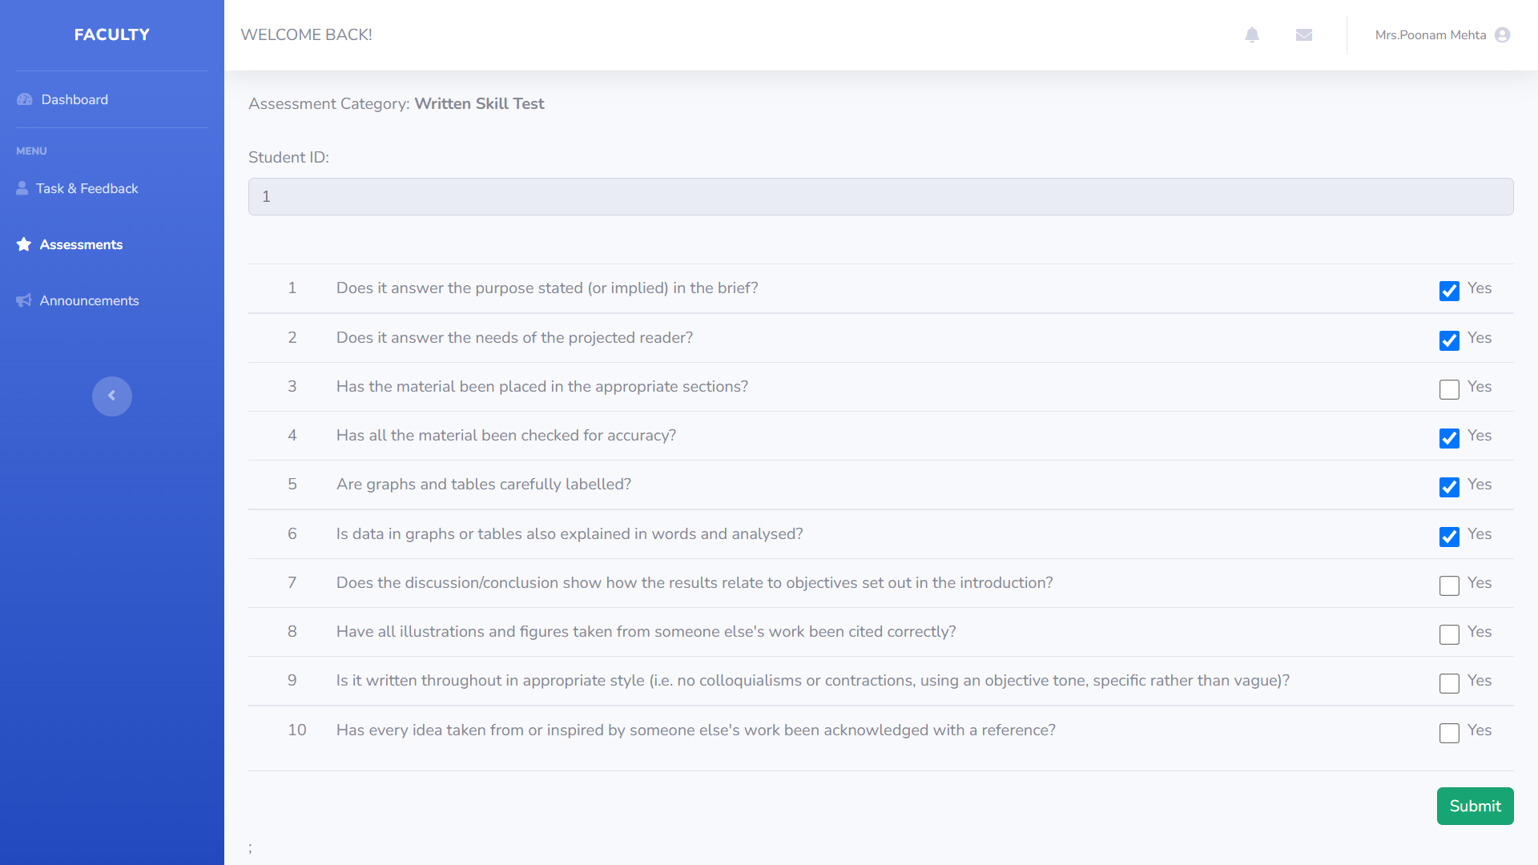
FACULTY DASHBOARD

Slide 20
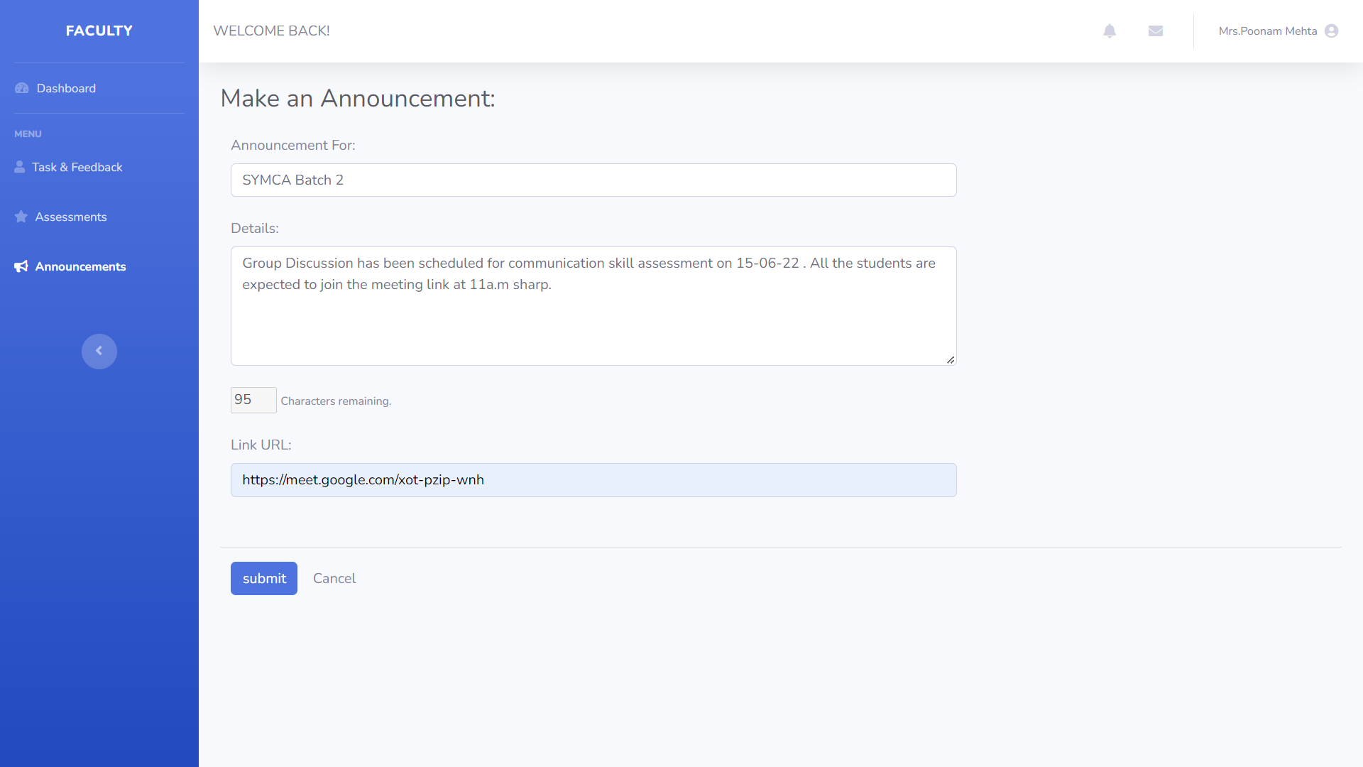
FACULTY DASHBOARD

Slide 21
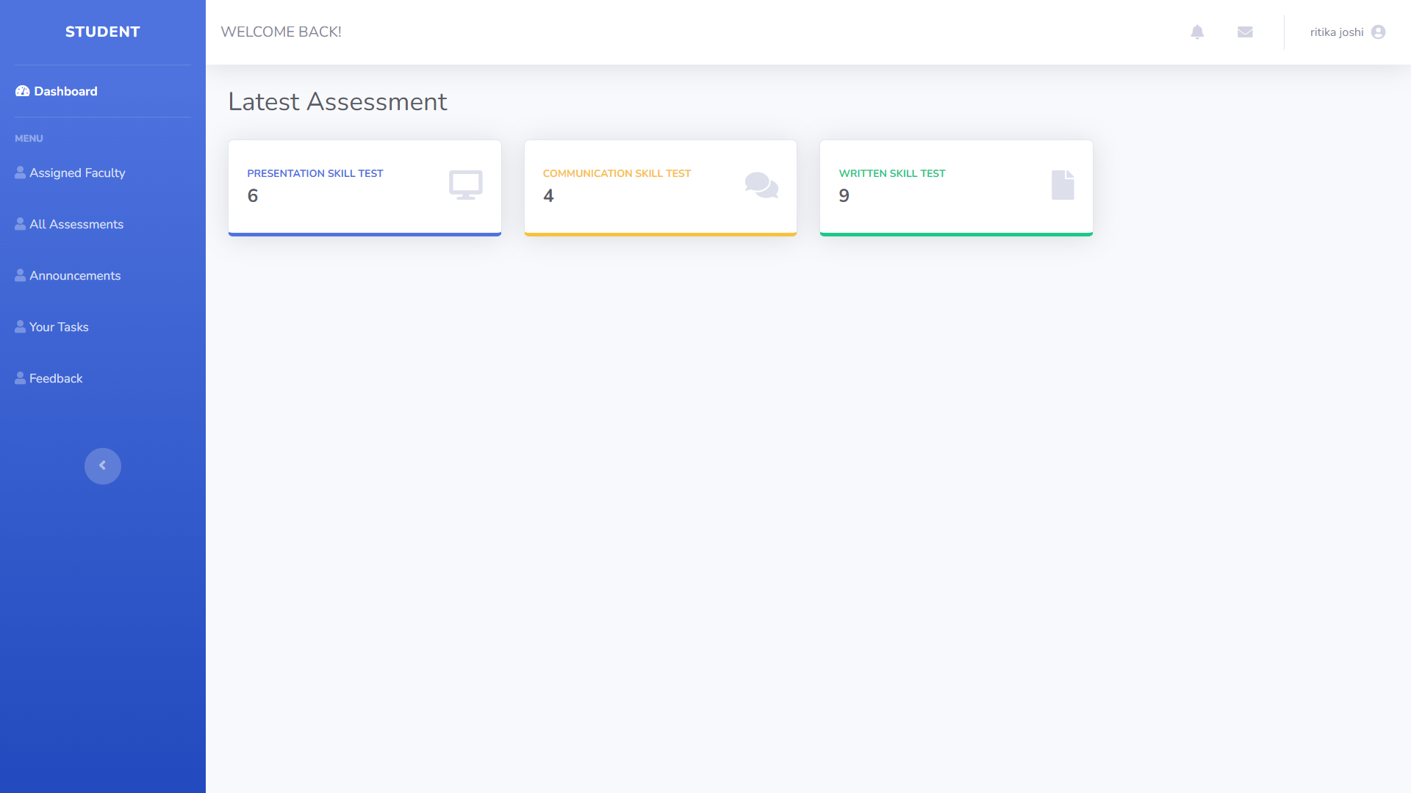
STUDENT DASHBOARD

Slide 22
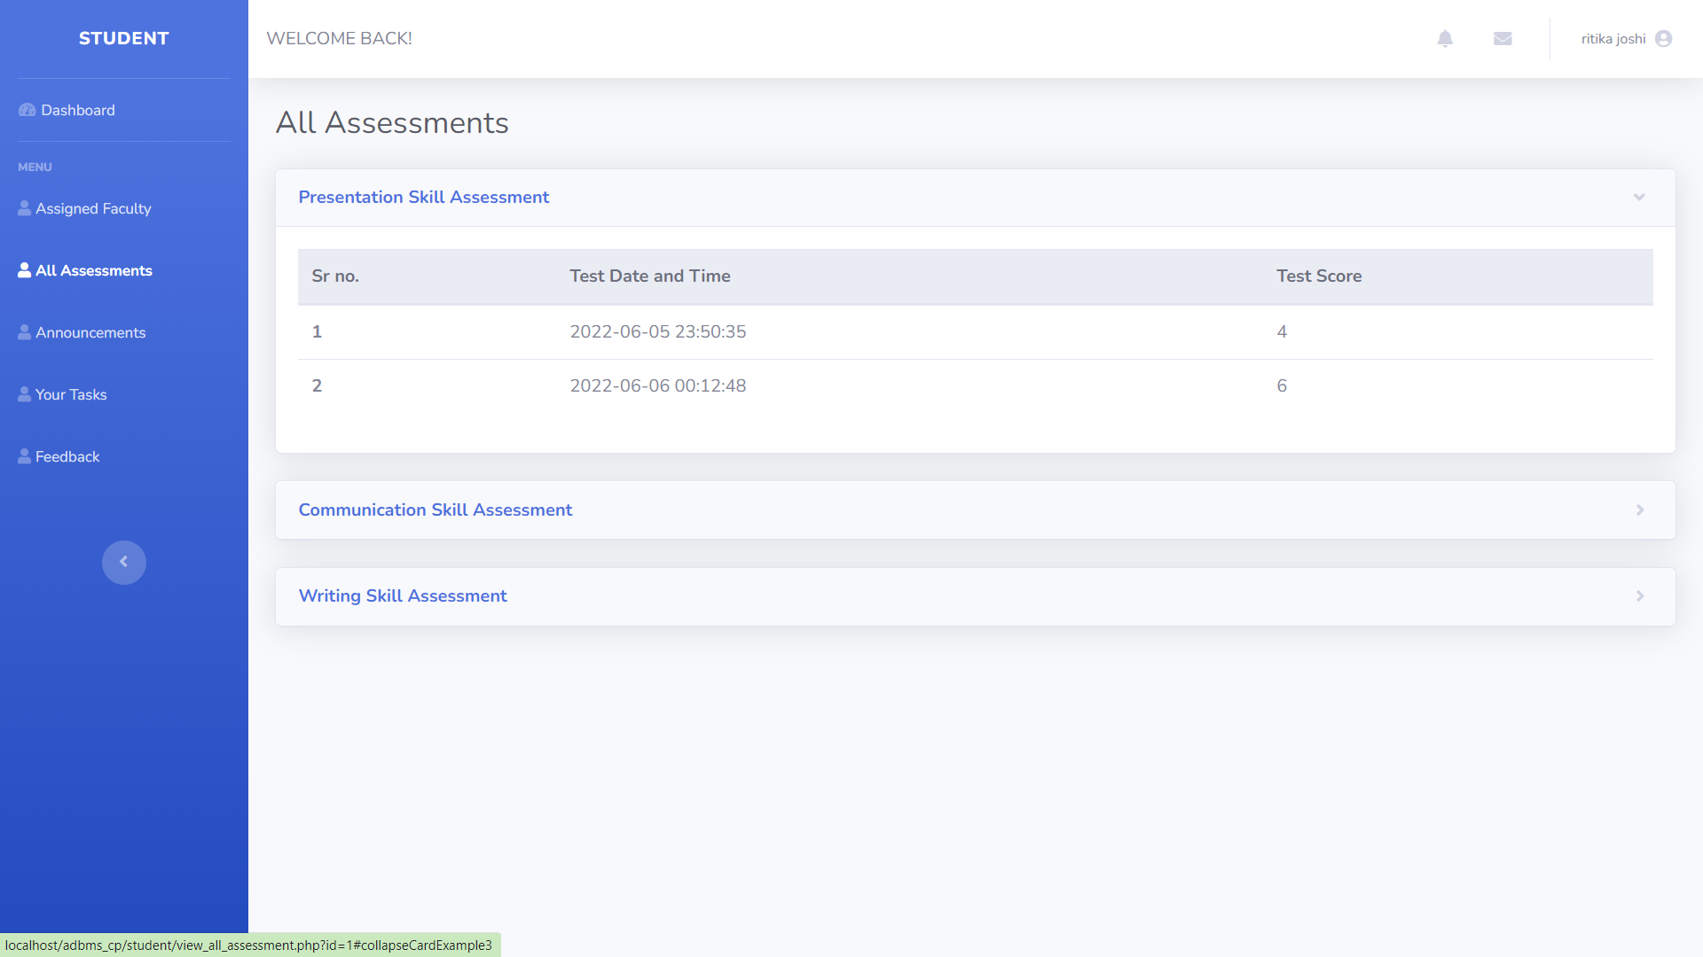
STUDENT DASHBOARD

Slide 23
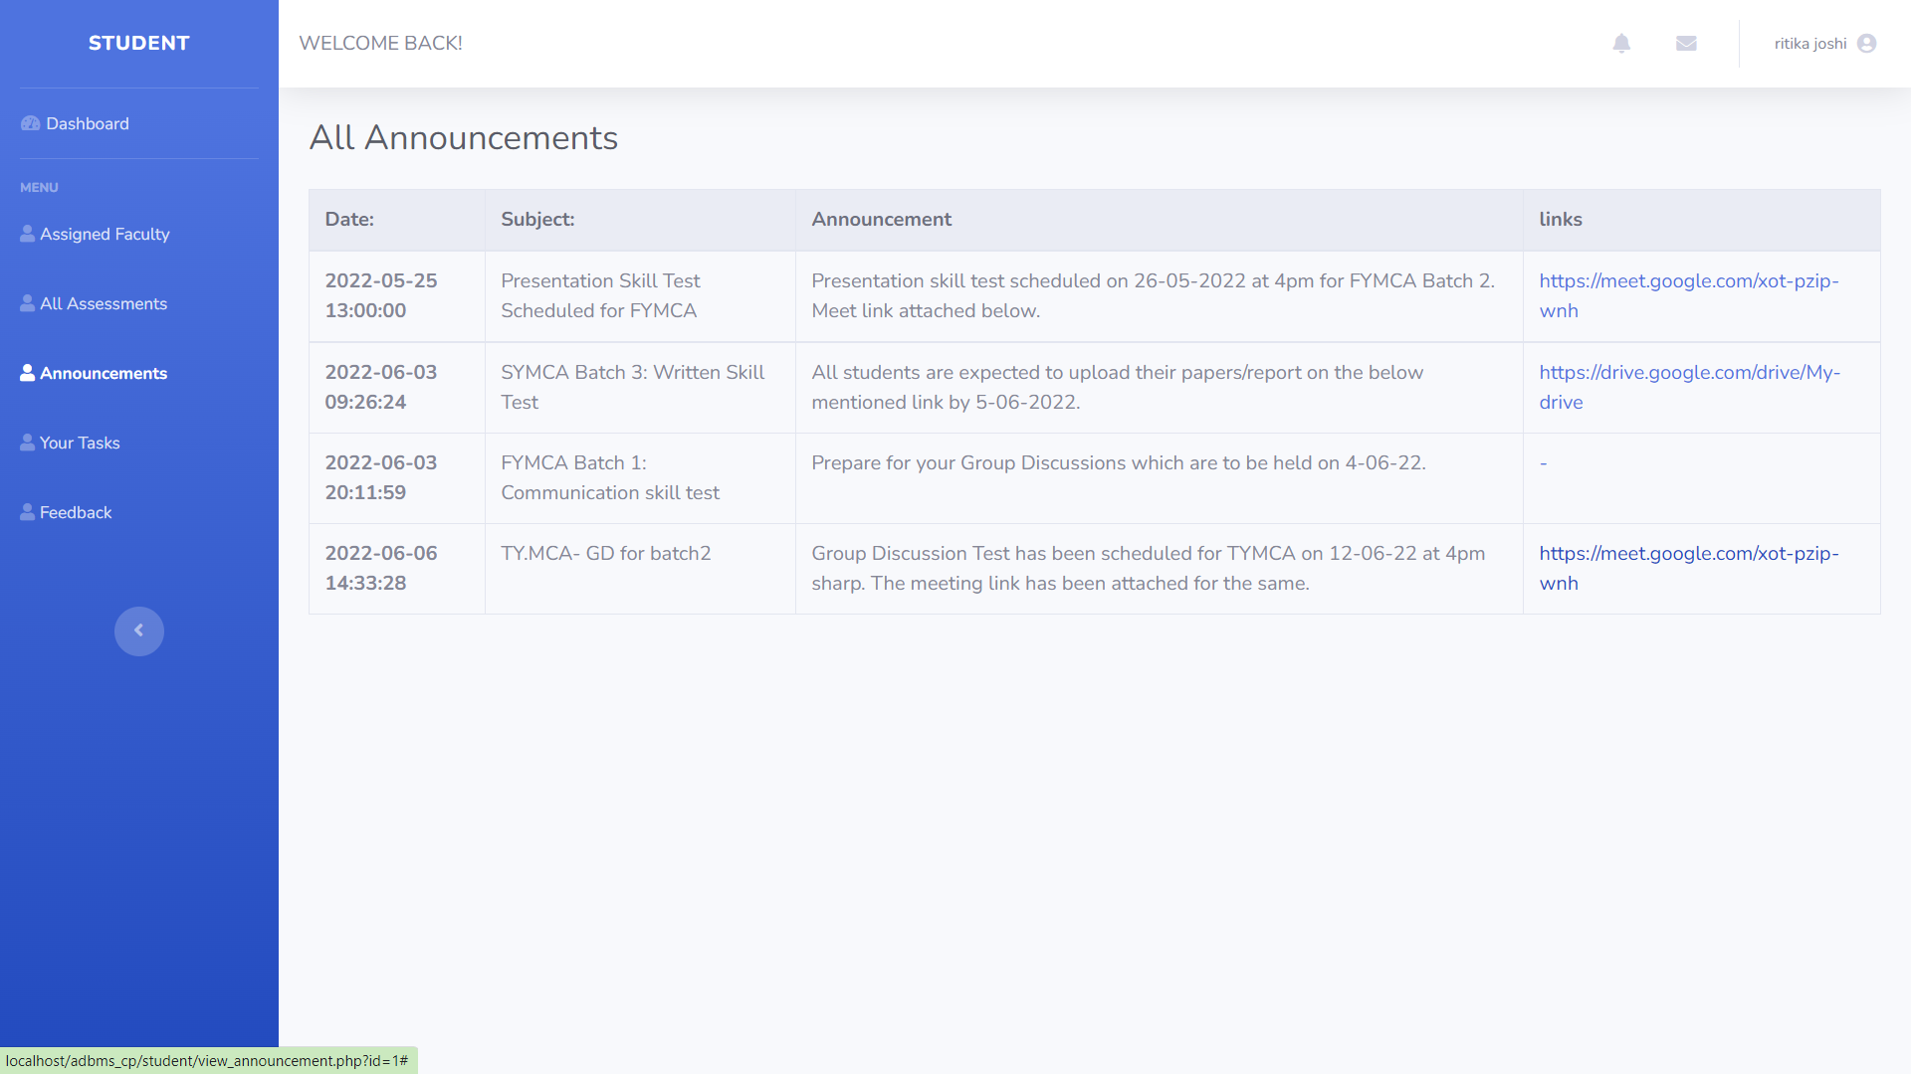
STUDENT DASHBOARD

Slide 24
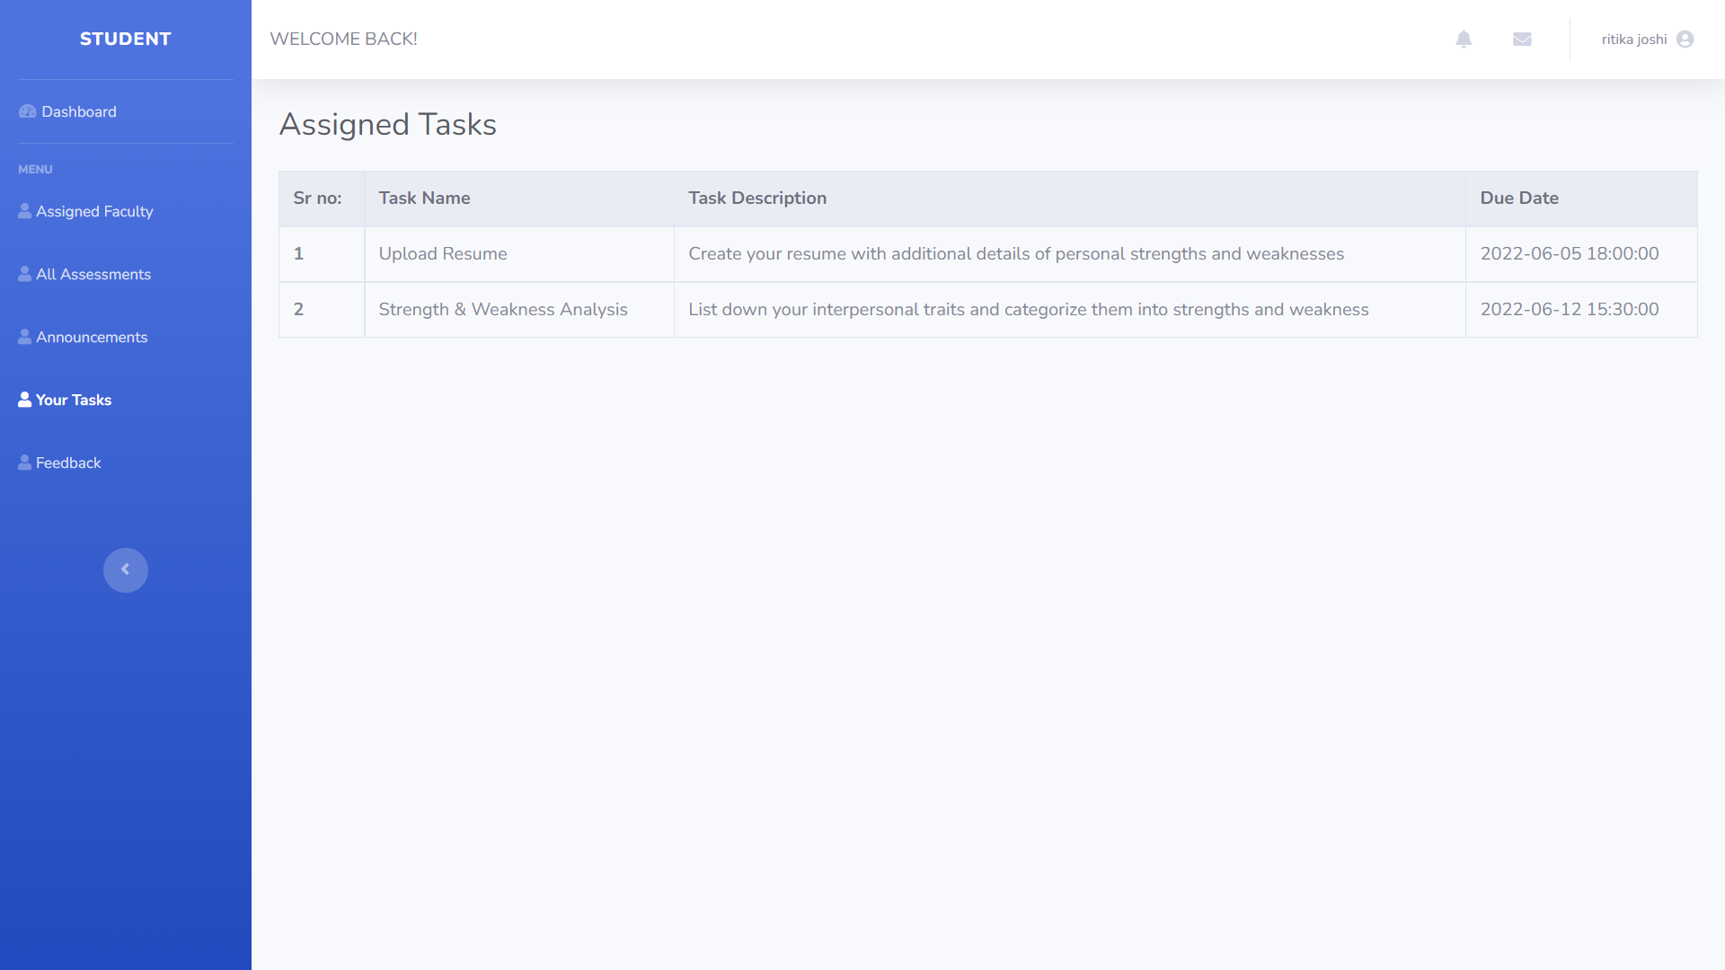
STUDENT DASHBOARD

Slide 25
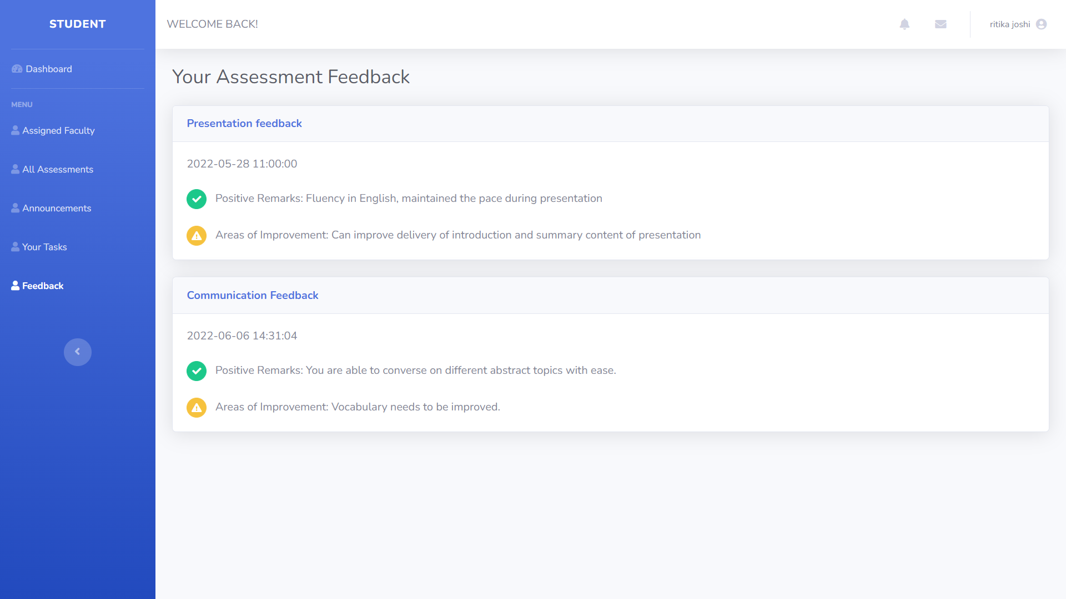
STUDENT DASHBOARD

Slide 26
CONCLUSION
The Soft skills assessment system is a user friendly system, which is very easy and convenient to use. The system is complete in the sense that it is operational and it is tested by entering data and getting the reports in proper order. But there is always a scope for improvement and enhancement. During the development of this,coding standards are followed for easy maintainability and extensibility.

