Slide 1
One-Shot Face Stylization Using GANs with AdaIN
Kushal Neupane
MSc IT (AI)
CC7009NI – Neural Networks and Deep Learning
Autumn 2025

Slide 2
Problem Statement & Motivation
Traditional style transfer is slow and style-specific
Face stylization must preserve identity
Need for real-time one-shot stylization

Slide 3
Project Objectives
Implement one-shot face stylization
Use Adaptive Instance Normalization (AdaIN)
Preserve facial identity
Evaluate using loss metrics and visuals

Slide 4
Adaptive Instance Normalization (AdaIN)
Aligns mean and variance of content features
Uses style statistics
Enables arbitrary style transfer

Slide 5
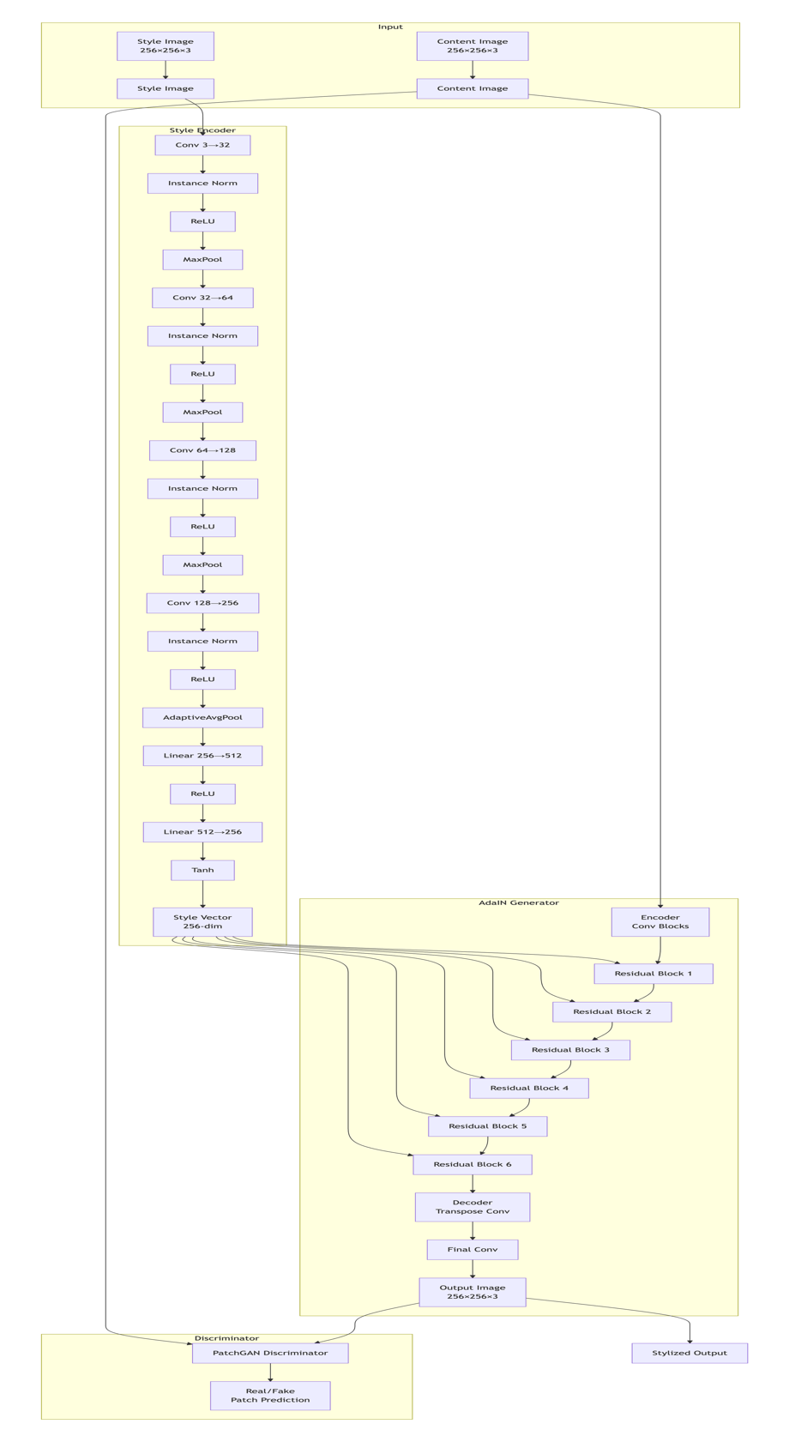
System Architecture
Style Encoder
AdaIN Generator
PatchGAN Discriminator

Slide 6
Training Configuration
Image size: 256×256
Batch size: 16
Epochs: 10
Optimizer: Adam
Device: Apple MPS

Slide 7
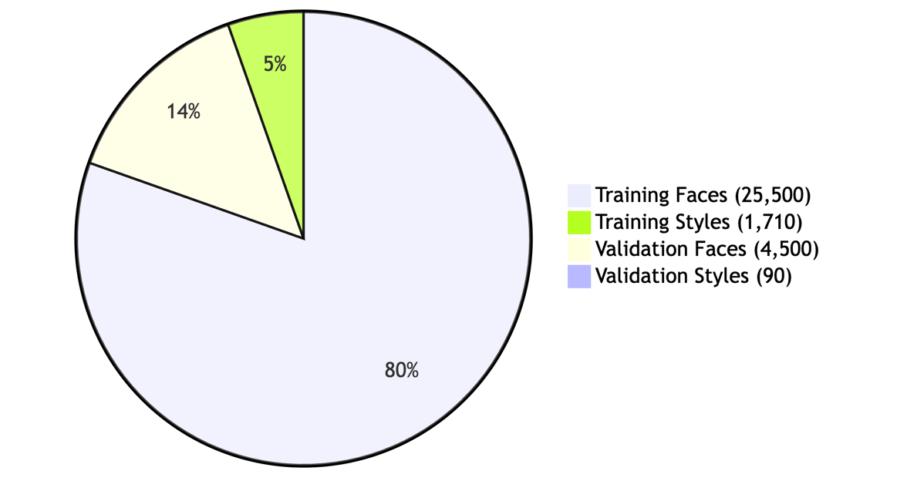
Dataset
CelebA face images
WikiArt styles
30,000 faces, 1,800 styles

Slide 8
Experimental Results
Best epoch: 8
Validation loss: 0.0670
Stable adversarial training

Slide 9
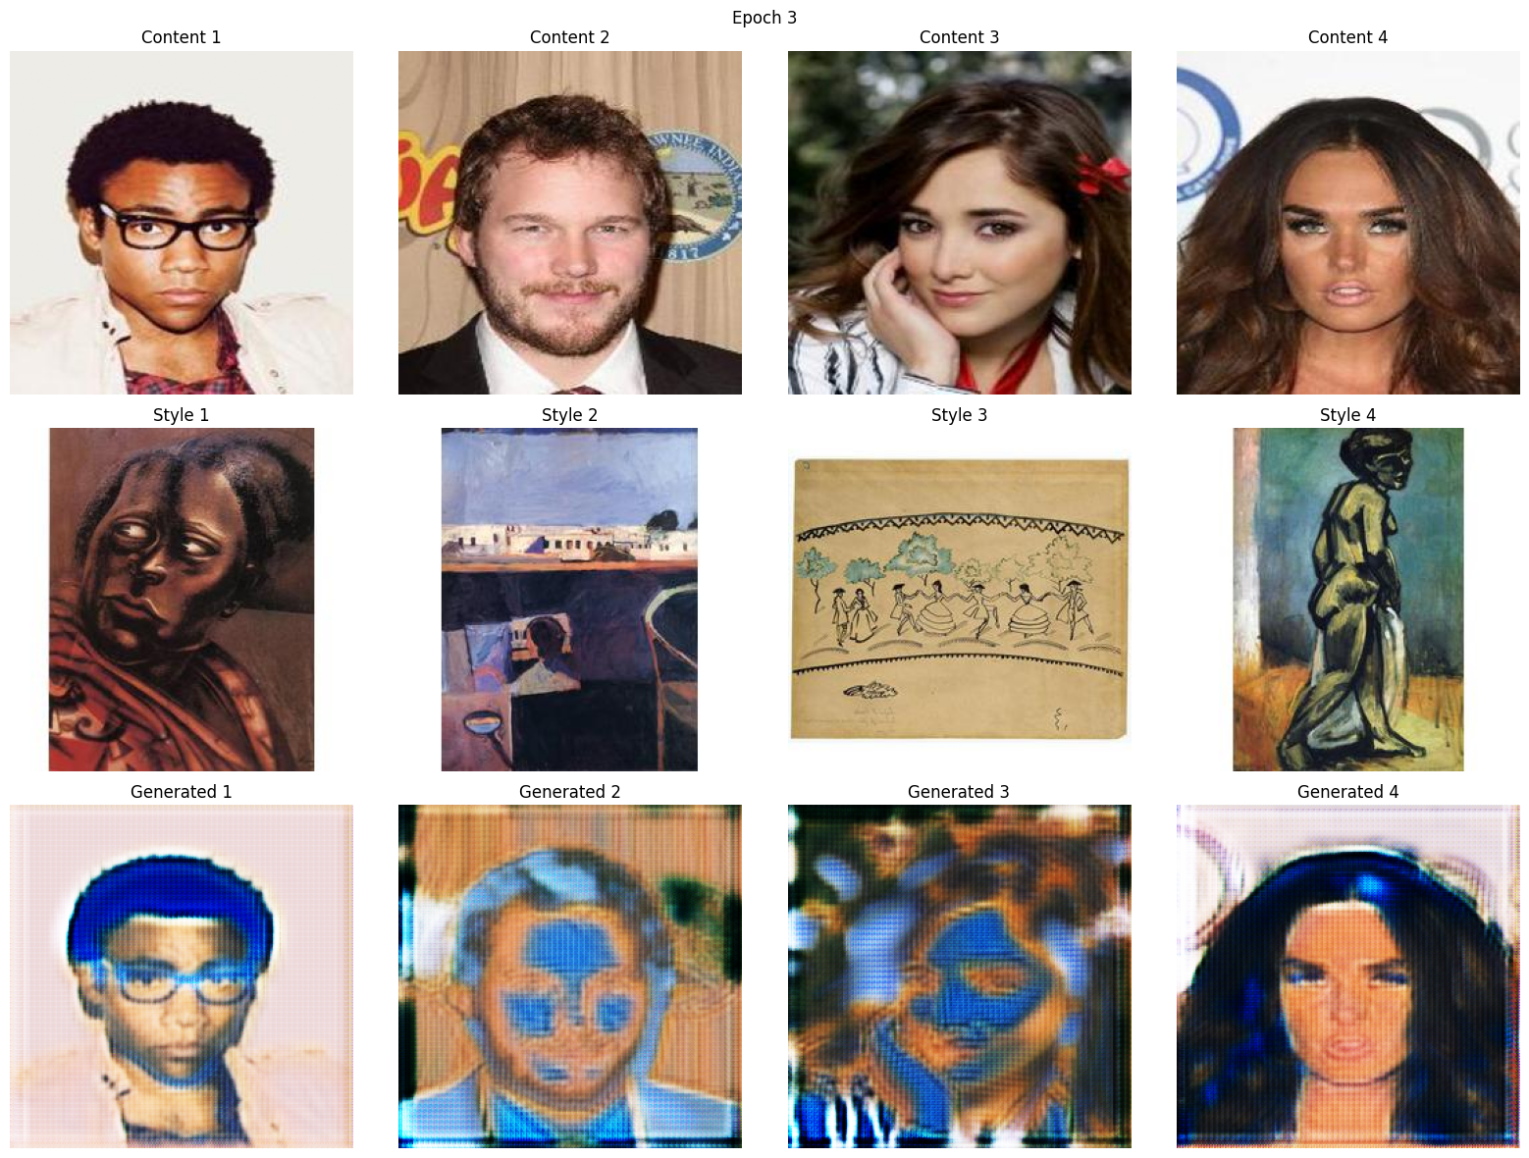
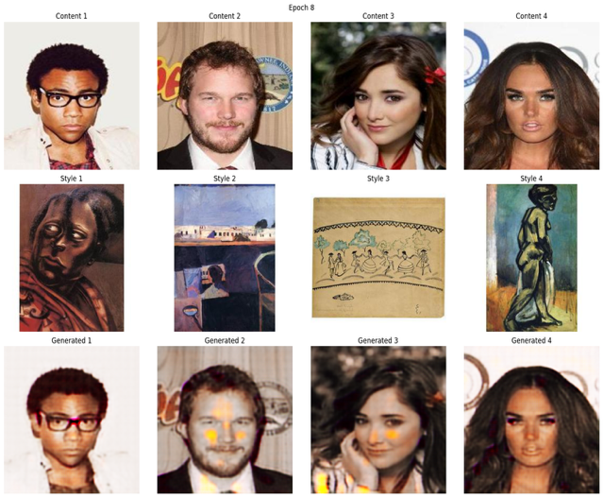
Visual Results
Weak Identity Loss
Strong Identity Loss

Slide 10
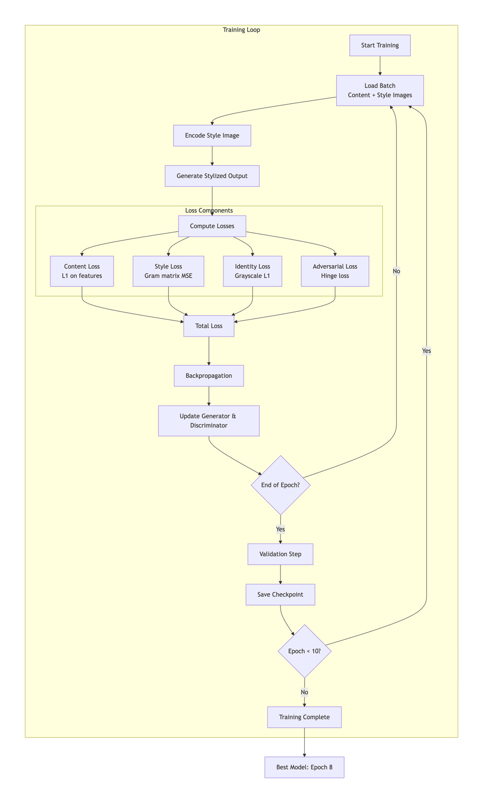
Training Pipeline
Load face & style images
Encode style
Generate output
Compute losses
Update networks

Slide 11
Technical Challenges
MPS limitations
Large model size
Long training time

Slide 12
Future Work
Multi-scale styles
Introduce user interface
Text based generator

Slide 13
Conclusion
Successful one-shot face stylization
Identity preserved

Slide 14

Thank You
Questions?

