Slide 1
Technology for Success: Computer Concepts

Slide 2
Module 9
Web Development

Slide 3

Lesson Objectives
Explain the uses of HTML5, CSS3, and JavaScript when developing websites
Explain strategies for creating and developing websites
Manage websites using analytics and data tools
Code and publish a website

Slide 4
Explain the Uses of HTML5, CSS3, and Javascript
Explain how to use HTML
Explain how to use CSS
Explain how to use JavaScript and scripting tools

Slide 5
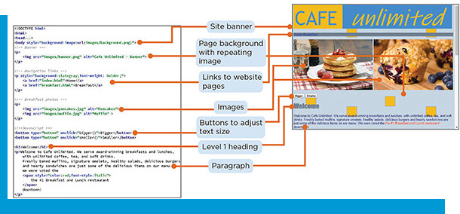
Explain How to Use HTML
A webpage contains tags written in HTML to describe the content of information
Webpages can contain headings, paragraphs, hyperlinks, lists, images, videos, forms, buttons, and other elements
HTML 5 is the current version
HTML code can be written by hand or by using tools

Slide 6
Explain How to Use CSS
CSS describes how content on a webpage will be displayed in a browser
Web developers use CSS to specify colors, position, alignment, fonts, background images, and other features

Slide 7
Explain How to Use JavaScript and Scripting Tools
JavaScript is a popular language for writing client-side scripts
Code written in JavaScript can check to make sure that you do not miss any of the required values

Slide 8
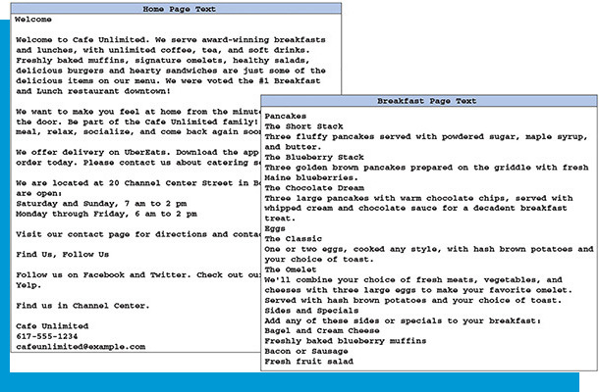
Explain Strategies for Creating and Publishing Websites
Describe when to use static and dynamic websites
Describe the importance of responsive design
Describe tools for creating websites
Use tools to aid hosting and publishing websites

Slide 9
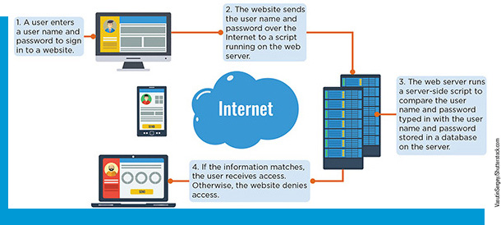
Statics and Dynamic Websites
Static websites provide basic information that is unlikely to change frequently and are usually coded in HTML
Dynamic websites are more complex and often are created using server-side scripting language

Slide 10

The Importance of Responsive Design
Pages with responsive design automatically adjust the size of their content to display appropriately relative to the size of the screen of the device on which it is displayed

Slide 11
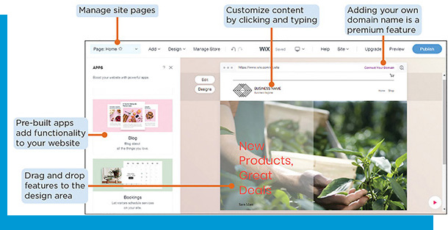
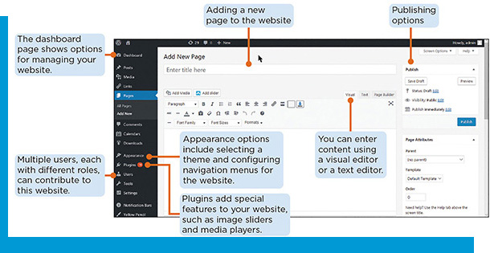
Tools for Creating Websites (1 of 3)
Website builder
Used to create professional looking websites, by dragging and dropping predefined elements to their desired locations on a page, without coding
Many include search engine optimization (S E O) capabilities
Content management system (C M S)
Allows one to create a more complex website with several contributors
Often open source applications

Slide 12
Tools for Creating Websites (2 of 3)
Table 9-1: HTML Comparing Website Builders and C M Ss
 | Website builder | Content management system
Examples | Google Sites, Wix, Weebly | WordPress, Drupal
Popular uses | Small businesses, personal websites, online stores | Blogs, websites for large businesses or organizations, online stores
Collaboration | Few contributors | Few or many contributors
Setup required | Little to none; can get a website up and running quickly | If self-hosted, need to manage and configure a web server and install software before designing the website, or use a fully hosted version for easier setup
Templates and themes | Available from provider | Available from provider or third-party designers free or for purchase
Ease of use | Enter content in a visual editor | Enter content in a visual or HTML editor
Customer support | Paid subscriptions provide tech support through chat or online forums | Self-hosted CMS users rely on a community of enthusiasts and online resources

Slide 13
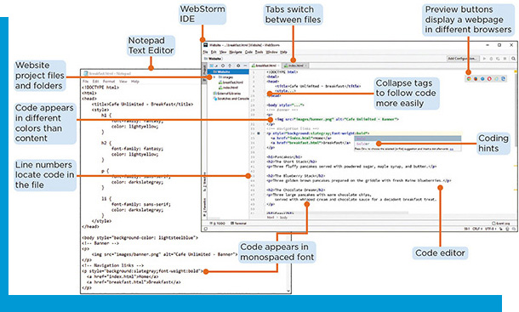
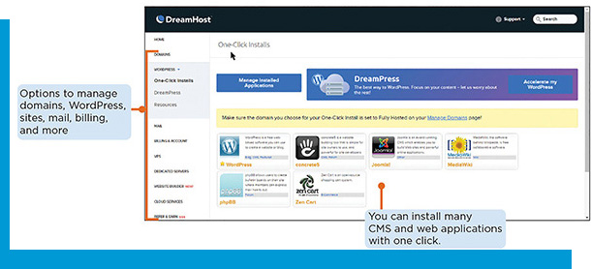
Tools for Creating Websites (3 of 3)
Text Editor
Can be used to type code for a website
Integrated Development Environment (I D E)
Combines advanced code editing and debugging, file management, and publishing tools to simplify the process of developing websites and applications
Most contain a code editor
Stores files and folders in your website in a project

Slide 14
Tools for Hosting and Publishing Websites
Select a domain name, perhaps for purchase from a domain registrar
When selecting a domain host:
Determine the amount of disk space needed
Determine the amount of bandwidth needed
Be sure that the operating system is compatible with software you want to host on the server
Check the host’s reliability (uptime)

Slide 15
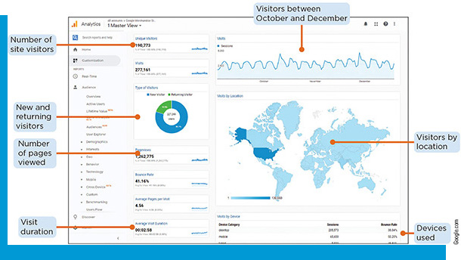
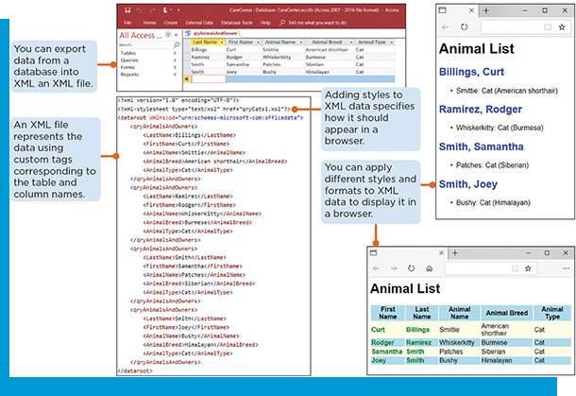
Manage Websites Using Analytics and Data Tools
Use analytics tools and track website usage
Leverage XML to update and structure data

Slide 16
Use Analytics Tools and Track Website Usage
Website analytics help one to understand how people use a website
Who visitors are
Where they are coming from
How they interact with the site
Google Analytics

Slide 17
Leverage XML to Update and Structure Data
Table 9-2: HTML Compared to XML
HTML | XML
Describes content and how to present it in a browser | Describes data without specifying how it will be presented
Stores layout information in a text format for a browser to interpret | Stores data in a text format to share between applications
Predefined tags describe placement of content on a webpage as a paragraphs, links, headings, images, and other elements | Customized tags describe data in context (LastName, FirstName, AnimalName, AnimalBreed, AnimalType)

Slide 18
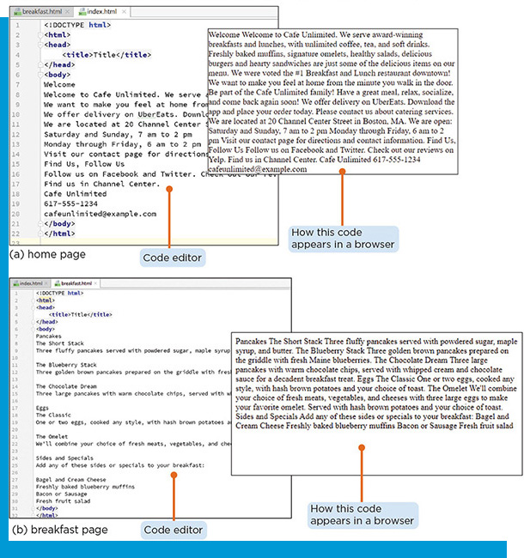
Code and Publish a Website
Describe steps involved when coding and publishing a website
Code a website

Slide 19
Steps Involved When Coding and Publishing a Website
Steps to code and publish a website:
Arrange and configure web hosting
Design the website
Create or obtain graphics and multimedia
Code each page
Preview the website in several browsers and devices with screens of various sizes to make sure the appearance and behavior is correct
Publish updated the website files to a server with F T P
View the published version of your website in one or more browsers to verify that all the files were updated correctly
Repeat steps 4–7 as you add more content to your website

Slide 20
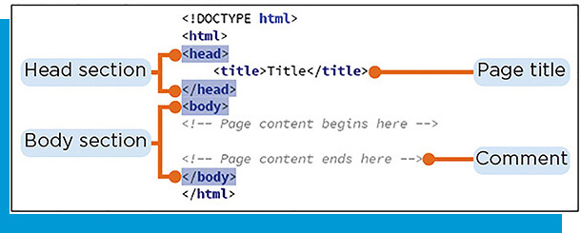
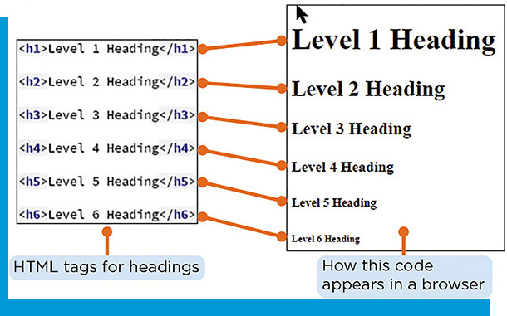
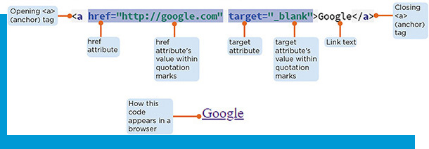
Code a Website (1 of 2)
HTML tags and attributes: written in lowercase characters, enclosed with angle brackets
Structure of an HTML page
Webpage files names

Slide 21
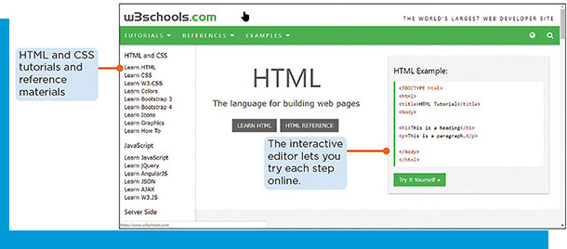
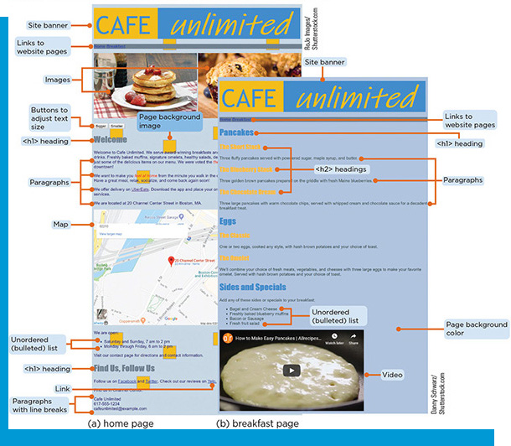
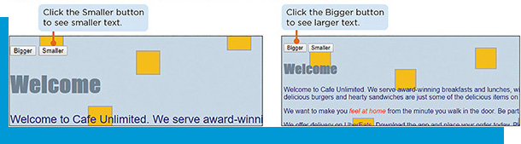
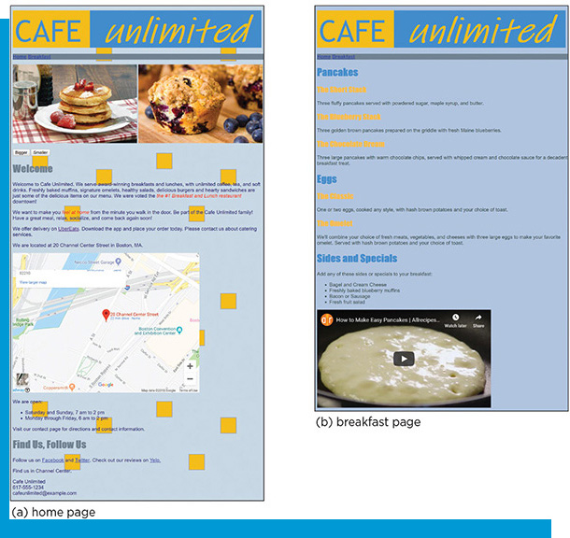
Code a Website (2 of 2)
Add titles, headings, paragraphs, and line breaks
Add images
Add links
Add unordered and ordered lists
Add multimedia content
Check the validity of the HTML code
Publish the website online
Modify the website’s appearance using CSS
Control the webpage using JavaScript

