Slide 1
Demand Forecast Executive Summary
Run: 20250812_200137
Records: 1000
Lookback: 12 | Horizon: 6

Slide 2
Key Performance Indicators
RMSE: 10.542 | MAE: 8.615 | MAPE: 2.535%

Slide 3
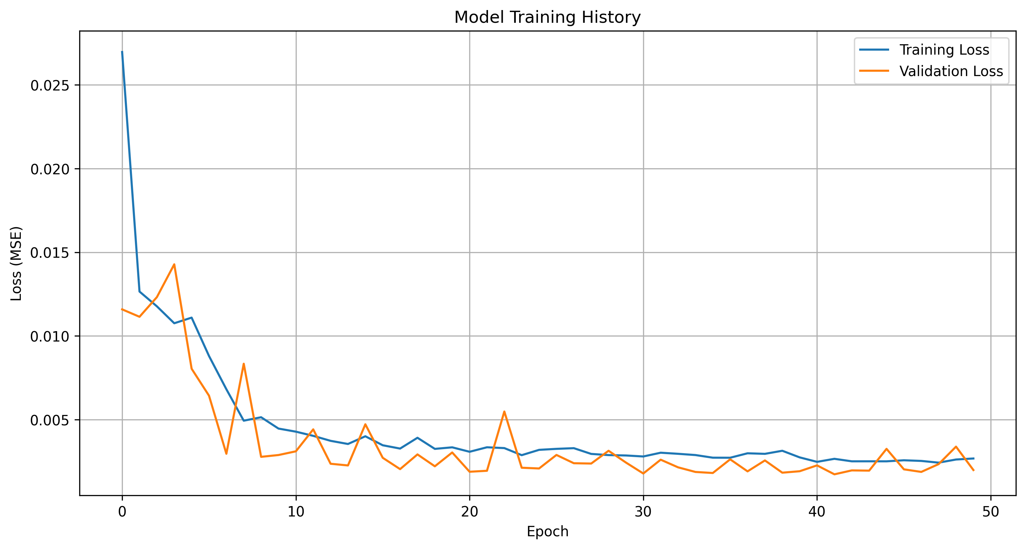
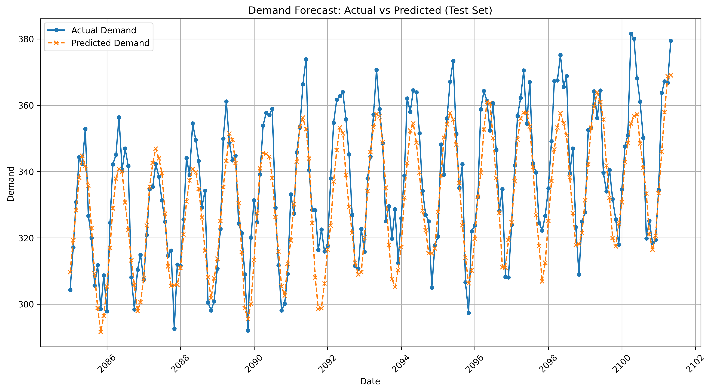
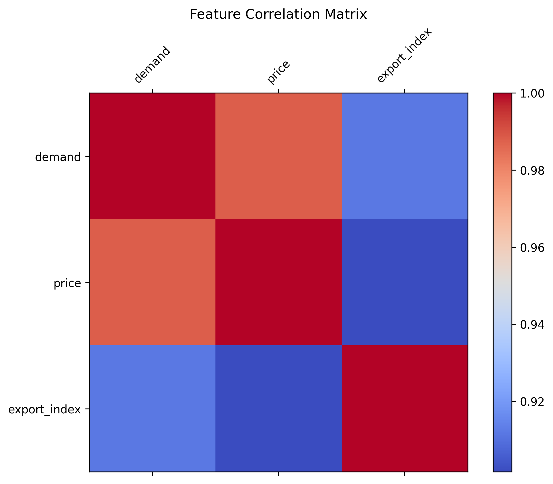

Slide 4
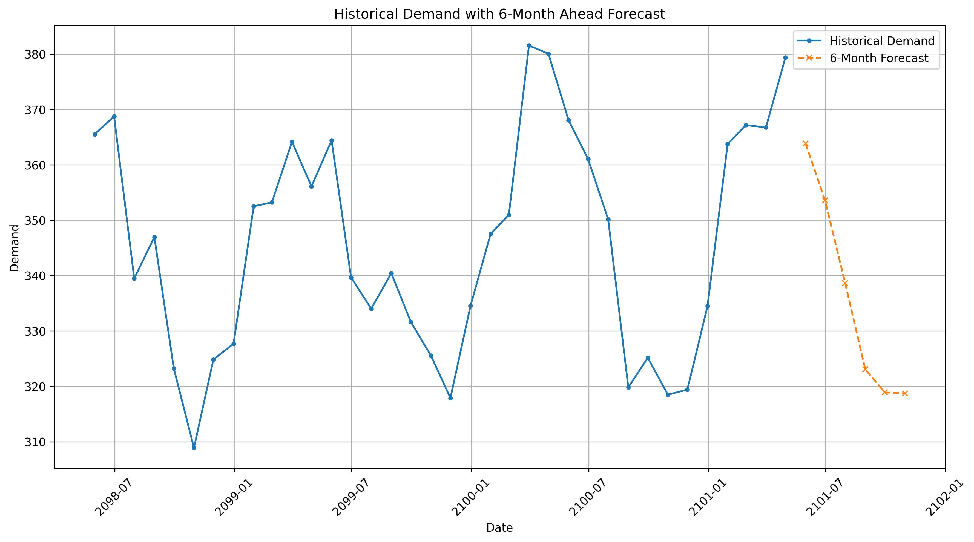
Forecast details: six_month_forecast_20250812_200137.csv

