Slide 1
DeepAxon
Simplified model training, segmentation, and morphometrics for bright-field microscope images

Slide 2
AxonDeepSeg
Segmentation for SEM and TEM
Difficult model training, making it inaccessible for the common user
New version involves 5-folds which takes significant time to segment each image
Utilizes U-net architecture

Slide 3
DeepAxon Overview
Train
Segment
Morphometrics

Slide 4

Training Flow
File setup
Image resizing
Patch generation
Training
Save model

Slide 5


File Setup
train
images
img1
img2
img3
masks
img1
img2
img3

Slide 6
Image Resizing
Original microscopy images
1024x1440
2048x2880
Resizes to square
1024x1024
2048x2048
Plan to change to rectangular shape to maximize image use for training
Limitation: the image must be cropped to dimensions divisible by 256x256

Slide 7

Patch Generation
Creates a folder of 256x256 patches
New folder structure
Going to modify so that it does not create new images but rather stores them in temporary memory

Slide 8
New Folder Structure
train
images
cropped
patches
img1_01
img1_02
img1_11 …
img1
img2
img3 …
img1 …
masks …

Slide 9
Training
Unet++ architecture
Can customize batch size and epochs
Will determine how long training takes and how good the trained model is
For simpler images – use lower batch size and fewer epochs
For worse stains – use medium batch size and higher epochs

Slide 10
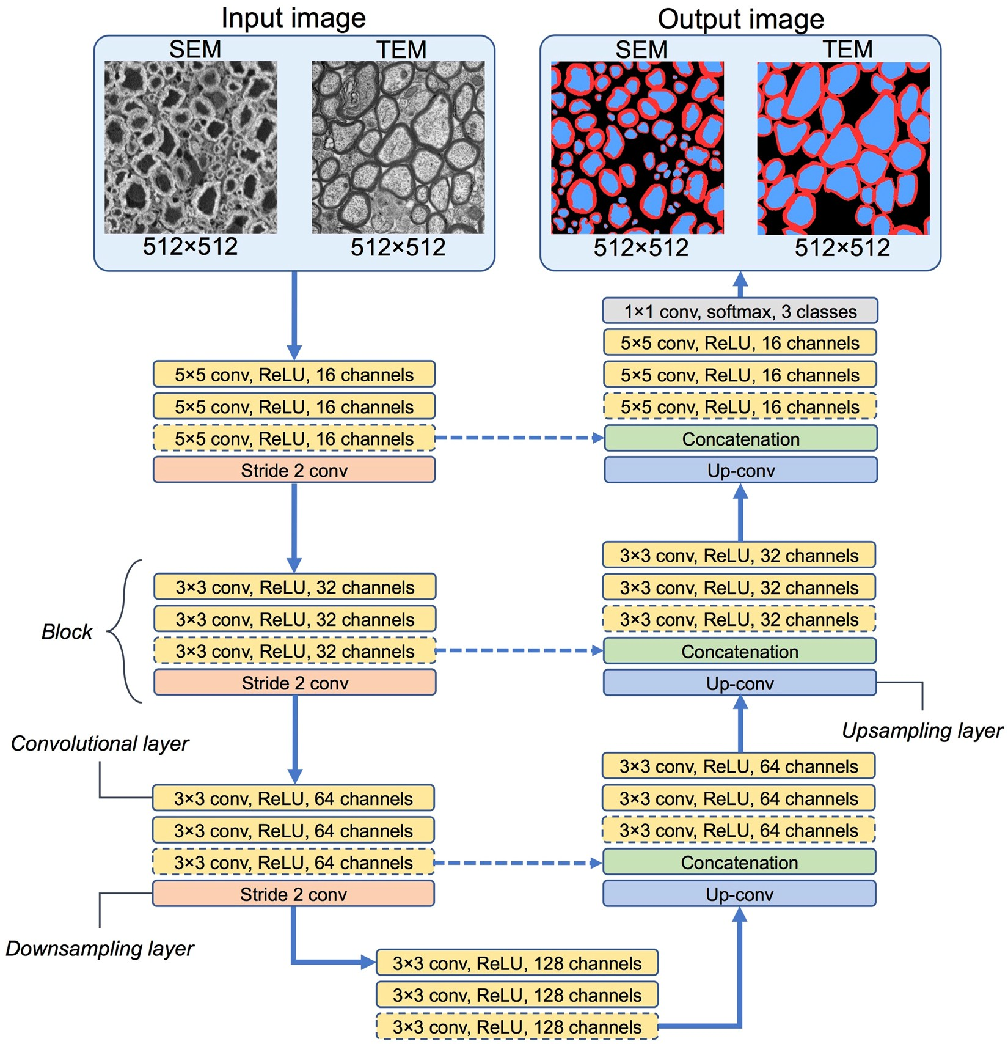
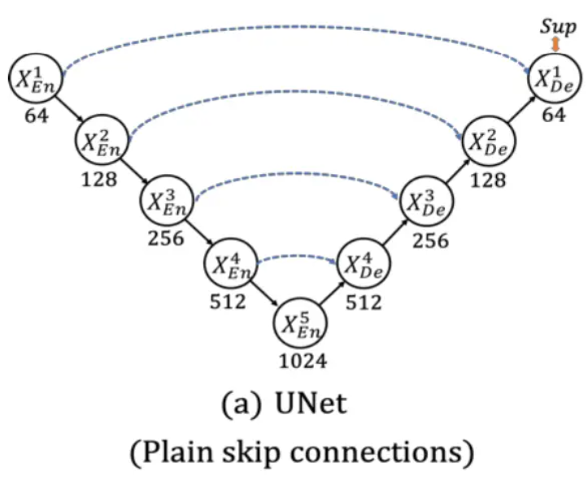
ADS Architecture

Slide 11
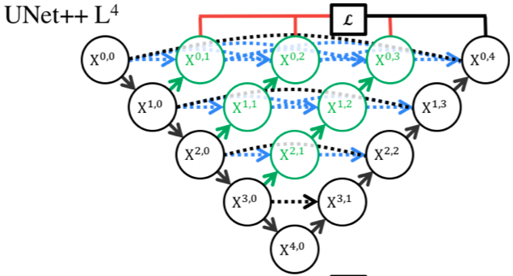
DeepAxon Architecture (UNet++)

Slide 12
Training
Currently done through Python
Goal: Make command line interface → GUI interface

Slide 13
Segmentation Flow
Cropping
Patch Generation
Segmentation
Stitching

Slide 14
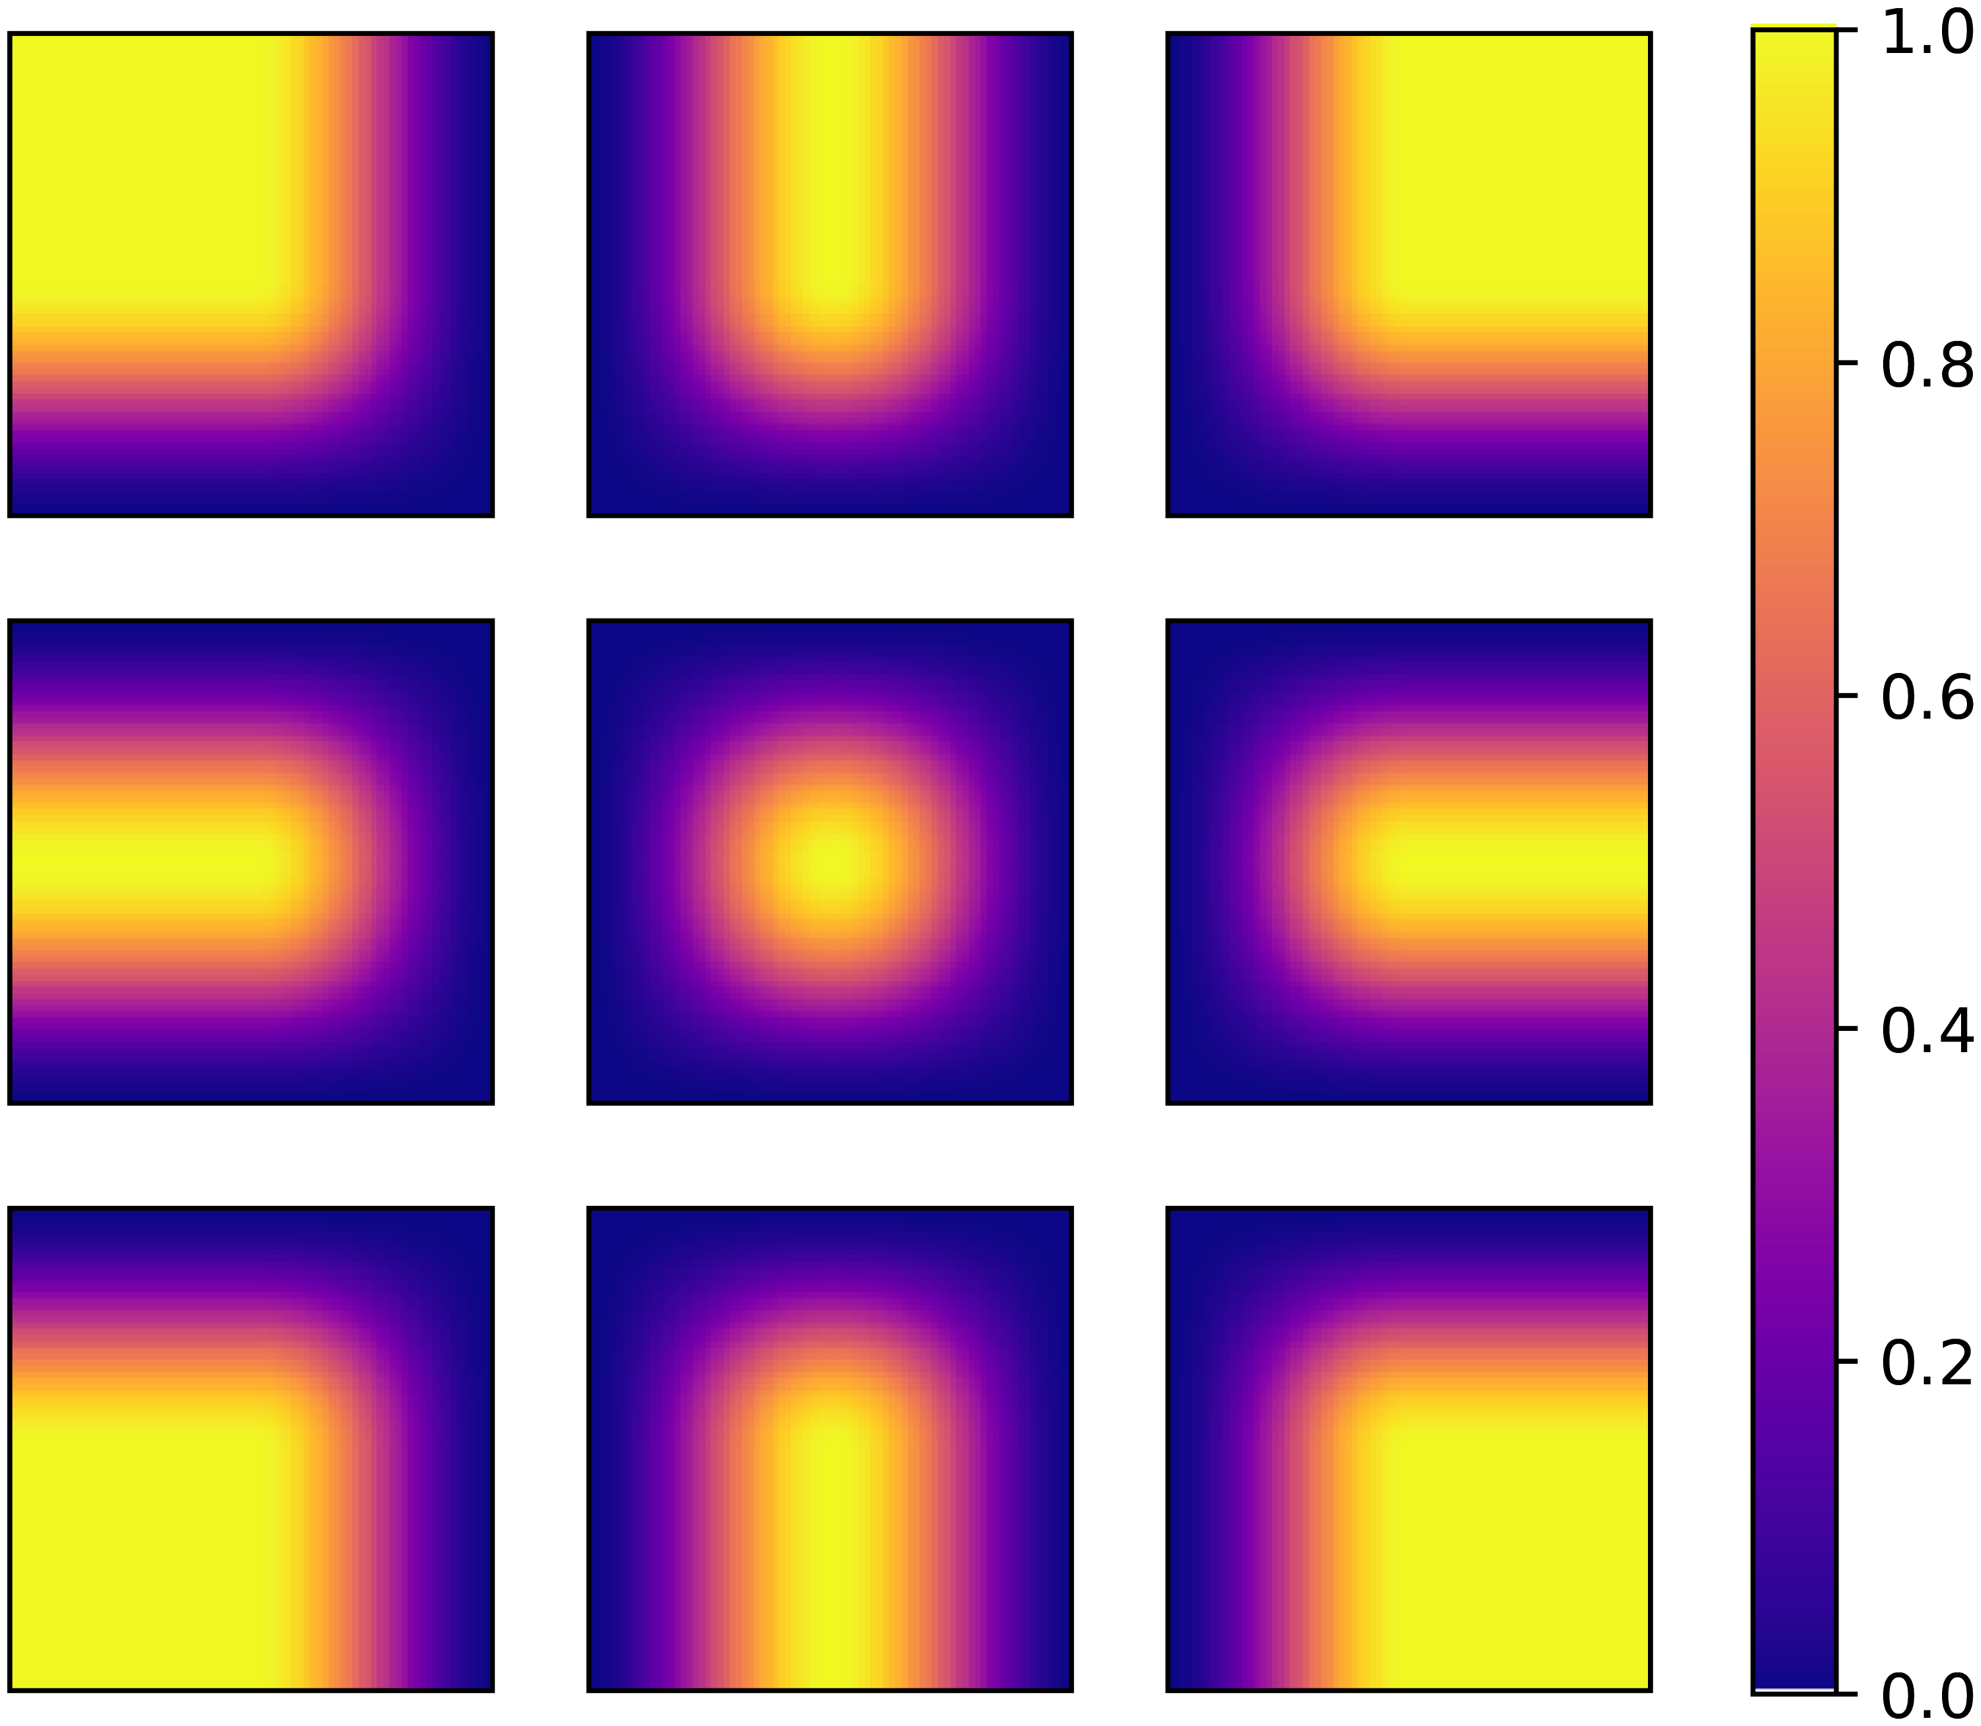
Stitching Using a Hann Window

Slide 15
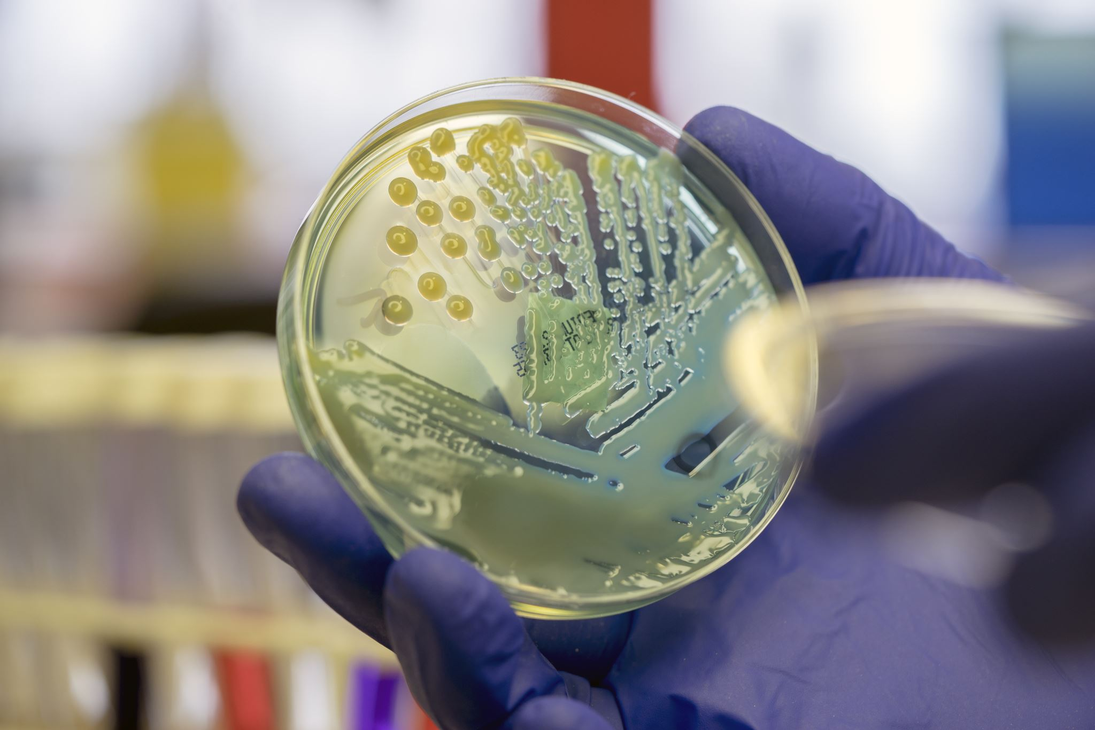
Morphometric Analysis

Slide 16
Pitfalls/Particulars of ADS Morphometrics
Elliptical waterfall segmentation
Causes irregularly shaped axons to be split
Leads to low gratios
Axon diameter is determined along elliptical minor axis

Slide 17

DeepAxon morphometrics
Waterfall based on distance instead of shape
Lower axon count (more accurate?)
Higher gratio values
Currently using major axis (can switch to minor axis if that is preferred)

Slide 18
Next Steps
Image Augmentation
Better models with a lower # of images
Model accuracy measures
Dice, IOU, etc. to quantify validity
Manual segmentation to create models
Classify in groups based on image quality
Play around to see segmentation quality based on training set size
Integrate with BatchAxon
Can be done easily
Need to go over desired folder structure

Slide 19
Morphometric validation w/ current program
Morphometric analysis with axis grouping
Morphometrics with Charles dataset

