Slide 1
TRACE-X
CYBER FORENSICS · ICA GROUP PROJECT · 2026–27
52b974b6
LOGIN
6ce34350
FILE_ACCESSED
be7ade1f
FILE_COPIED
Temporal Relationship Analysis & Correlation Engine for Digital Forensics
73b397f0
DEVICE_CONNECTED
a896ffab
DEVICE_DISCONNECTED
Validation of an explainable anti-forensics detection and correlation prototype
b5530e93
FILE_DELETED
99cf0fca
LOG_CLEARED
Hiya Navalakha
Kushagra Sinha
Dr. Abhishek Vichare
B083 · B.Tech CE
B127 · B.Tech CE
Faculty
e987bfc2
FILE_MODIFIED
Submitted 27 October 2026
Notes:
TRACE-X is a forensic engine we built ourselves and then used as the subject of our investigation. The column on the right is the real eight-event evidence trail from our case, listed by evidence ID.

Slide 2




Anti-forensics hides the trail from investigators
// THE PROBLEM
Evidence is deleted
Logs are cleared
Timestamps are forged
Files are copied out, then the original is removed to hide what was taken.
The audit trail is wiped so the session leaves no record behind.
File times are rewritten ("timestomping") so the timeline lies.
The gap
Each step looks innocent on its own. A plain timeline lists the events but doesn't link them, and black-box scores can't be defended in a report.
Notes:
Three classic anti-forensic moves. Individually they look routine. Together they look like concealment, and that's the connection a tool needs to surface and explain.

Slide 3



We built the forensic engine, then investigated with it
// OUR APPROACH
01
02
03
Build
Validate
Generalise
TRACE-X: parsers, 5 anti-forensics rules, a correlation engine, chain detection and an investigator dashboard.
6 synthetic scenarios with known ground truth, so every result can be checked against a correct answer.
2 real, public forensic artefacts with no answer key, to see if the behaviour holds outside the lab.
FIVE QUESTIONS WE SET OUT TO ANSWER
Q1
Detection
Q2
Explainability
Q3
Restraint
Q4
False positives
Q5
Generalisation
Better than a timeline alone?
Is every score explainable?
Does it avoid over-claiming?
Reported honestly?
Does it hold on real data?
Notes:
Unlike a typical case study, we didn't just run Autopsy on an image. We built the engine, validated it where the right answer is known, then checked it on real evidence. The five questions frame everything; we answer each at the end.

Slide 4






An insider-concealment scenario with known ground truth
// THE CASE
Access
Copy
USB
Delete
Clear log
Modify
secret.txt
stage a copy
connect device
the original
Windows audit
file metadata
CASE PARAMETERS
Why a synthetic case?
Actor
alice @ HOST-01
Generator
synth_generator.py
No real incident was reported to us. Building the case ourselves means we know the right answer, so every detection can be marked right or wrong. Real evidence comes later, to check the results hold up.
Seed
7 (reproducible)
Clock
All times UTC
Data
Fictitious, no real PII
Notes:
The story: Alice opens a sensitive file, copies it to USB, deletes the original, clears the audit log and modifies metadata. A deliberate concealment pattern, generated with a fixed seed so anyone can reproduce it.

Slide 5




Three evidence items: one with ground truth, two real
// EVIDENCE & PRESERVATION
EV-01
EV-02
EV-03
Synthetic 'combined' scenario
M57-Patents USB image
EVTX-ATTACK-SAMPLES
8 canonical events
NTFS E01 · 128 files · 9.27 MB
System-log clear · 69.6 KB
synth_generator.py, seed 7
SHA-256 7A998C55…FB40A
SHA-256 5579CDCA…C558C2AF
Generated 26 Sep 2026
Digital Corpora · 27 Sep 2026
GitHub (GPL-3.0) · 27 Sep 2026
GROUND TRUTH
REAL · NO LABELS
REAL · ISOLATED EVENT
CHAIN OF CUSTODY FOR REAL EVIDENCE
Download once
Hash on receipt
Store read-only
Re-verify before reuse
Notes:
Only EV-01 has a known answer. EV-02 and EV-03 come from corpora published for forensics research and were used under their terms. Both were hashed on download and re-verified before every use.

Slide 6





From raw artefacts to an explained hypothesis
// HOW TRACE-X WORKS
Sources
Parsers
Event store
Analysis
Dashboard
Event logs (EVTX)
NTFS $MFT
Browser history
USB / registry
python-evtx
dissect.target
python-registry
SQLite readers
One shared schema
SHA-256 per record
Source & parser kept
Sorted, de-duplicated
5 detection rules
Pairwise correlation
Chain detection
Timeline & findings
Entity graph
Cited report
EVERY OUTPUT CARRIES ONE OF THREE LABELS
What the artefacts directly show.
A measured link between two events.
An interpretation + what it does not prove.
● Evidence
● Correlation
● Hypothesis
Notes:
Every source is parsed into one shared event format, with a hash and its provenance kept per record. Rules, correlation and chains run on that store, and the dashboard shows the result. The three labels are how we keep observation separate from interpretation, which is the heart of Q3. Everything is open-source and runs offline on a laptop.

Slide 7
Every score can be rebuilt by hand
// EXPLAINABLE SCORING
CORRELATION SCORE · WORKED EXAMPLE
SUSPICION SCORE · log_clearing
FILE_ACCESSED ↔ FILE_COPIED 2 min apart
0.98
● HIGH
Time proximity
30 × (1 − 2/30)
+28
Same user
alice = alice
+20
relevant_prior_activity
1.00
Same file
secret.txt
+20
short_temporal_distance
0.95
Same device
HOST-01
+15
Same process
no match
0
multiple_related_events
1.00
evidence_directly_affected
1.00
= 83%
matches the dashboard exactly
Four named indicators, weighted and summed. No hidden model.
Notes:
This answers Q2. Correlation: five weighted factors, with time proximity decaying linearly across the 30-minute window. Two minutes apart gives 28 of 30 points; same user, file and device add 55; total 83%, exactly what the dashboard shows. The same arithmetic reproduces the other pairs: 6 minutes gives 79%, 8 minutes gives 77%. Suspicion scores combine four named indicators the investigator can inspect.

Slide 8
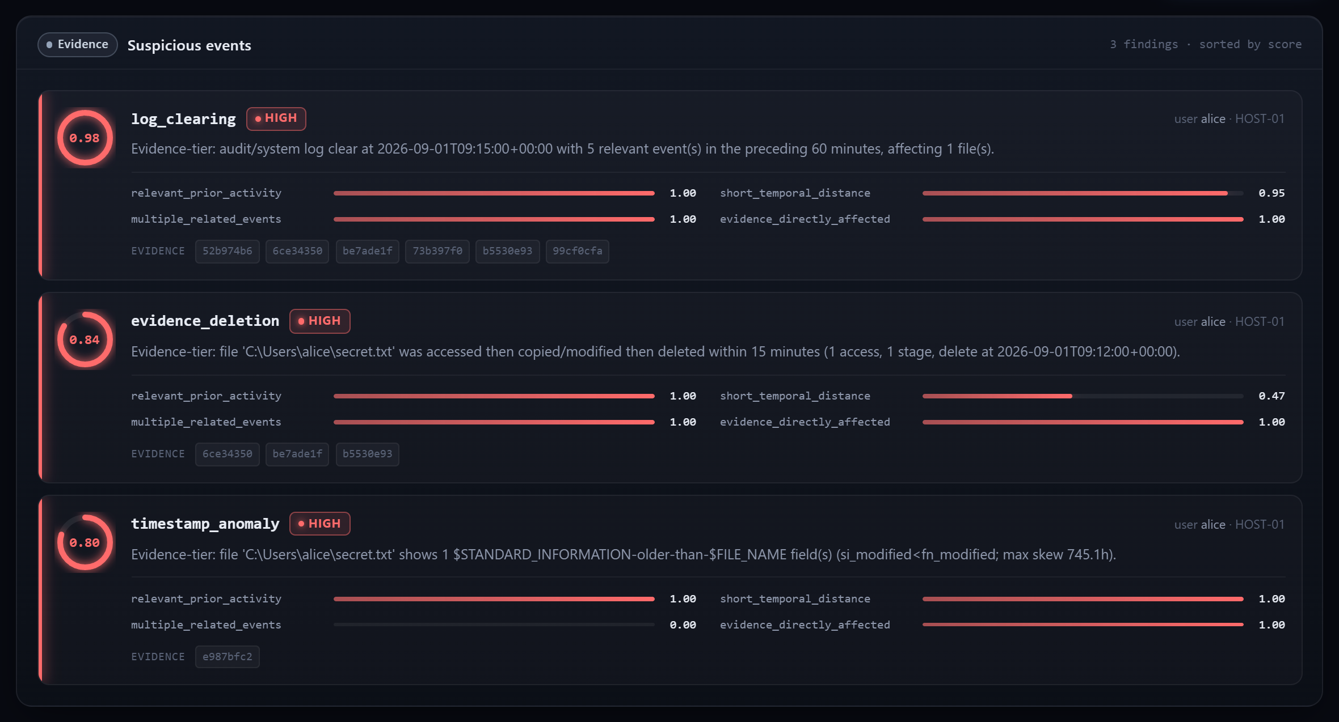
Three anti-forensic rules fired on the case, all HIGH
// STEP 1 · DETECTION
WHY A TIMESTAMP CAN BETRAY TAMPERING
NTFS stores each file's times twice:
$SI
$STANDARD_INFORMATION
Easy to rewrite with common tools
$FN
$FILE_NAME
Set by Windows itself, hard to fake
$SI older than $FN suggests someone backdated the file. Here the skew was 745.1 hours.
Supports a concealment-like pattern. It does not prove who did it, or why.
Findings tab: each rule, its score, and the four indicators behind it
Notes:
Three rules fired: log clearing at 0.98, evidence deletion at 0.84 (secret.txt accessed, copied and deleted inside 15 minutes) and timestamp anomaly at 0.80. The panel explains the timestamp rule, since it's the least intuitive: $SI times can be rewritten from user space, $FN times are maintained by the kernel, so $SI being older is the classic timestomping signature.

Slide 9
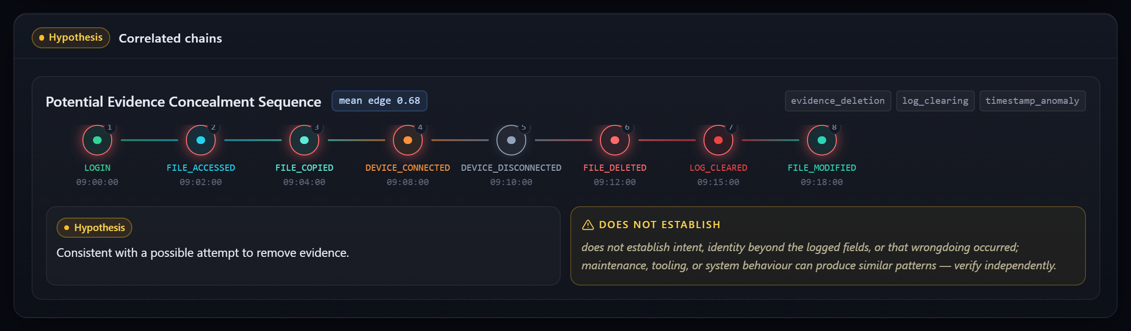
Linked events became one hypothesis, with its limits attached
// STEP 2 · CORRELATION → CHAIN
0.68
mean link score
8 of 8 events in the chain, 3 rule families cited
HOW A CHAIN FORMS
1
Score all 15 event pairs; keep links of 0.6 or more
2
Keep only paths that touch a rule finding
3
Label the path and state what it does not prove
Notes:
Correlation links pairs of events; the strongest were access to copy at 83% and delete to modify at 79%. Links of at least 0.6 that touch a finding are chained. The result is 'Potential Evidence Concealment Sequence', and the UI puts its limitation right next to it: it does not establish intent, identity or wrongdoing. That's our clearest answer to Q3.

Slide 10
Eight events in eighteen minutes
// RECONSTRUCTED TIMELINE · 2026-09-01 UTC
09:00
09:02
09:04
09:08
09:10
09:12
09:15
09:18
LOGIN
FILE_COPIED
DEVICE_DISCONNECTED
LOG_CLEARED
user alice
83% linked to access
same device
3 min after delete
log clear
FILE_ACCESSED
DEVICE_CONNECTED
FILE_DELETED
FILE_MODIFIED
secret.txt
SanDisk USB
secret.txt
$SI/$FN skew
deletion
timestamp
3
independent rules point at the same file and window
5/8
events linked at 75% or more to a neighbour
0
unobserved gaps over 30 min: nothing is guessed
Notes:
No single event supports a concealment story. The strength comes from three things together: the events are close in time, they share the same user, file and device, and three separately designed rules converge on them. Red tags show where each rule fired.

Slide 11
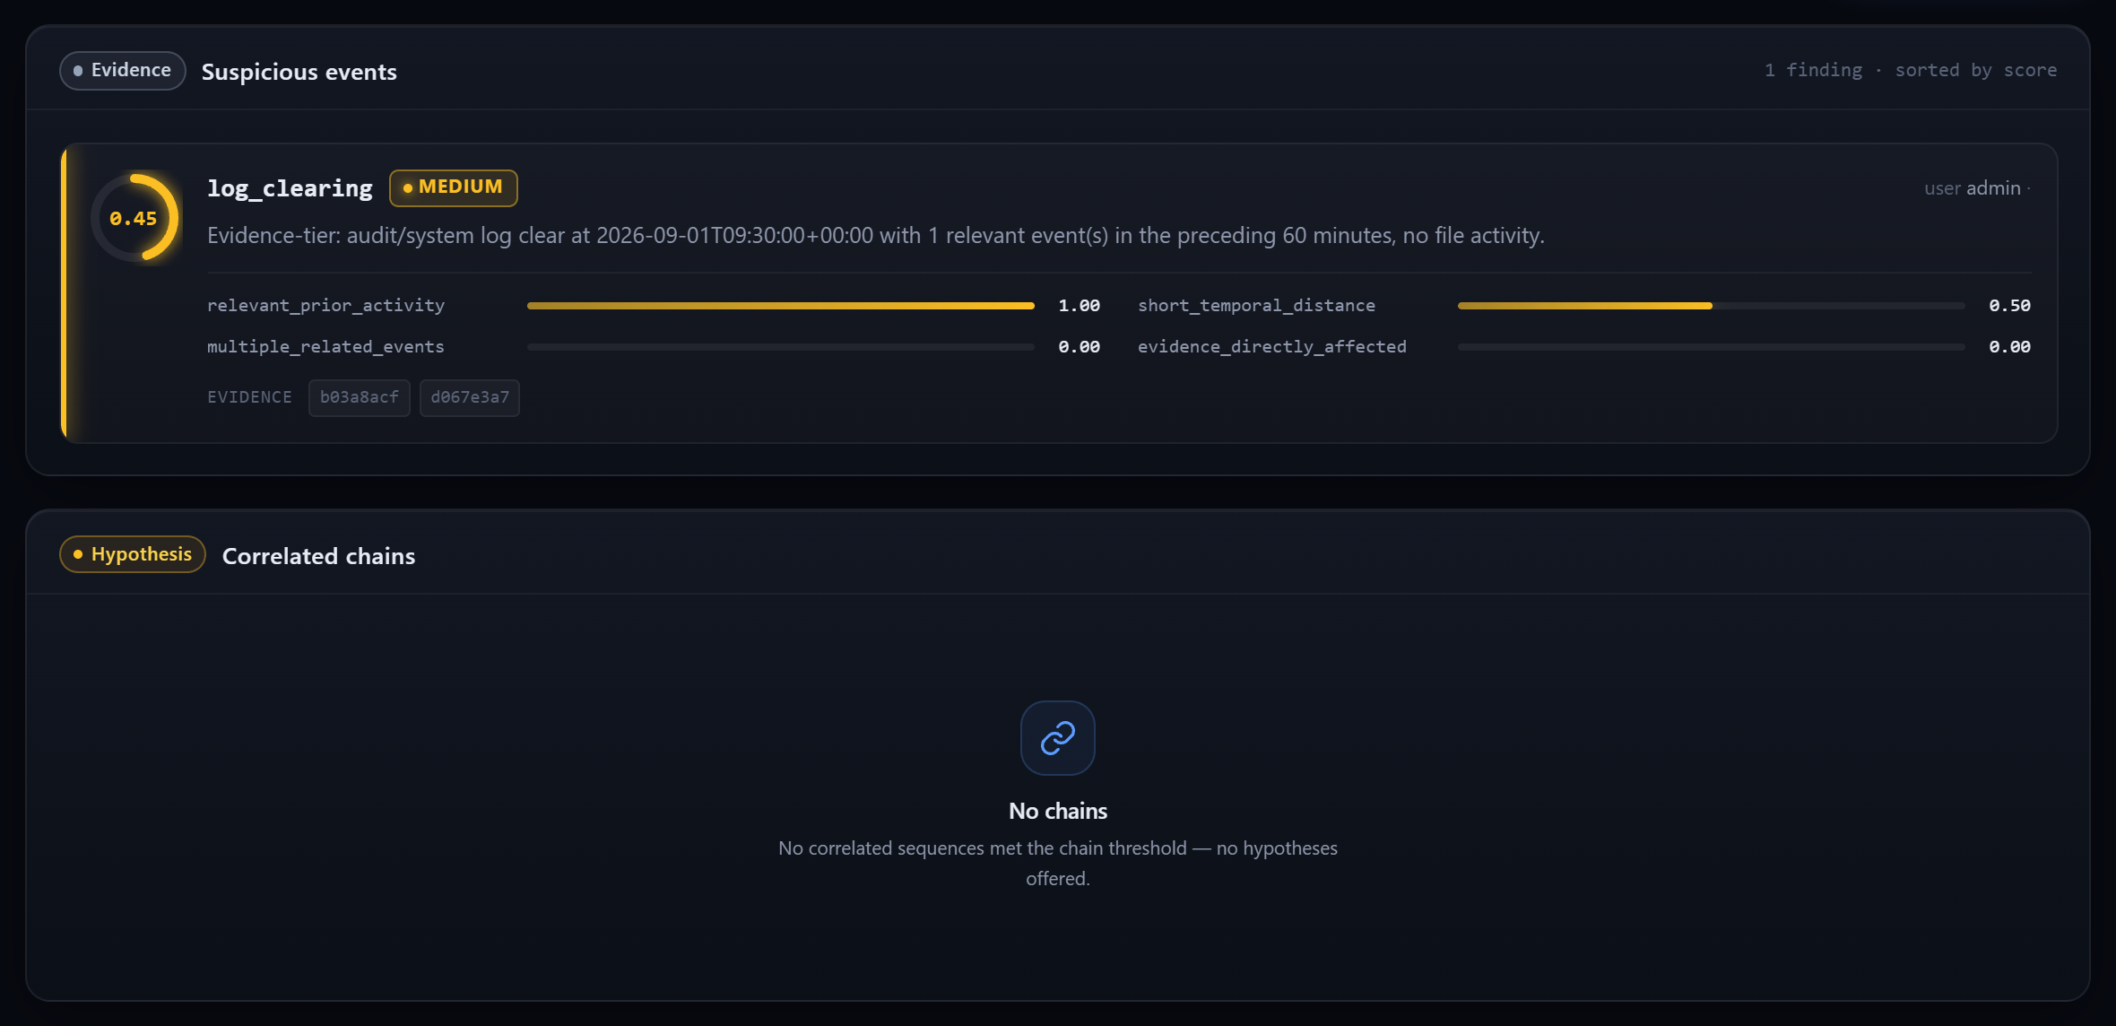
A legitimate admin log clear is flagged, but never escalated
// STEP 3 · FALSE-POSITIVE STRESS TEST
THE TEST
An admin clears logs during planned maintenance (change ticket CHG-2026-0901). Innocent, but it looks bad.
WHAT HAPPENED
Rule fired at 0.45 (MEDIUM)
We counted it against ourselves: 1 false positive of 7
No chain, no accusation; ticket kept for review
Notes:
We deliberately built a scenario that looks bad but is legitimate. The pattern really is present, so the rule fires, and our evaluation counts that as a false positive. What matters for Q4 is that it's reported honestly and never turned into an accusatory chain.

Slide 12
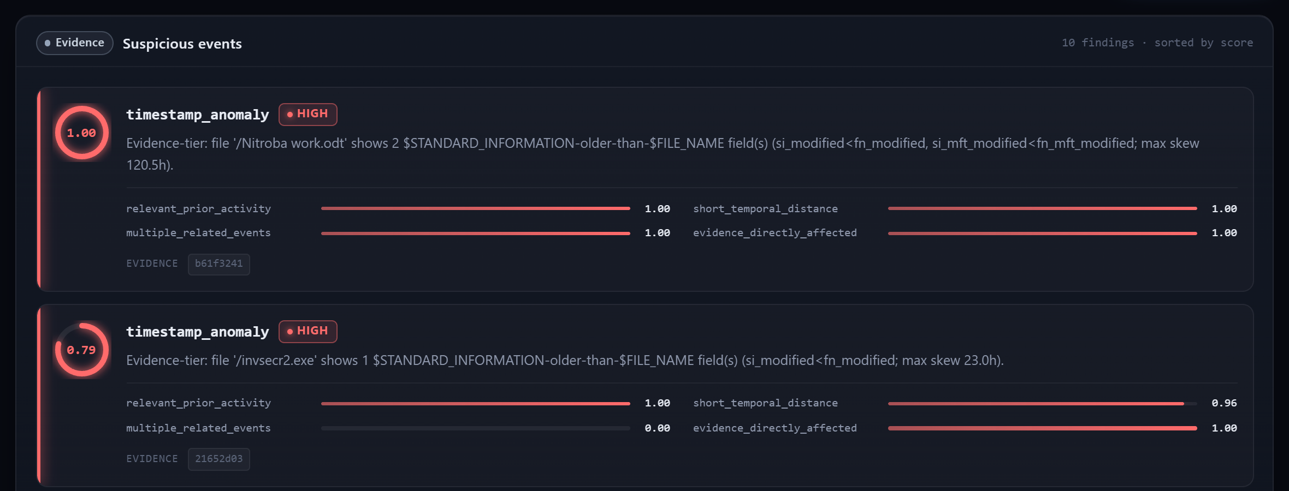
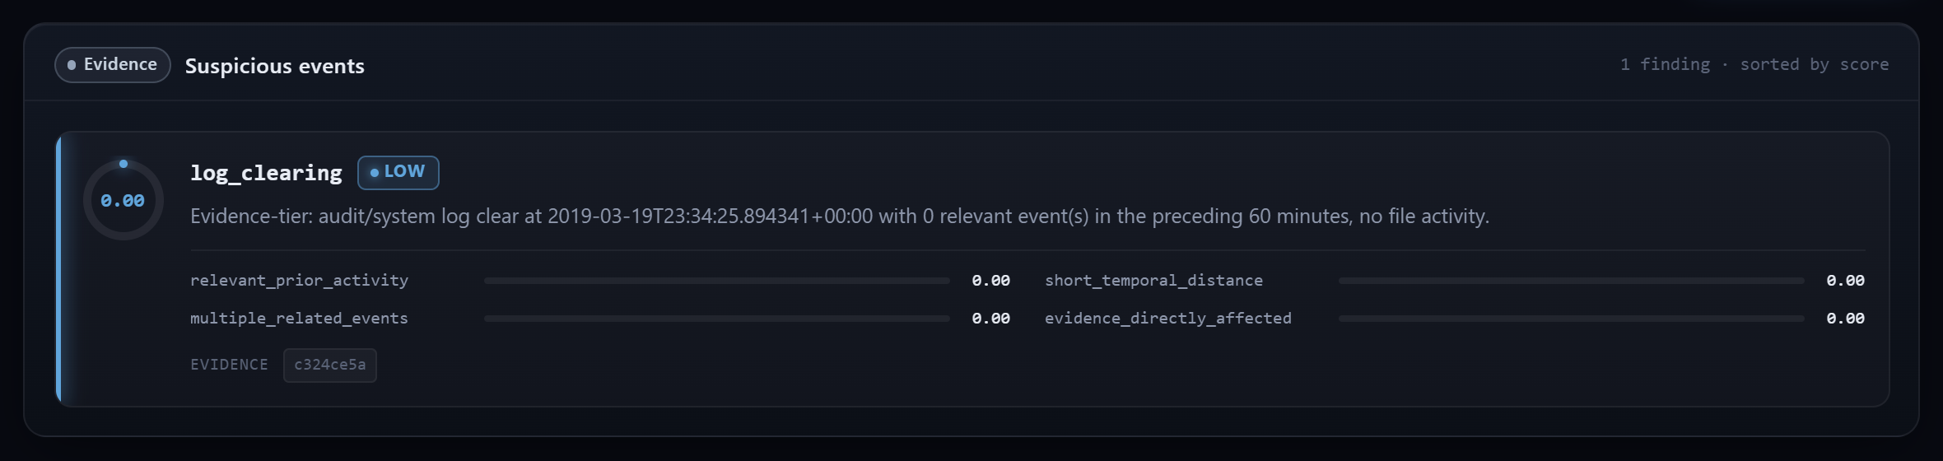
On real data, the engine flagged without over-claiming
// STEP 4 · REAL EVIDENCE
EV-02
M57-Patents USB image
EV-03
Real log-clear EVTX
128
10
0
1
0.0
LOW
events
flags
chains
event
score
level
Flags were $SI/$FN mismatches from an ordinary file copy (copying resets $FN), not tampering. With no second rule to back them up, no hypothesis was made.
A log clear with no surrounding activity. It was recorded for audit, but there was no context to make it suspicious.
Notes:
EV-02: the top flag scored 1.0 on 'Nitroba work.odt'. On manual review, the pattern is the well-known signature of a cross-volume copy. The engine flagged it for review but formed no chain, which is the right behaviour. EV-03: one real Event ID 104 record, scored 0.0 because nothing surrounds it. Both show the restraint we saw on synthetic data carries over to real evidence (Q5).

Slide 13
Detection is strong; correlation precision is the weak spot
// EVALUATION · 6 SYNTHETIC SCENARIOS
1.0 vs 0.0
Recall vs plain timeline
A timeline alone flags nothing. The rules caught every planted indicator.
0.404
Correlation precision
Many false links are background events sharing a user and host. 0.6 is a tunable threshold.
1.0 · 33/33
Ordering · tests
Event order rebuilt perfectly, none missing; all automated tests pass.
Notes:
Detection recall is 1.0 with precision 0.857 and F1 0.923. A timeline-only baseline has recall 0, because a timeline doesn't flag anything by itself. Correlation at the default 0.6 threshold is weaker: precision 0.404, recall 0.75. Most false links are same-user, same-host background events, which is why we treat the threshold as something to tune per case.

Slide 14
All five questions answered, with caveats stated
// CONCLUSION
Q1
Detection
Recall 1.0 for the layered pipeline vs 0.0 for a timeline alone.
YES
Q2
Explainability
Every score is a weighted sum of named factors you can rebuild by hand.
YES
Q3
Restraint
Evidence, correlation and hypothesis kept apart; each hypothesis states its limits.
YES
Q4
False positives
They happen, and they're reported in the results rather than hidden.
HONEST
Q5
Generalisation
Restraint held on real evidence. *Small real sample, no answer key.
YES*
Notes:
Closing the loop on the five questions. Nothing here goes beyond the cited evidence; no finding establishes any individual's intent or guilt.

Slide 15
What we can't claim yet, and how we'd fix it
// LIMITATIONS → NEXT STEPS
LIMITATION
NEXT STEP
Ground truth only for synthetic data
Build an answer key for a real corpus (e.g. NIST CFReDS)
Small real sample: 1 USB image, 1 EVTX
Add Windows XP .evt parsing to unlock the M57 workstation images
Correlation precision 0.404 at 0.6
Tune the threshold per case and report it with results
Speed benefit only piloted
Run the timed study with a second investigator
No live seizure or write-blocking
Add formal custody procedures before real-world use
Notes:
We state limitations openly, consistent with the tool's own philosophy. Each one maps to a concrete next step.

Slide 16

Questions?
// END OF REPORT
Scores are measured indicators, not verdicts.
Hiya Navalakha
Kushagra Sinha
Dr. Abhishek Vichare
B083 · B.Tech CE
B127 · B.Tech CE
Faculty
Notes:
Thank the panel and invite questions. Have the dashboard ready for a live demo, especially the Graph tab with its provenance panel.

