Slide 1
Data Science and Machine Learning using Python
Raunak Joshi

Slide 2
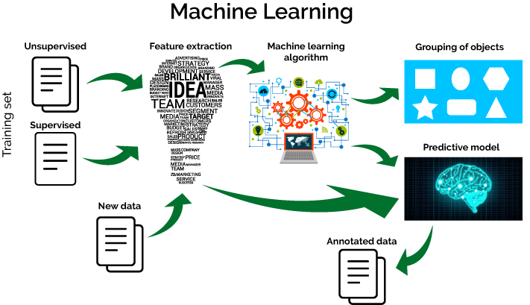
Image Source - https://towardsdatascience.com/machine-learning-65dbd95f1603

Slide 3
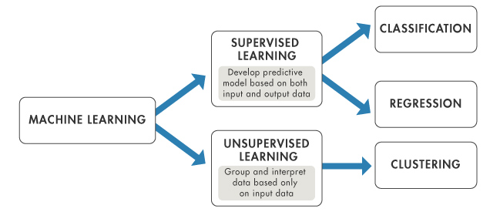
Image Source - https://in.mathworks.com/help/stats/machine-learning-in-matlab.html

Slide 4
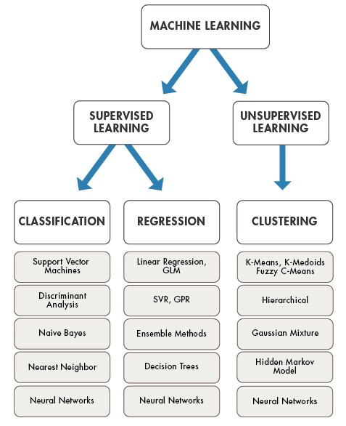
Image Source - https://medium.com/technology-nineleaps/popular-machine-learning-algorithms-a574e3835ebb

Slide 5
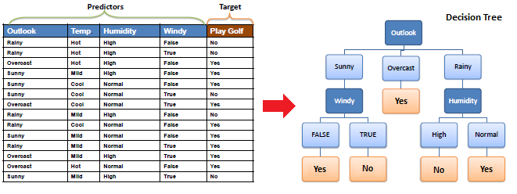
Image Source - http://www.saedsayad.com/decision_tree.htm

