Slide 1
MNIST with Scikit-Learn using Random Forest Classifier in Python
Raunak Joshi

Slide 2
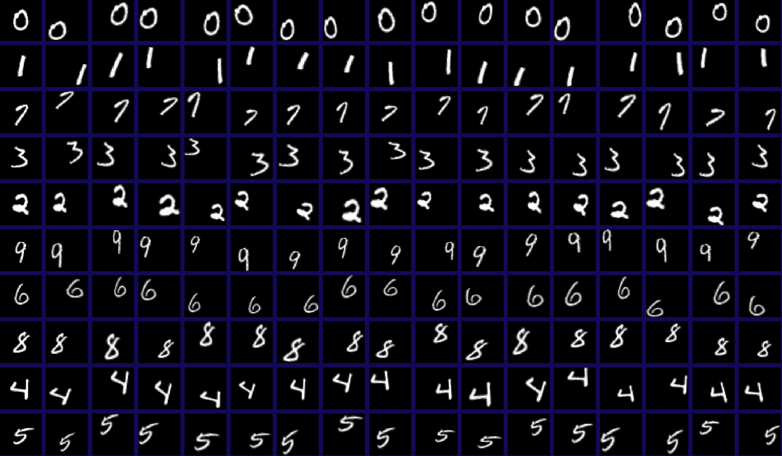
What is MNIST
Source - www.cs.toronto.edu

Slide 3
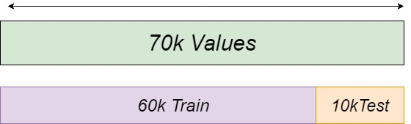
Understanding the DataSet

Slide 4
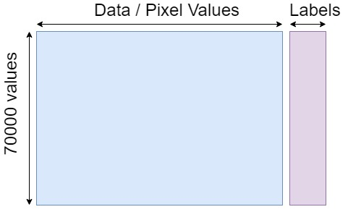
Understanding the DataSet

Slide 5
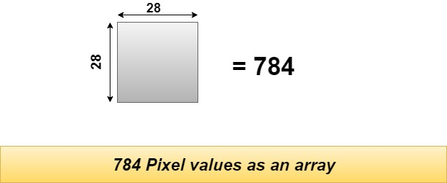
Understanding the DataSet

Slide 6
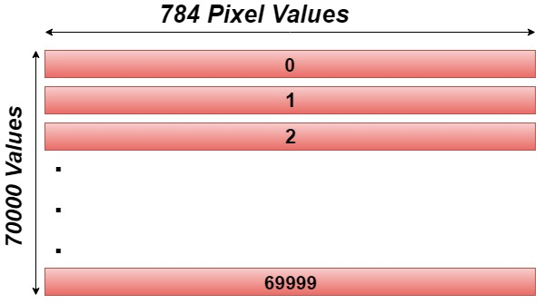
Understanding the DataSet

