Slide 1
Design and Implementation of a Digital Library System
- Fems, Seimiekumo Solomon , Zifawei O. Kennedy, George Deinbofa, Oberhiri Oruma Godwin
Kush Vora - 1911064

Slide 2
Content
Introduction
Aim and Objective
Problems with existing system
Solution to the problem
Advantages of the proposed system
Methodology employed
Use case diagrams and DFD’s
Conclusion
Bibliography
Strategy to Implement

Slide 3
Introduction
Libraries have been a fundamental fragment of educational and information sector of any university.
The success of any library largely depends on proper management.
Several libraries have suffered catastrophe as a consequence of insufficient administration and weaknesses in handling delicate information as regards members of the library, searching for, and finding desired books, availability of library and library materials at all times etc.

Slide 4
Aim and Objective of the Research Paper
The main aim of the research work is the design and implementation of an electronic library system for Universities.
This research work will create a platform where users can access the library content without considering opening or closing time of the library.

Slide 5
Problems with the existing system
Limited availability
Large maintenance costs
Others problems are :
It does not license the concurrent or multiple use of the same library materials by different library users at same time – dissimilar to the digital library services.
Physical library have to employ large amount of money for the imbursement of staff, payment of rent, maintenance of book, and procurement of additional books
Lack of security
Data redundancy
Unavailability of library resources at all time

Slide 6
Solution
As a solution to the problems faced by traditional library, this research work proposes the design, implementation and use of a Digital Library System (DLS).
This system will focus on collection of digital objects encompassing visual material and store them in an electronic media format, along with having techniques for the organization,retrieval and making them available online, in a searchable form.

Slide 7
Advantages of the proposed system
The system would support round-the-clock availability, that is, the library system can be accessed at any time, 24 hours a day and 365 days of the year.
Other advantages of the system include:
Structured approach: The system would provide access to much richer content in a more structured manner i.e. one can easily move from a catalog to a particular book then to a particular chapter.
Information retrieval: A user would be able to use any information (book title, author, department, faculty or level) about a book to search for and retrieve the book.

Slide 8
Advantages of the proposed system
No physical boundaries: A user can access the library from anywhere, as long as internet connection is available. A user needs not to go the library physically.
Multiple access: The same resources can be accessed and or use at the same time by a number of users at same or different locations.
Other Advantages include :
Eliminates data redundancy
Cheaper
Increases Portability

Slide 9
Methodology
The methodology used for this research work is the waterfall methodology.
Waterfall methodology is a methodical and chronological approach towards software development process and the phases are
conception,
initiation,
analysis,
design,
construction,
integration and testing,
implementation and maintenance.

Slide 10
System Modules
The DLS is divided into three (3) main modules;
the administration module
the student/user module and
staff module.
Each with different levels of functionalities, which are shown in the use case diagram in the next slide.

Slide 11
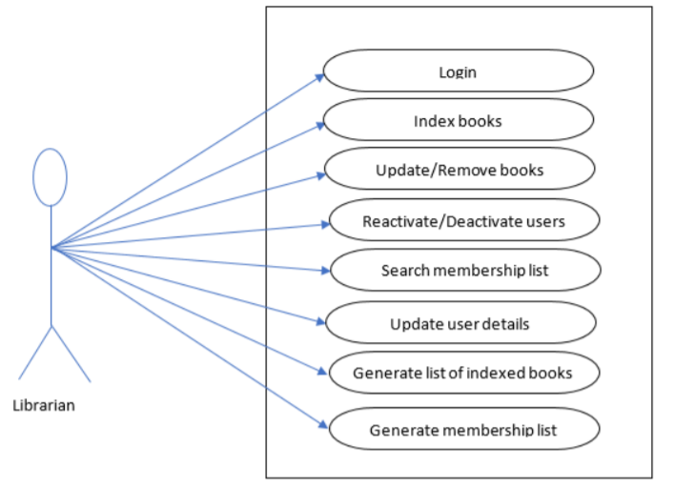
Use case diagram of Librarian Admin

Slide 12
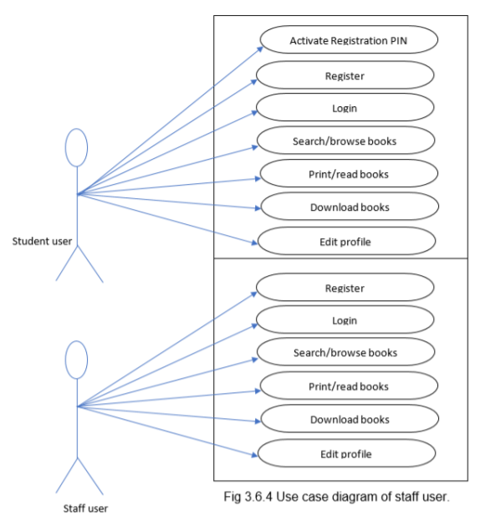
Use case diagram of student and staff user

Slide 13
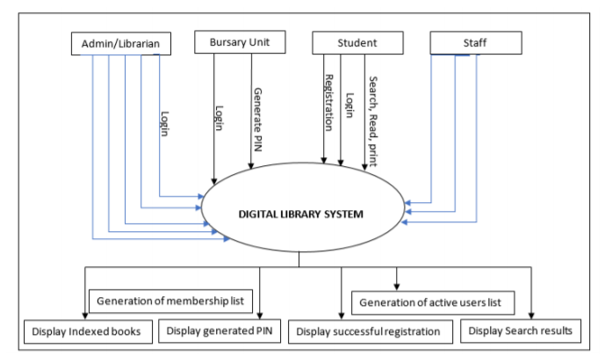
Level 0 DFD

Slide 14
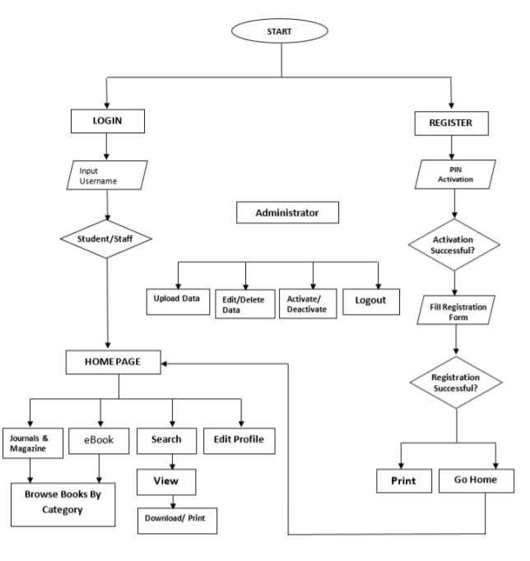
Level 1 DFD

Slide 15
Conclusion
This study has recognized that digitization is an indispensable job in current day libraries. If a library is to live up to present challenges, it must go digital, that is, provide digital contents and services.
This will empower it preservation of threatened library resources, improve the productivity of information search mechanisms and boost access to library resources.
Moreover, A digital library, also known as virtual library, has fully-fledged to a special field of study.

Slide 16
Bibliography
L. A. Ogunsola (2005): Nigerian University Libraries and the Challenges of Globalization: The Way forward. J. Soc. Sci., 10(3): 199-205 (2005)
Aguolu, I. E. (1996). Nigerian University Libraries: What Future? The International Information and Library Review, 28(3), 261.
Ajayi, G. O. (2000). Challenge to Nigeria of Globalization and the Information Age. Keynote address at the Workshop on National Information Communication Infrastructure (NICI) Policy Plans and Strategies for Implementation, Maitama, Abuja.
Hanumat G. Sastry (2011) User Interface Design Challenges for Digital Libraries. Volume 15–No.6, February 2011
Maurice P. Marchant (1991). Library & Information Science Research 13(3) · What Motivates Adult Use of Public Libraries? January 1991

Slide 17
Strategy to implement
Web application which allows user search books using keywords from title, author, etc of the book and lets the user download the book of his/her choice.
60-80% implementation
Techstack
ReactJS
Django
PostgreSQL

Slide 18
THANK
YOU

