Slide 1
BKK Budapest Network
Network Science Term Project 15: Imagine, that a group of travelling salesman wants to visit all public transport stations in Budapest…
Vatsa Kush – I3B326

Slide 2
The Data
The data was downloaded from the BKK Website - General Transit Feed Specification (gtfs)
Agency.txt - Basic information about service provider.
calendar_dates.txt - Service patterns that don't repeat such as for a one-time special event.
feed_info.txt - Basic information about the BKK service.
pathways.txt - Contains all paths connected via directional -bidirectional route.
routes.txt - Contains a list of all the routes with their names, short description and color coding for the online map.
shapes.txt - Contains collections of GPS coordinates.
stop_times.txt – contains information about trip_id, stop_id, arrival_time, departure_time and other attributes.
stops.txt - Contains a list of all the stops with their location(GPS coordinates) and other attributes.
trips.txt - Contains which shape corresponds to which route.

Slide 3
The Data
General Transit Feed Specification (gtfs)
agency - Basic information about service provider.
calendar_dates - Service patterns that don't repeat such as for a one-time special event.
feed_info - Basic information about the BKK service.
pathways - Contains all paths connected via directional -bidirectional route.
routes - Contains a list of all the routes with their names, short description and color coding for the online map.
shapes - Contains collections of GPS coordinates.
stop_times – contains information about trip_id, stop_id, arrival_time, departure_time and other attributes.
stops - Contains a list of all the stops with their location(GPS coordinates) and other attributes.
trips - Contains which shape corresponds to which route.
agency.txt
calendar_dates.txt
feed_info.txt
pathways.txt
routes.txt ✓
shapes.txt
stop_times.txt ✓
stops.txt ✓
trips.txt ✓
The data was downloaded from the BKK Website

Slide 4
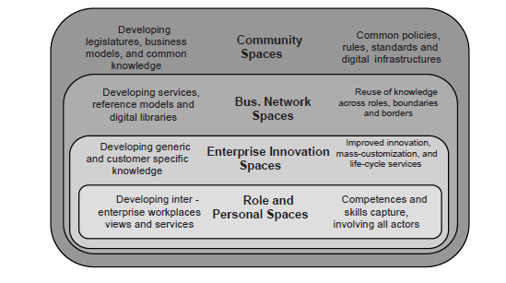
Data Preprocessing
There are modeling methodologies associated with each of the four knowledge spaces.
Personal Workspace
Innovation Space
Business Networking Space
Community Space

Slide 5
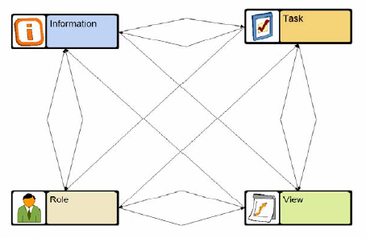
1. Personal Workspace
Information (I), which information is needed to perform the work, which information is produced, etcetera.
Roles (R), who are involved in the work, what is their responsibilities, which tasks do they perform, which information do they use, which views should their workplace consist of, etcetera.
Tasks (T), which tasks are performed, which services are used to achieve the results.
Views (V), which views should be available in the workplaces, which information and services should they give access to, what should it look like, etcetera.

Slide 6
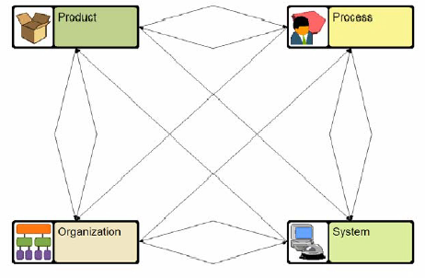
2. Innovation Space
Product (P), the result and content of the work.
Organization (O), the personnel resources and skills required, available or applied.
Process (P), the structure of work tasks.
System (S), the underlying support tools and equipment used.

Slide 7
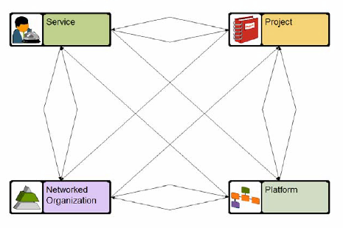
3. Business Networking Space
Services (S) required and provided by the different companies and groups.
Network organization (N) structures of established collaborations.
Projects (P) where multiple partners cooperate to create new services.
Platforms (P) providing interoperable IT support for the networks.

Slide 8
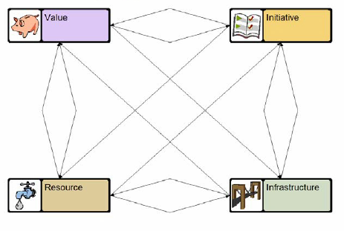
4. Community Space
Values (V) represent the worth of commodities, services, assets, or work, and the principles, standards, or quality that guides human actions.
Resources (R) are the personnel and material applied to create value.
Initiatives (I) to apply resources and infrastructure to create new values.
Infrastructure (I) is the overall set of tools and mechanisms for communication, logistics, and value creation in general.

Slide 9
Roles vs knowledge spaces
 | What/Why | Who | How | Enabler
Community and network | Value | Resource | Initiative | Infrastructure
Business | Service | Network | Project | Platform
Team Innovation | Product | Organization | Process | System
Individual | Information | Role | Task | View
Software | Data | User | Code | Programming

Slide 10
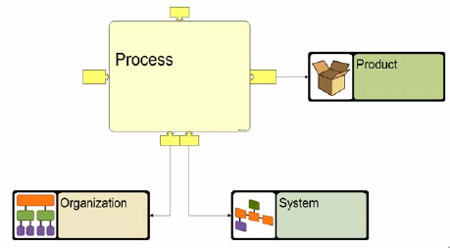
Reflection Across Knowledge Spaces
The dimensions of a knowledge space are interdependent. When you work on one dimension, you should take the others into account.

Slide 11
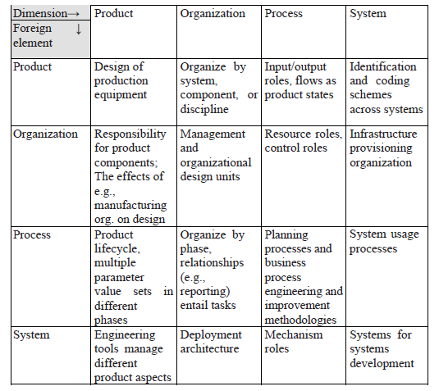
4. Refection in innovation space

Slide 12
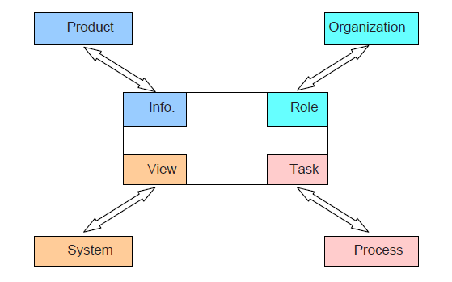
Dominant reflections across knowledge spaces
The dominant relationships for managing lower layer structures typically follow the main dimensions. For instance, tasks are aggregated into processes, roles into organizations, views into systems, and the primary information elements reflect product structures.
This simplistic view is held by most modeling methodologies, such a business process management, information and data modeling, organization hierarchy charts, etc.
In the design, the product structures capture the critical dependencies between tasks, and the product structures are also used for managing and coordinating tasks.

Slide 13
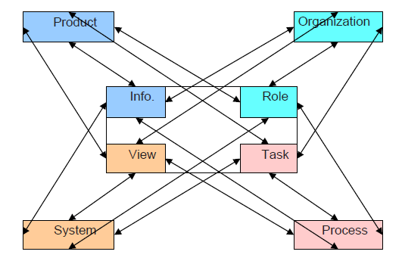
Totality of reflections across knowledge spaces
POPS elements can be seen from four different workspace perspectives (sides), as information, role/responsibility, task, and view, respectively. When these spaces are brought together, we thus define derived concepts, such as
Product role, process role, organization role, and system roles
Product, organization, process, and system information
Product lifecycle, organizational, process, and system tasks
Product, organization role, process phase, and system (aspect) view
Similar arguments can be made for the surrounding business and community knowledge spaces.

Slide 14
Summary
The enterprise knowledge spaces are bounded by identifiable but fuzzy borders. Whether the borders are a result of pragmatic boundaries, such as gateways between project phases and the isolated roles of engineering disciplines and so forth, or whether they are caused by limitations inherent in the mental models of our brains remains a research issue.

Slide 15
Thank You

