Slide 1
BKK Budapest Network
Network Science Term Project 15: Imagine, that a group of travelling salesman wants to visit all public transport stations in Budapest…
Vatsa Kush – I3B326

Slide 2
The Data
General Transit Feed Specification (gtfs)
agency - Basic information about service provider.
calendar_dates - Service patterns that don't repeat such as for a one-time special event.
feed_info - Basic information about the BKK service.
pathways - Contains all paths connected via directional -bidirectional route.
routes - Contains a list of all the routes with their names, short description and color coding for the online map.
shapes - Contains collections of GPS coordinates.
stop_times – contains information about trip_id, stop_id, arrival_time, departure_time and other attributes.
stops - Contains a list of all the stops with their location(GPS coordinates) and other attributes.
trips - Contains which shape corresponds to which route.
agency.txt
calendar_dates.txt
feed_info.txt
pathways.txt
routes.txt ✓
shapes.txt
stop_times.txt ✓
stops.txt ✓
trips.txt ✓
The data was downloaded from the BKK Website

Slide 3
Data Preprocessing
The main problem : lots of attributes containing null data.
Removing the unnecessary columns.
Initiatives (I) to apply resources and infrastructure to create new values.
Infrastructure (I) is the overall set of tools and mechanisms for communication, logistics, and value creation in general.

Slide 4
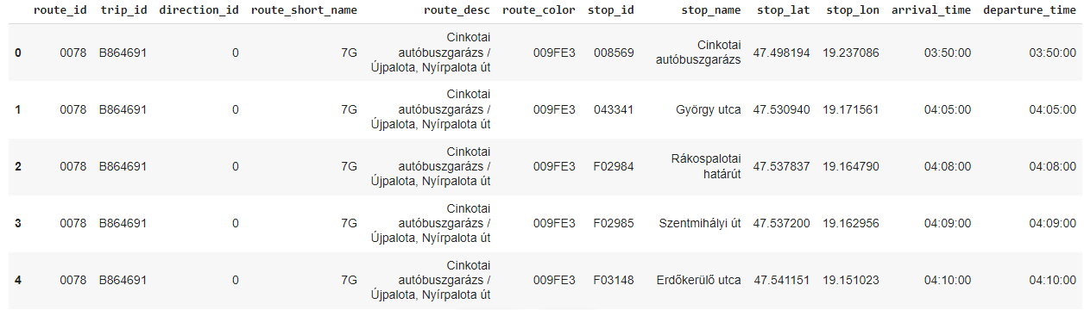
Data Preprocessing
There are modeling methodologies associated with each of the four knowledge spaces.

Slide 5
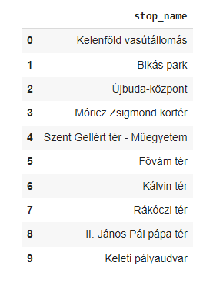
M4 Metro Visualize
Visualizing the directional path for the m4 line from kelenfold to keleti.

Slide 6
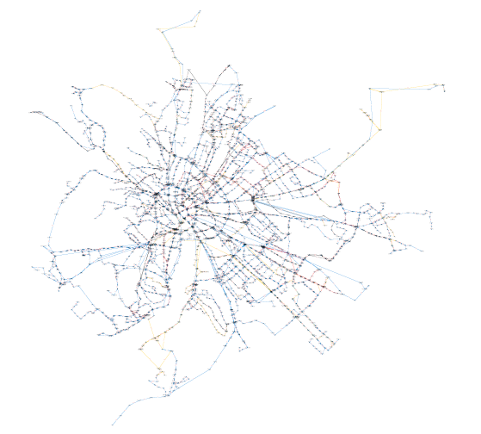
Data Preprocessing
There are modeling methodologies associated with each of the four knowledge spaces.

Slide 7
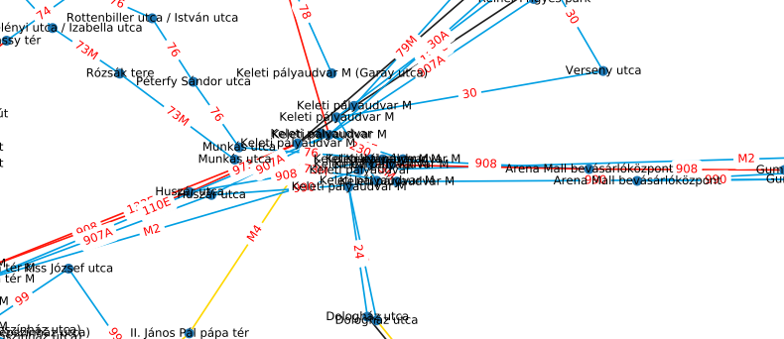
2. Innovation Space
Product (P), the result and content of the work.
Organization (O), the personnel resources and skills required, available or applied.
Process (P), the structure of work tasks.
System (S), the underlying support tools and equipment used.

Slide 8
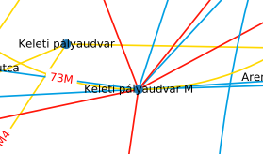
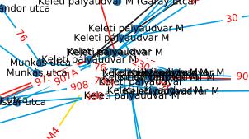
3. Business Networking Space

Slide 9
Results
Networks | Previous Nodes | New Nodes
Network 1 | 3581 | 2147
Network 2 | 4093 | 2276
Reshuffled Network | 4041 | 2291

Slide 10
Edges
Networks | Previous Edges | New Edges
Network 1 | 4135 | 3053
Network 2 | 4745 | 3277
Reshuffled Network | 4671 | 3292

Slide 11
Results
Networks | Steps
Network 1 | 2102
Network 2 | 2258
Reshuffled Network | 2273

Slide 12
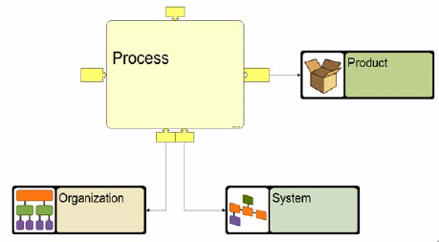
Reflection Across Knowledge Spaces
The dimensions of a knowledge space are interdependent. When you work on one dimension, you should take the others into account.

Slide 13
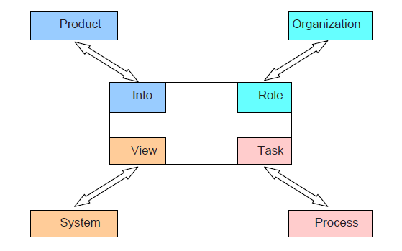
Dominant reflections across knowledge spaces
The dominant relationships for managing lower layer structures typically follow the main dimensions. For instance, tasks are aggregated into processes, roles into organizations, views into systems, and the primary information elements reflect product structures.
This simplistic view is held by most modeling methodologies, such a business process management, information and data modeling, organization hierarchy charts, etc.
In the design, the product structures capture the critical dependencies between tasks, and the product structures are also used for managing and coordinating tasks.

Slide 14
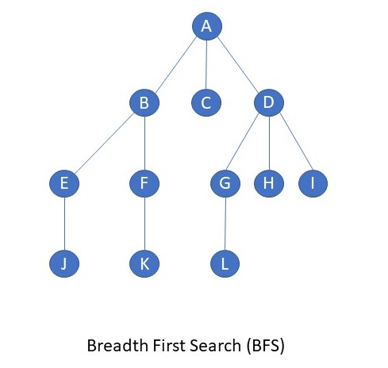
Totality of reflections across knowledge spaces
POPS elements can be seen from four different workspace perspectives (sides), as information, role/responsibility, task, and view, respectively. When these spaces are brought together, we thus define derived concepts, such as
Product role, process role, organization role, and system roles
Product, organization, process, and system information
Product lifecycle, organizational, process, and system tasks
Product, organization role, process phase, and system (aspect) view
Similar arguments can be made for the surrounding business and community knowledge spaces.

Slide 15
References
https://bkk.hu/apps/gtfs
https://networkx.org/
Mátrai, T., Ábel, M., & Kerényi, L. S. (2015, June). How can a transport model be integrated to the strategic transport planning approach: A case study from Budapest. In 2015 International Conference on Models and Technologies for Intelligent Transportation Systems (MT-ITS) (pp. 192-199). IEEE.
Wessel, N., & Farber, S. (2019). On the accuracy of schedule-based GTFS for measuring accessibility. Journal of Transport and Land Use, 12(1), 475-500.
Kurant, M., Markopoulou, A., & Thiran, P. (2010, September). On the bias of bfs (breadth first search). In 2010 22nd International Teletraffic Congress (lTC 22) (pp. 1-8). IEEE.
ELTE Network Science course lectures and practices.

Slide 16
Thank You

