Slide 1

Titanic Survival Predictor
An End-to-End Data Science Project

Slide 2
Problem Definition
Objective: Predict whether a passenger survived the Titanic disaster.
• Binary Classification (0 = Died, 1 = Survived)
• Input features: Age, Sex, Class, Fare, Family details, etc.
• Goal: Build ML models to understand key survival factors.

Slide 3
Data Collection & Cleaning
Dataset: titanic_train.csv and titanic_test.csv
• Handled missing values: Age, Fare, Embarked
• Dropped irrelevant columns: Ticket, Cabin
• Feature Engineering: Title, FamilySize, IsAlone, CabinDeck, TicketGroupSize
• Encoded categorical variables for ML

Slide 4
Exploratory Data Analysis
Key insights from EDA:
• Higher survival rate among females compared to males
• First-class passengers had better survival rates
• Passengers traveling alone had lower survival chances
• Fare and Age distributions showed survival patterns

Slide 5
Model Building
Algorithms used:
• Logistic Regression
• Random Forest Classifier
• Gradient Boosting Classifier
Performed hyperparameter tuning using GridSearchCV
Evaluation metrics: Accuracy, Precision, Recall, F1-score, ROC-AUC

Slide 6
Model Checking
Best Model: Logistic Regression
Performance on validation set:
• Accuracy: 85%
• Precision: 0.86 (Class 0), 0.84 (Class 1)
• Recall: 0.91 (Class 0), 0.77 (Class 1)
• F1-score: 0.88 (Class 0), 0.80 (Class 1)

Slide 7
Results & Insights
• Logistic Regression outperformed RF & GB in balanced accuracy
• Gender, Pclass, and Family features were strongest predictors
• Females in higher classes had the highest survival rate
• Alone travelers were less likely to survive

Slide 8
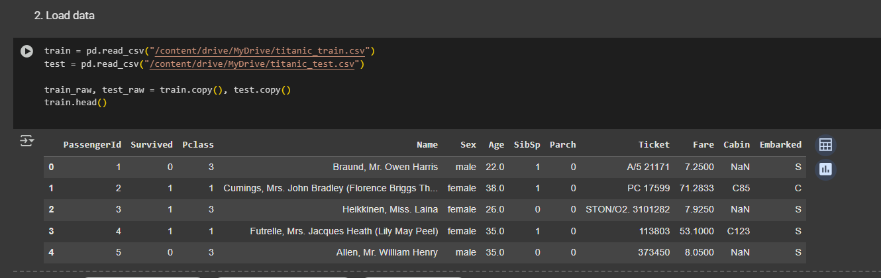
Code

Slide 9
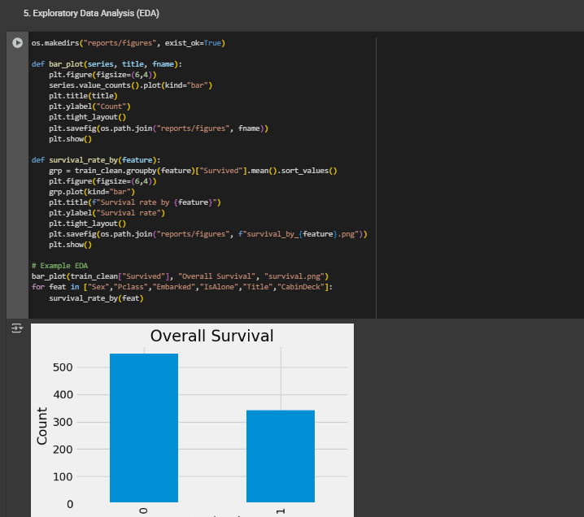
Code

Slide 10
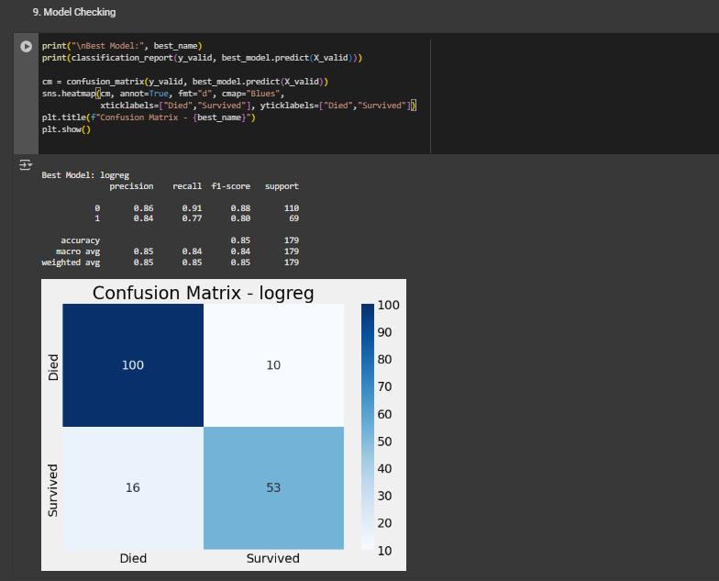

Slide 11
Report & Documentation
Deliverables:
• Cleaned datasets (train & test)
• EDA charts saved in reports/figures/
• Model metrics stored in reports/metrics.json
• PowerPoint report for presentation

Slide 12
Conclusion
This project demonstrates a complete data science workflow:
• Defined and understood the problem
• Cleaned and preprocessed real-world data
• Conducted EDA for insights
• Built and validated multiple ML models
• Logistic Regression achieved best performance (~85% accuracy)
Outcome: A reliable model to predict Titanic passenger survival

