Slide 1

Titanic Survival Predictor
End-to-End Data Science Project
Dataset: titanic_train.csv & titanic_test.csv
Presented by: Sagar Kumar

Slide 2
Problem Definition
Predict survival of Titanic passengers.
Input: Demographics & travel features.
Output: Survived (1) or Died (0).
Dataset: titanic_train.csv and titanic_test.csv.

Slide 3
Data Collection & Cleaning
Source: Titanic dataset (CSV format).
Handled missing values: Age (median), Fare (median), Embarked (mode).
Feature engineering: Title, FamilySize, IsAlone, CabinDeck, TicketGroupSize.
Generated train_cleaned.csv & test_cleaned.csv.

Slide 4
Data Analysis & EDA
Females had higher survival (~74%).
1st class passengers survived more than 3rd class.
Travelling alone had lower survival.
Visuals: Age/Fare distributions, survival by Sex, Pclass, Embarked, Title, CabinDeck.

Slide 5
Model Building
Preprocessing pipeline: Scaling + OneHotEncoding.
Models trained: Logistic Regression, Random Forest, Gradient Boosting.
Hyperparameter tuning with GridSearchCV (5-fold CV).

Slide 6
Model Evaluation
Metrics: Accuracy, Precision, Recall, F1, ROC-AUC.
Logistic Regression ≈ 85% accuracy, best balanced performance.
Random Forest & Gradient Boosting slightly lower.
Confusion matrix & ROC curve plotted.

Slide 7
Results & Insights
Key Influencers: Sex, Pclass, Title, Family Size.
Logistic Regression selected as best model.
Preprocessing & feature engineering improved accuracy.

Slide 8
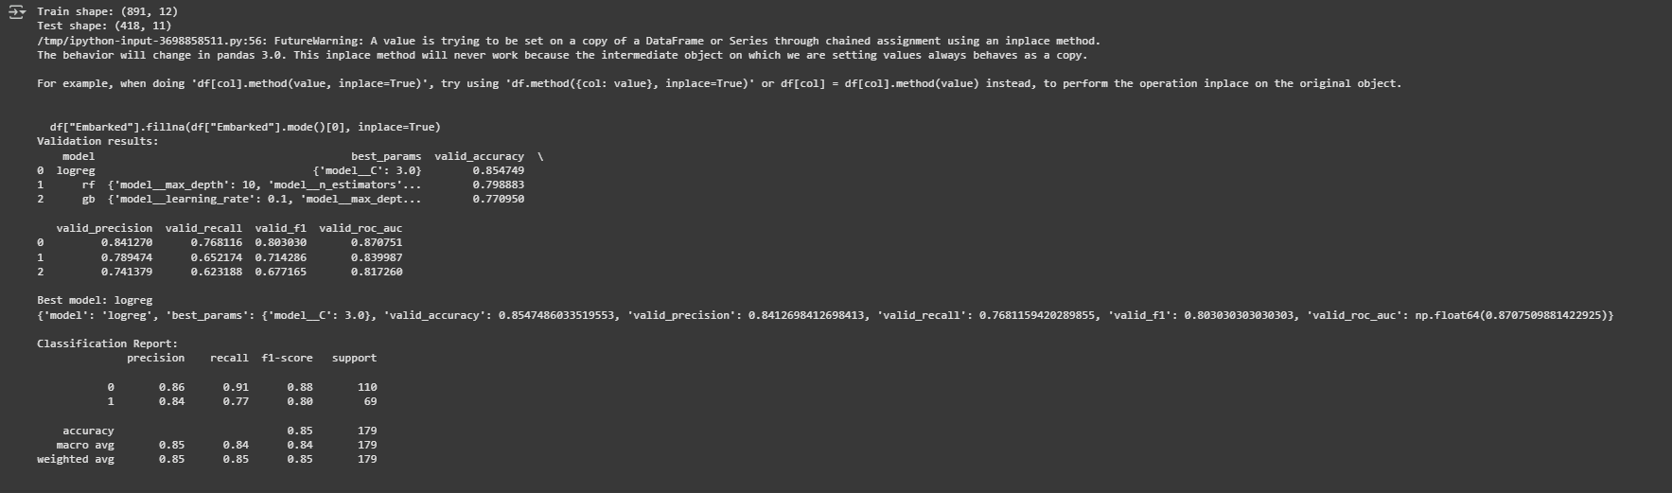
Code Outcome

Slide 9
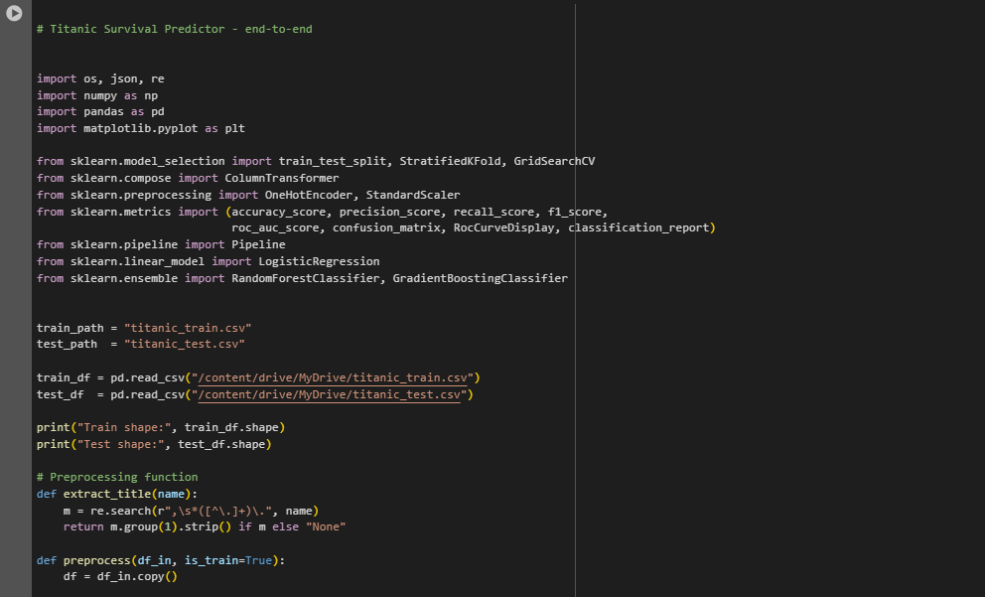
Code

Slide 10
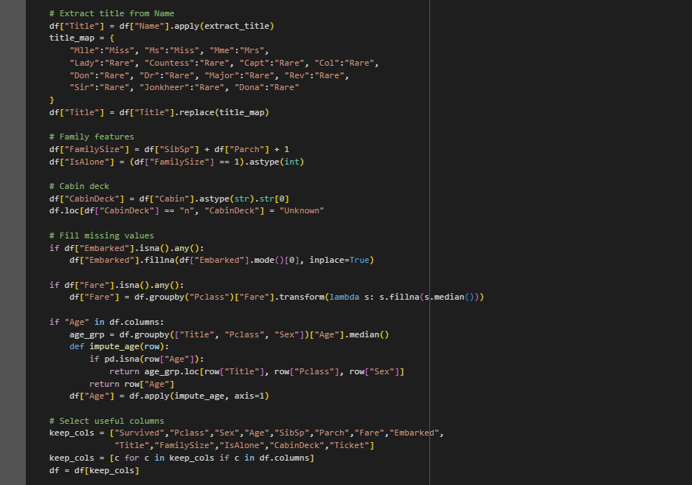
Code

Slide 11
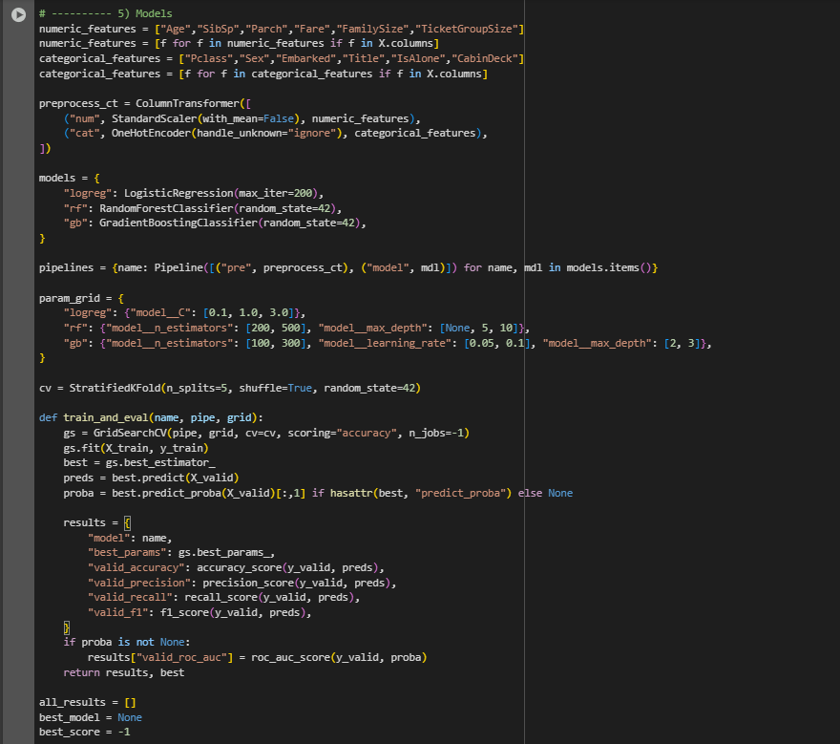
Code

Slide 12
Conclusion
Full ML workflow covered: Cleaning, EDA, Training, Evaluation, Insights.
Logistic Regression = final model.
Demonstrates practical application of Data Science.

