Slide 1

Web Technologies - CSE4004
Module No-1 : Introduction to Web Design
Part-1
Introduction to HTML 5, syntax, attributes, events, SVG, Web storage, Introduction to Canvas, Audio & Video, Geolocations, Drag & Drop, Web workers, working with Fonts, working with other graphics.

Slide 2
Course Objectives:
Understand state-of-the-art in Client-side application development web technologies, architectures, and applications.
To get hands on experience on various Full Stack Development tools and techniques.
To understand Java script ES6 features to perform CRUD operations

Slide 3
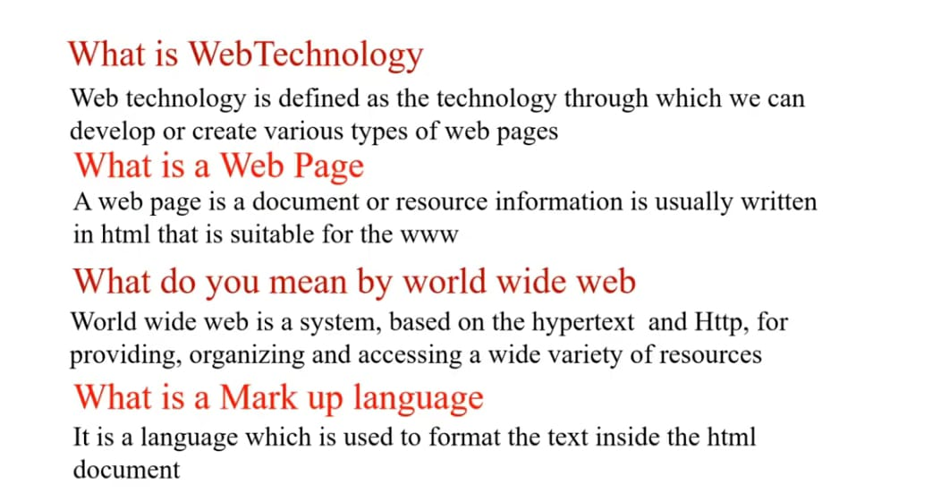
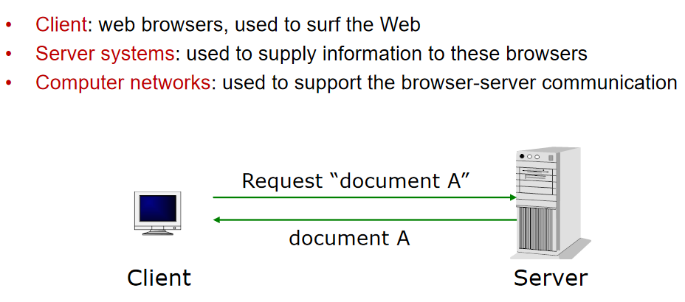
Web Essentials

Slide 4
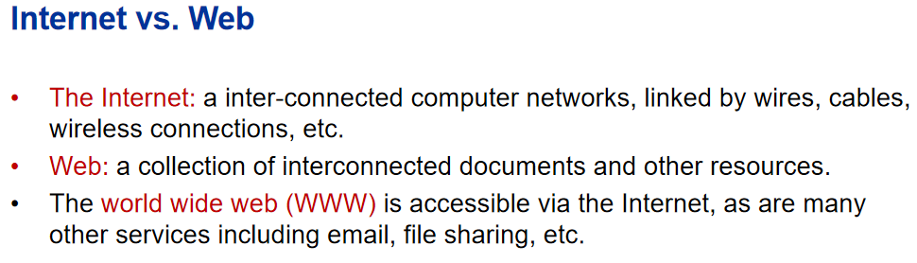
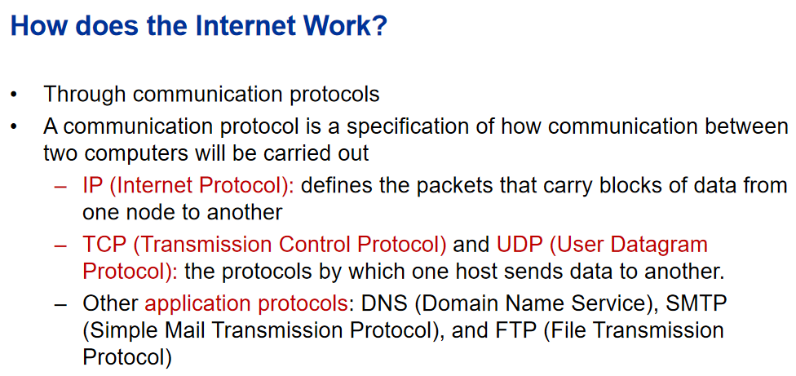

Slide 5
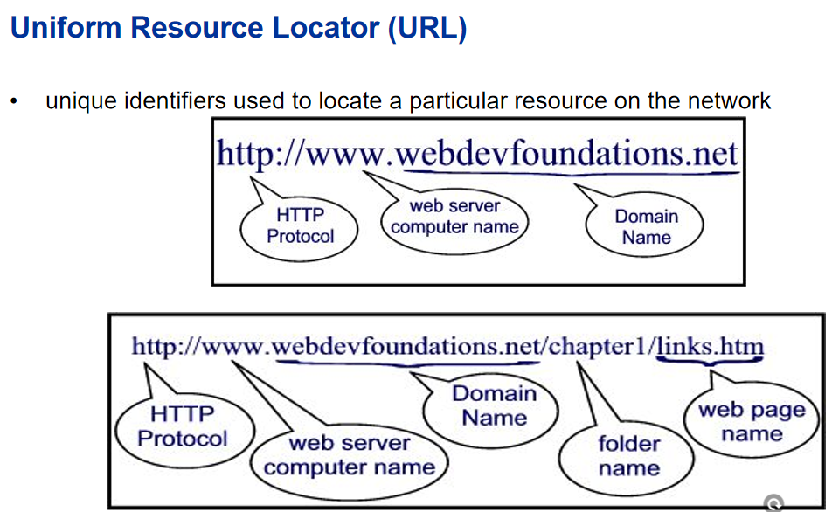

Slide 6
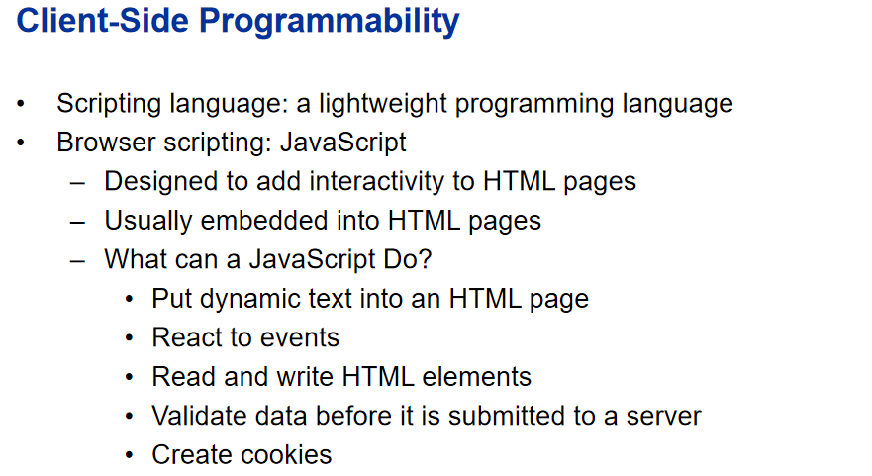
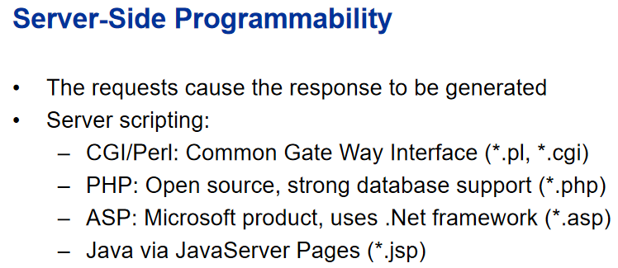

Slide 7
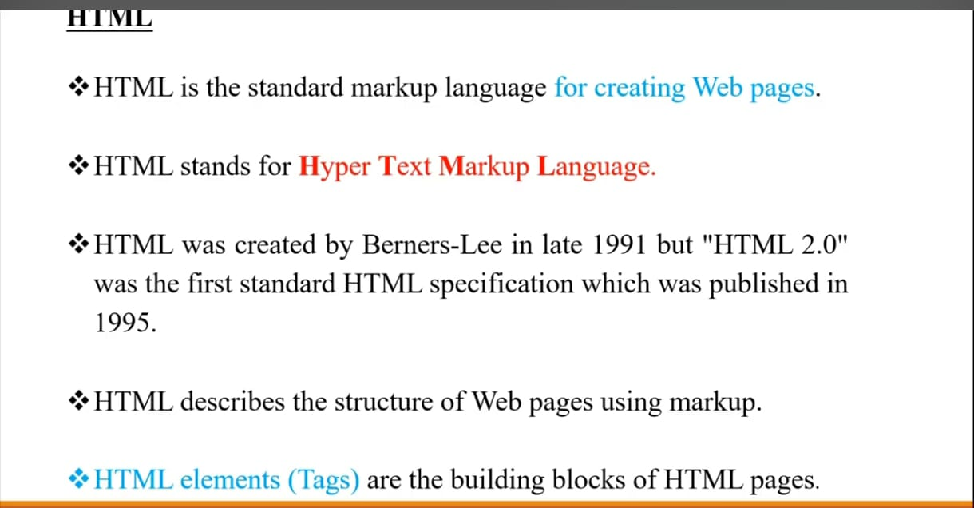

Slide 8
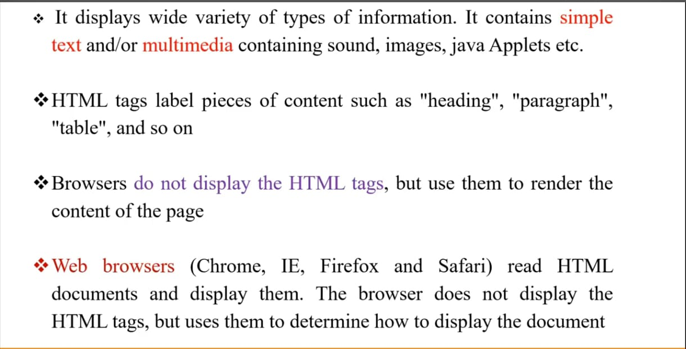

Slide 9
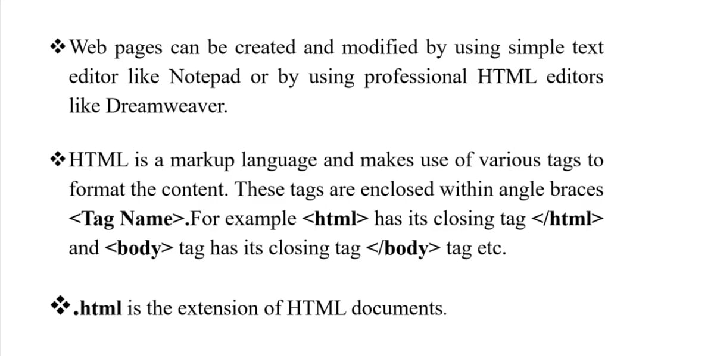

Slide 10
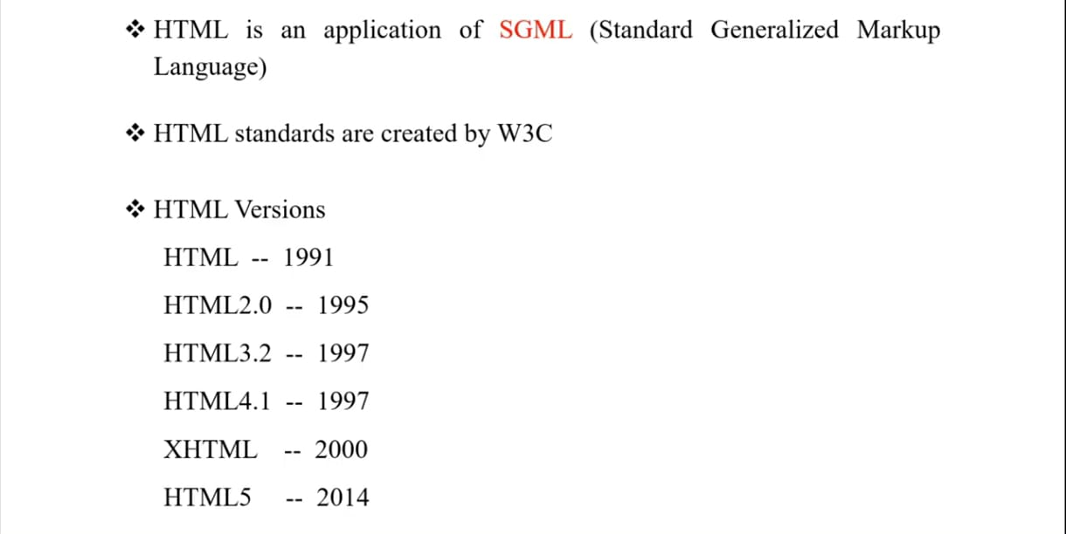
(World Wide Web Consortium)

Slide 11
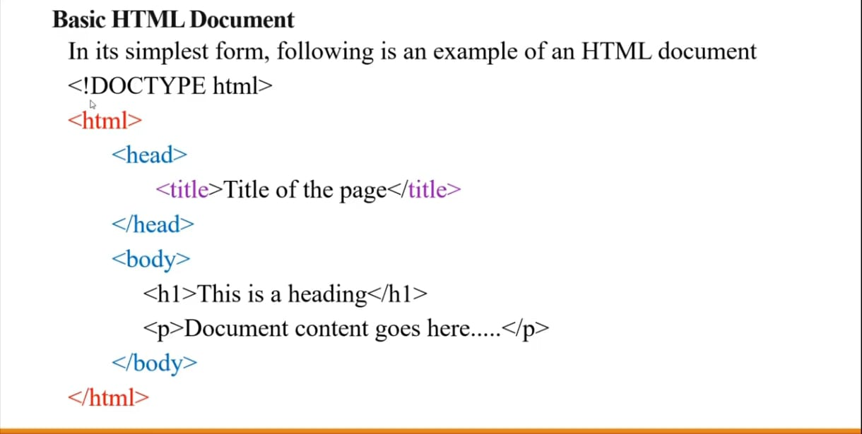

Slide 12
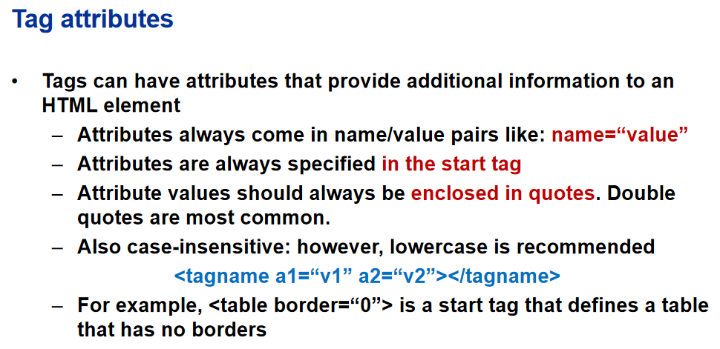

Slide 13
Paired/Non-Paired
<html> | begins html file | paired
<head> | first section of html file | paired
<body> | second, main section of html file | paired
<title> | within HEAD - title goes in top bar | paired
<p> | paragraph | paired
<br> | line break | single
<hr> | horizontal rule | single
<h1> <h2> | headings | paired
<a href=" "> | link | paired
<img src=" "> | image | single
<pre> | preformatted - displayed like the source | paired
<blockquote> | separate, indented text | paired
<!-- --> | comments | single
<i> | italic physical style | paired
<b> | bold physical style | paired

Slide 14
condt
<tt> | teletype physical style | paired
<em> | emphasis logical style | paired
<strong> | strong logical style | paired
<tt> | code logical style | paired
<cite> | citation logical style | paired
<ol> | ordered list | paired
<ul> | unordered list | paired
<li> | list item | can be paired
<dl> | definition list | paired
<dt> | term name (left aligned) | can be paired
<dd> | term definition (indented) | can be paired
<a name=" "> | anchor | paired
&...; | escape sequences | single
<table> | table | paired
<tr> | table row | paired
<td> | table cell | paired

Slide 15
HTML Events
HTML events are actions or occurrences triggered by user interaction or browser activity, such as clicking a button, typing on a keyboard, loading a page, or playing media.
Events enable interactivity in web pages, allowing dynamic responses like validation, content updates, and visual effects without reloading the page.
HTML events are specified as attributes inside HTML elements using the prefix on, for example: onclick, onload, onfocus.
Mouse Events handle actions performed using the mouse: onclick, ondblclick, onmouseover, onmouseout, onmousedown, onmouseup
Keyboard Events are triggered by keyboard interactions: onkeydown, onkeyup, onkeypress
Form and Input Events occur during user input and form handling: onfocus, onblur, onchange, oninput, onsubmit, onreset
Window Events occur at the browser or document level: onload, onresize, onunload, onscroll
Clipboard Events manage copy–paste operations: oncopy, oncut, onpaste
Media Events are associated with audio and video elements: onplay, onpause, onended, onvolumechange
Touch and Drag-Drop Events support mobile and interactive UI features: Touch: ontouchstart, ontouchmove, ontouchend, Drag-Drop: ondragstart, ondragover, ondrop

Slide 16
HTML SVG
SVG (Scalable Vector Graphics) is an XML-based vector image format used to create two-dimensional graphics on the web that scale without loss of quality.
SVG graphics are resolution-independent, making them suitable for responsive web design, icons, diagrams, charts, and animations.
SVG elements are written directly inside HTML using the <svg> tag and can be styled using CSS and controlled using attributes.
Basic Shape Elements are used to draw simple geometric figures: <rect>, <circle>, <ellipse>, <line>, <polyline>, <polygon>
Path Element is used to draw complex shapes and curves: <path> (using commands like M, L, C, Q, Z){M (Move To), L (Line To), H (Horizontal Line To), V (Vertical Line To), C (Cubic Curve), S (Smooth Cubic Curve), Q (Quadratic Curve), T (Smooth Quadratic Curve), A (Arc), Z (Close Path)}
Text Elements are used to display text in graphics: <text>, <textPath>
Structural and Reusable Elements help organize and reuse graphics: <g> (grouping), <defs> (definitions), <use> (reuse elements)
Painting and Styling Elements control colors and fills: <linearGradient>, <radialGradient>, <stop>, <pattern>
Media and Visual Effect Elements enhance graphics: <image>, <clipPath>, <mask>
Animation Elements add motion to SVG graphics: <animate>, <animateTransform>, <animateMotion>

Slide 17
Web storage
With web storage, applications can store data locally within the user's browser.
Before HTML5, application data had to be stored in cookies, included in every server request. Web storage is more secure, and large amounts of data can be stored locally, without affecting website performance.
Unlike cookies, the storage limit is far larger (at least 5MB) and information is never transferred to the server.
Web storage is per origin (per domain and protocol). All pages, from one origin, can store and access the same data.
Web Storage API Objects: Web storage provides two objects for storing data in the browser.
window.localStorage - stores data with no expiration date (data is not lost when the browser tab is closed)
window.sessionStorage - stores data for one session (data is lost when the browser tab is closed)

Slide 18
Introduction to Canvas
HTML Canvas is a bitmap-based graphics system introduced in HTML5 for drawing graphics dynamically on web pages.
The <canvas> element is the only HTML element, used to define a rectangular drawing area on the web page.
The <canvas> element uses attributes such as id, width, and height to identify and size the drawing surface.
Canvas graphics are rendered using a rendering context, most commonly the 2D context (getContext("2d")).
Canvas supports drawing primitives through context methods, including lines, rectangles, circles, arcs, paths, text, and images.
Rectangle – Rectangles are drawn using methods like fillRect(), strokeRect(), and clearRect().
Line , Circle / Arc , Path – beginPath(), closePath(), moveTo(), and lineTo(), Text , Stroke Text, Linear Gradient , Circular (Radial) Gradient, Colors and Styles, Images – Images are drawn onto the canvas using the drawImage() method.

Slide 19
Audio & Video
HTML5 provides built-in support for multimedia using the <audio> and <video> tags, which allow developers to embed sound and video content directly into web pages without relying on external plugins. The <audio> tag is used for sound files such as music and speech, while the <video> tag is used for video playback. The <source> tag is used inside both audio and video elements to specify media files in different formats, and the <track> tag is used with video to add subtitles or captions.
Both audio and video elements support important attributes such as controls for playback controls, autoplay, loop, and muted to manage playback behavior. The poster attribute in the video tag displays an image before the video starts playing. HTML audio and video elements also support media events like play, pause, and ended, enabling interactive and user-controlled multimedia experiences on web pages.
<audio src="audio.mp3" controls autoplay loop muted preload="auto"></audio>
<video src="video.mp4" controls autoplay loop muted width="640" height="360" poster="poster.jpg">
<source src="video.mp4" type="video/mp4">
<source src="video.webm" type="video/webm">
<track src="subtitles.vtt" kind="subtitles" srclang="en" label="English" default></video>

Slide 20
Geolocations
HTML5 Geolocation API allows web pages to access a user’s geographical location, including latitude, longitude, and optionally altitude, accuracy, speed, and heading. It is commonly used for location-based services such as maps, navigation, weather updates, and location tracking. Geolocation is not an HTML tag, but a JavaScript API accessed via navigator.geolocation, which requires user permission before retrieving location data. The main methods include getCurrentPosition() to get the current location once, watchPosition() to continuously track location changes, and clearWatch() to stop tracking.
<button onclick="navigator.geolocation.getCurrentPosition(showPosition)">Get My Location</button>
<p id="demo"></p>
<script>
function showPosition(position){
document.getElementById("demo").innerHTML = "Latitude: "+position.coords.latitude+", Longitude: "+position.coords.longitude;
}
</script>

Slide 21
Webworkers
Web workers are multithreaded objects that are used to execute Javascript in the background without affecting the performance of the application or webpage. Web Workers allow for long-running scripts that are not interrupted by scripts that respond to clicks or other user interactions and allow long tasks to be executed without affecting the responsiveness of the web page. Generally, it is used for big CPU-intensive tasks.
Dedicated Workers: Dedicated workers are typically used within a single script.
Shared Workers: A shared worker can be accessed by multiple scripts running in different windows, iframes, or other contexts, as long as they are in the same domain.
create a web worker
worker = new Worker("webWorker.js");
terminate a web worker.
worker.terminate();

Slide 22
THANK YOU

