Slide 1
Module No. 1
Introduction to HTML 5, syntax, attributes, events, SVG, Web storage, Introduction to Canvas, Audio & Video, Geolocations, Drag & Drop, Web workers, working with Fonts, working with other graphics. Style sheets: Introduction CSS, Applying CSS to HTML, Selectors, Properties and Values, CSS Colors and Backgrounds, CSS Box Model, CSS Margins, Padding, and Borders, CSS Text and Font Properties

Slide 2
Internet
A inter-connected computer networks, linked by wires, cables, wireless connections, etc.
It is the largest network in the world that connects thousands of individual networks all over the world.
The popular term for the Internet is the “information highway”.
• A network may include PCs, and other devices like servers or printers
• A network is connected through a communication channel

Slide 3
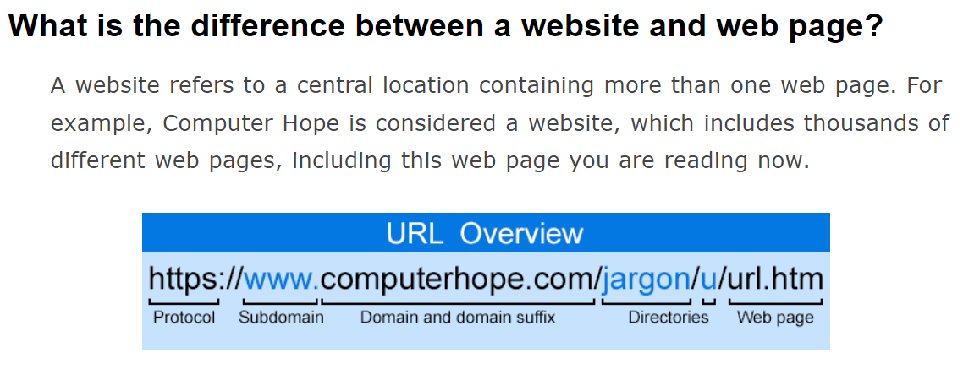
Web page
A web page or webpage is a document, commonly written in HTML, that is viewed in an Internet browser. A web page can be accessed by entering a URL address into a browser's address bar. A web page may contain text, graphics, and hyperlinks to other web pages and files.)

Slide 4
Website
A set of related web pages located under a single domain name.
A website is a collection of related web pages, including multimedia content, typically identified with a common domain name, and published on at least one web server
The first website was built at CERN by Tim Berners-Lee and put online August 6, 1991.
Any business, government, or person can create a website on the Internet. Today, the Internet consists of billions of websites created by billions of different people
Ex: https://www.w3schools.com/

Slide 5

Client/Server Architecture
Client-server architecture, architecture of a computer network in which many clients request and receive service from a centralized server .
Clients : Applications that runs on client computers
Servers: Computers or processes that manage resources
Communication Networks

Slide 6
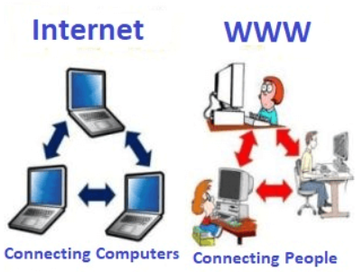
Internet vs. Web
The Internet: a inter-connected computer networks, linked by wires, cables, wireless connections, etc.
The internet was developed by "Advanced Research Projects Agency" (ARPA net) department of the United States. And, it was first connected in 1969.
Web: a collection of interconnected documents and other resources.
The world wide web (WWW) is accessible via the Internet, as are many other services including email, file sharing, etc.

Slide 7
How does the Internet Work?
Through communication protocols
A communication protocol is a specification of how communication between two computers will be carried out
  IP (Internet Protocol): defines the packets that carry blocks of data from one node to another
  TCP (Transmission Control Protocol) and UDP (User Datagram Protocol): the protocols by which one host sends data to another.
  Other application protocols: DNS (Domain Name Service), SMTP (Simple Mail Transmission Protocol), and FTP (File Transmission Protocol)

Slide 8
The Internet Protocol (IP)
A key element of IP is IP address, a 32-bit number
The Internet authorities assign ranges of numbers to different organizations
IP is responsible for moving packet of data from node to node
A packet contains information such as the data to be transferred, the source and destination IP addresses, etc.
Packets are sent through different local network through gateways
A checksum is created to ensure the correctness of the data; corrupted packets are discarded
IP-based communication is unreliable

Slide 9
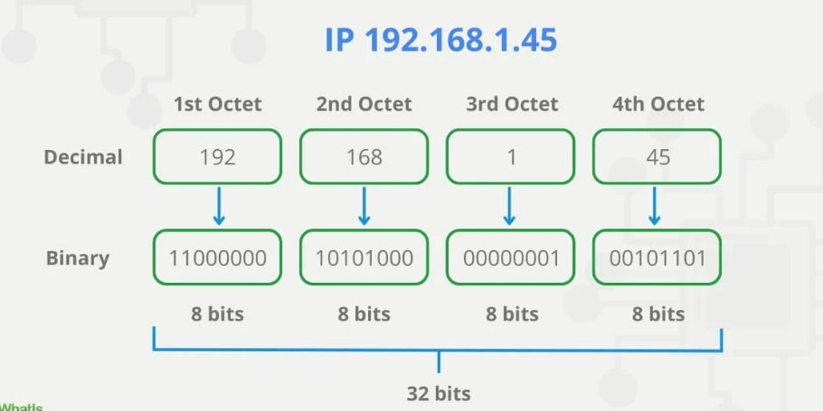
The Internet Protocol (IP)

Slide 10
Transmission Control Protocol (TCP)
TCP is a higher-level protocol that extends IP to provide additional functionality: reliable communication
TCP adds support to detect errors or lost data and to trigger retransmission until the data is correctly and completely received
Connection
Acknowledgment

Slide 11
Uses of the Internet
Email – Sending and receiving messages electronically.
Video Conferencing – Real-time video communication (e.g., Zoom, Google Meet).
Online Shopping – Buying and selling goods/services (e.g., Amazon, Flipkart).
Online Banking – Managing bank accounts and transactions via the internet.
E-Learning – Studying through online courses and materials.
Social Networking – Connecting and interacting with others (e.g., Facebook, Instagram).
Entertainment – Streaming videos, music, playing games (e.g., YouTube, Netflix).
Research – Finding information for education or work (e.g., Google, Wikipedia).
Job Search – Looking for employment opportunities online (e.g., LinkedIn, Naukri).
E-Commerce – Buying/selling and conducting commercial transactions online

Slide 12
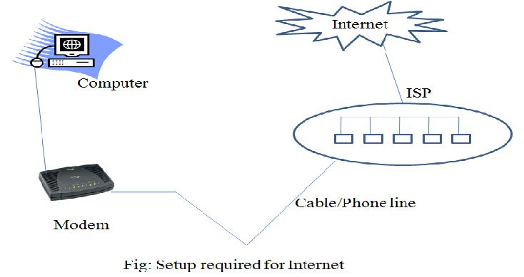
World wide web
World Wide Web(WWW) is a collection of software and corresponding protocols used to access the resources over the network.
The Web gives users access to a vast array of documents that are connected to each other by means of hypertext or hypermedia links.

Slide 13
WWW
Web page is a document available on world wide web. Web Pages are stored on web server and can be viewed using a web browser.

Slide 14
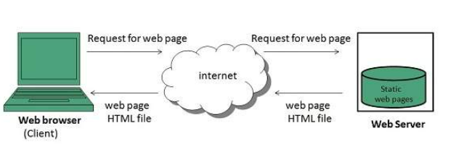
Static Websites
Static websites are also known as flat or stationary websites. They are loaded on the clients browser as exactly they are stored on the web server. Such websites contain only static information. User can only read the information but cant do any modification or interact with the information.

Slide 15
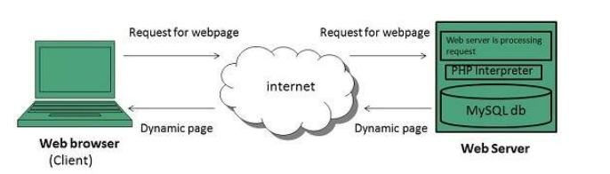
Dynamic Websites
Dynamic websites shows different information at different point of time. It is possible to change a portion of a web page without loading the entire web page. It has been made possible using Ajax technology

Slide 16
Web Browser
It is an application software that allows us to view and explore information on the web. User can request for any web page by just entering a URL into address bar.
A web browser (commonly referred to as a browser) is a software application for accessing information on the World Wide Web.
Documents provided by servers on the web are requested by browsers.
A browser is a client on the web because it initiates communication with a server.
Example: IE, chrome, Mozilla Firefox, Netscape Navigator, opera, safari,..

Slide 17
Domain Name Service
Every machine attached to the internet has an IP address.
But we generally access web servers by name, such as google.com.
The browser consults an additional internet service called the Domain Name Service (DNS) to find the server’s associated IP address and then uses it to communicate with the computer.

Slide 18
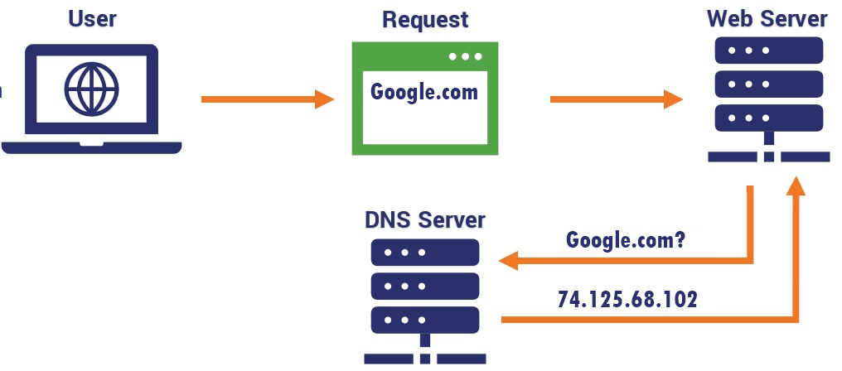
DNS

Slide 19
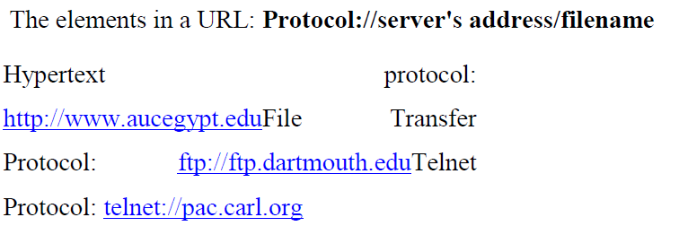
Uniform Resource Locator (URL)
URL is the address of a document found on the WWW. Browser interprets the information in the URL in order to connect to the proper Internet server and to retrieve your desired document .

Slide 20

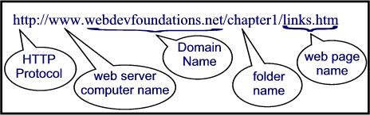
Uniform Resource Locator (URL)
unique identifiers used to locate a particular resource on the network

Slide 21
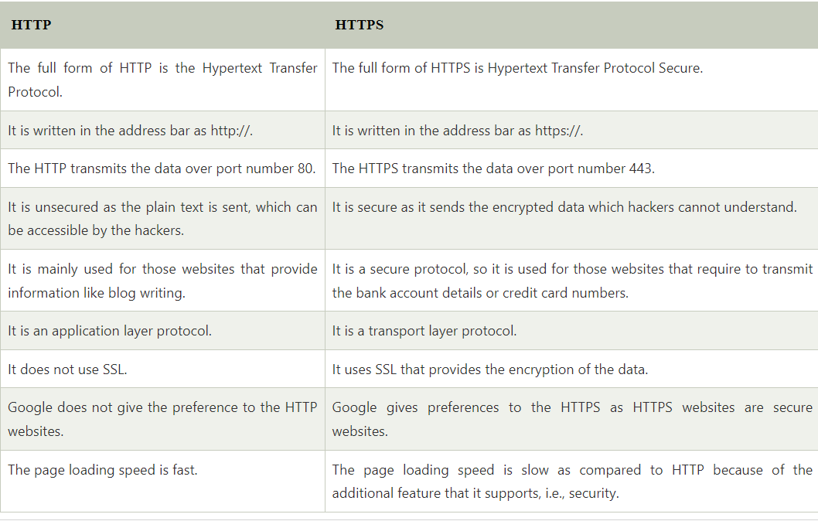
Difference between HTTP and HTTPS
HTTP lacks security mechanism to encrypt the data
HTTPS provides SSL or TLS Digital Certificate to secure the communication between server and client
HTTP operates at Application Layer whereas HTTPS operates at Transport Layer
HTTP by default operates on port 80 whereas HTTPS by default operates on port 443
HTTP transfers data in plain text while HTTPS transfers data in cipher text
HTTP is fast as compared to HTTPS because HTTPS consumes computation power to encrypt the communication channel
It provides encrypted and secure identification of a network server

Slide 22
Web Programming Languages
Web programming languages are used to develop websites and web applications. Common languages include:
HTML (HyperText Markup Language): The standard markup language for creating web pages.
CSS (Cascading Style Sheets): Used to style and format HTML documents.
JavaScript: A programming language to make web pages interactive.
PHP: A server-side scripting language for dynamic content.
Python: Popular for backend development using frameworks like Django and Flask.
Ruby: Known for web development with the Ruby on Rails framework.
Java: Used for building server-side applications.
SQL: Essential for managing and querying databases.

Slide 23
Html is used to create web pages(static web pages)
Html is not a procedural language like C, C++,Java..etc
It is a markup language which Identifies the element of the page so that , a browser like internet explorer or Netscape navigator can display that page on our computer screen.
A markup language is a set of markup tags.
The tag describes document content.
Html documents are also called web pages.

Slide 24
Introduction to HTML 5
Html5 is a language developed by Ian Hickson (Google) and David Hyatt (Apple) in 22 January 2008.
Filename extension .html , .htm
Open Source Hyper Text Resources
HTML5 =HTML + CSS+JS
HTML= Next Generation Features for Modern web Development.
Html5=WHATWG+W3C
It is Web Platform. It will be the new standard for HTML.
HTML5 is currently under development as the next major revision of the HTML standard.
HTML5 is a markup language for structuring and presenting World Wide Web and a core technology of the Internet.

Slide 25
1991–1999
HTML was created by web legend Tim Berners-Lee in 1991, and HTML versions 1–4 were developed throughout the 1990s by W3C. In these early days of widespread internet use, HTML efficiently displays the vast majority of web content, since at this time it largely consists of static, non-interactive sites.
2000
W3C recommends XHTML 1.0 – an XML-based markup language that mirrors/extends HTML. Previous versions of HTML are now showing their age, struggling to handle the latest generation of multimedia, and interactive sites. To get the best results, developers are resorting to third-party plugins.
2004
Development of HTML is closed by W3C, who instead decide to focus on XHTML. WHATWG is formed to develop HTML further, with the aim of reflecting the modern dynamic web, while keeping backwards compatibility with existing HTML code.
2004–2006
WHATWG gains support from major web browser developers. In 2006, W3C also announced its support for the project.
2008
The first public draft of HTML5 is released by WHATWG. Web Hypertext Application Technology Working Group

Slide 26
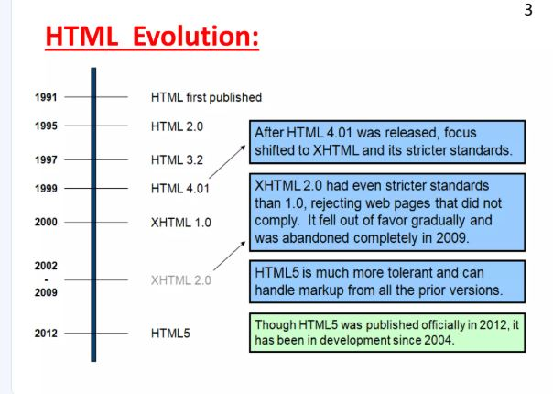

Slide 27
Why use HTML5
It allows you to play a video and audio file.
It allows you to draw on a canvas.
It facilitate you to design better forms and build web applications that work offline.
It provides you advance features for that you would normally have to write JavaScript to do.
The most important reason to use HTML 5 is, we believe it is not going anywhere.
It will be here to serve for a long time according to W3C recommendation.

Slide 28
syntax
</html> <!DOCTYPE html>
<html>
<head>
<title>Page Title</title>
</head>
<body>
<h1>My First Heading</h1>
<p>My first paragraph.</p>
</body>
</html>

Slide 29
HTML5-Syntax
<!DOCTYPE html>
<html lang="en">
<head>
<title>My Web Page</title>
</head>
<body>
<!-- This is a comment in HTML -->
<h1>welcome to web technology</H1>
</body>
</html>

Slide 30
Text Formatting Tags
Text formatting tags modify the text between the opening tag and the closing tag
<b> | Used to display bold text
<i> | Used to display italic text
<u> | Used to display underlined text
<sup> | used to superscript a text(Sample^{superscript)}
<sub> | used to subscript a text(Sample_{subscript )}
<MARK> | Defines marked/highlighted text
font | To change style of text
<pre></pre> | defines preformatted text.
<del></del> | Deleted text – strike through
<hr> | Defines horizontal line

Slide 31
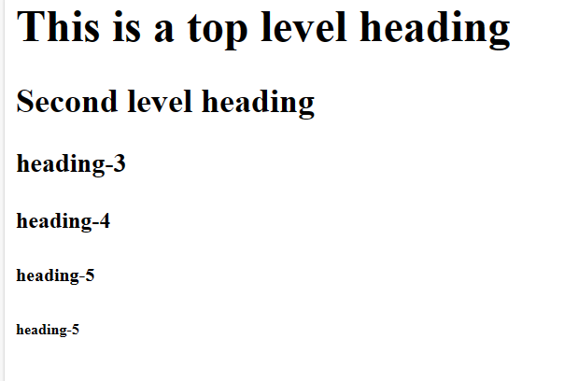
Heading Tags…
<HTM>
<BODY>
<H1>This is a top level heading</H1>
<H2>Second level heading</H2>
<h3> heading-3</h3>
<h4>heading-4</h4>
<h5> heading-5</h5>
<h6> heading-5</h6>
</BODY>
</HTML>

Slide 32
<img/video> Tag
<html>
<body>
<h1>HI,Rahul Dravid</h1>
<img src="rd.jpg" align="right" width="100" height="300"></img>
<video width="320" height="240" controls>
<source src="movie.mp4" type="video/mp4">
Your browser does not support the video tag.
</video>
</body>
</html>

Slide 33
HTML Links – <a> tag
The <a> tag defines a hyperlink, which is used to link from one page to another.
Hyperlinks allow visitors to navigate between Webpages by clicking on words and images.
<a href="Document URL" ... attributes-list>LinkText</a>
The href attribute specifies the destination address of the link.

Slide 34
LISTS
HTML supports 3 types of lists
unordered list
Ordered list
definition lists

Slide 35
1. Unordered lists
An unordered list is a collection of related items that have no special order or sequence.
Each item in the list is marked with a bullet by default.
<ul> tag is used to create un ordered list.
<li> tag is used to add items to the list.
<ul type=“circle|disc|square”>
Apple
Orange
Pear
Apple
Orange
Pear
Apple
Orange
Pear

Slide 36
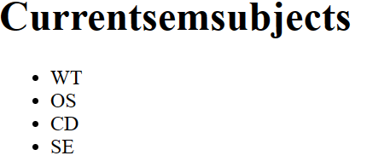
Example
<html>
<body>
<h1>Currentsemsubjects</h1>
<ul type=“circle”>
<li></li>
<li>WT</li>
<li>OS</li>
<li>CD</li>
<li>SE</li>
</ul>
</body>

Slide 37
2. Ordered Lists
An ordered list is a list of items marked with numbers.
<ol> tag is used to create an ordered list.
<li> tag is used to add items to the list.
The numbering starts at one and is incremented by one for each successive ordered list element tagged with <li>.
Syntax:
<ol type=“A”|a|”I”|”i”|”1”>

Slide 38
Example:
<html>
<body>
<ol type=“1”>
<li>Sachin</li>
<li>Dravid</li>
<li>Ganguly</li>
</ol>
</body>
</html>

Slide 39
3. Definition Lists
A definition list is a list of items , with a description of each item
A definition list starts with a <dl> tag (definition list).
Each term starts with a <dt> tag (definition term).
Each description starts with a <dd> tag (definition description).
<dl>
  <dt>HTML</dt>
  <dd>A markup language …</dd>
  <dt>CSS</dt>
  <dd>Language used to …</dd>
</dl>

Slide 40
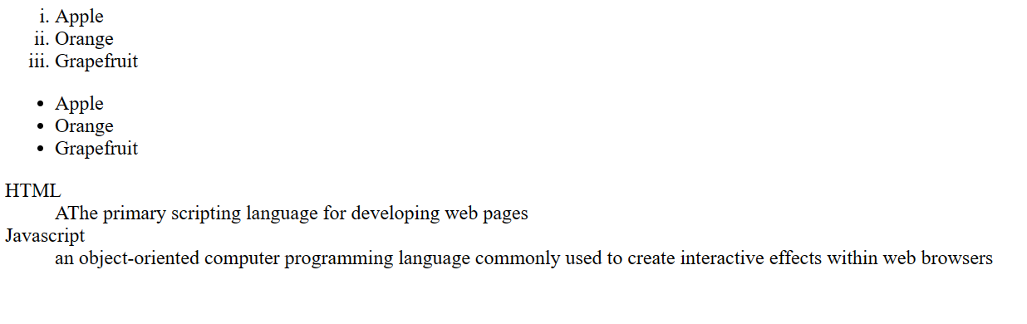
Example:
<html>
<body>
<ol type="1">
<li>Apple</li>
<li>Orange</li>
<li>Grapefruit</li>
</ol>
<ul type="disc">
<li>Apple</li>
<li>Orange</li>
<li>Grapefruit</li>
</ul><dl>
<dt>HTML</dt>
<dd>AThe primary scripting language for developing web pages </dd>
<dt>Javascript</dt>
<dd>an object-oriented computer programming language commonly used to create interactive effects within web browsers</dt>
</dl></body></html>

Slide 41
Tables
Tables represent tabular data
  A table consists of one or several rows
  Each row has one or more columns
The HTML tables are created using the <table> tag
The <tr> tag is used to create table rows and <td> tag is used to create data cells.
Table heading can be defined using <th> tag.
<td> tag, which is used to represent actual data cell.

Slide 42
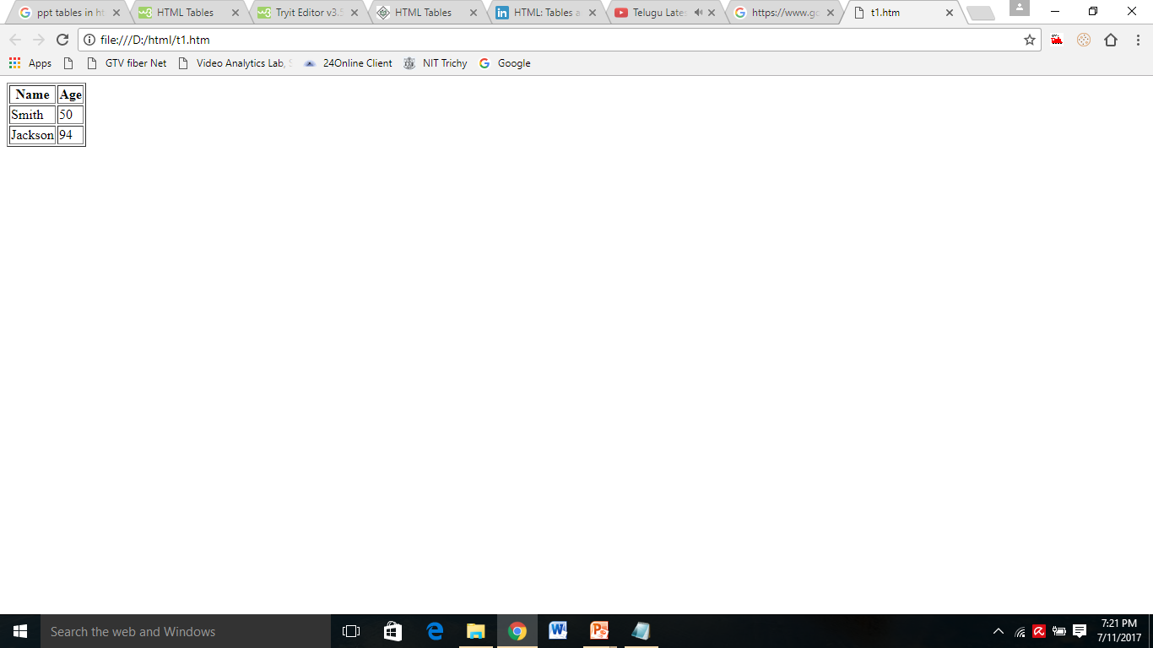
Cont ..
<table style border=1>
<tr>
<th>Name</th>
<th>Age</th>
</tr>
<tr>
<td>Smith</td>
<td>50</td>
</tr>
<tr>
<td>Jackson</td>
<td>94</td>
</tr>

Slide 43
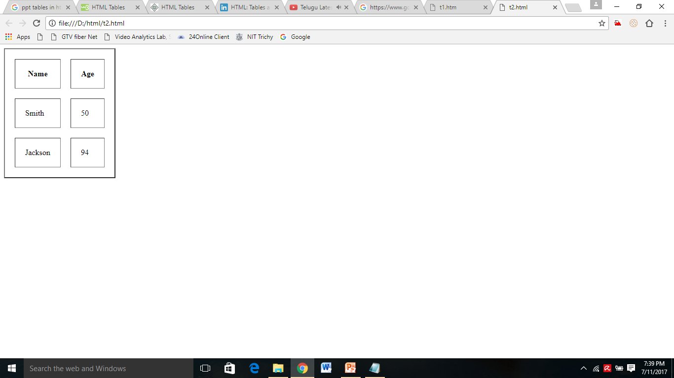
Cellpadding and Cellspacing Attributes
The cellspacing specifies the width of the border
Cell padding specifies the space between the cell content and its borders.
<table style border=2 cellpadding="10" cellspacing="10">
<tr>
<th>Name</th>
<th>Age</th>
</tr>
<tr>
<td>Smith</td>
<td>50</td>
</tr>
<tr>
<td>Jackson</td>
<td>94</td>
</tr>
</table>

Slide 44
Colspan and Rowspan Attributes
colspan attribute merge two or more columns into a single column. Ex: <td colspan=2>
rowspan merge two or more rows. Ex: <td rowspan=3>

Slide 45
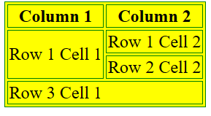
<table border="1" bordercolor="green" bgcolor=“yellow">
<tr><th>Column 1</th><th>Column 2</th></tr>
<tr><td rowspan="2">Row 1 Cell 1</td><td>Row 1 Cell 2</td></tr>
<tr><td>Row 2 Cell 2</td></tr>
<tr><td colspan="2">Row 3 Cell 1</td></tr>
</table>

Slide 46
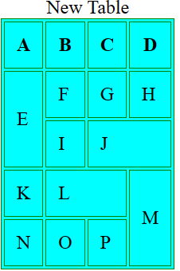
<html>
<body>
<table border="1" bordercolor="green" bgcolor="cyan" cellspacing="2" cellpadding="10">
<caption>New Table</caption>
<tr><th>A</th><th>B</th><th>C</th><th>D</th></tr>
<tr><td rowspan=2>E</td><td>F</td><td>G</td><td>H</td></tr>
<tr><td>I</td><td colspan=2>J</td></tr>
<tr><td>K</td><td colspan=2>L</td><td rowspan=2>M</td></tr>
<tr><td>N</td><td>O</td><td>P</td></tr>
</table>
</body>
</html>

Slide 47
HTML Frames:
HTML Frames are used to divide the web browser window into multiple sections where each section can be loaded separately
HTML provides multiple frames at one browser with frameset
Every <frame> within the <frameset> tag may use attributes for different purpose like: border, resizing capability, include scrolling etc.
With frames display menu(s) in any portion of your page along with the content in another part of the page

Slide 48
Frames
The <frame> tag was used in HTML 4 to define one particular window (frame) within a <frameset>.
      <frameset cols = "25%,50%,25%">
      <frame name = "left" src = "/html/top_frame.htm" />
      <frame name = "center" src = "/html/main_frame.htm" />
      <frame name = "right" src = "/html/bottom_frame.htm" />
      <noframes>
      <body>Your browser does not support frames.</body>
      </noframes>
      </frameset>

Slide 49
iframe
<iframe> tag to embed another document within the current HTML document.
    <iframe src=“www.HTMLSamples.com" title=“Sample HTML Page">
    </iframe>

Slide 50
FORMS
HTML Forms are required when you want to collect data from the user.
For example during user registration you would like to collect information such as name, email address, credit card, etc.
A form will take input from the user and then will post it to a back-end application such as CGI, Servlets ,JSP or PHP script etc.
There are various form elements available like text fields, text area fields, drop-down menus, radio buttons, checkboxes, etc.

Slide 51
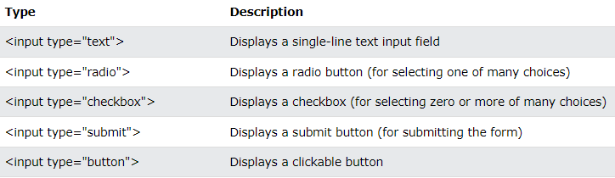
HTML Forms:
An HTML form is used to collect user input.
The user input is most often sent to a server for processing.
The HTML <form> element is used to create an HTML form
The <form> element is a container for different types of input elements: text fields, checkboxes, radio buttons, submit buttons, etc.
The HTML <input> element is the most used form element.
It can be displayed in many ways, depending on the type attribute.

Slide 52
FORMS
The HTML <form> tag is used to create an HTML form and it has following syntax:
<form action="Script URL" method="GET|POST">
form elements like input, text area etc.
</form>
Attribute | Description
action | url of Backend script ready to process your passed data.
method | Method to be used to send data. The most frequently used are GET and POST methods.

Slide 53
HTML Form Controls or Elements
There are different types of form controls that you can use to collect data using HTML form
Text Input Controls
Radio Box Controls
Checkboxes Controls
Select Box Controls
File Select boxes
Submit and Reset Button

Slide 54
Text Input Controls
Text Field
Password field
Text Area
Text Field:
This is used for items that require only one line of user input, such as search boxes or names.
They are created using HTML <input> tag.
Syntax:
<input type="text" name="first_name" value=“initial value”/>

Slide 55
Cont …
Password field:
This is also a single-line text input but it masks the character as soon as a user enters it.
They are also created using HTML <input> tag but type attribute is set to password.
Syntax:
<input type=“password" name=“password" />
Textarea:
This is used when the user is required to give details that may be longer than a single sentence.
Multi-line input controls are created using HTML <textarea> tag.
<textarea rows="5" cols="50" name="description">

Slide 56
Example
<html>
<body bgcolor="green">
<form >
User ID : <input type="text" name="user_id" />
<br>
Password: <input type="password" name="password" /><br>
Description : <br>
<textarea rows="5" cols="50" name="description">
Enter description here...
</textarea>
</form>
</body>
</html>

Slide 57
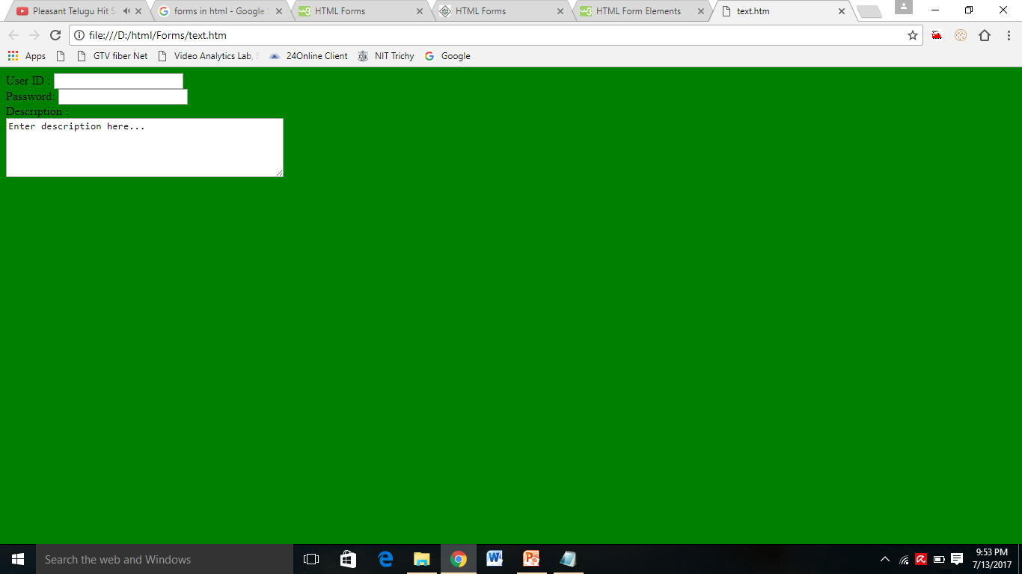
OUTPUT:

Slide 58
Radio Buttons
Radio buttons are used when out of many options, just one option is required to be selected.
They are also created using HTML <input> tag but type attribute is set to radio.
Syntax:
<input type="radio" name=“name" value=“value">
Attribute | Description
type | Indicates the type of input control and for checkbox input control it will be set to radio.
name | Used to give a name to the control which is sent to the server to be recognized and get the value.
value | The value that will be used if the radio box is selected.
checked | Set to checked if you want to select it by default.

Slide 59
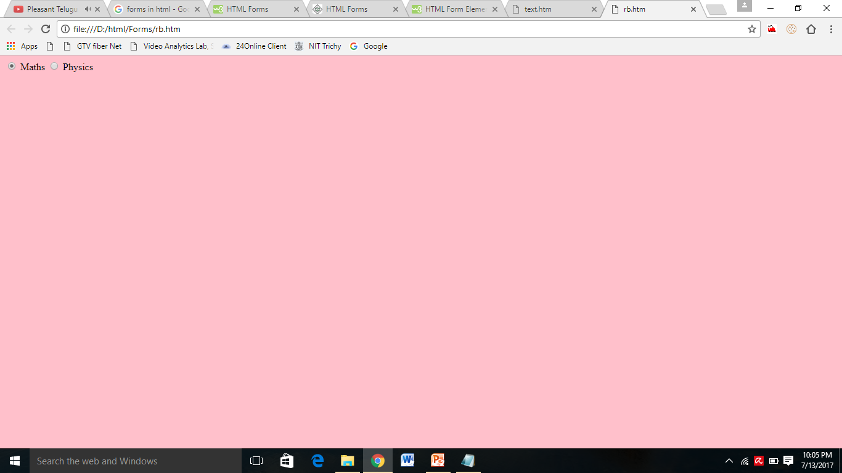
<html>
<body bgcolor="pink">
<form>
<input type="radio" name="subject" value="maths"> Maths
<input type="radio" name="subject" value="physics"> Physics
</form>
</body>
</html>

Slide 60
Checkboxes
Checkboxes are used when more than one option is required to be selected.
They are also created using HTML <input> tag but type attribute is set to checkbox
Syntax:
<input type="checkbox" name=“name" value=“value">
Attribute | Description
type | Indicates the type of input control and for checkbox input control it will be set to checkbox.
name | Used to give a name to the control which is sent to the server to be recognized and get the value.
value | The value that will be used if the checkbox is selected.
checked | Set to checked if you want to select it by default.

Slide 61
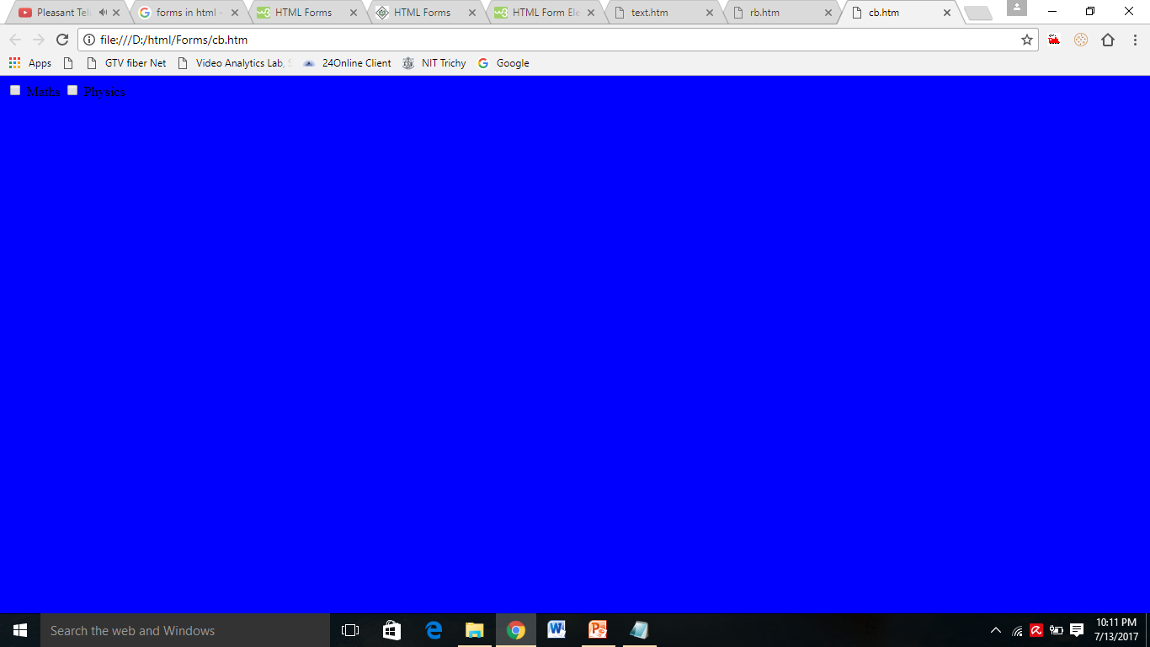
Example
<html>
<body bgcolor="blue">
<form>
<input type="checkbox" name="maths" value="on"> Maths
<input type="checkbox" name="physics" value="on"> Physics
</form>
</body>
</html>

Slide 62
Select Box
A select box, also called drop down box which provides option to list down various options in the form of drop down list, from where a user can select one or more options.
multiple attribute specifies that multiple options can be selected at once.
Size attribute specifies that no of options can be visible at once.
<select name="dropdown">
<option value="Maths" selected>Maths</option>
<option value="Physics">Physics</option> </select>

Slide 63
Example
<select name=”selColor”>
<option selected=”selected” value=”“>Select color</option>
<option value=”red”>Red</option>
<option value=”green” selected>Green</option>
<option value=”blue”>Blue</option>
</select>

Slide 64
Output

Slide 65
File Select boxes
If you want to allow a user to upload a file to your web site, you will need to use a file upload box, also known as a file select box.
This is also created using the <input> element but type attribute is set to file.
Syntax :
<input type="file" name="fileupload" accept="image/*" />
Attribute | Description
name | Used to give a name to the control which is sent to the server to be recognized and get the value.
accept | Specifies the types of files that the server accepts.

Slide 66
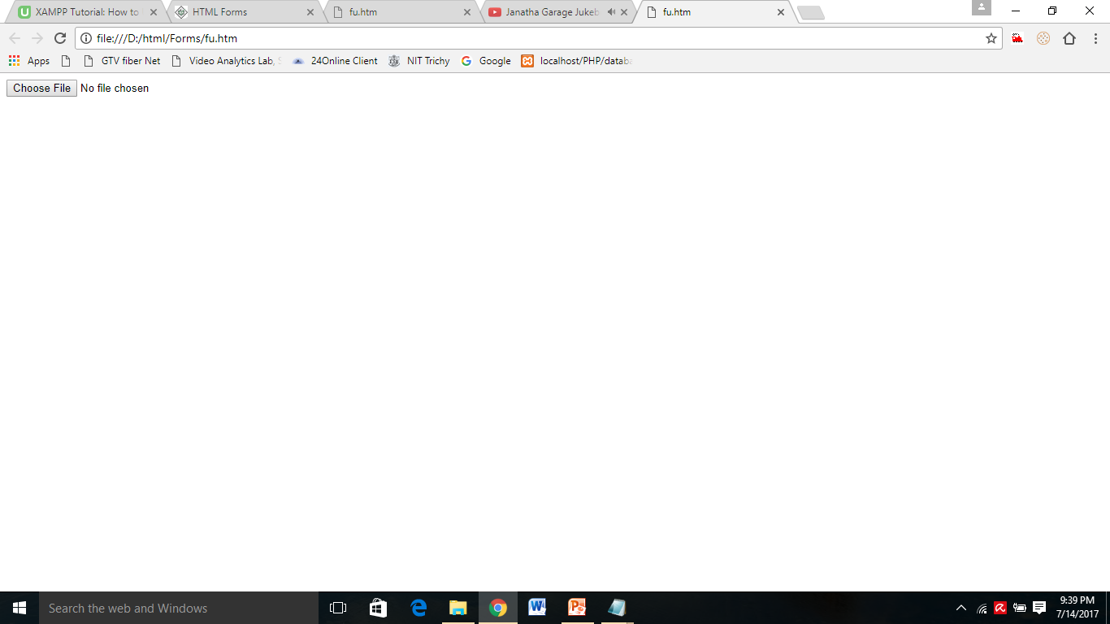
File Select boxes
<html>
<body>
<form>
<input type="file" name="fileupload" accept="image/*" />
</form>
</body>
</html>

Slide 67
Button Controls
There are various ways in HTML to create clickable buttons. You can also create a clickable button using <input> tag by setting its type attribute to button.
The type attribute can take the following values:
Type | Description
submit | This creates a button that automatically submits a form.
reset | This creates a button that automatically resets form controls to their initial values.
image | This creates a clickable button but we can use an image as background of the button.

Slide 68
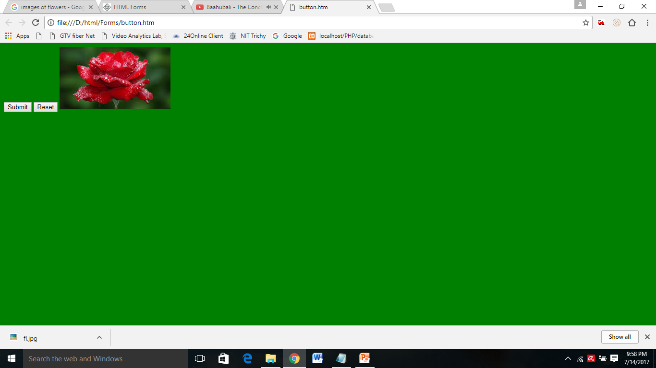
<html>
<body bgcolor="green">
<form>
<input type="submit" name="submit" value="Submit" />
<input type="reset" name="reset" value="Reset" />
<input type="image" name="imagebutton" src="fl.jpg" />
</form>
</body>
</html>

Slide 69
Fieldsets & Labels
Fieldsets are used to enclose a group of related form fields:
The <legend> is used to set the fieldset's title.
<fieldset>
<legend>Title</legend>
</fieldset>
Form labels are used to associate an text to a form field
<label>First Name</label>

Slide 70
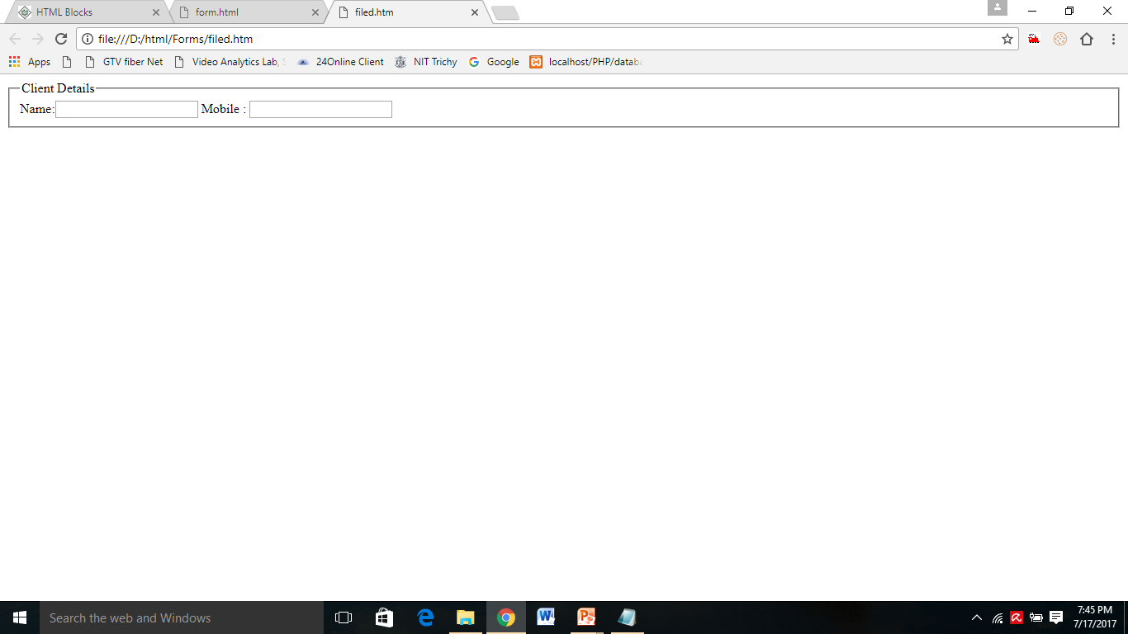
<html>
<form method="post" action="form.aspx">
<fieldset>
<legend>Client Details</legend>
<Label>Name:</label><input type="text" id="Name" />
<Label>Mobile :</label> <input type="text" id="Phone" />
</fieldset>
</html>

Slide 71
<marquee> tag
An HTML marquee is a scrolling piece of text displayed either horizontally across or vertically down your webpage depending on the settings.
This is created by using HTML <marquee> tag.
<marquee attribute_name="attribute_value"....more attributes> One or more lines or text message or image </marquee>

Slide 72
<marquees> tag
Attribute | Description
width | This specifies the width of the marquee. This can be a value like 10 or 20% etc.
height | This specifies the height of the marquee. This can be a value like 10 or 20% etc.
direction | This specifies the direction in which marquee should scroll. This can be a value like up, down, left or right.
loop | This specifies how many times to loop. The default value is INFINITE, which means that the marquee loops endlessly.
bgcolor | This specifies background color in terms of color name or color hex value.

Slide 73
EVENTS
HTML5 events are actions or occurrences that happen in the browser, such as a user clicking a button, a page finishing loading, or a video starting to play. These events can be "listened" for by JavaScript code, which can then execute specific functions in response. This allows for dynamic and interactive web pages.
Here's a breakdown of common HTML5 event categories and some examples:
1. Window Events: These events are triggered on the window object.
onload: Triggered once the entire page (including all resources like images and scripts) has finished loading.
onunload: Triggered just before the page is unloaded (e.g., when the user navigates away or closes the window).
onresize: Triggered when the browser window has been resized.
onscroll: Triggered when the user scrolls the window.

Slide 74
2. Form Events: These events are related to HTML forms and their elements.
onsubmit: Triggered when a form is submitted.
onreset: Triggered when a form is reset to its default values.
onfocus: Triggered when an element (like an input field) gains focus.
onblur: Triggered when an element loses focus.
onchange: Triggered when the value of an element (like an input, select, or textarea) has been changed and the element loses focus.
oninput: Triggered when the value of an input, textarea, or select element is changed.
onselect: Triggered when the user selects some text in an input field or textarea.

Slide 75
3. Mouse Events: These events occur due to user interaction with the mouse.
onclick: Triggered when an element is clicked.
ondblclick: Triggered when an element is double-clicked.
onmousedown: Triggered when a mouse button is pressed down over an element.
onmouseup: Triggered when a mouse button is released over an element.
onmousemove: Triggered when the mouse pointer moves while it is over an element.
onmouseover: Triggered when the mouse pointer moves onto an element.
onmouseout: Triggered when the mouse pointer moves out of an element.
onwheel: Triggered when the mouse wheel is rotated over an element.

Slide 76
4. Keyboard Events: These events are related to user interaction with the keyboard.
onkeydown: Triggered when a key is pressed down.
onkeypress: Triggered when a key is pressed and released (for character-producing keys).
onkeyup: Triggered when a key is released.
5. Media Events: These events are specific to HTML5 <audio> and <video> elements.
onplay: Triggered when the media starts playing.
onpause: Triggered when the media is paused.
onended: Triggered when the media has reached the end.
onvolumechange: Triggered when the volume of the media changes.
onseeking: Triggered when the user starts moving to a new position in the media.
onseeked: Triggered when the seeking operation is complete.
ondurationchange: Triggered when the duration of the media changes.
ontimeupdate: Triggered when the current playback position of the media changes.

Slide 77
SVG (Scalable Vector Graphics)
In HTML5, SVG (Scalable Vector Graphics) is used to define vector-based graphics for the web. SVG is an XML-based markup language that can be embedded directly into HTML documents. It allows for resolution-independent, scalable, and interactive graphics, making it ideal for responsive web design, data visualizations, icons, and more.
Basic Example of SVG in HTML5
<html lang="en">
<head>
<meta charset="UTF-8">
<title>SVG Example</title>
</head>
<body>
<h1>My SVG Circle</h1>
<svg width="200" height="200">
<circle cx="100" cy="100" r="80" stroke="blue" stroke-width="4" fill="lightblue" />
</svg>
</body>
</html>

Slide 78
Element | Description
<svg> | The container element
<circle> | A circle
<rect> | A rectangle
<line> | A line
<ellipse> | An ellipse
<polygon> | A closed shape with multiple sides
<path> | A complex shape using commands
<text> | Text inside SVG
Embedding SVG
Inline SVG (recommended for dynamic or styled content):
<svg>...</svg>
2. Object tag:
<object type="image/svg+xml" data="image.svg"></object>
3.Image tag (no interactivity):
<img src="image.svg" alt="My SVG" />

Slide 79
Introduction to Canvas
The HTML5 <canvas> element is used to draw graphics on the fly via JavaScript. It's a powerful feature for rendering shapes, images, animations, games, and data visualizations—all directly in the browser.
Basic Syntax
<canvas id="myCanvas" width="400" height="200"></canvas>
The <canvas> tag creates a rectangular drawing area.
By itself, it’s just a container; all drawing must be done with JavaScript.
JavaScript to Draw on Canvas
<canvas id="myCanvas" width="400" height="200" style="border:1px solid #000;"></canvas>
<script>
const canvas = document.getElementById("myCanvas");
const ctx = canvas.getContext("2d"); // 2D rendering context
ctx.fillStyle = "blue";
ctx.fillRect(50, 50, 150, 100); // x, y, width, height</script>

Slide 80
Purpose | Method
Draw rectangle | fillRect(x, y, w, h)
Draw circle | arc(x, y, radius, startAngle, endAngle)
Draw line | moveTo(x, y) + lineTo(x, y) + stroke()
Set color | fillStyle, strokeStyle
Clear canvas | clearRect(x, y, w, h)
Draw text | fillText(text, x, y)
Example: Draw a Circle
ctx.beginPath();
ctx.arc(100, 75, 50, 0, 2 * Math.PI); // x, y, radius, startAngle, endAngle
ctx.stroke();
When to Use <canvas>
Use canvas when you need:
Dynamic, pixel-based graphics
Games
Graphing/Charting
Image editing
Real-time visualizations

Slide 81
Geolocations
HTML Geolocation is used to get the geographical position of a user. Due to privacy concerns, this position requires user approval.
Geo-location in HTML5 is used to share the location with some websites and be aware of the exact location. It is mainly used for local businesses, and restaurants, or showing locations on the map. It uses JavaScript to give latitude and longitude to the backend server.
Most browsers support Geolocation API. Geo-location API uses a global navigator object. HTML Geolocation, various properties, methods & their implementation through examples.

Slide 82
Geolocations
<script>
const x = document.getElementById("demo");
function getLocation() {
if (navigator.geolocation) {
navigator.geolocation.getCurrentPosition(success, error);
} else {
x.innerHTML = "Geolocation is not supported by this browser.";
}
}
function success(position) {
x.innerHTML = "Latitude: " + position.coords.latitude +
"<br>Longitude: " + position.coords.longitude;
}</script>

Slide 83
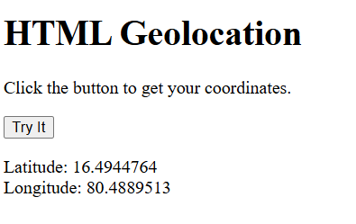
Geolocations

Slide 84
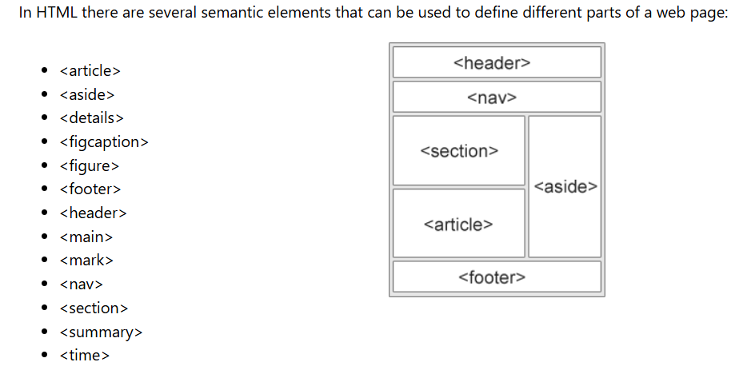
Semantic Elements

Slide 85
How CSS is different from HTML?
HTML is used to define a structure of a web page whereas CSS is used to style of the web pages by using different styling features.
HTML consists of tags inside which text is enclosed and CSS consists of selectors and declaration blocks.
CSS can be internal or external depending upon the requirement.
We cannot use HTML inside a CSS sheet but we can use CSS inside an HTML document.
CSS has comparatively higher backup and support than HTML.

Slide 86
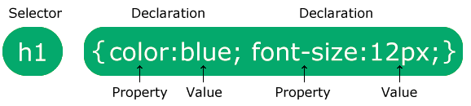
CSS Syntax
A CSS rule consists of a selector and a declaration block
The selector points to the HTML element you want to style
The declaration block contains one or more declarations
Each declaration includes a CSS property name and a value, separated by a colon
Multiple CSS declarations are separated with semicolons, and declaration blocks are surrounded by curly braces

Slide 87
CSS (Cascading Style Sheets)
CSS (Cascading Style Sheets) is a style sheet language used to design a webpage to make it attractive. The reason for using this is to simplify the process of making web pages presentable. It allows you to apply styles on web pages.

Slide 88
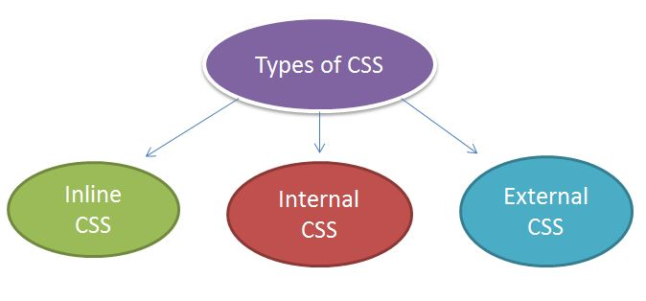
CSS

Slide 89
Inline Style Sheet
The inline CSS is also a method to insert style sheets in HTML document.
Syntax
<htmltag style="cssproperty1:value; cssproperty2:value;"> </htmltag>
Example
<h2 style="color:red;margin-left:40px;">Inline CSS is applied on this heading.</h2>

Slide 90
Example Program
<html>
<head>
<title>Login Page </title>
</head>
<body>
<h1 style = "color:green; font-family:Time new roman;
font-size:26pt;"> VIT-AP</h1>
<h2 style = "color:red; font-family:verdana;
font-size:26pt;"> One of the best university in AP </h1>
<p>Vijayawada</p>
  </body>
  </html>

Slide 91
Internal Style Sheet
The internal style sheet is used to add a unique style for a single document. It is defined in <head> section of the HTML page inside the <style> tag.

Slide 92
Example
<!DOCTYPE html>
<html>
<head>
<style>
body {
background-color: red;
}
h1 {
color: yellow; margin-left: 80px;
}
</style>
</head>
<body>
<h1>The internal style sheet is applied on this heading.</h1>
<p>This paragraph will not be affected.</p>
</body>
</html>

Slide 93
External CSS
The external style sheet is generally used when you want to make changes on multiple pages.
It uses the <link> tag on every pages and the <link> tag should be put inside the head section.
Example
<head>
<link rel="stylesheet" type="text/css" href="mystyle.css">
</head>

Slide 94
body {
background-color: lightblue;
}
h1 {
color: navy;
margin-left: 20px;
}

Slide 95
Selectors - Patterns-To apply the different styles to various html elements
Simple selector-Single style applied in single element
Universal selector(*)-Single style applied in all the elements
Class selector-Assign different styles to same element
Generic selector-Particular style applied to any tag
ID selector-Style applied to one specific element
Pseudo class selector-Give special effects on the elements
_{STM-boris beizer}
₉₅

Slide 96
_{Simple selector:}
_{<html>}
_{<head>}
_{<title>Simple Selector</title>}
_{<style type="text/css">}
_{h1}
{
_{font-family:Arial;}
_{color:green;}
}
_{</style>}
_{</head>}
_{<body>}
_{<h1>India is My Country</h1>}
_{</body>}
_{</html>}
₉₆

Slide 97
_{Universal selector(*):}
_{<html><head>}
<title>Universal Selector</title>
_{<style type="text/css">}
*
{
_{font-family:Arial;}
_{color:blue;}
}
_{</style></head><body>}
_{<h1>Welcome to VIT AP</h1>}
_{<h2>Amaravati</h2>}
_{<h3>AP</h3>}
_{</body>}
_{</html>}
₉₇

Slide 98
_{Class selector:}
_{<html><head>}
_{<title>Class Selector</title>}
_{<style type="text/css">}
_{h1.RedText}
{
_{font-family:Arial;}
_{color:red;}
}
_{h1.BlueText}
{
_{font-family:Monotype Corsiva;}
_{color:blue;}
}
_{</style></head><body>}
<h1 class="RedText">Artificial Intelligence</h1>
<h1 class="BlueText">Machine Learning</h1>
_{</body>}
_{</html>}
₉₈

Slide 99
_{Generic selector:}
_{<html>}
_{<head>}
<title>Generic Selector</title>
_{<style type="text/css">}
_{.RedText}
{
_{font-family:Arial;}
_{color:red;}
}
_{</style>}
_{</head>}
_{<body>}
<h2 class="RedText">Deep Learning</h2>
<p class="RedText"> Artificial Intelligence </p>
_{</body>}
_{</html>}
₉₉

Slide 100
_{ID selector:}
_{<html><head>}
_{<title>ID Selector</title>}
_{<style type="text/css">}
_{#top}
{
_{font-family:Arial;}
_{color:red;}
_{font-size:16pt;}
}
_{</style></head><body>}
_{<h1>India is My Country</h1>}
<h2 id="top">India is My Country</h2>
_{</body></html>}
_{STM-boris beizer}
₁₀₀

Slide 101
_{Pseudo class selector:}
_{<html>}
_{<head>}
_{<title>Focus Selector</title>}
_{<style type="text/css">}
_{input:focus}
{
_{background-color:skyblue;}
_{color:white;}
_{font-family:Arial;}
_{font-size:16pt;}
}
_{</style>}
_{</head>}
_{<body>}
Enter some string:<input type="text" name="mytext"/>
_{</body>}
_{</html>}
₁₀₁

Slide 102
CSS Align
Center Align Elements
To horizontally center a block element (like <div>), use margin: auto;
Left, right, center, top and bottom

Slide 103
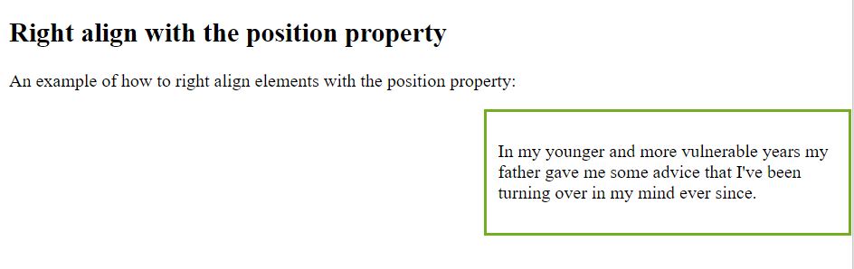
CSS Align
<html>
<head>
<style>
.right {
position: absolute;
right: 0px;
width: 300px;
border: 3px solid #73AD21;
padding: 10px;
}
</style>
</head>
<body>
<h2>Right align with the position property</h2>
<p>An example of how to right align elements with the position property:</p>
<div class="right">
<p>In my younger and more vulnerable years my father gave me some advice that I've been turning over in my mind ever since.</p>
</div>
</body>
</html>

Slide 104
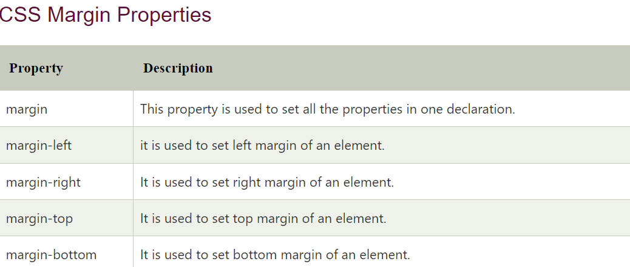
CSS Margin
CSS Margin property is used to define the space around elements. It is completely transparent and doesn't have any background color. It clears an area around the element.
Top, bottom, left and right margin can be changed independently using separate properties. You can also change all properties at once by using shorthand margin property.

Slide 105
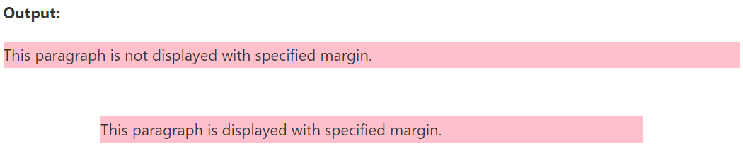
CSS Margin
<body>
<p>This paragraph is not displayed with specified margin. </p>
<p class="ex">This paragraph is displayed with specified margin.</p>
</body>
</html>
<html> <head> <style>
p {
background-color: pink;
}
p.ex {
margin-top: 50px;
margin-right: 100px;
margin-bottom: 50px;
margin-left: 100px;
(or)margin: 50px 100px 150px 200px;
}
</style> </head>

Slide 106
CSS Background
CSS background property is used to define the background effects on element.
There are 5 CSS background properties that affects the HTML elements:
  background-color
  background-image
  background-repeat
  background-attachment
  background-position

Slide 107
CSS background-color
The background-color property is used to specify the background color of the
element.
h2
{
background-color: color nameor rgb or hexadecimal;
background-color: green;
background-color: rgb(255,0,0);
background-color: #ff000080;
}

Slide 108
Example
<!DOCTYPE html>
<html>
<head>
<style>
h2{
background-color: yellow;
}
p{
background-color: red; }
</style>
</head>
<body>
<h2>VIT-AP</h2>
<p>Vijayawada</p>
</body>
</html>

Slide 109
CSS background-image
The background-image property is used to set an image as a background of an element.
<!DOCTYPE html>
<html>
<head>
<style>
body {
background-image:url("vit.jpg");
margin-left:100px;
}
</style>
</head>
<body>
<h1>VIT-AP, Vijayawada</h1>
</body>
</html>

Slide 110
CSS background-repeat
By default, the background-image property repeats the background image horizontally and vertically. Some images are repeated only horizontally or vertically.
If The background looks better if the image repeated horizontally only.
<!DOCTYPE html>
<html>
<head>
<style>
body {
background-image: url("vit.jpg");
background-repeat: repeat-x;
}
</style>
</head>
<body>
<h1>Hello VIT-AP</h1>
</body>
</html>

Slide 111
CSS background-attachment
The background-attachment property is used to specify if the background image is fixed or scroll with the rest of the page in browser window. If you set fixed the background image then the image will not move during scrolling in the browser.
background: white url('bbb.gif');
background-repeat: no-repeat;
background-attachment: fixed;

Slide 112
CSS background-position
The background-position property is used to define the initial position of the
background image. By default, the background image is placed on the top-left
of the webpage.
You can set the following positions:
  center
  top
  bottom
  left
  right

Slide 113
CSS Border
The CSS border is a shorthand property used to set the border on an element.
The CSS border properties are use to specify the style, color and size of the border of an element. The CSS border properties are
  border-style
  border-color
  border-width
  border-radius

Slide 114
CSS border-style
The Border style property is used to specify the border type which you want to display on the web page.
There are some border style values which are used with border-style property to define a border.
  None - It doesn't define any border.
  Dotted - It is used to define a dotted border.
  Dashed -It is used to define a dashed border.
  Solid - It is used to define a solid border.
  Double- It defines two borders with the same border-width value.

Slide 115
CSS border-width
The border-width property is used to set the border's width. It is set in pixels. You can also use the one of the three pre-defined values, thin, medium or thick to set the width of the border.

Slide 116
CSS border-color
There are three methods to set the color of the border.
  Name: It specifies the color name. For example: "red".
  RGB: It specifies the RGB value of the color. For example: "rgb(255,0,0)".
  Hex: It specifies the hex value of the color. For example: "#ff0000".
There is also a border color named "transparent". If the border color is not set it is inherited from the color property of the element.

Slide 117
CSS Grid
A grid can be defined as an intersecting set of horizontal lines and vertical lines.
CSS Grid layout divides a page into major regions.
Grid property offers a grid-based layout system having rows and columns. It makes the designing of web pages easy without positioning and floating.
We can define columns and rows on the grid by using grid-template-rows and grid-template-columns properties.

Slide 118
Grid Container
We can define the grid container by setting the display property to grid or inline-grid on an element.
Grid container contains grid items that are placed inside rows and columns.

Slide 119
<style>
.main {
display: grid;
grid: auto auto / auto auto auto auto;
grid-gap: 10px;
background-color: black;
padding: 10px;
}
.num {
background-color: grey;
text-align: center;
color: white;
padding: 10px 10px;
font-size: 30px;
}
</style>

Slide 120
Grid
some of the shorthand properties:
  grid-template-columns: It is used to specify the size of the columns.
  grid-template-rows: It is used to specify the row size.
  grid-template-areas: It is used to specify the grid layout by using the named items.
  grid-auto-rows: It is used to specify the automatic size of the rows.
  grid-auto-columns: It is used to specify the automatic size of the columns.
  grid-auto-flow: It is used to specify how to place auto-placed items and the automatic row size.

Slide 121
CSS Table
We can apply style on HTML tables for better look and feel. There are some
CSS properties that are widely used in designing table using CSS:
  border
  border-collapse
  padding
  width
  height
  text-align
  color
  background-color

Slide 122
CSS Table Border
We can set border for the table, th and td tags using the CSS border property.
Syntax
<style>
table, th, td {
border: 1px solid black;
}
</style>

Slide 123
CSS Table Border Collapse
By the help of border-collapse property, we can collapse all borders in one
border only.
Syntax
<style>
table, th, td {
border: 2px solid black;
border-collapse: collapse;
}
</style>

Slide 124
CSS Table Padding
We can specify padding for table header and table data using the CSS padding
property.
<style>
table, th, td {
border: 1px solid black;
border-collapse: collapse;
  }
th, td {
padding: 10px;
}
</style>

Slide 125
CSS Padding
CSS Padding property is used to define the space between the element content and the element border.
It is different from CSS margin in the way that CSS margin defines the space around elements. CSS padding is affected by the background colors. It clears an area around the content.
Top, bottom, left and right padding can be changed independently using separate properties.

Slide 126
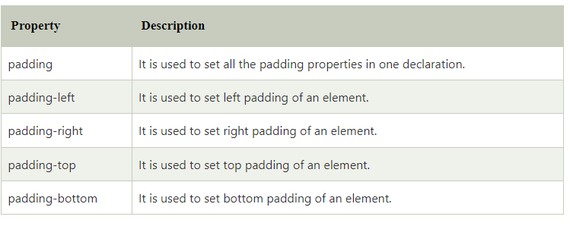
CSS Padding Properties

Slide 127
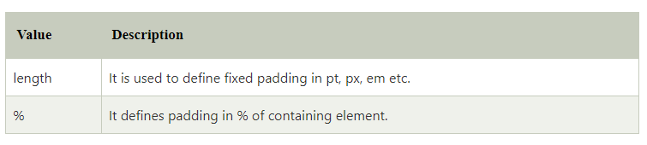
CSS Padding Values

Slide 128
CSS Box Model
A CSS box model is a compartment that includes numerous assets, such as edge, border, padding and material. It is used to develop the design and structure of a web page. It can be used as a set of tools to personalize the layout of different components.
The CSS box model contains the different properties in CSS. These are listed below.
  Border
  Margin
  Padding
  Content

Slide 129
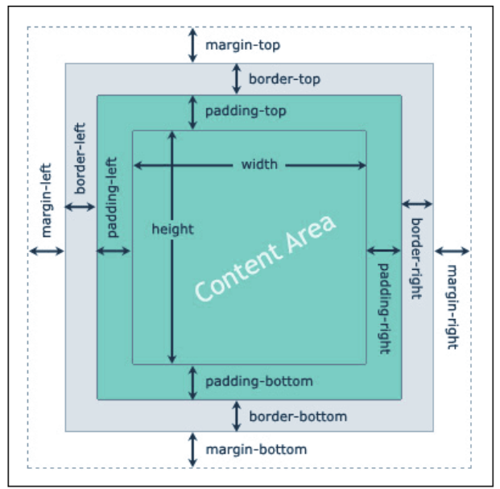

Slide 130
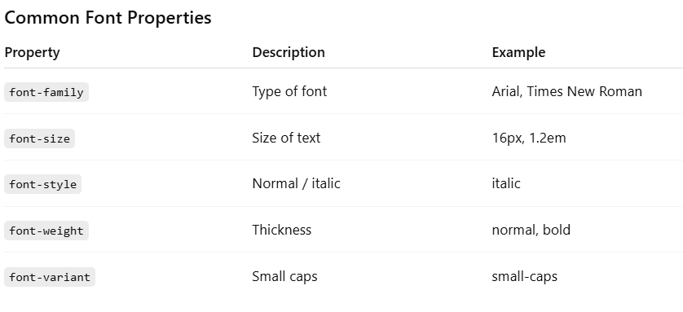
CSS TEXT and FONT Properties

Slide 131
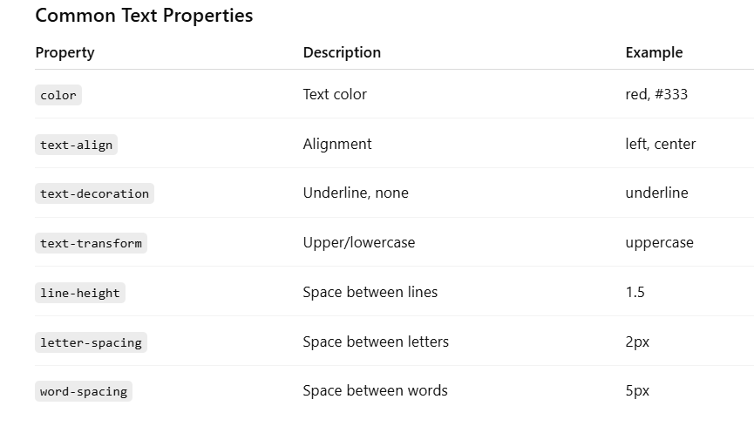
CSS TEXT and FONT Properties

