Slide 1
CSE4004 – Web Technologies
Client-Side Programming:
The JavaScript Language

Slide 2
What is JavaScript?
JavaScript (js) is a light-weight object-oriented programming language which is used by several websites for scripting the webpages.
It is an interpreted, full-fledged programming language that enables dynamic interactivity on websites when applied to an HTML document.
It was introduced in the year 1995 for adding programs to the webpages in the Netscape Navigator browser.
JavaScript is one of the popular scripting languages having following features :
  It can be used for client and server applications.
  It is platform independent which means it can run on any operating systems (i.e. Linux, Microsoft Windows, Mac OS X etc.).
  JavaScript codes are needed to be embedded or referenced into HTML documents then only it can run on a web browser.
  It is a case-sensitive language and its keywords are in lowercase only.

Slide 3
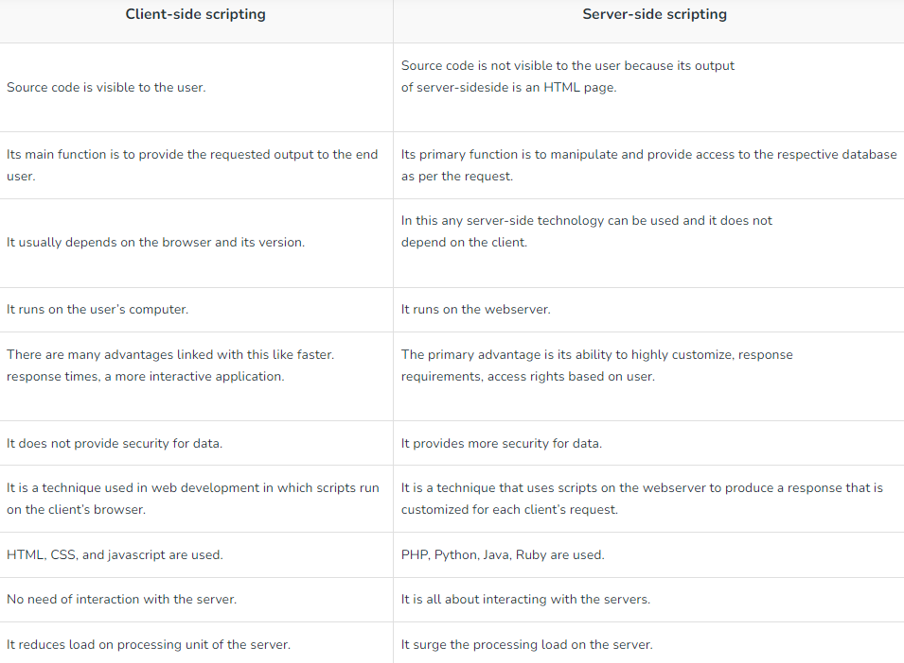
What can JavaScript Do?

Slide 4
Java Script Example
JavaScript provides 3 places to put the JavaScript code: within body tag, within head tag and external JavaScript file.
      <script type="text/javascript">
      alert("Hello Javatpoint");
      </script>

Slide 5
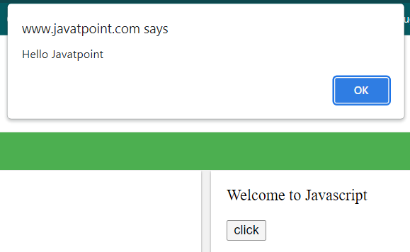
JavaScript Example : code between the head tag
<html> <head>
<script type="text/javascript">
function msg(){
alert("Hello Javatpoint");
}
</script> </head>
<body>
<p>Welcome to JavaScript</p>
<form>
<input type="button" value="click" onclick="msg()"/>
</form>
</body>
</html>

Slide 6
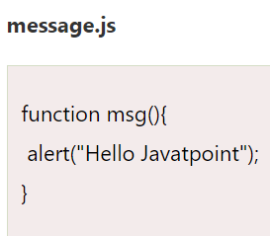
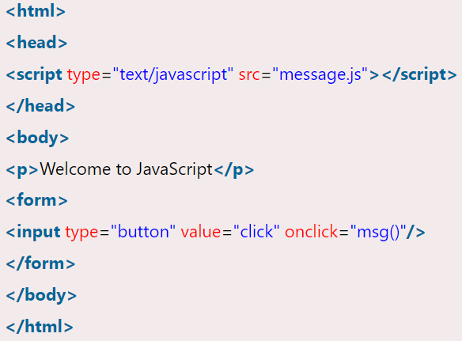
External JavaScript file

Slide 7
JavaScript Comment Line
There are two types of comments in JavaScript.
    Single-line Comment (//)
    Multi-line Comment (/* your code here */)
Single line Comment
<script>
var a=10;
var b=20;
var c=a+b;//It adds values of a and b variable
document.write(c);//prints sum of 10 and 20
</script>

Slide 8
JavaScript Variable
A JavaScript variable is simply a name of storage location. There are two types of variables in JavaScript : local variable and global variable.
There are some rules while declaring a JavaScript variable (also known as identifiers).
Name must start with a letter (a to z or A to Z), underscore( _ ), or dollar( $ ) sign.
After first letter we can use digits (0 to 9), for example value1.
JavaScript variables are case sensitive, for example x and X are different variables.

Slide 9
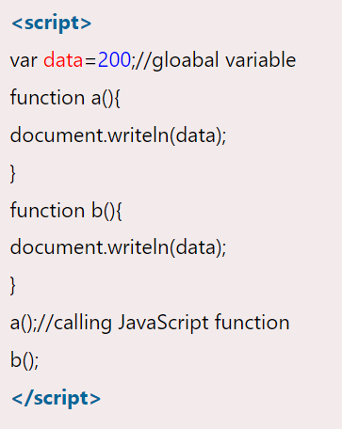
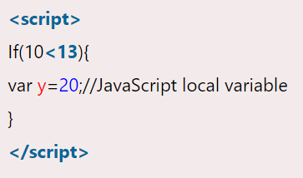
Local and Global Variable

Slide 10
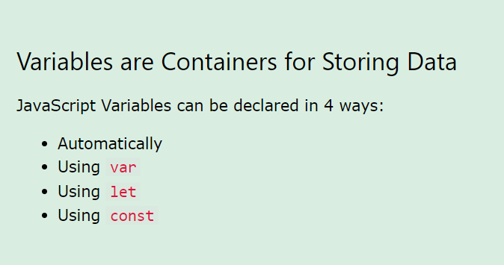
Java script variables

Slide 11
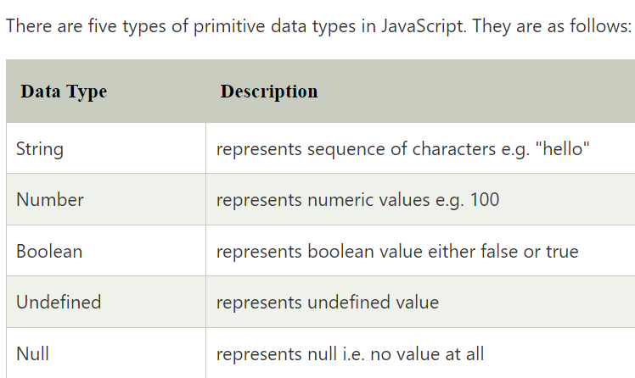
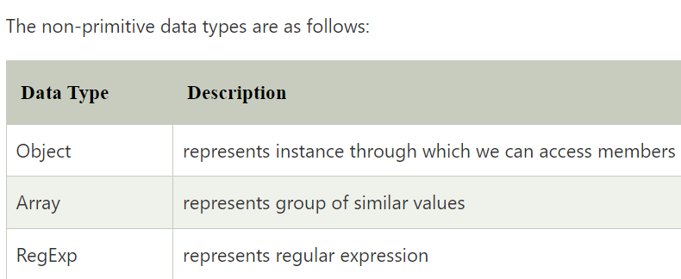
Java script Data Types
JavaScript provides different data types to hold different types of values. There are two types of data types in JavaScript.
      Primitive data type
      Non-primitive (reference) data type

Slide 12
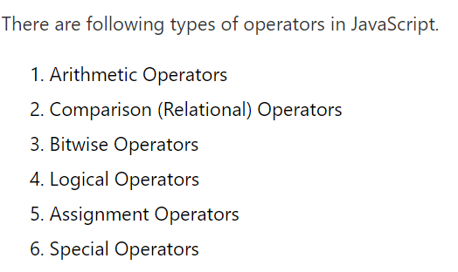
JavaScript Operators

Slide 13
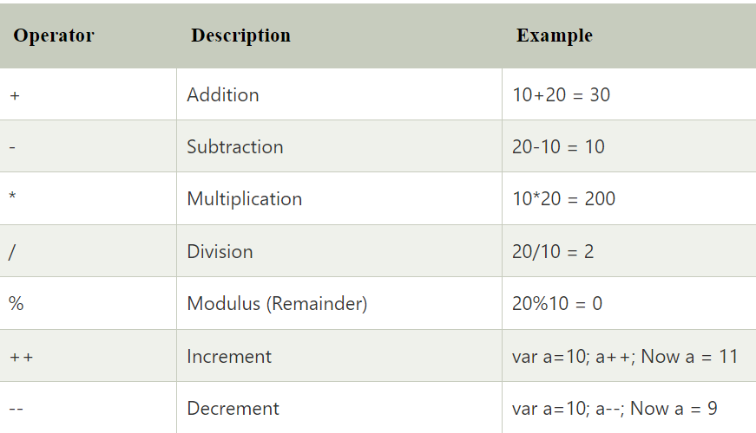
Arithmetic Operators

Slide 14
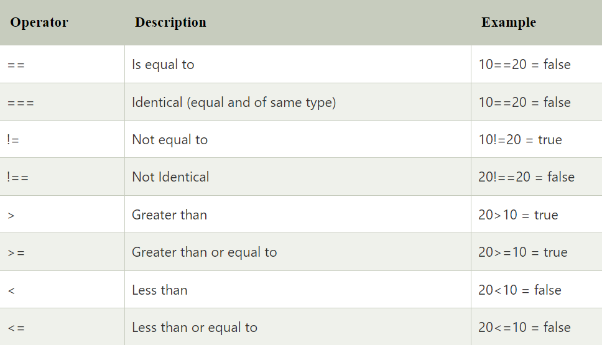
JavaScript Comparison Operators

Slide 15
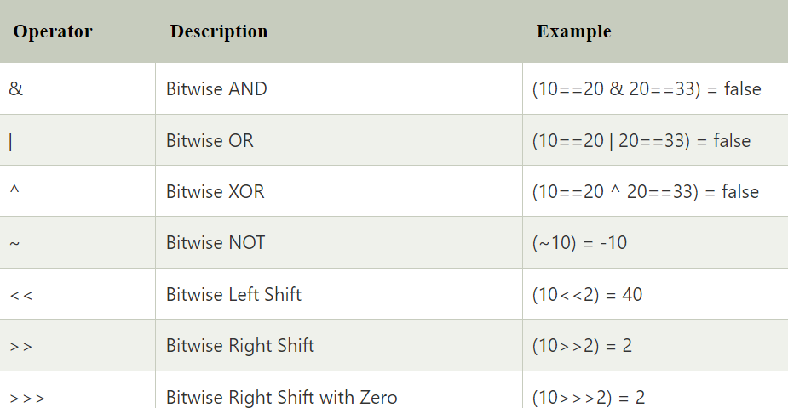
JavaScript Bitwise Operators

Slide 16
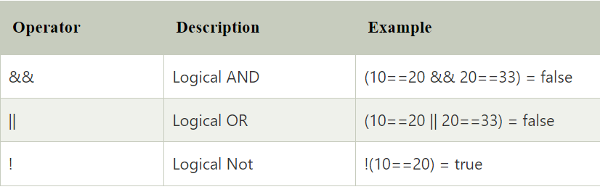
JavaScript Logical Operators

Slide 17
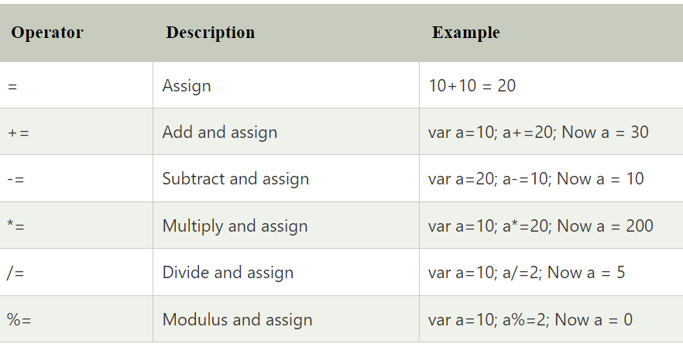
JavaScript Assignment Operators

Slide 18
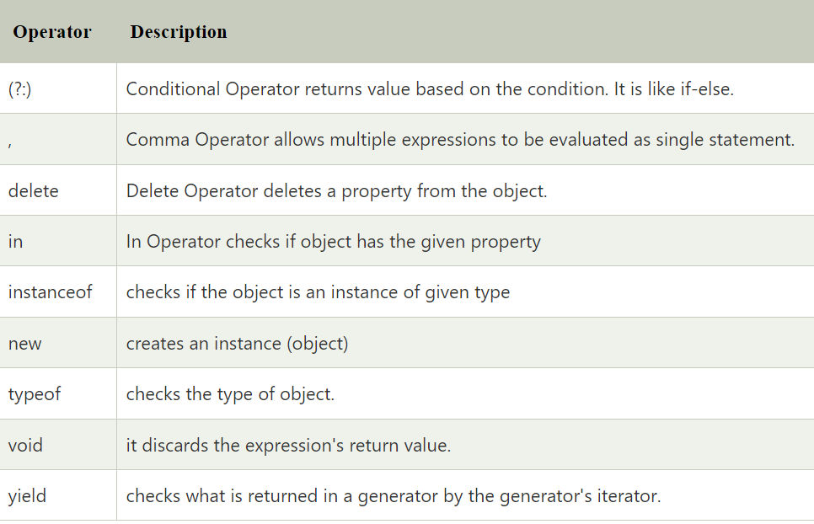
JavaScript Special Operators

Slide 19
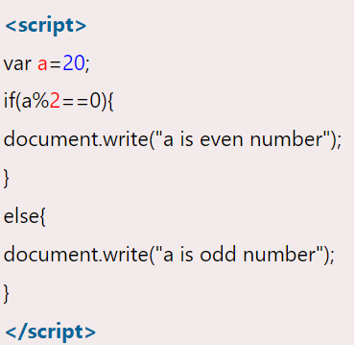
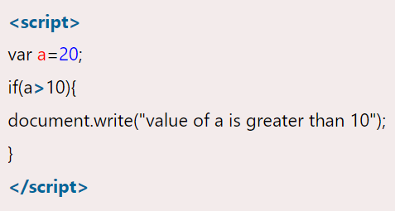
JavaScript If-else
The JavaScript if-else statement is used to execute the code whether condition is true or false. There are three forms of if statement in JavaScript.
        If Statement
        If else statement
        Nested if statement

Slide 20
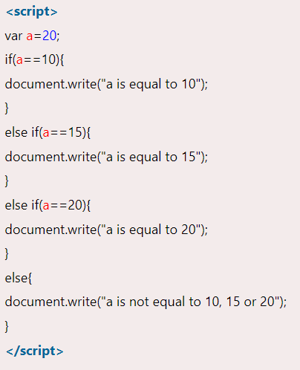
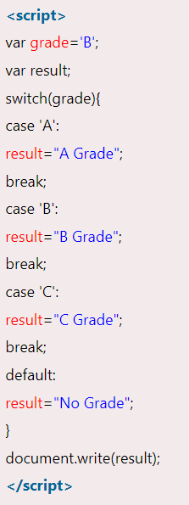
Nested If and Switch Statement

Slide 21
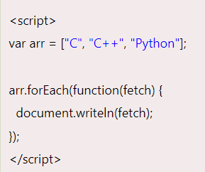
JavaScript Loops
There are four types of loops in JavaScript.
      for loop
      while loop
      do-while loop
      for-in loop
<script>
const person = {fname:"John", lname:"Doe", age:25};
let text = “ ”;
for (let x in person) {
text += person[x] + " ";
}
document.getElementById("demo").innerHTML = text;
</script>

Slide 22
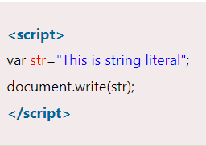
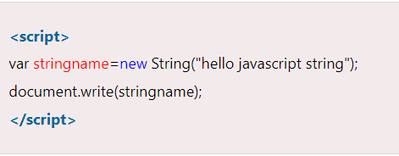
JavaScript String
The JavaScript string is an object that represents a sequence of characters.
There are 2 ways to create string in JavaScript
      By string literal
      By string object (using new keyword)

Slide 23
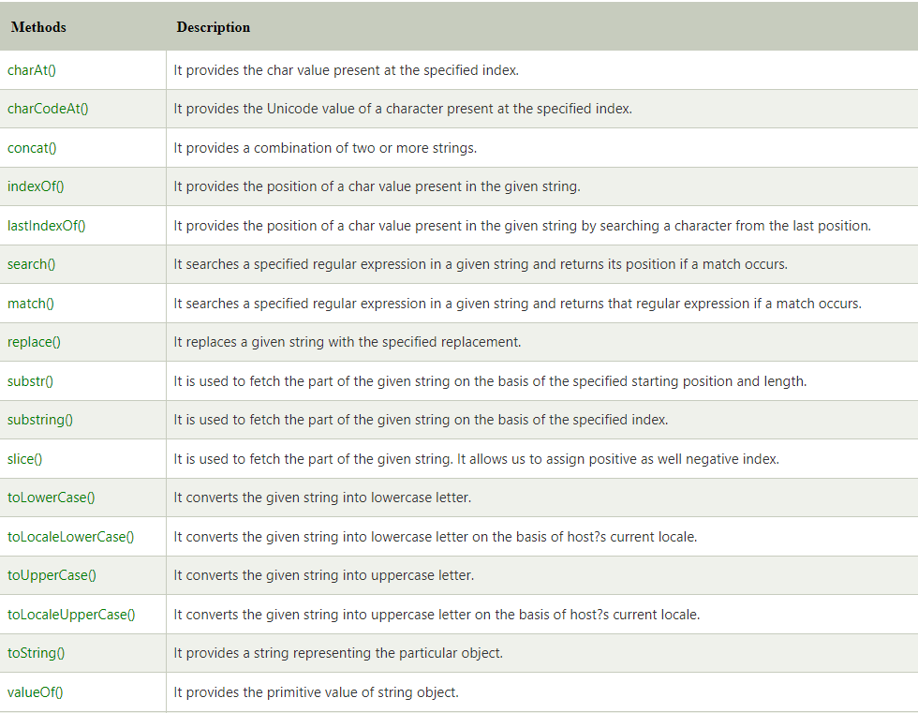
String Operations

Slide 24
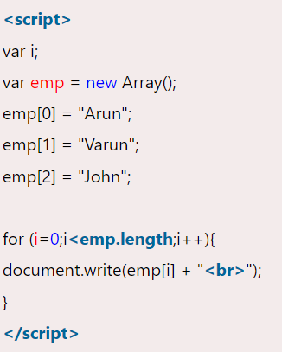
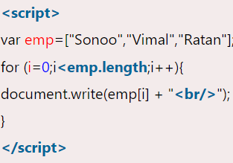
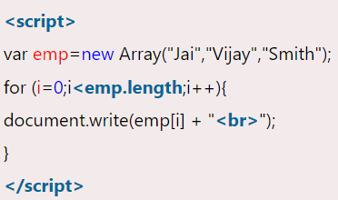
Array
JavaScript array is an object that represents a collection of similar type of elements.
There are 3 ways to construct array in JavaScript
      By array literal
      By creating instance of Array directly (using new keyword)
      By using an Array constructor (using new keyword)

Slide 25

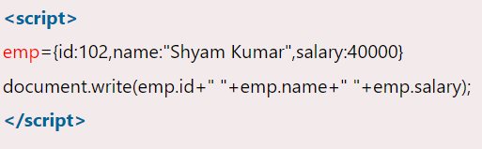
JavaScript Objects
A javascript object is an entity having state and behaviour (properties and method). For example: car, pen, bike, chair, glass, keyboard, monitor etc.
There are 3 ways to create objects.
      By object literal
      By creating instance of Object directly (using new keyword)
      By using an object constructor (using new keyword)

Slide 26
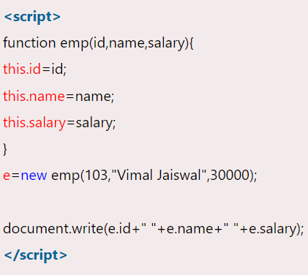
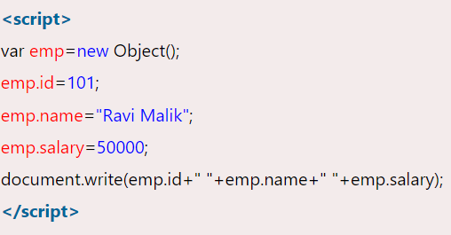
creating instance of Object and Object constructor
var objectname=new Object();

Slide 27
JavaScript Objects
JavaScript is object-oriented and uses the same method-calling syntax as Java
We have already seen this with the document object
document.write("Hello World!");
Some basic objects are built-in to JavaScript
– String
– Date
– Array
– Boolean
– Math

Slide 28
JavaScript Events
The change in the state of an object is known as an Event. In html, there are various events which represents that some activity is performed by the user or by the browser.
When javascript code is included in HTML, js react over these events and allow the execution. This process of reacting over the events is called Event Handling. Thus, js handles the HTML events via Event Handlers.

Slide 29
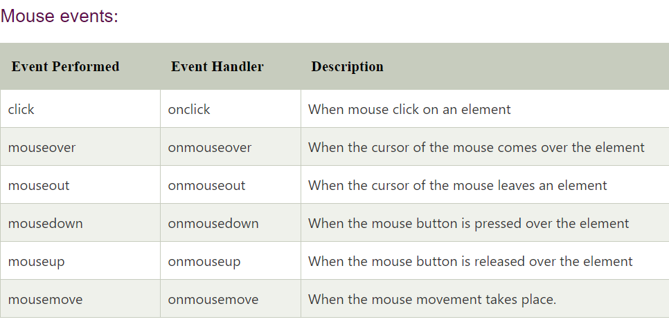
Mouse Events

Slide 30
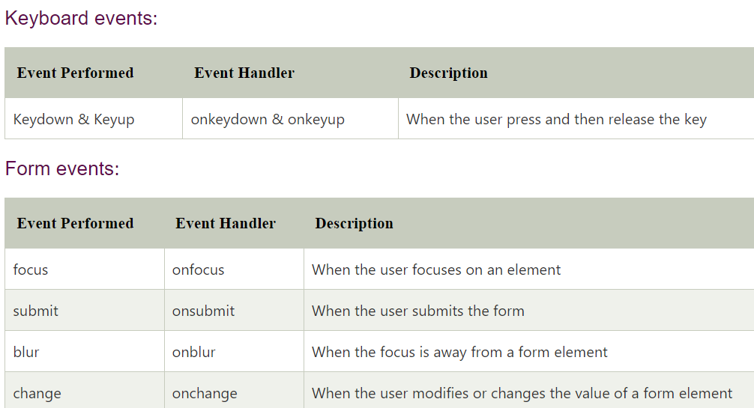
What can JavaScript Do?

Slide 31
Simple User Interaction
There are three built-in methods of doing simple user interaction
– alert(msg) alerts the user that something has happened
syntax: window.alert(“message”);
example: window.alert(“this is alert box”);
– confirm(msg) asks the user to confirm (or cancel) something
syntax: window.confirm(“message”);
example: window.confirm(“do u continue”);
– prompt(msg, default) asks the user to enter some text
syntax: window.prompt(“--------”, “default text”);
example: window.prompt(“enter a value”,”4”);

Slide 32
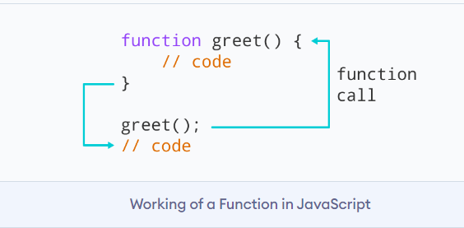
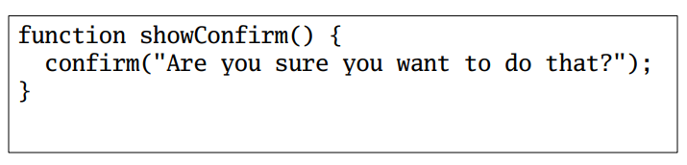
JavaScript Functions
JavaScript lets you define functions using the function keyword
Functions can return values using the return keyword

Slide 33
JavaScript Function Example
<html>
<body>
<script>
function msg()
{
alert("hello! this is message");
}
</script>
<input type="button" onclick="msg()" value="call function"/>
</body>
</html>

Slide 34
JavaScript Function Arguments
<script>
function getcube(number){
alert(number*number*number);
}
</script>
<form>
<input type="button" value="click" onclick="getcube(4)"/>
</form>
Output

Slide 35
Document Object Model(DOM)
Document Object Model (DOM) is a programming interface for HTML (HyperText Markup Language) and XML(Extensible markup language) documents. It defines the logical structure of documents and the way a document is accessed and manipulated.
DOM is a way to represent the webpage in a structured hierarchical way so that it will become easier for programmers and users to glide through the document. With DOM, we can easily access and manipulate tags, IDs, classes, Attributes, or Elements of HTML using commands or methods provided by the Document object.
So basically Document Object Model is an API that represents and interacts with HTML or XML documents.

Slide 36
Why DOM is required?
HTML is used to structure the web pages and Javascript is used to add behavior to our web pages. When an HTML file is loaded into the browser, the javascript can not understand the HTML document directly. So, a corresponding document is created(DOM).
DOM is basically the representation of the same HTML document but in a different format with the use of objects.
Javascript interprets DOM easily i.e javascript can not understand the tags(<h1>H</h1>) in HTML document but can understand object h1 in DOM. Now, Javascript can access each of the objects (h1, p, etc) by using different functions.

Slide 37
Structure of DOM
DOM can be thought of as a Tree or Forest
One important property of DOM structure models is structural isomorphism.
Isomorphism means the application uses a similar rendering engine on the server and the client
If any two DOM implementations are used to create a representation of the same document, they will create the same structure model, with precisely the same objects and relationships.
<P ALIGN="right">This is a <B>paragraph</B></P>

Slide 38
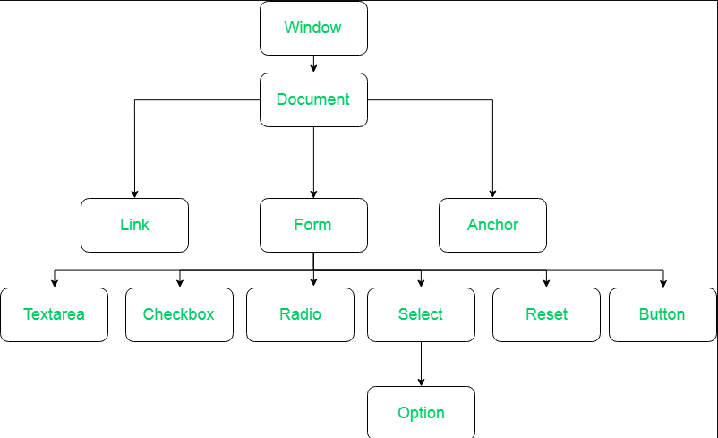
Why called an Object Model?
Documents are modeled using objects, and the model includes not only the structure of a document but also the behavior of a document and the objects of which it is composed like tag elements with attributes in HTML.

Slide 39
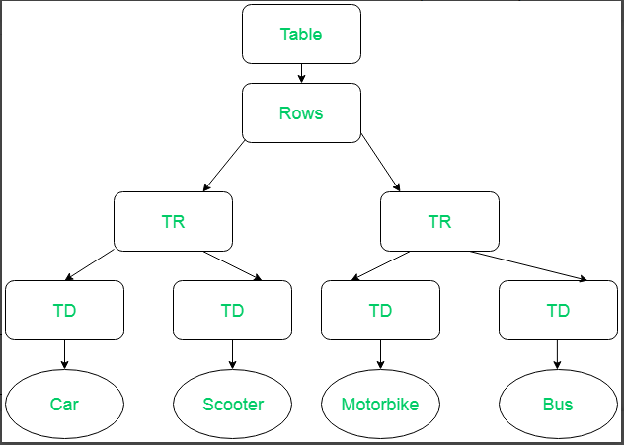
For example
<table>
<ROWS>
<tr>
<td>Car</td>
<td>Scooter</td>
</tr>
<tr>
<td>MotorBike</td>
<td>Bus</td>
</tr>
</ROWS>
</table>

Slide 40
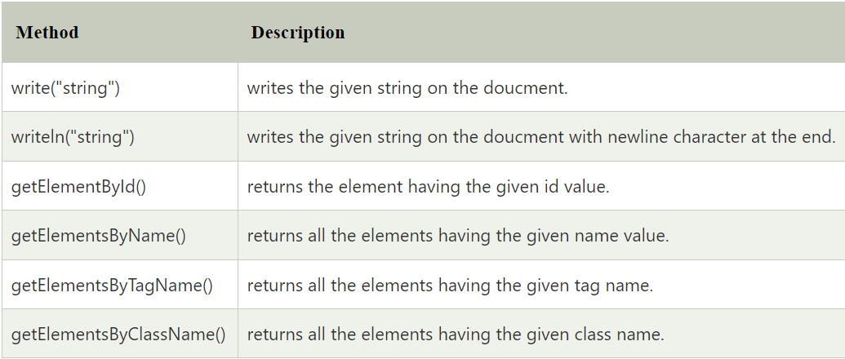
Methods of Document Object

Slide 41
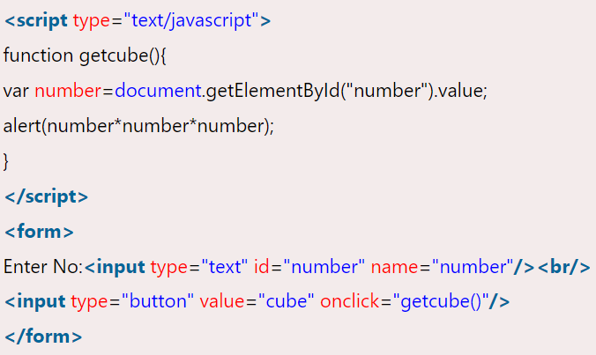
document.getElementById() method
document.getElementById() method returns the element of specified id.
In the previous, we have used document.form1.name.value to get the value of the input value. Instead of this, we can use document.getElementById() method to get value of the input text.

Slide 42
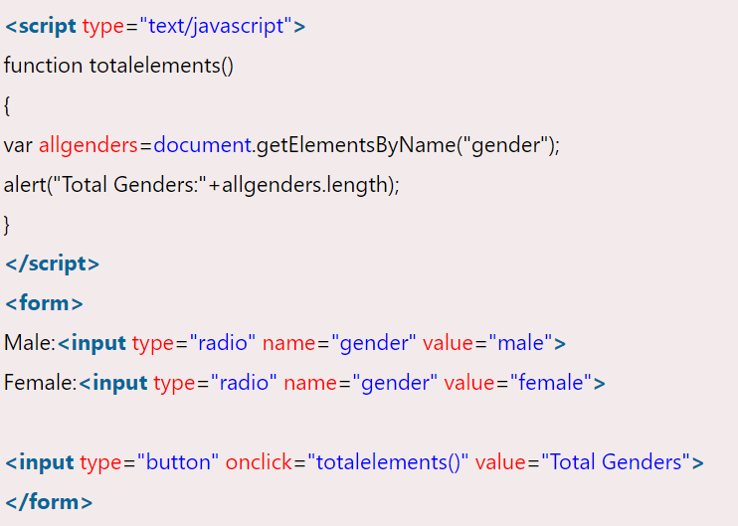
document.getElementsByName()
The document.getElementsByName() method returns all the element of specified name.
The syntax of the getElementsByName() method is given below:
Syntax: document.getElementsByName("name")

Slide 43
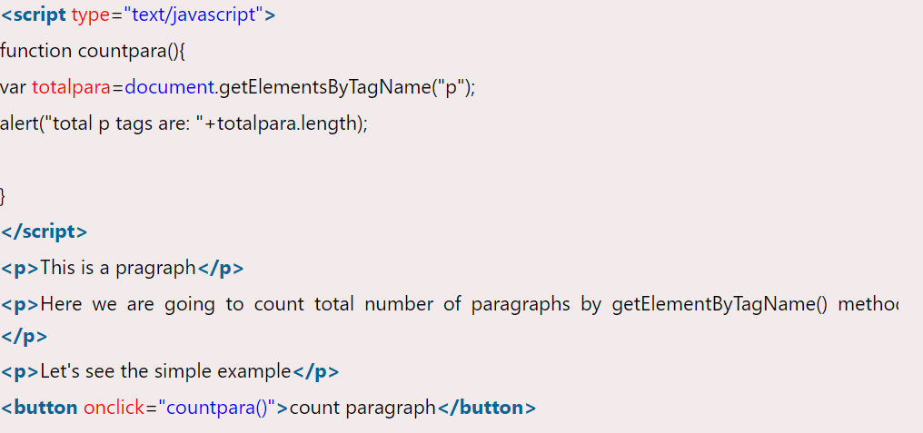
document.getElementsByTagName()
The document.getElementsByTagName() method returns all the element of specified tag name.

Slide 44
Javascript - innerHTML
The innerHTML property can be used to write the dynamic html on the html document.
It is used mostly in the web pages to generate the dynamic html such as registration form, comment form, links etc.

Slide 45
JavaScript Form Validation
It is important to validate the form submitted by the user because it can have inappropriate values. So, validation is must to authenticate user.
JavaScript provides facility to validate the form on the client-side so data processing will be faster than server-side validation. Most of the web developers prefer JavaScript form validation.

Slide 46
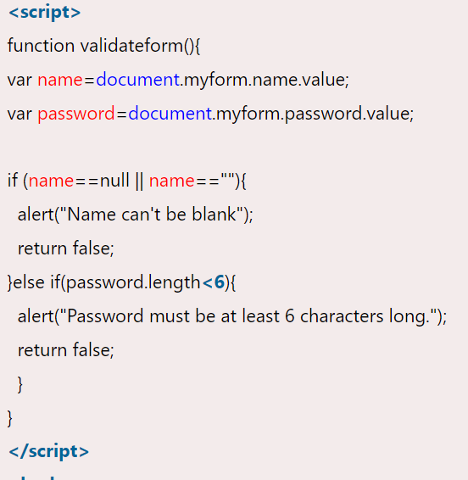
Password Length

Slide 47
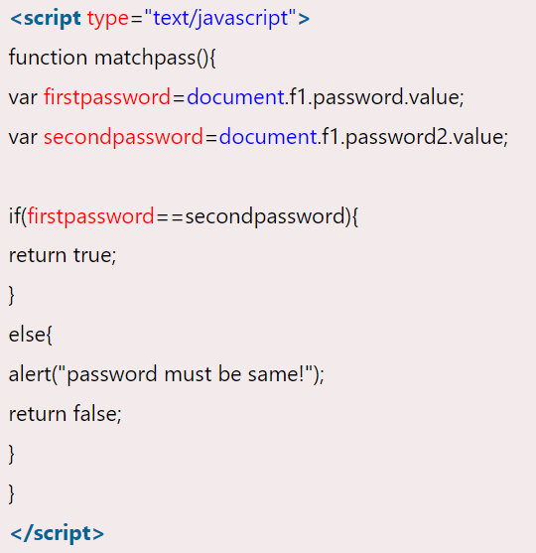
JavaScript Retype Password Validation

Slide 48
Phone Number Validation
<script>
function valid()
{
var p=/^\d{10}$/;
var val=document.getElementById('pnum');
if(val.value.length!=10){
alert("Plz Enter 10 Digit Only!!");
}
else{
if(val.value.match(p)){
alert("Submitted Successfully..");
}
else{
alert("Wrong format");
}
}
}
</script>
Numbers only
10 digit number only

Slide 49
AJAX
AJAX is an abbreviation for Asynchronous JavaScript and XML.
It is a group of inter-related technologies like JavaScript, DOM, XML, HTML/XHTML, CSS, XMLHttpRequest etc.
AJAX allows you to send and receive data asynchronously without reloading the web page. So it is fast.
AJAX allows web pages to be updated asynchronously by exchanging data with a web server behind the scenes.
This means that it is possible to update parts of a web page, without reloading the whole page.

Slide 50
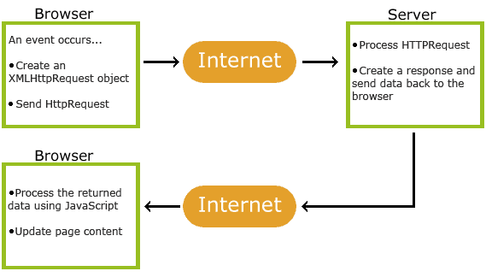
How AJAX Works?

Slide 51
How AJAX Works?
Step | Process
1 | An event occurs in a web page (the page is loaded, a button is clicked)
2 | An XMLHttpRequest object is created by JavaScript
3 | The XMLHttpRequest object sends a request to a web server
4 | The server processes the request
5 | The server sends a response back to the web page
6 | The response is read by JavaScript
7 | Proper action (like page update) is performed by JavaScript

Slide 52
XMLHttpRequest
There are two common methods for sending HTTP requests:
  GET - used for most requests. The browser uses a GET method whenever it requests a new web page, CSS file, image, and so on. Use GET when you want to "get" something from the server.
  POST - frequently used with web forms to send data to the server. Use POST when sending data that will be stored, deleted or updated on the server.
You can send parameters with GET in the URL, and that's a benefit as well as the downside, as there's a limit to the length of the parameters in a GET request, as well as there's a security issue.
With POST you can send way more data, and in a secure way.

Slide 53
XMLHttpRequest
All modern browsers (Chrome, Firefox, IE7+, Edge, Safari Opera) have a built-in XMLHttpRequest object.
Syntax for creating an XMLHttpRequest object:
variable = new XMLHttpRequest();
        if (window.XMLHttpRequest) {
        // code for modern browsers
        xmlhttp = new XMLHttpRequest();
        } else {
        // code for old IE browsers
        xmlhttp = new ActiveXObject("Microsoft.XMLHTTP");
        }

Slide 54
XMLHttpRequest Methods
Method | Description
new XMLHttpRequest() | Creates a new XMLHttpRequest object
abort() | Cancels the current request
getAllResponseHeaders() | Returns header information
getResponseHeader() | Returns specific header information
open(method,url,async,user,psw) | Specifies the request
send() | Sends the request to the server Used for GET requests
send(string) | Sends the request to the server. Used for POST requests
setRequestHeader() | Adds a label/value pair to the header to be sent

Slide 55
XMLHttpRequest Properties
Property | Description
onreadystatechange | Defines a function to be called when the readyState property changes
readyState | Holds the status of the XMLHttpRequest. 0: request not initialized 1: server connection established 2: request received 3: processing request 4: request finished and response is ready
responseText | Returns the response data as a string
responseXML | Returns the response data as XML data
status | Returns the status-number of a request 200: "OK“ 403: "Forbidden“ 404: "Not Found"
statusText | Returns the status-text (e.g. "OK" or "Not Found")

Slide 56
XML
Xml (eXtensible Markup Language) is a mark up language.
XML is designed to store and transport data.
Xml was released in late 90’s. it was created to provide an easy to use and store self describing data.
XML became a W3C Recommendation on February 10, 1998.
XML is not a replacement for HTML.
XML is designed to be self-descriptive.
XML is designed to carry data, not to display data.
XML tags are not predefined. You must define your own tags.
XML is platform independent and language independent.

Slide 57
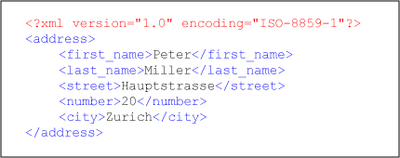

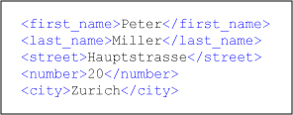


Sample XML
Root Element
Comment
Child Elements
End of Root Element

Slide 58
Reading an XML
We can access XML file using Java Script.
Other programming languages including JAVA, PHP, etc.,could also be used to access and store XML data.
Property | Meaning
documentElement | Returns the root element of the document
firstChild | Is the first element within another element (the first child of the current node)
lastChild | Is the last element within another element (the last child of the current node)
nextSibling | Is the next element in the same nested level as the current one
previousSibling | Is the previous element in the same nested level as the current one
nodeValue | Is the value of a document element
getElementsByTagName | Used to place all elements into an object

Slide 59
JSON
JSON or JavaScript Object Notation is a lightweight text-based open standard.
It was designed for human-readable data interchange.
It has been extended from the JavaScript scripting language.
The filename extension is .json.

Slide 60
JSON
Uses
  JSON format is used for serializing and transmitting structured data over network connection.
  It is primarily used to transmit data between a server and web applications.
  Web services and APIs use JSON format to provide public data.
  It can be used with modern programming languages.
Characteristics
  JSON is easy to read and write.
  It is a lightweight text-based interchange format.
  JSON is language independent.

Slide 61
JSON
Arrays
  It is an ordered collection of values.
  These are enclosed in square brackets which means that array begins with .[. and ends with .]..
  The values are separated by , (comma).
  Array indexing can be started at 0 or 1.
  Arrays should be used when the key names are sequential integers.
  { "books": [
  { "language":"Java" , "edition":"second" },
  { "language":"C++" , "lastName":"fifth" },
  { "language":"C" , "lastName":"third" }
  ]
  } – JSON with array of objects

Slide 62
JSON Vs XML
  Parsing
    JavaScript's eval method parses JSON. When applied to JSON, eval returns the described object.
JSON
  A={ "company": Volkswagen, "name": "Vento", "price": 800000 }
XML
  <car> <company>Volkswagen</company>
  <name>Vento</name>
  <price>800000</price>
  </car>

