Slide 1




Slide 2

THE CELEBRITY PROBLEM

Slide 3

TEST TIME ON MINIMUM STACK
URL:https://forms.gle/cqoa4QcjjL8rPkzD8

Slide 4
THE CELEBRITY PROBLEM
EXPLANATION
The celebrity problem is identifying a celebrity in a group of people. In this context, a celebrity is defined as someone who is known by everyone in the group, but who does not know anyone else in the group.
This problem can be used as an illustrative example for understanding algorithms and data structures.

Slide 5
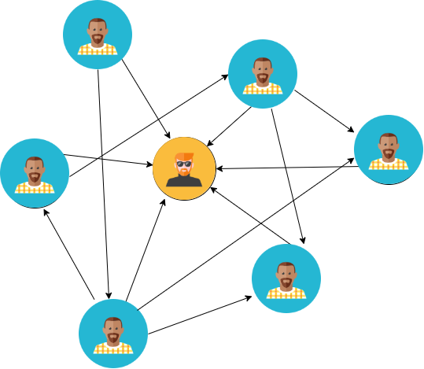
THE CELEBRITY PROBLEM

Slide 6
THE CELEBRITY PROBLEM
EXPLANATION
Given a group of people, each person may or may not know other people in the group.
Your task is to identify if there is a celebrity in the group and, if so, who that celebrity is.
A celebrity is someone who is known by everyone in the group but does not know anyone else.

Slide 7
THE CELEBRITY PROBLEM
ALGORITHM
To solve the celebrity problem, you can use a two-pass algorithm.
In the first pass, you find a potential celebrity candidate, and in the second pass, you verify if the candidate meets the celebrity criteria.

Slide 8
THE CELEBRITY PROBLEM
ALGORITHM
Step 1: Find a potential celebrity candidate.
Initialize two pointers, `left` and `right`, both initially pointing to the first person in the group.
Use a loop to iterate until `left` is not equal to `right`.
In each iteration, compare the knowledge of the two people pointed to by `left` and `right`.
If `left` knows `right`, set `left` to the next person; otherwise, set `right` to the next person.
At the end of this loop, `left` or `right` will be a potential celebrity candidate.

Slide 9
THE CELEBRITY PROBLEM
ALGORITHM
Step 2: Verify if the candidate is a celebrity.
Reset `left` to the beginning of the group, and set `right` to the candidate.
Iterate through the group again and check if everyone knows the candidate (i.e., `left` knows `right` for all pairs).
If the candidate is known by everyone and doesn't know anyone, they are the celebrity.

Slide 10
THE CELEBRITY PROBLEM
PSEUDOCODE
function findCelebrity(group):
left = 0
right = 0
// Step 1: Find a potential celebrity candidate
while left != right:
if group[left].knows(group[right]):
left = left + 1
else:
right = right + 1

Slide 11
THE CELEBRITY PROBLEM
PSEUDOCODE
// Step 2: Verify if the candidate is a celebrity
right = candidate
left = 0
while left < length(group):
if left != right and (group[left].knows(group[right]) or !group[right].knows(group[left])):
return "No celebrity found"
left = left + 1
return candidate

Slide 12
THE CELEBRITY PROBLEM
SAMPLE PROGRAM 1
INPUT
2 //n count
0 1
0 0
OUTPUT
Celebrity ID: 1

Slide 13
THE CELEBRITY PROBLEM
SAMPLE PROGRAM 1
INPUT
3
0 1 0
0 0 0
1 0 0
OUTPUT
No Celebrity

Slide 14
THE CELEBRITY PROBLEM
import java.io.*; import java.util.*; class Main { public static void main(String args[]) throws IOException { Scanner sc = new Scanner(System.in); int N = sc.nextInt(); int[][] relationshipMatrix = new int[N][N]; for (int i = 0; i < N; i++) { for (int j = 0; j < N; j++) { relationshipMatrix[i][j] = sc.nextInt(); } } int celebrityId = new Solution().findCelebrity(relationshipMatrix, N); if (celebrityId != -1) { | System.out.println("Celebrity id: " + celebrityId); } else { System.out.println("No Celebrity"); } } } class Solution { int findCelebrity(int M[][], int n) { int candidate = 0; for (int i = 1; i < n; i++) { if (M[candidate][i] == 1) { candidate = i; } } for (int i = 0; i < n; i++) { if (i != candidate && (M[candidate][i] == 1 || M[i][candidate] == 0)) { return -1; } } return candidate; }}

Slide 15
THE CELEBRITY PROBLEM
import java.util.*; public class Main { public static int celebritySolution(int[][] mat) { Stack<Integer> stk = new Stack<>(); for(int i=0;i<mat.length;i++) { stk.push(i); } while(stk.size() > 1) { int col = stk.pop(); int row = stk.pop(); if(mat[row][col] == 1) { stk.push(col); } else { stk.push(row); } int x = stk.pop(); for(int j=0;j<mat.length;j++) { if(j == x) continue; if(mat[x][j] == 1) { | return -1; }} for(int i=0;i<mat.length;i++) { if(i == x) continue; if(mat[i][x] == 0) { return -1; }} return x;} public static void main(String[] args) { int[][] matrix = {{0,1,1,0}, {0,0,0,0}, {0,1,0,0}, {1,1,0,0}}; int res = celebritySolution(matrix); if(res == -1) { System.out.println("There is no celebrity in the party"); } else { System.out.println(res + " is the celebrity in the party"); }}}

Slide 16
THE CELEBRITY PROBLEM
TIME AND SPACE COMPLEXITY
Time complexity: O(N), where N is the number of people in the group
Space complexity:O(N) because the code uses a constant amount of additional space regardless of the input size, mainly for variables like candidate and loop counters.

Slide 17
INTERVIEW QUESTIONS
1. Explain the Celebrity Problem
Answer: The Celebrity Problem involves finding a celebrity in a group of people. A celebrity is someone who is known by everyone in the group but doesn't know anyone. It can be represented using a square matrix where M[i][j] represents whether person i knows person j (1 for "knows" and 0 for "doesn't know"). The goal is to identify the celebrity efficiently.

Slide 18
INTERVIEW QUESTIONS
2. What is the time complexity of the stack-based solution for the Celebrity Problem?
Answer: The time complexity is O(N), where N is the number of people in the group. The stack-based solution iteratively compares pairs of people, reducing the number of candidates until only one potential celebrity remains. This is done in linear time.

Slide 19
INTERVIEW QUESTIONS
3.Can the Celebrity Problem be solved using a brute-force approach? What would be the time complexity?
Answer: Yes, the Celebrity Problem can be solved using a brute-force approach by checking each person's compatibility with the definition of a celebrity. However, the time complexity would be O(N^2) because you would need to check every pair of people to determine if one knows the other.

Slide 20
INTERVIEW QUESTIONS
4. How does the Min Stack approach handle scenarios when the minimum element is popped from the main stack?
Answer: When the minimum element is popped from the main stack, the Min Stack approach ensures consistency by also popping the corresponding minimum element from the min stack. This guarantees that the top of the min stack always represents the minimum element present in the main stack at any given time.

Slide 21

https://learn.codemithra.com

Slide 22




THANK YOU
+91 78150 95095
codemithra@ethnus.com
www.codemithra.com

