Slide 1




Slide 2

LOOP DETECTION

Slide 3
LINKED LIST
A linked list is a collection of nodes that organize and store elements.
Unlike arrays, which use a contiguous block of memory to store elements, linked lists use a series of nodes.
This structure allows for efficient insertion and deletion of elements at any position within the list but may result in slower random access times.

Slide 4
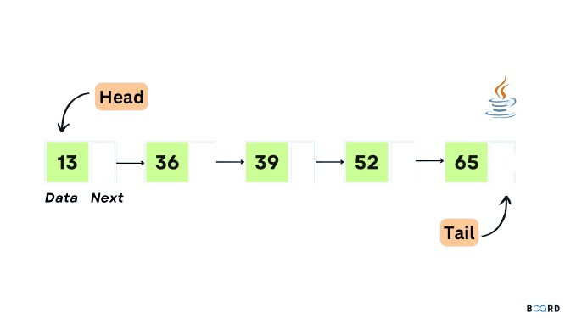
LINKED LIST

Slide 5
LINKED LIST-STRUCTURE
1. Node: Each node in a linked list contains two fields:
Data: This field stores the actual data or values you want in the list.
Next (or Link): This field contains a reference (a pointer or link) to the next node in the sequence
.
2. Head: The head of the linked list refers to the first node in the list. It is the starting point for traversing the list.
3. Tail: In some cases, linked lists may have a tail pointer, which refers to the last node in the list.

Slide 6
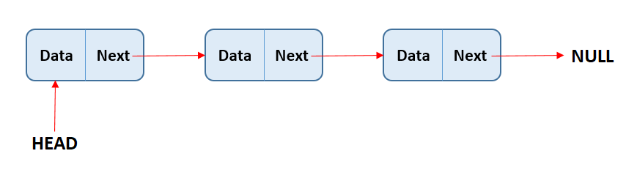
LINKED LIST
Types
Singly Linked List:
    Each node has a reference to the next node in the list.
    Traversal can only be done in one direction, from the head to the tail.

Slide 7
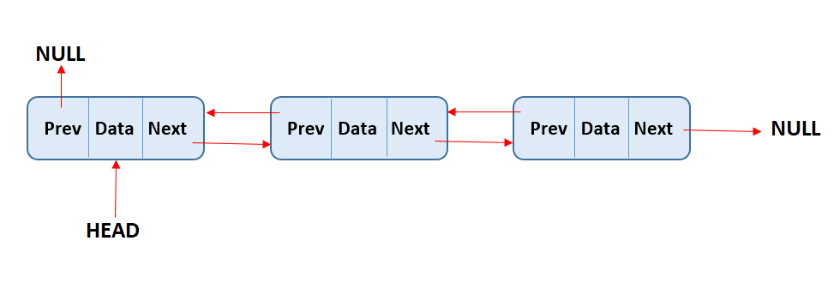
LINKED LIST
Types
2. Doubly Linked List:
Each node has references to both the next and the previous nodes in the list. This allows for bidirectional traversal but requires more memory.

Slide 8
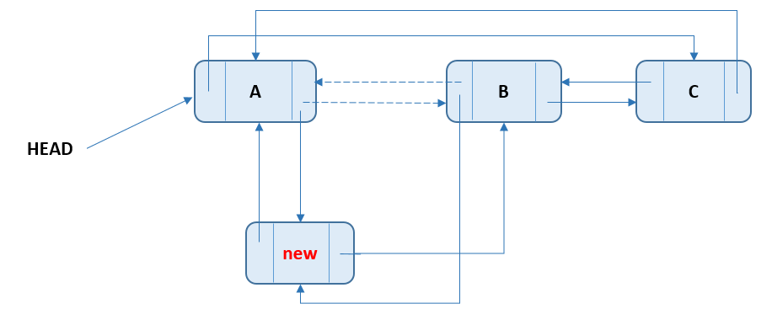
LINKED LIST
Types
3. Circular Linked List:
  In this type, the tail node's reference points back to the head, forming a closed loop. It can be either singly or doubly linked.

Slide 9
LOOP DETECTION
Loop & linked list cycle
A circumstance that arises when a linked list has no ends is known as a loop in a linked list.
When a loop is present, the last pointer in the linked list points to the linked list's head rather than the Null as is the case in a singly or doubly linked list and the circular linked list, respectively.
The linked list cycle, commonly known as the loop, is present when it points to another node.

Slide 10
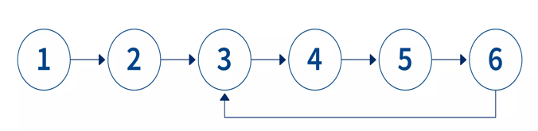
LOOP DETECTION
Loop & linked list cycle

Slide 11
LOOP DETECTION
Algorithm
1. Initialize two pointers, slow and fast, both pointing to the head of the linked list.
2. Traverse the linked list using the slow and fast pointers.
3. Move the slow pointer one step at a time and the fast pointer two steps at a time.
4. If there is no loop in the linked list, the fast pointer will eventually reach the end (become null) because it moves faster than the slow pointer. In this case, return "No Loop Detected."

Slide 12
LOOP DETECTION
Pseudocode
function detectLoop(head):
slow = head
fast = head
while fast is not null and fast.next is not null:
slow = slow.next // Move one step at a time
fast = fast.next.next // Move two steps at a time
if slow is equal to fast:
return "Loop Detected" // Cycle detected
return "No Loop Detected" // No cycle detected

Slide 13
LOOP DETECTION
Algorithm
1 -> 2 -> 3 -> 4 -> 5
|
6
|
9 <- 8 <- 7

Slide 14
LOOP DETECTION
Explanation
1. Initially, both `slow` and `fast` pointers point to the head (node 1).
2. Iteration 1: `slow` moves to node 2, `fast` moves to node 3.
3. Iteration 2: `slow` moves to node 3, `fast` moves to node 5.
4. Iteration 3: `slow` moves to node 4, `fast` moves to node 7.
5. Iteration 4: `slow` moves to node 5, `fast` moves to node 9.
6. Iteration 5: `slow` moves to node 6, `fast` moves to node 6.
7. At this point, `slow` and `fast` are both at node 6, and they meet. The algorithm returns "Loop Detected."

Slide 15
LOOP DETECTION
Algorithm
5. If there is a loop in the linked list, the fast pointer will eventually catch up to the slow pointer within the loop. This is because it moves twice as fast and will "lap" the slow pointer within the loop.
6. When the fast pointer equals the slow pointer, return "Loop Detected."

Slide 16
LOOP DETECTION
Approach
Approach 1: Hashing
Approach 2: Floyd's Cycle Detection

Slide 17
LOOP DETECTION
Detect a loop in a linked list-hashing approach
Hashing in loop detection involves using a hash function to map unique identifiers (e.g., memory addresses) of visited nodes to distinct values in a data structure (e.g., a HashSet).
This allows efficient tracking and detection of previously visited nodes while traversing a linked list, helping identify loops by detecting nodes that appear more than once.

Slide 18
LOOP DETECTION
Detect a loop in a linked list-hashing approach
detect a loop in a linked list using a hashing approach.
Algorithm:
In this approach, we use a HashSet to store the references of nodes as we traverse the linked list.
If we encounter a node whose reference already exists in the HashSet, it means there is a loop in the linked list.
Otherwise, we continue traversing the list until we reach the end.

Slide 19
LOOP DETECTION
Detect a loop in a linked list-hashing approach
import java.util.*; public class LinkedList { static Node head; static class Node { int data; Node next; Node(int d) { data = d; next = null; } } static public void push(int new_data) { Node new_node = new Node(new_data); new_node.next = head; head = new_node; } | static boolean detectLoop(Node h) { HashSet < Node > s = new HashSet < Node > (); while (h != null) { if (s.contains(h)) return true; s.add(h); h = h.next; } return false; }

Slide 20
LOOP DETECTION
Detect a loop in a linked list-hashing approach
public static void main(String[] args) {
LinkedList llist = new LinkedList();
llist.push(20);
llist.push(4);
llist.push(15);
llist.push(10);
llist.head.next.next.next.next = llist.head;
if (detectLoop(head))
System.out.println("Loop Exists");
else
System.out.println("Loop doesn't exists");
}
}

Slide 21
LOOP DETECTION
Detect a loop in a linked list-hashing approach
Time Complexity: O(n) where n is the number of nodes in the linked list.
Space Complexity: O(n) for the HashSet to store the visited nodes.

Slide 22
LOOP DETECTION
Detect a loop in a linked list-Floyd’s Detection
detect a loop in a linked list using Floyd's Cycle Detection.
Algorithm:
In this approach, we use two pointers - one slow (tortoise) and one fast (hare).
The slow pointer moves one step at a time, while the fast pointer moves two steps at a time.
If there is a loop in the linked list, the fast pointer will eventually catch up to the slow pointer.
If there is no loop, the fast pointer will reach the end of the list.

Slide 23
LOOP DETECTION
Detect a loop in a linked list-Floyd’s Detection
public class LinkedList { //1.Node structure static class Node { int data; Node next; Node(int d) { data = d; next = null; } } //2.push operation Node head; void push(int newData) { Node newNode = new Node(newData); newNode.next = head; head = newNode; } | //3.detect loop void detectLoopAndPrint() { Node slow = head, fast = head; while (slow != null && fast != null && fast.next != null) { slow = slow.next; fast = fast.next.next; if (slow == fast) { System.out.println("Loop found"); return; } } System.out.println("Loop not found"); }

Slide 24
LOOP DETECTION
Detect a loop in a linked list-Floyd’s Detection
//4.main method public static void main(String[] args) { LinkedList list = new LinkedList(); list.push(20); list.push(41); list.push(5); list.push(10); //5.Creating a loop for testing list.head.next.next.next.next = list.head; list.detectLoopAndPrint(); } }

Slide 25
LOOP DETECTION
Detect a loop in a linked list-Floyd’s Detection-Time & space complexity
Time Complexity: O(n) - Linear time complexity, where n is the number of nodes in the linked list.
Space Complexity: O(1) - Constant space complexity, as it uses a fixed amount of additional memory regardless of the size of the linked list.

Slide 26
LOOP DETECTION
Hashmap vs Floyd’s Detection
Detecting a loop in a linked list using a HashSet has a time and space complexity of O(n) due to the need to store all visited nodes, while Floyd's Cycle Detection has a time complexity of O(n) and a space complexity of O(1) as it uses two pointers, making it more memory-efficient for large lists. Floyd's algorithm is generally preferred for loop detection in linked lists.

Slide 27
INTERVIEW QUESTIONS
1. How do you detect a loop in a linked list?
You can detect a loop in a linked list using techniques like Floyd's Cycle Detection (Tortoise and Hare) algorithm or using a HashSet to track visited nodes. The former has a time complexity of O(n) and space complexity of O(1), while the latter has a time complexity of O(n) and a space complexity of O(n).

Slide 28
INTERVIEW QUESTIONS
2. Explain the Floyd's Cycle Detection algorithm.
Floyd's Cycle Detection, also known as the Tortoise and Hare algorithm, uses two pointers - one slow and one fast. The slow pointer moves one step at a time, while the fast pointer moves two steps at a time. If there's a loop, the fast pointer will eventually catch up to the slow pointer. If there's no loop, the fast pointer will reach the end of the list.

Slide 29
INTERVIEW QUESTIONS
3. Can you implement loop detection using a HashSet?
Yes, you can implement loop detection using a HashSet. While traversing the linked list, you store references to visited nodes in a HashSet. If you encounter a node that's already in the HashSet, you've detected a loop. Otherwise, you continue traversing. This approach has a space complexity of O(n).

Slide 30
INTERVIEW QUESTIONS
4. What is the time and space complexity of loop detection using Floyd's Cycle Detection?
Floyd's Cycle Detection has a time complexity of O(n) because it makes at most two full passes over the list. Its space complexity is O(1) because it only uses two pointers, regardless of the list's size.

Slide 31
INTERVIEW QUESTIONS
5. Explain how you would remove a loop in a linked list.
To remove a loop in a linked list, you can use Floyd's Cycle Detection to find the meeting point of the two pointers. Then, reset one pointer to the head and move both pointers one step at a time until they meet again. The point where they meet is the starting node of the loop. Set the `next` of the previous node to null to break the loop.

Slide 32

https://learn.codemithra.com

Slide 33




THANK YOU
+91 78150 95095
codemithra@ethnus.com
www.codemithra.com

