Slide 1




Slide 2

SEGREGATE EVEN AND ODD NODES IN A LINKED LIST

Slide 3

Test time on Sort the bitonic in Doubly LL
Url: https://forms.gle/3BybjYD1x4CNBmC78

Slide 4
SEGREGATE EVEN AND ODD NODES IN A LINKED LIST
EXPLANATION
To segregate even and odd nodes in a singly linked list, you can create two separate linked list, you can create two separate linked list: one for even nodes and one for odd nodes.
Then traverse the original list moving nodes to their respective new lists based on whether their values are even or odd. Finally merge the two list to obtain the final segregated linked list.

Slide 5
SEGREGATE EVEN AND ODD NODES IN A LINKED LIST
EXPLANATION
Algorithm
The original list now contains only even nodes, and the odd list contains only odd nodes.
After traversing the entire original list, connect the last node of the even list to the first node of the odd list to join them.
Return the head of the original list (which contains even nodes).

Slide 6
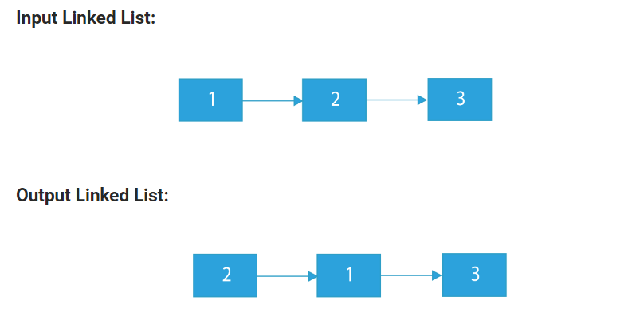
SEGREGATE EVEN AND ODD NODES IN A LINKED LIST
Example 1:

Slide 7
SEGREGATE EVEN AND ODD NODES IN A LINKED LIST
EXPLANATION
In our original linked list, we have numbers: 1 → 2 → 3.
We want to separate even numbers from odd numbers and keep the order the same.
So, first, we find the even number, which is 2. We keep it at the beginning.
Next, we find the odd numbers, which are 1 and 3. We keep their order and put them after 2.
Now, our new linked list is segregated: 2 → 1 → 3.

Slide 8
SEGREGATE EVEN AND ODD NODES IN A LINKED LIST
Example 2:
2 → 1 → 6 → 4 → 8.
Input linked list
2
1
6
4
8
Output linked list
2
4
6
8
1

Slide 9
SEGREGATE EVEN AND ODD NODES IN A LINKED LIST
Example 2:
2 → 1 → 6 → 4 → 8.
In our original linked list, we have numbers: 2 → 1 → 6 → 4 → 8.
We want to separate even numbers from odd numbers and keep the order the same.
So, first, we find the even numbers, which are 2, 6, 4, and 8. We keep them at the beginning in the same order, forming 2 → 6 → 4 → 8.
Next, we find the odd number, which is 1. We keep it after the even numbers, maintaining its original order, forming 2 → 6 → 4 → 8 → 1.

Slide 10
SEGREGATE EVEN AND ODD NODES IN A LINKED LIST
EXPLANATION
Input:
Original list:
1 2 3 4 5
Output:
Segregated list (even before odd):
2 4 1 3 5

Slide 11
SEGREGATE EVEN AND ODD NODES IN A LINKED LIST
class Node { int data; Node next; public Node(int data) { this.data = data; this.next = null; } } class LinkedList { Node head; public void append(int data) { Node newNode = new Node(data); if (head == null) { head = newNode; return; } Node current = head; while (current.next != null) { current = current.next; | } current.next = newNode; } public void segregateEvenOdd() { if (head == null) { System.out.println("The list is empty."); return; } Node evenHead = null, evenTail = null; Node oddHead = null, oddTail = null; Node current = head; while (current != null) { int data = current.data; if (data % 2 == 0) { // even node if (evenHead == null) { evenHead = evenTail = current;

Slide 12
SEGREGATE EVEN AND ODD NODES IN A LINKED LIST
} else { evenTail.next = current; evenTail = current; } } else { // odd node if (oddHead == null) { oddHead = oddTail = current; } else { oddTail.next = current; oddTail = current; } } current = current.next; } // Join even and odd lists if (evenHead != null) { evenTail.next = oddHead; } | if (oddHead != null) { oddTail.next = null; } head = evenHead != null ? evenHead : oddHead; } public void printList() { Node current = head; while (current != null) { System.out.print(current.data + " "); current = current.next; } System.out.println(); } }

Slide 13
SEGREGATE EVEN AND ODD NODES IN A LINKED LIST
public class Main { public static void main(String[] args) { LinkedList list = new LinkedList(); list.append(1); list.append(2); list.append(3); list.append(4); list.append(5); System.out.println("Original list:"); list.printList(); list.segregateEvenOdd(); System.out.println("Segregated list (even before odd):"); list.printList(); } }

Slide 14
SEGREGATE EVEN AND ODD NODES IN A LINKED LIST
Time complexity and space complexity
Time complexity: O(N), where N is the number of nodes in the linked list.
Space complexity: O(1), constant space is used for the pointers and temporary variables.

Slide 15
INTERVIEW QUESTIONS
1. How would you segregate even and odd nodes in a singly linked list while maintaining the order of nodes?
Answer: To segregate even and odd nodes while preserving the order, you can iterate through the linked list, move even nodes to a separate even list, and odd nodes to an odd list. Finally, merge the two lists while keeping the order.

Slide 16
INTERVIEW QUESTIONS
2. What is the time complexity of segregating even and odd nodes in a singly linked list using the above approach?
Answer: The time complexity is O(n), where n is the number of nodes in the linked list, as we traverse the list once to segregate the nodes.

Slide 17
INTERVIEW QUESTIONS
3. Can you solve this problem in-place without using extra space for additional lists?
Answer: Yes, an in-place solution is possible. You can maintain two pointers, one for even nodes and one for odd nodes, while rearranging the nodes within the existing list.

Slide 18
INTERVIEW QUESTIONS
4. What is the space complexity of the in-place solution for segregating even and odd nodes?
Answer: The in-place solution has a space complexity of O(1), as it does not require additional data structures.

Slide 19
INTERVIEW QUESTIONS
5. How can you modify the linked list to place all even nodes before all odd nodes, regardless of the original order?
Answer: To place all even nodes before odd nodes, you can create two separate lists for even and odd nodes, then concatenate the odd list to the end of the even list.

Slide 20
INTERVIEW QUESTIONS
6.If the linked list nodes contain values, and you need to maintain the order of nodes based on their values while segregating even and odd nodes, how would you modify your approach?
Answer: In this case, you would need to compare node values and reorder nodes accordingly while segregating even and odd nodes, ensuring that the relative order of values is preserved in both the even and odd portions of the list.

Slide 21

https://learn.codemithra.com

Slide 22




THANK YOU
+91 78150 95095
codemithra@ethnus.com
www.codemithra.com

