Slide 1
ELECTROCHEMICAL SENSORS
R Khushwith Kumar
1RN22CD069
CSDS-B

Slide 2
ELECTROCHEMICAL SENSOR
An electrochemical sensor is a type of sensor that uses electrochemical reactions to detect and measure the concentrationof various chemical substances in a sample.
The basic principle behind electrochemical sensors involves exploiting the interactions between the target analyte and an electrode surface coated with a specific sensing material.
Transducer and chemical recognition system are the two main components of an electrochemical sensor, these two components form a sensing electrode.

Slide 3
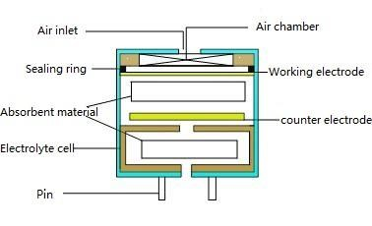
CONSTRUCTION :
Electrochemical sensor
consists of a working
electrode, counter electrodes
and a reference electrode.
The electrodes are
typically mounted on a
substrate, which is usually
an insulating material such
as glass, ceramic, or polymer. The substrate provides mechanical support and electrical isolation between the electrodes.

Slide 4

​WORKING :
The working electrode is coated with a sensing layer or material that interacts specifically with the target analyte. This interaction results in an electrochemical signal that can be measured.
The electrodes are immersed in an electrolyte solution that contains the analyte to be detected. The electrolyte allows ions to move between the working and counter electrodes, completing the electrochemical circuit.
The electrochemical signal generated at the working electrode needs to be converted into a measurable signal which is done using transducers like amplifiers . Signal processing and data analysis methods are used to interpret the signal and determine the analyte concentration.
​
​

Slide 5

APPLICATION :
Environmental monitoring of air quality.
Detection of explosive gases and toxic vapors.
Oxygen monitoring in the medical sector.
Detection of contaminants, allergens,
and pathogens in food products.
Monitoring of battery health and
performance in electric vehicles
and renewable energy systems.

Slide 6

THANK YOU

