Slide 1
Improved the performance of copra type classification model using ensemble learning algorithms
Presented By:
Aryajaya Alamsyah, S.Kom., M.Kom.

Slide 2
Material details
1. Introduction
2. Releted Work
3. Research Method
4. Results and Discussion
4. Conclusion

Slide 3
Research problem

Slide 4
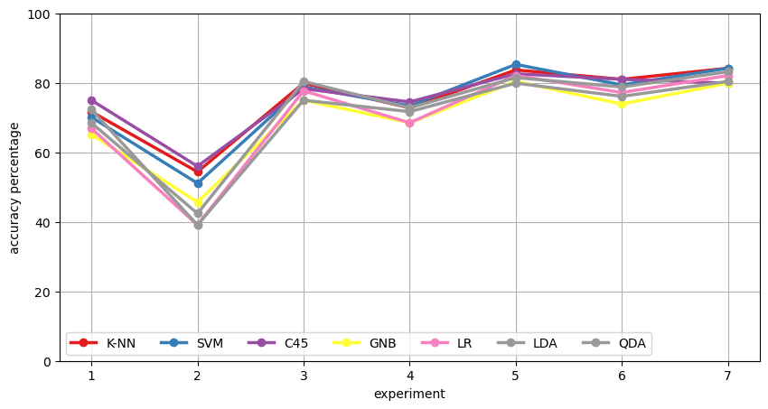
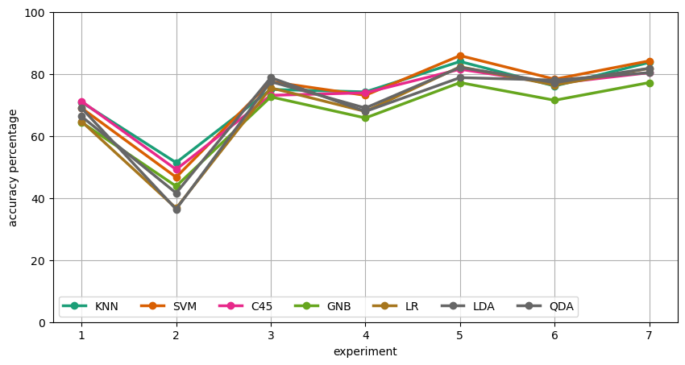
Result supervised learning with somes algorithm
with data train 90% and data test 10%
with data train 80% and data test 20%

Slide 5
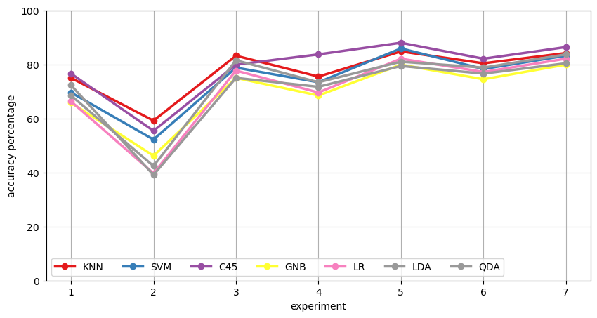
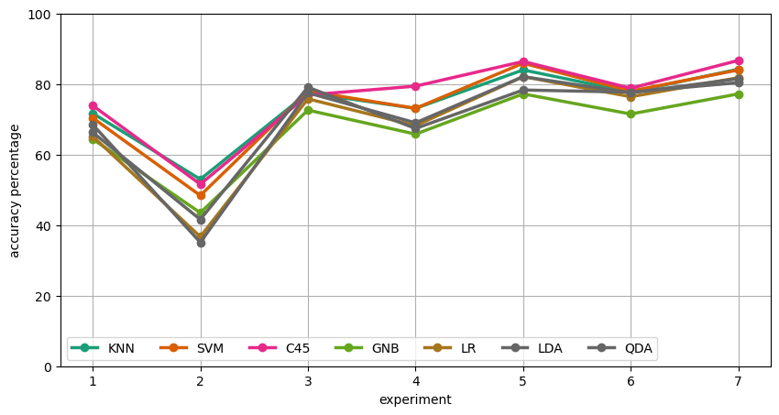
Result ensemble with bagging algorithm
with data train 90% and data test 10%
with data train 80% and data test 20%

Slide 6
Result ensemble with voting and stacking algorithm
with data train 90% and data test 10%
with data train 80% and data test 20%

