Slide 1
Tcl/Tk

Slide 2
#!/usr/bin/tclsh
puts "Hello, World!“
To run:
tclsh filename.tcl

Slide 3
Comments
#!/usr/bin/tclsh
# my first program in Tcl
puts "Hello World!“
Multi line or block comment is written using if with condition 0.
#!/usr/bin/tclsh
if 0 {
my first program in Tcl program
Its very simple
}
puts "Hello World!"

Slide 4
Inline comments use ;#
#!/usr/bin/tclsh
puts "Hello World!" ;# my first print in Tcl program

Slide 5
Variable substitution
In variable substitutions, $ is used before the variable name and this returns the contents of the variable.
#!/usr/bin/tclsh
set a 3
puts $a
Backslash substitution
#!/usr/bin/tclsh
puts "Hello\nWorld"

Slide 6
Simple Tcl Objects
In Tcl, whether it is an integer number, boolean, floating point number, or a string. When you want to use a variable, you can directly assign value to it, there is no step of declaration in Tcl.
It can transform one data-type to an other when required.
#!/usr/bin/tclsh
set myVariable 18
puts $myVariable
#!/usr/bin/tclsh
set myVariable 18
puts [expr $myVariable + 6 + 9]

Slide 7
String representations
you need not include double quotes when it's only a single word.
#!/usr/bin/tclsh
set myVariable hello
puts $myVariable
When we want to represent multiple strings, we can use either double quotes or curly braces.
#!/usr/bin/tclsh
set myVariable "hello world"
puts $myVariable
set myVariable {hello world}
puts $myVariable

Slide 8
Lists
List is nothing but a group of elements. A group of words either using double quotes or curly braces can be used to represent a simple list.
lindex- built-in tcl command that retrieves an element from a list or a nested list.
#!/usr/bin/tclsh
set myVariable {red green blue}
puts [lindex $myVariable 2]
set myVariable "red green blue"
puts [lindex $myVariable 1]

Slide 9
Associative Array
Associative arrays have an index (key) that is not necessarily an integer. It is generally a string that acts like key value pairs.
#!/usr/bin/tclsh
set marks(english) 80
puts $marks(english)
set marks(mathematics) 90
puts $marks(mathematics)

Slide 10
Dynamic Typing
Tcl is a dynamically typed language. The value of the variable can be dynamically converted to the required type when required.
#!/usr/bin/tclsh
set variableA "10"
puts $variableA
set sum [expr $variableA +20];
puts $sum

Slide 11
Mathematical expressions
expr is used for representing mathematical expression
#!/usr/bin/tclsh
set variableA "10"
set result [expr $variableA / 9];
puts $result
set result [expr $variableA / 9.0];
puts $result
set variableA "10.0"
set result [expr $variableA / 9];
puts $result

Slide 12
operators
Arithmetic Operators
Relational Operators
Logical Operators
Bitwise Operators
Ternary Operator

Slide 13
Arithmetic Operators +,-,*,/,%
Relational Operators ==,!=,>,<,>=,<=
Logical Operators &&,||,!
Ternary Operator ? :

Slide 14
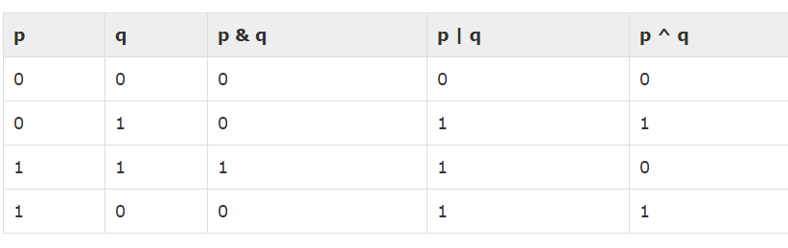
Bitwise Operators Bitwise operator works on bits and perform bit-by-bit operation.

Slide 15
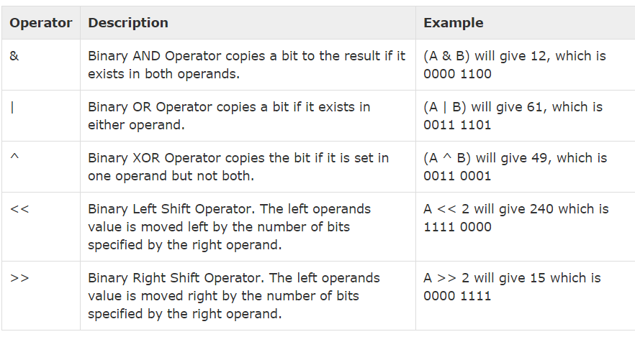
Assume if A = 60; and B = 13; now in binary format they will be as follows: A = 0011 1100 B = 0000 1101

Slide 16
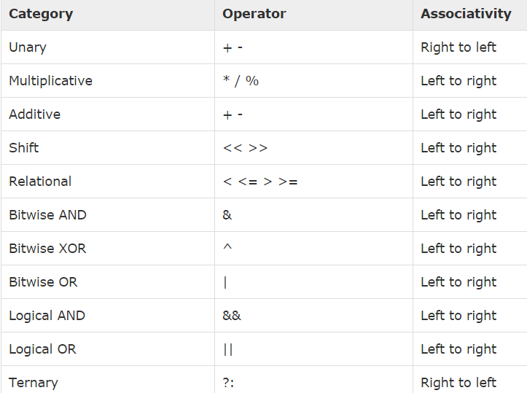
Operators Precedence

Slide 17
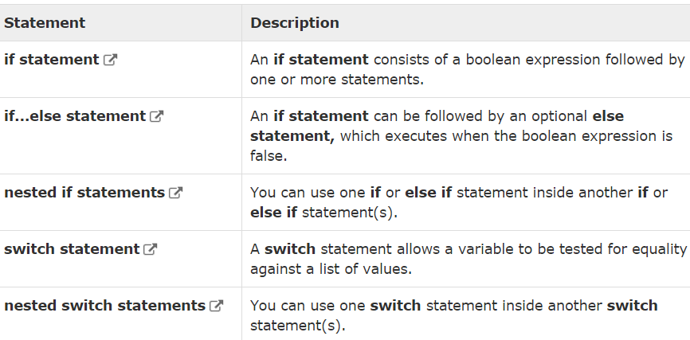
Decisions

Slide 18
If statement
#!/usr/bin/tclsh
set a 10
#check the boolean condition using if statement
if { $a < 20 }
{
# if condition is true then print the following
puts "a is less than 20"
}
puts "value of a is : $a"

Slide 19
If-else statement
#!/usr/bin/tclsh
set a 100
#check the boolean condition
if {$a < 20 }
{
#if condition is true then print the following
puts "a is less than 20“
}
else {
#if condition is false then print the following
puts "a is not less than 20"
}
puts "value of a is : $a"

Slide 20
If-elseif-else
#!/usr/bin/tclsh
set a 100
#check the boolean condition
if { $a == 10 } {
# if condition is true then print the following
puts "Value of a is 10"
} elseif { $a == 20 } {
# if else if condition is true
puts "Value of a is 20"
} elseif { $a == 30 } {
# if else if condition is true
puts "Value of a is 30"
} else {
# if none of the conditions is true
puts "None of the values is matching"
}
puts "Exact value of a is: $a"

Slide 21
Nested-if
#!/usr/bin/tclsh
set a 100
set b 200
# check the boolean condition
if { $a == 100 } {
# if condition is true then check the following
if { $b == 200 } {
#if condition is true then print the following
puts "Value of a is 100 and b is 200"
}
}
puts "Exact value of a is : $a"
puts "Exact value of b is : $b"

Slide 22
switch
Unquoted version
#!/usr/bin/tclsh
set grade C
switch $grade A { puts "Well done!" } B { puts "Excellent!" } C { puts "You passed!" } F { puts "Better try again" } default { puts "Invalid grade" }
puts "Your grade is $grade"

Slide 23
Quoted version
#!/usr/bin/tclsh
set grade B
switch $grade {
A {
puts "Well done!"
}
B {
puts "Excellent!"
}
C {
puts "You passed!"
}
F {
puts "Better try again"
}
default {
puts "Invalid grade"
}
}
puts "Your grade is $grade"

Slide 24
Nested Switch statement
#!/usr/bin/tclsh
set a 100
set b 200
switch $a {
100 {
puts "This is part of outer switch"
switch $b {
200 {
puts "This is part of inner switch!"
}
}
}
}
puts "Exact value of a is : $a"
puts "Exact value of a is : $b"

Slide 25
Loop-while
#!/usr/bin/tclsh
set a 10
#while loop execution
while { $a < 20 } {
puts "value of a: $a"
incr a
}

Slide 26
loop- for
#!/usr/bin/tclsh
# for loop execution
for { set a 10} {$a < 20} {incr a} {
puts "value of a: $a"
}

Slide 27
Nested loop
# the prime numbers from 2 to 100
#!/usr/bin/tclsh
set j 0
for {set i 2} {$i<100} {incr i} {
for {set j 2} {$j <= [expr $i/$j] } {incr j} {
if { [expr $i%$j] == 0 } {
break
}
}
if {$j >[expr $i/$j] } {
puts "$i is prime"
}
}

Slide 28
Break statement
#!/usr/bin/tclsh
set a 10
# while loop execution
while {$a < 20 } {
puts "value of a: $a"
incr a
if { $a > 15} {
# terminate the loop using break statement
break
}
}

Slide 29
Continue statement
#!/usr/bin/tclsh
set a 10
# do loop execution
while { $a < 20 } {
if { $a == 15} {
#skip the iteration
incr a
continue
}
puts "value of a: $a"
incr a
}

Slide 30
Infinite loop
while {1} {
puts "This loop will run forever."
}

Slide 31
set ArrayName(Index) value
#!/usr/bin/tclsh
set languages(0) Tcl
set languages(1) "C Language"
puts $languages(0)
puts $languages(1)

Slide 32
Size of array
[array size variablename]
#!/usr/bin/tclsh
set languages(0) Tcl
set languages(1) "C Language"
puts [array size languages]

Slide 33
Array Iteration
#!/usr/bin/tclsh
set languages(0) Tcl
set languages(1) "C Language"
for { set index 0 } { $index < [array size languages] } { incr index } {
puts "languages($index) : $languages($index)"
}

Slide 34
output
languages(0) : Tcl
languages(1) : C Language

Slide 35
Associative Arrays
In Tcl, all arrays by nature are associative. Arrays are stored and retrieved without any specific order.
associative array with non-number indices
#!/usr/bin/tclsh
set personA(Name) "Dave"
set personA(Age) 14
puts $personA(Name)
puts $personA(Age)

Slide 36
Indices of array
The syntax for retrieving indices of array is shown below
#!/usr/bin/tclsh
set personA(Name) "Dave"
set personA(Age) 14
puts [array names personA]
Output:
Age Name

Slide 37
Iteration of associative array
#!/usr/bin/tclsh
set personA(Name) "Dave"
set personA(Age) 14
foreach index [array names personA] {
puts "personA($index): $personA($index)"
}
Output:
personA(Age): 14
personA(Name): Dave

Slide 38
String comparison
#!/usr/bin/tclsh
set s1 "Hello"
set s2 "World"
set s3 "World“
if {[string compare s2 s3] == 0} {
puts "String \'s1\' and \'s2\' are same."
}
if {[string compare s1 s2] == -1} {
puts "String \'s1\' comes before \'s2\'."
}
if {[string compare s2 s1] == 1} {
puts "String \'s2\' comes before \'s1\'."
}
Output:
-1
String 's1' comes before 's2'.
String 's2' comes before 's1'.

Slide 39
Index of string
#!/usr/bin/tclsh
set s1 "Hello World"
set s2 "o"
puts "First occurrence of $s2 in s1"
puts [string first $s2 $s1]
puts "Character at index 0 in s1"
puts [string index $s1 0]
puts "Last occurrence of $s2 in s1"
puts [string last $s2 $s1]
Output:
First occurrence of o in s1
4
Character at index 0 in s1
H
Last occurrence of o in s1
7

Slide 40
Length of string
#!/usr/bin/tclsh
set s1 "Hello World"
puts "Length of string s1“
puts [string length $s1]
Length of string s1
11

Slide 41
Handling cases
#!/usr/bin/tclsh
set s1 "Hello World“
puts "Uppercase string of s1"
puts [string toupper $s1]
puts "Lowercase string of s1“
puts [string tolower $s1]
Uppercase string of s1 HELLO WORLD Lowercase string of s1 hello world

Slide 42
Trimming characters
#!/usr/bin/tclsh
set s1 "Hello World"
set s2 "World“
puts "Trim right $s2 in $s1“
puts [string trimright $s1 $s2]
set s2 "Hello"
puts "Trim left $s2 in $s1“
puts [string trimleft $s1 $s2]
set s1 " Hello World "
set s2 " "
puts "Trim characters “
puts [string trim $s1 $s2]
Trim right World in Hello World
Hello
Trim left Hello in Hello World
World
Trim characters s1 on both sides of s2
Hello World

Slide 43
Matching strings
#!/usr/bin/tclsh
set s1 "test@test.com"
set s2 "*@*.com"
puts "Matching pattern s2 in s1“
puts [string match "*@*.com" $s1 ]
puts "Matching pattern tcl in s1"
puts [string match {tcl} $s1]
Matching pattern s2 in s1
1
Matching pattern tcl in s1
0

Slide 44
Append command
#!/usr/bin/tclsh
set s1 "Hello"
append s1 " World“
puts $s1
Hello World

Slide 45
Format command
#!/usr/bin/tclsh
puts [format "%f" 43.5]
puts [format "%e" 43.5]
puts [format "%d %s" 4 tuts]
puts [format "%s" "Tcl Language"]
43.500000
4.350000e+01
4 tuts
Tcl Language

Slide 46
Creating a list
set listName { item1 item2 item3 .. itemn }
# or
set listName [list item1 item2 item3]
# or
set listName [split "items separated by a character" split_character]

Slide 47
Creating a list
#!/usr/bin/tclsh
set colorList1 {red green blue}
set colorList2 [list red green blue]
set colorList3 [split "red_green_blue" _]
puts $colorList1
puts $colorList2
puts $colorList3

Slide 48
Appending item to a list
append listName split_character value
# or
lappend listName value
#!/usr/bin/tclsh
set var orange
append var " " "blue“
lappend var "red“
lappend var "green“
puts $var

Slide 49
Length of list
llength listName
#!/usr/bin/tclsh
set var {orange blue red green}
puts [llength $var]
Output:
4

Slide 50
List item at index
lindex listname index
#!/usr/bin/tclsh
set var {orange blue red green}
puts [lindex $var 1]
Insert item at index
linsert listname index value1 value2..valuen
#!/usr/bin/tclsh
set var {orange blue red green}
set var [linsert $var 3 black white]
puts $var

Slide 51
Replace items at indices
lreplace listname firstindex lastindex value1 value2..valuen
#!/usr/bin/tclsh
set var {orange blue red green}
set var [lreplace $var 2 3 black white]
puts $var
Set item at index
lset listname index value
#!/usr/bin/tclsh
set var {orange blue red green}
lset var 0 black
puts $var

Slide 52
Sorting a list
lsort listname
#!/usr/bin/tclsh
set var {orange blue red green}
set var [lsort $var]
puts $var

Slide 53
Dictionary
A dictionary is an arrangement for mapping values to keys.
dict set dictname key value
# or
dict create dictname key1 value1 key2 value2 .. keyn valuen

Slide 54
#!/usr/bin/tclsh
dict set colours colour1 red
puts $colours
dict set colours colour2 green
puts $colours
set colours [dict create colour1 "black" colour2 "white"]
puts $colours

Slide 55
colour1 red
colour1 red colour2 green
colour1 black colour2 white

Slide 56
Size of dict
[dict size dictname]
#!/usr/bin/tclsh
set colours [dict create colour1 "black" colour2 "white"]
puts [dict size $colours]
Output:
2

Slide 57
Dictionary Iteration
#!/usr/bin/tclsh
set colours [dict create colour1 "black" colour2 "white"]
foreach item [dict keys $colours] {
set value [dict get $colours $item]
puts $value
}

Slide 58
Value for key in dict
[dict get $dictname $keyname]
#!/usr/bin/tclsh
set colours [dict create colour1 "black" colour2 "white"]
set value [dict get $colours colour1]
puts $value

Slide 59
All keys in dict
[dict keys $dictname]
#!/usr/bin/tclsh
set colours [dict create colour1 "black" colour2 "white"]
set keys [dict keys $colours]
puts $keys
All values in dict
[dict values $dictname]

Slide 60
Key exists in dict
[dict values $dictname]
#!/usr/bin/tclsh
set colours [dict create colour1 "black" colour2 "white"]
set result [dict exists $colours colour1]
puts $result
Output:
1

Slide 61
procedures
proc procedureName {arguments} {
body
}
#!/usr/bin/tclsh
proc helloWorld {} {
puts "Hello, World!“
}
helloWorld

Slide 62
Procedures with multiple arguments
#!/usr/bin/tclsh
proc add {a b} {
return [expr $a+$b]
}
puts [add 10 30]

Slide 63
Procedures with variable arguments
#!/usr/bin/tclsh
proc avg {numbers} {
set sum 0
foreach number $numbers {
set sum [expr $sum + $number]
}
set average [expr $sum/[llength $numbers]]
return $average
}
puts [avg {70 80 50 60}]
puts [avg {70 80 50 }]

Slide 64
Procedures with default arguments
#!/usr/bin/tclsh
proc add {a {b 100} } {
return [expr $a+$b]
}
puts [add 10 30]
puts [add 10]

Slide 65
Recursive procedures
#!/usr/bin/tclsh
proc factorial {number} {
if {$number <= 1} {
return 1
}
return [expr $number * [factorial [expr $number - 1]]]
}
puts [factorial 3]
puts [factorial 5]

