Slide 1


DATA MIGRATION
USING XML
INTERNAL GUIDE:
Mrs.J.Brindha Merin
PRESENTED BY:
Shama Hina.D
Kusma Thummagunta

Slide 2
TITLE DESCRIPTION
XML Database Migration is a project of migrating information from one database to another database through XML as a migration tool.
Migration of a database to another database is a huge process and a complex one. In such case our project can be used as we are converting the entire database into a XML file and then it is converted into a single database.

Slide 3
OBJECTIVE
Conversion of databases to XML file format and then retreiving the information from XML into the destination database is the objective of this project.
Through this project, not just the conversion has been made easier but also the native database also will remain unchanged.

Slide 4
ABSTRACT
This project is a migration system that accepts user input and converts that into a migration command for migrating tables in one database to another.
Various databases like MySQL Server, PostgreSQL, MSAccess, SQLite are considered in the project. The Databases may also be Oracle or MS SQL Server etc. but not considered as the process would be similar for all these Databases.
All these databases are in various encoding systems and cannot be directly migrated. Therefore XML is used for migration of these tables from one database to another database as XML is platform independent and supports all Encoding shemes.

Slide 5
EXISTING SYSTEM
Existing systems of migration are difficult or complicated processes that require the conversion of tables from one database into another database by exporting them as excel sheets or csv files.
Disadvantages:
Slow and tedious migration process.
Some of the tools available are not free and require a lot of expenditure.
Not very user friendly.

Slide 6
PROPOSED SYSTEM
The proposed system is a fast migration tool to be implemented using JSP and XML. Migrates any RDBMS with an easy GUI.
Advantages:
Very fast migration process.
Completely free as all the technologies are open source.
Very user friendly.

Slide 7
LITERATURE SURVEY
AUTHORS | PAPER | YEAR | SUMMARY
Shabana Ramzan , Imran Sarwar Bajwa | Intelligent Data Engineering for Migration to NoSQL Based Secure Environments | 2019 | This publication providies an efficient way to transfer the RDB to a bigdata database and to improve the data quality. This proposal approach has two phases. a) Data transformation module b) Data cleansing module. This paper provides a solution to overcome unlimited scalability, high performance, data modeling, data distribution, and continuous availability. It also helps in solving the challenges faced by the business organizations in transforming the conventional databases to NOSQL databases. The future scope of the project is to extend this approach to allow multiple data inputs.
Winda Sekar Dewi, Ema Utami, Bambang Sudaryatno | Database Migration using Data Synchronization and Transactional Replication | 2019 | This International journal focuses on eliminating the data lost issues through Database migration. Two important techniques are discussed for the database migration : a) Data Synchronization b) Transactional Replication. Data Synchronization helps the migrated database to be synchronized with the original database. Transactional Replication is used to migrate one cloud database to another cloud storage by working on the service area. Th evaluation method used in the paper is presented by the comparison of two techniques. The factors influencing the results of migration varies from no.of rows to table size as well as location of the server and also the speed of data uploading and downloading.

Slide 8
LITERATURE SURVEY
AUTHORS | PAPER | YEAR | SUMMARY
Mohd Kamir Yusof, Mustafa Man | Efficiency of Flat file Database approach in data storage and data extraction for big data | 2018 | The paper describes three methods to manage and analyze large amount of structured and unstructured data transfer. The three approaches used for the data transfer are XML, JSON and through FLAT FILE. The core of the paper is to evaluate the three approaches and find the suitable one to handle large amount of publication data. This paper highlights that the text file format is the best flexible approach huge amount of data while XML and JSON works efficiently and more scalable than FLAT FILE approach. It proves that FLAT FILE approach is the best option for CPU usage as well as Query retrieving speed .
Alae El Alami, Mohamed Bahaj | Schema and Data Migration of a RDB to the Extensible Markup Language XML | 2015 | This paper explains the conversion of RDB to XML document based on Meta data and semantic enrichment. The RDB is flattened and enriched by using object concepts. This usage of object concept in XML uses the syntax which allows the verification of XML document conformity while creating it. The extracted RDB information is then analyzed, filtered to adjust with the structure of the XML files and the object model associated with it. The implementation in the XML document is built dynamically using SQL Query. A prototype is developed to implement this automatic migration to prove the approach’s effectiveness.

Slide 9
LITERATURE SURVEY
AUTHORS | PAPER | YEAR | SUMMARY
Kanagaraj S, Dr Sunitha Abburu | Converting Relational Database Into Xml Document | 2012 | This paper presents a model to convert Relational Data base to XML database. Through extended entity relationships model, the Relational database schema is converted into XML. EER model helps to map the captured Relational Database schema to XML schema. Various databases like MS - ACCESS, MS- SQL is converted to XML file format and the file is given to the end user. This paper doesn’t include the semantic constraints in the database and is limited to MS- ACCESS and MS- SQL databases only. The future scope is given to extend this to other databases.
V. Rajeswari, Dr. Dharmisthan, K. Varughese | A Novel Approach for Integrating Heterogeneous Database through XML | 2011 | This paper illustrates the development of new technique to store and map XML and different databases by an interactive mapping technique. It is based on XML tested in different scenarios and its verified adaptability in simplifying and integrating data exchange between various database systems. This paper identifies the problems that arise during the creation of integrated interface schema over existing local heterogeneous databases. A new method is proposed to create integrated schema from local database schema. The processing time is calculated by the parser parses the files along with the processing speed calculated on different database types.

Slide 10
LITERATURE SURVEY
AUTHORS | PAPER | YEAR | SUMMARY
B. Nagarajan and Dr.J. Suguna | A Review on Cloud Data Storage in Virtual Perspective | 2014 | This paper is a study on cloud computing in virtual perspective. There are many “on-demad” service models in the cloud out of which cloud storage model lacks a clear structure and neither have a defined set of capabilities nor single architecture. This paper emphasizes it’s study on the storage virtualization taxonomy which is the basis of cloud storage. This paper provides in-depth knowledge in understanding the cloud computing and its service models by reviewing the key technologies like CDMI and OCCI in virtual perspective. This helps in building a compendium in understanding the concept of cloud storage.
M. Anshar, M. W. Ashraf, M. Fatima | Data Migration in Cloud : A Systematic Review | 2018 | This paper discusses the systematic review on Data migration in the cloud. Data migration has to transfer data secure way and maintain confidentiality in a way there is no data loss due to active attacks. This paper gives a overview of the problems and solutions as well give a proposed solution for migration of data through attuntiy and helps in optimizing data to replicate and transfer and hence resulting in safer and faster path to accelerate data. s.

Slide 11
ARCHITECTURE DIAGRAM
T
O
M
C
A
T
-
8
0
8
1
Migration
Tool
Browser
Modules 1.Login Module
2.Change Password
3.Database selection module
4.Migration module
5.Database module
DATA
BASE

Slide 12
IPO
INPUT:
Source DB and Destination DB
OUTPUT:
Tables in a schema from Source DB are migrated to schema(Database) in Destination DB

Slide 13
ALGORITHM
Login
Select source and destination databases
Auto Execution of Migration JSP code process
converts the entire data of source Db into XML format
Inserts XML format generated by sourceDB into destination DB in its format
Generation of XML Format from SourceDBProcess:
Connect to the jdbc driver
If table=sourceDB,get column names,constraints and data
Create_tags_xml process:
Insert table name as the root tag in xml
Get the table details to create xml tags
Get the schema of table to insert into xml
Insert XML format data into DestDB process:
Connect to jdbc driver
Parse the xml file of source database
Get the table name from the root tag
All the column names are obtained by considering the child tags
Insert the values into table

Slide 14
MODULES
Login Module:
This is an authentication module for entering into the migration software.
Change Password:
This is for providing better security for the admin password, so that the password is changed regularly for better authentication.
Database Selection Module:
This module is responsible for selecting a particular source database and a destination database for migration.
Migration Module:
This module is responsible for migration of tables from a source database to a destination database.
Database Module:
This module is responsible for storing the tables in various databases before or after migration.

Slide 15
REQUIREMENTS
Software Requirement
Hardware Requirement(Minimum)
Operating System | : Windows XP/7/8/8.1/10 or Linux/MAC
Coding Languaguage | : JAVA 1.7, JSP Servlets
Front End | : HTML5, Jquery, JavaScript
Web Server | : Apache Tomcat 7.0
Database | : MySQL Server 5.1, SQLite, PostGreSQL
Processor | : Pentium-IV 2.4GHz or above
RAM | : Minimum 1 GB
Hard Disk Drive | : Minimum 160GB

Slide 16
FRONT END DESIGN
Design :
Client
(Browser)
User request
Web Server
Process and
Execute query
Database
Fetch the result
Response

Slide 17
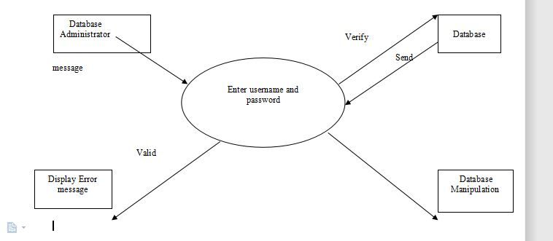
DATA FLOW DIAGRAMS
LEVEL 1 DFD :

Slide 18
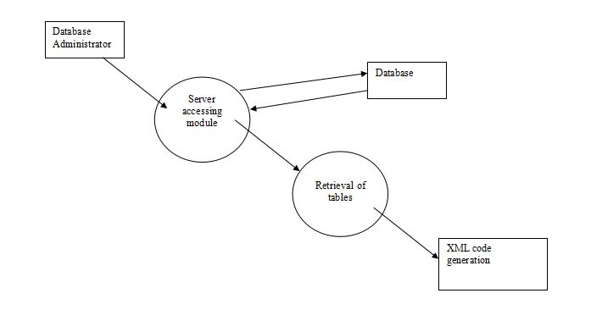
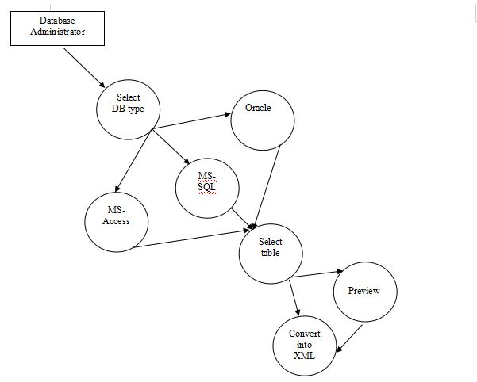
DATA FLOW DIAGRAMS
LEVEL 2 DFD : (Retrieval of tables)

Slide 19
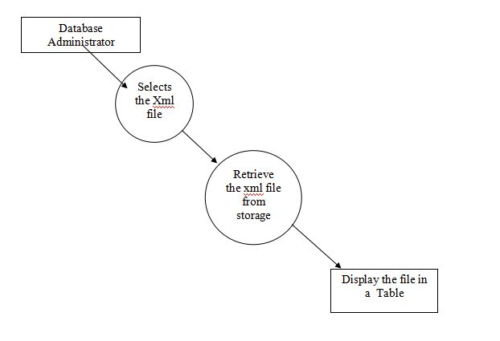
DATA FLOW DIAGRAMS
Preview of XML file :

Slide 20
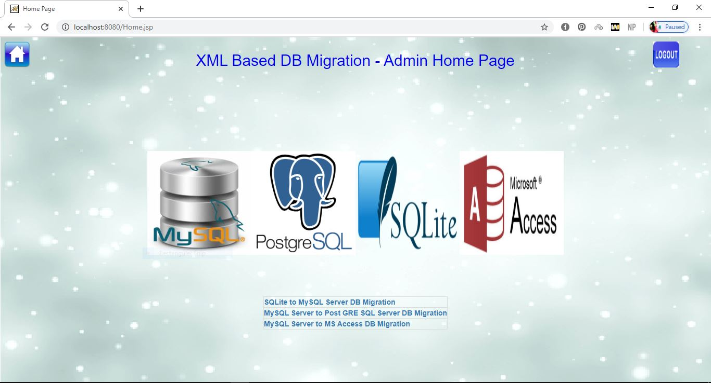
DESIGN sCREENSHOTS

Slide 21
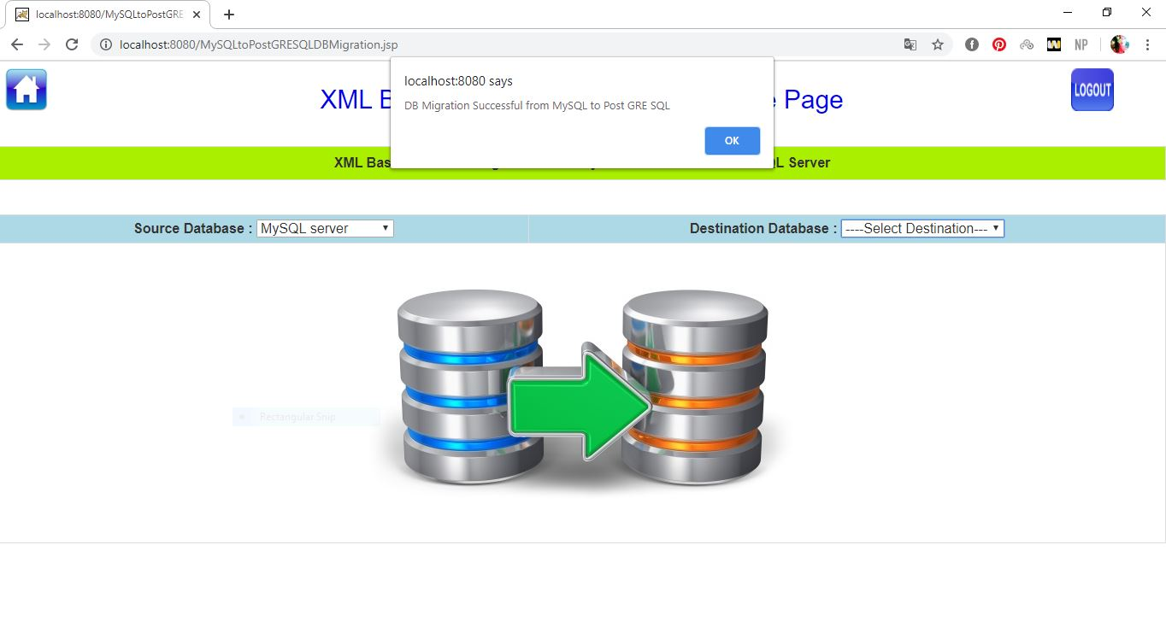
DESIGN sCREENSHOTS

Slide 22
CONCLUSION
The project is as such an attempt to convert any database format into one single format called XML, as it is a cross-platform, machine independent file format.Where, the database formats like .mdb, .sql, .dmp, .dbf etc.. cannot interact with each other directly, xml comes for rescue.
Moreover, it can easily communicate with front-end languages like C#,.NET,VB.NET or Java etc.., by serving as a database for these coding languages. It could be secure and can include constraints also.

Slide 23
FUTURE WORK
The Project could be extended further to include XSD/XS schema related conversions for further enhancement of the XML file format. Using this schema-based XML Format would greatly improve the security of XML File at file level.

Slide 24
REFERENCES
[1] Shabana Ramzan,Imran Sarwar Bajwa et al.,“Intelligent Data Engineering for Migration to NoSQL Based Secure Environments”,IEEE Access Advanced Software and Data Engineering for Secure Societies, Vol. 7, pp. 69042 - 69057,2019.
[2] Winda Sekar Dewi, Ema Utami, Bambang Sudaryatno,“Database Migration using Data Synchronization and Transactional Replication”,International Journal of Innovative technology and Exploring Engineering, ISSN: 2278-3075, Volume-8 Issue-10, August 2019.
[3] Mohd Kamir Yusof, Mustafa Man, “Efficiency of FlatFile Database Approach in Data Storage and Data Extraction for Big Data”, Indonesian Journal of Electrical Engineering and Computer Science,Vol. 9, No.2,pp.460~473,February 2018.
[4] Alae El Alami, Mohamed Bahaj, “Schema and DataMigration of a Relational Database RDB to the Extensible Markup Language XML”, World Academy of Science, Engineering and Technology ,International Journal of Computer and Information Engineering , Vol:9, No:7, 2015.
[5] Kanagaraj S,Dr SunithaAbburu,“ Converting Relational Database Into Xml Document”. IJCS International Journal of Computer Science Issues, Vol. 9, Issue 2, No 1, March 2012.

Slide 25


Slide 26


