Slide 1
Relationship Between
Sleep and Stress
Team #5
Kim Semin and Oh Jinwoo

Slide 2

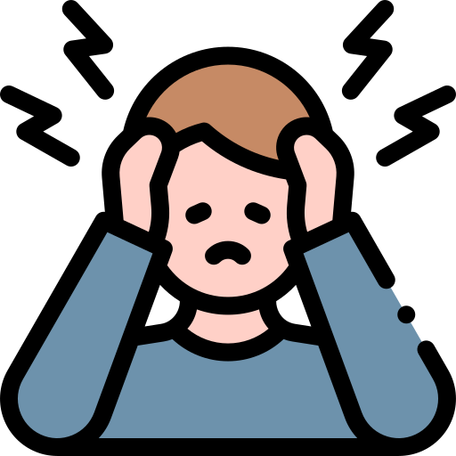
Sleep and Stress
Sleep quality
Stress and anxiety
Notes:
As we commonly know, sleep quality and Stress level are higly correlated each other. Poor Sleep quality affects High stress level, and High Stress level ruin sleep quality.
We will analyze how sleep pattern affects stress level,

Slide 3
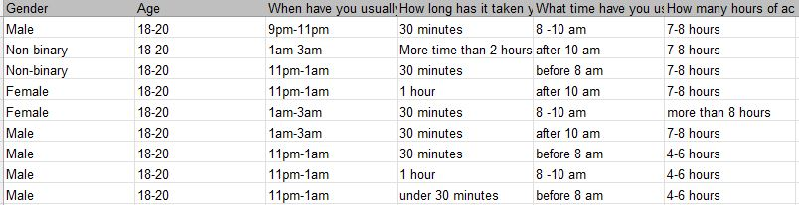
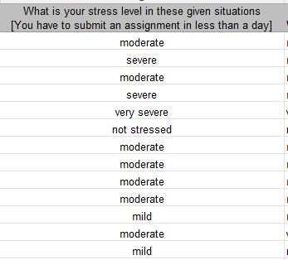
About the Dataset
Dataset From Kaggle
Survey of 2000 students from
technical university in India.
Key Data:
Sleep hours
Stress level in given situations
Recent Sleep Pattern
Notes:
We are using a real-world dataset from Kaggle, originally collected from a technical university in Tamil Nadu, India.
The participants are university students, and the dataset records their sleep habits and stress levels.
Stress was measured in various daily situations, such as:
when an assignment is due in less than a day,
a week before exams,
or during social interactions like asking for help or meeting someone new.
It also includes demographic information such as age, gender, and major, which allows us to explore patterns across different student groups.
This dataset is meaningful because it reflects the actual experiences of students in a university setting.

Slide 4
Project Plan
1. Train a model to predict stress level based on sleep hours.
- Sleep hours (Numeric Value)
- Additional Questions
- Yes/No question will be treated by One-hot vector.
- Make a model using Decision Tree model such as LightGBM, XGboost.
2. Users will enter their own sleep hours.
- Then, the model will estimate their stress level.
3. The result will compare:
- The user’s stress level with the average level of similar users.
4. Finally, the model will personalized ways to decrease the stress level.

Slide 5
Thank you

