Slide 1
WRITING PERSUASIVE MESSAGES
Chapter 11

Slide 2
What is persuasion?

Slide 3
USING THE THREE-STEP WRITING PROCESS FOR PERSUASIVE MESSAGES
Persuasion is the attempt to change someone’s attitudes, beliefs, or actions.
It’s more challenging, it asks the audiences to:
give something of value
Take substantial action
It is not about trickery, it’s about letting audiences know they have choices and presenting that our offering is the best option

Slide 4
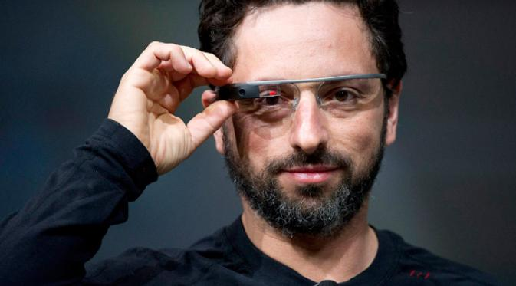
USING THE THREE-STEP WRITING PROCESS FOR PERSUASIVE MESSAGES
Having a great idea is no longer enough!
Where is Google Glass now?

Slide 5
USING THE THREE-STEP WRITING PROCESS FOR PERSUASIVE MESSAGES
STEP 1: Planning Persuasive Messages
Analyzing situation
The best persuasive = closely connected to audience desire and interest
Make sure you’re clear about what you really hope to achieve! Money? Support? Staff?
What are your audiences needs?
What do you want?
How might they resist? Are there alternatives need to be examined?
What are the most important issues for the audiences?
Culture?
Demographics, psychographics, motivation
Gathering information
Selecting the right media and channels
Organizing your information
Mostly indirect approach
Depends on your position within organization

Slide 6

USING THE THREE-STEP WRITING PROCESS FOR PERSUASIVE MESSAGES
STEP 1: Planning Persuasive Messages
Motivation
Basic physiological requirements
Safety and security
Affiliation and belonging
Power and control
Achievement
Adventure and distraction
Knowledge, exploration, understanding
Aesthetic appreciation
Self-actualization
Helping others

Slide 7
USING THE THREE-STEP WRITING PROCESS FOR PERSUASIVE MESSAGES
STEP 2: Writing Persuasive Messages
Positive language is essential feature for persuasive
Understand cultural difference!
Do not use over-the-top language, sometime its unfavorable by audiences
Use these techniques
Use simple language
Provide objective evidence
Identifying your source materials
Establishing common ground with audiences
Being objective, fair, and logical
Focusing on the audience’s interests
Using logic, evidence, and narratives, avoid hard-selling
Building credibility before presenting

Slide 8
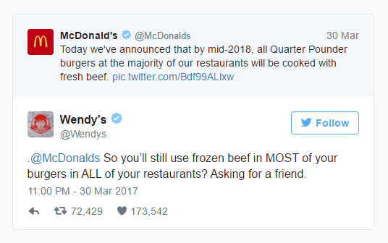
USING THE THREE-STEP WRITING PROCESS FOR PERSUASIVE MESSAGES
STEP 3: Completing Persuasive Messages
Evaluate Your Content
Proofread Your Message
Produce Your Message
Distribute Your Message

Slide 9
DEVELOPING PERSUASIVE BUSINESS MESSAGES
Framing Your Arguments
Aida
Attention
Desire
Action
Catch the audience’s attention
Provide additional details or benefits
Explain benefits, address objections
Suggest specific audience action
Interest
AIDA usually for indirect approach

Slide 10
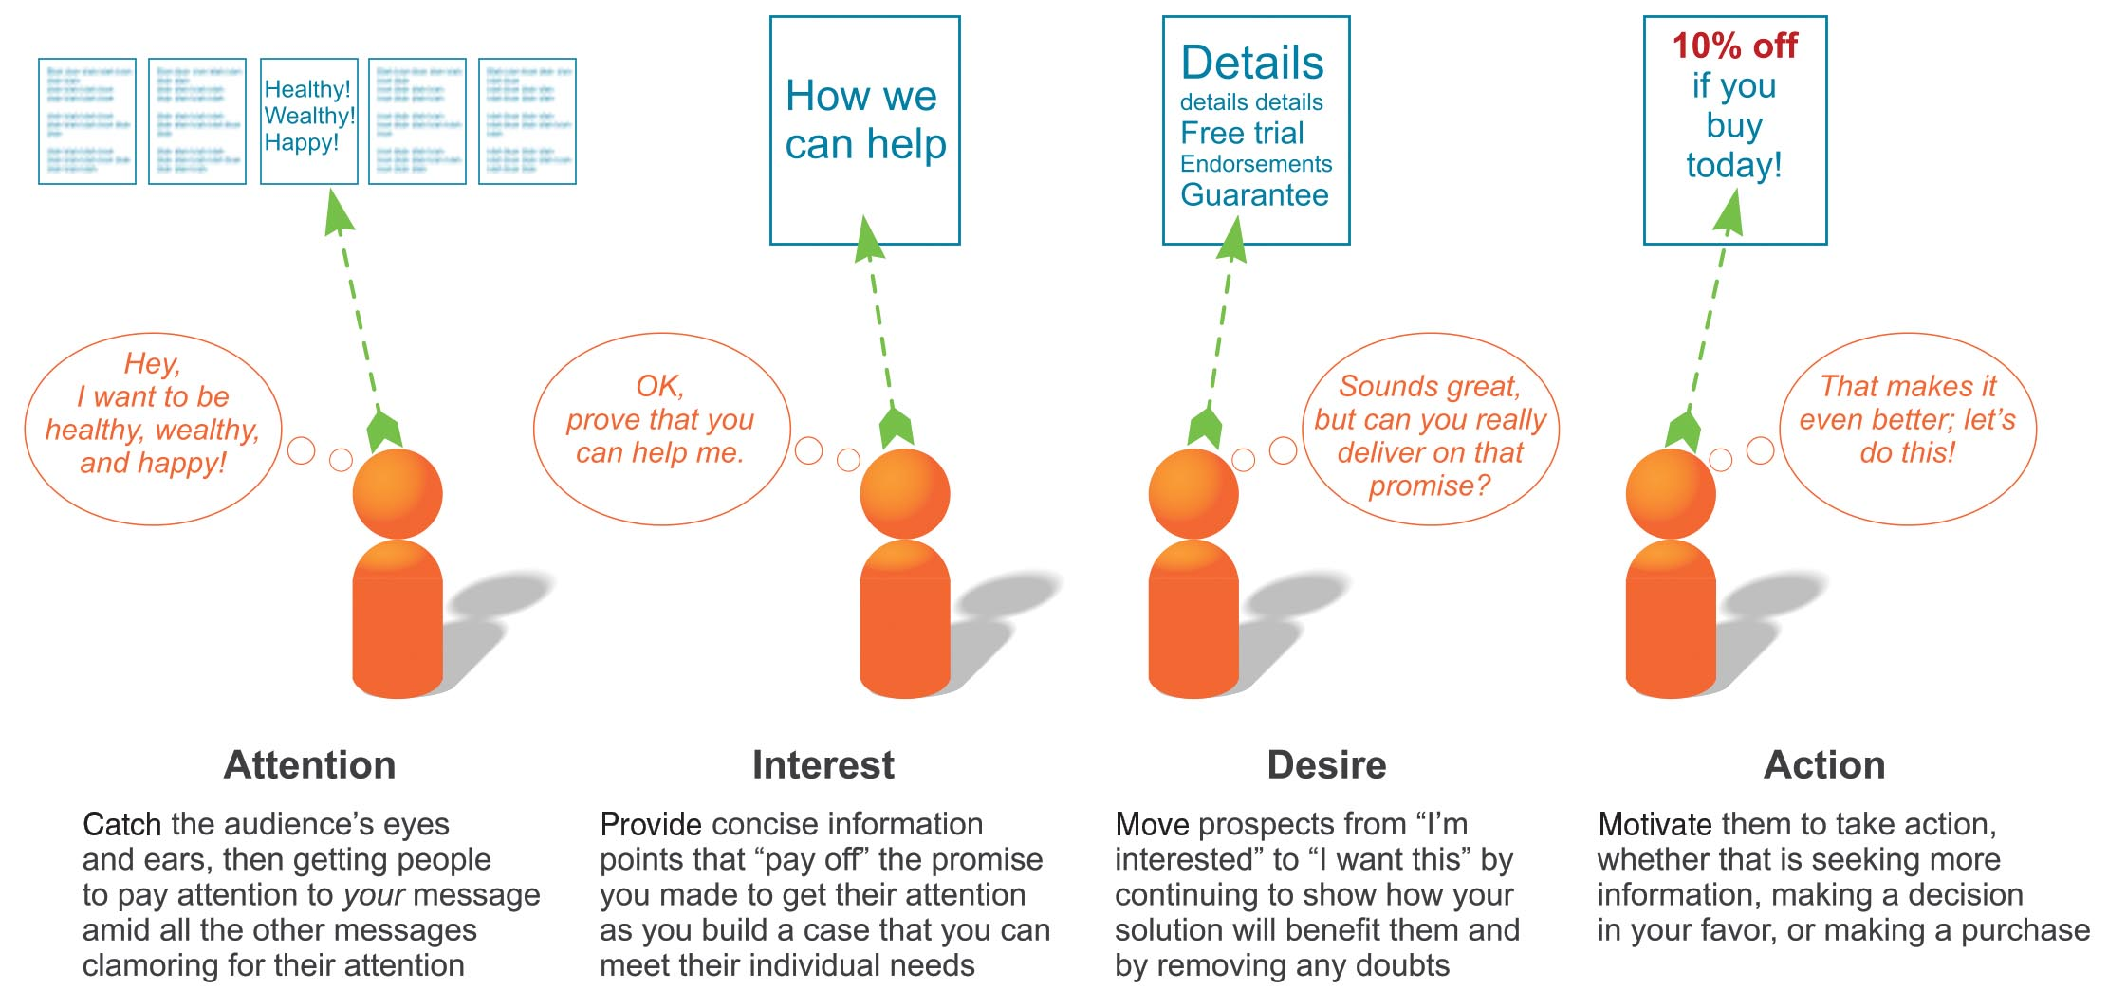
DEVELOPING PERSUASIVE BUSINESS MESSAGES
Framing Your Arguments

Slide 11
DEVELOPING PERSUASIVE BUSINESS MESSAGES
Balancing Emotional and Logical Appeals
Emotional Appeals
The actions you hope to motivate
Your readers’ expectation
The degree of resistance
Your position in the formal or informal power structure
Connect with the readers feelings and sympathies
Logical Appeals
Based in readers’ notion of reason. May use analogy, induction, or deduction
Consider four factors:

Slide 12
DEVELOPING PERSUASIVE BUSINESS MESSAGES
Avoiding Faulty Logics
Hasty Generalizations
Circular Reasoning
Attacking an Opponent
Oversimplification
False Cause-Effect
Faulty Analogies
Illogical Support

Slide 13

DEVELOPING PERSUASIVE BUSINESS MESSAGES
Reinforcing Your Position
Evidence?
Language?
Expert recognition?
Choose your words carefully!
Anticipating Objections
Anticipate Potential Objections
Develop Solutions to the Objections
Present All Sides of the Situation

Slide 14

DEVELOPING PERSUASIVE BUSINESS MESSAGES
Common Mistakes in Persuasive Communication
Avoid!
Being Resistant to Compromise
Relying Solely on Great Arguments
Using a “One-Shot” Approach
Using a Hard Sell Approach

Slide 15
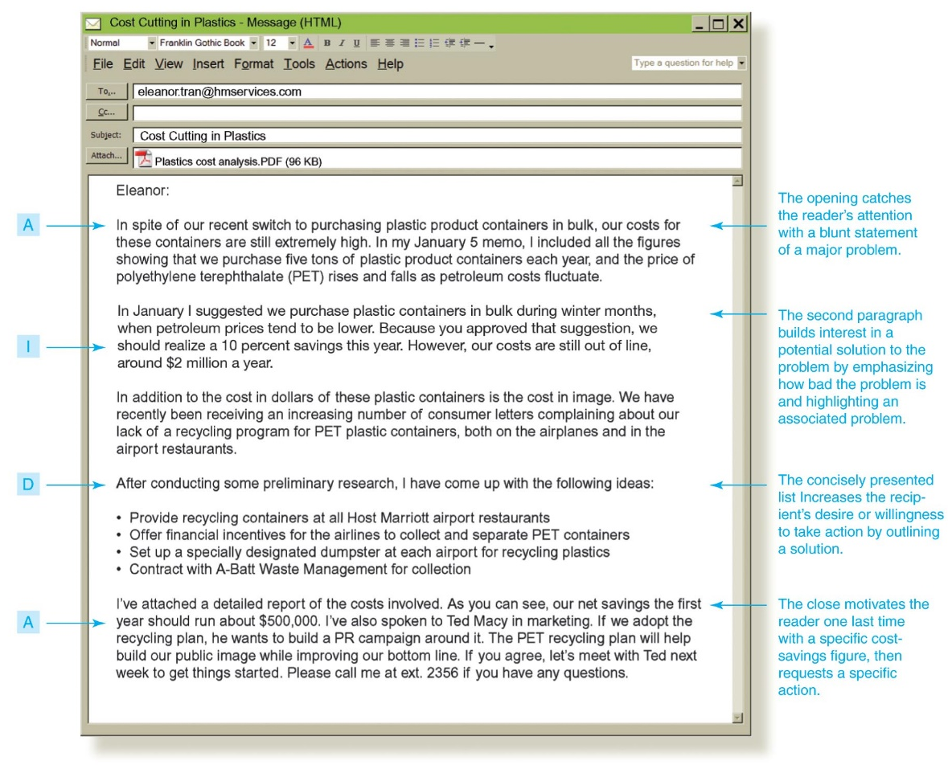
DEVELOPING PERSUASIVE BUSINESS MESSAGES
Examples of Persuasive Messages

Slide 16
DEVELOPING MARKETING AND SALES MESSAGES
Planning
Audience Needs
Competition
Selling Points and Benefits
Purchase objections
Writing Conventional
AIDA!
Writing Promotional for Social Media
Facilitate community building
Listen at least as much as you talk
Initiate and respond to conversations
Provide information people want
Identify and support champions
Be real
integrate Conventional Strategies
Creating Promotional for Mobile Devices
Short and simple
Fast and straightforward
CONSIDER ETHICS, LEGAL AND REGULATIONS!
Be truthful!
Children? Evidence? Contracts? Copyright?

Slide 17
D☺NE !

