Slide 1
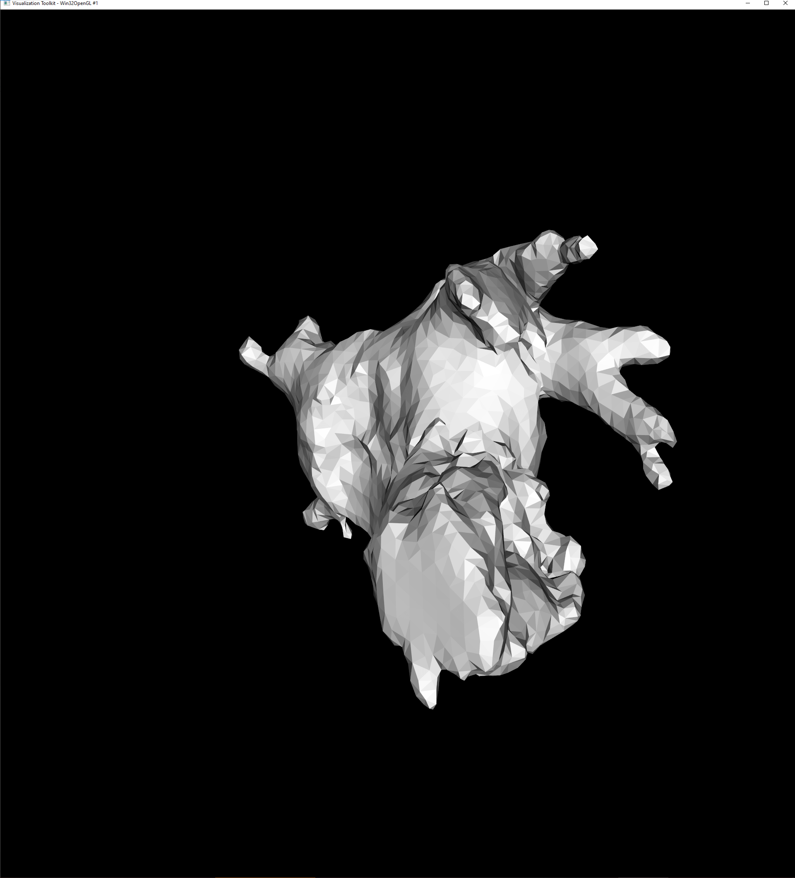
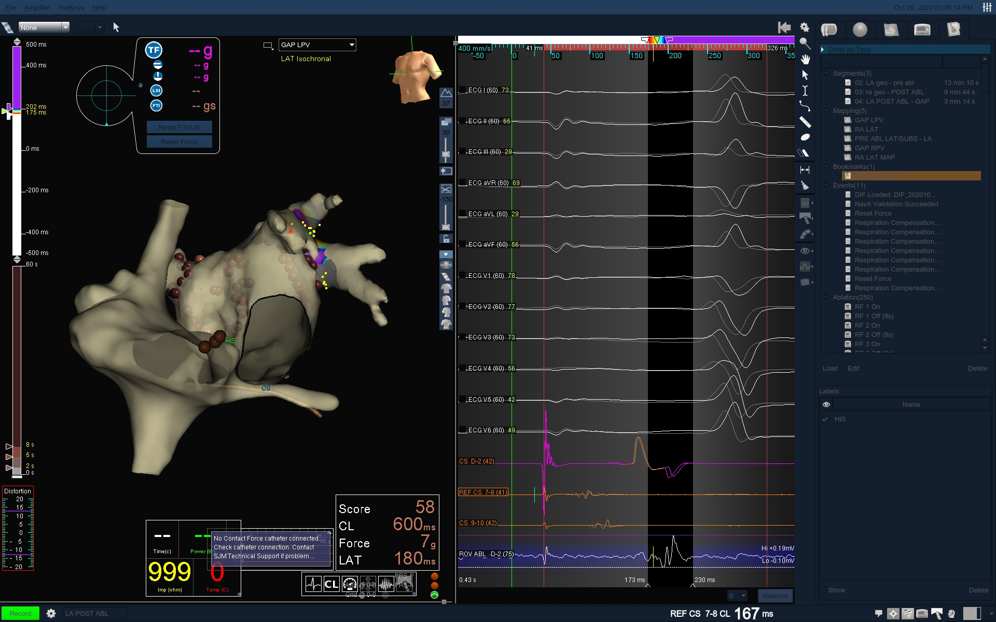
Volume from raw xml
\PrecisionMaps\study_dwsG700471_2020_10_28_08_38_34\images\ IMAGE_000048.jpg
Raw\Velocity_Export\study_dwsG700471_2020_10_28_08_38_34\2020_10_28_13_39_31\dif001.xml

Slide 2
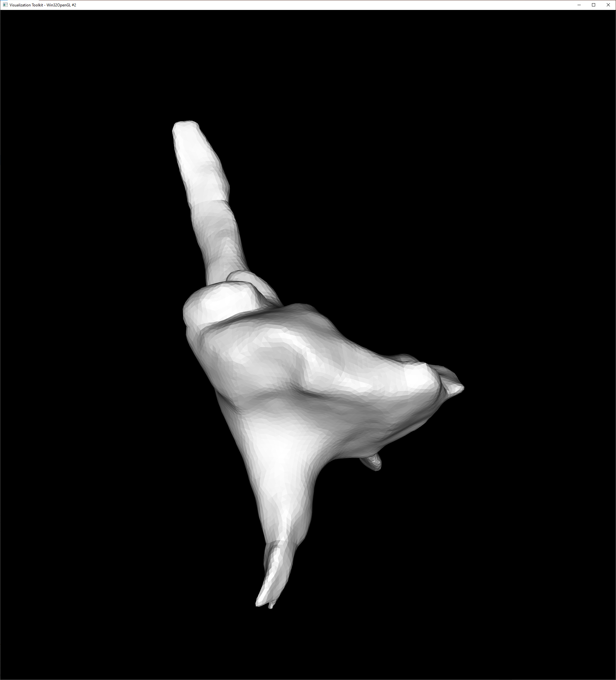
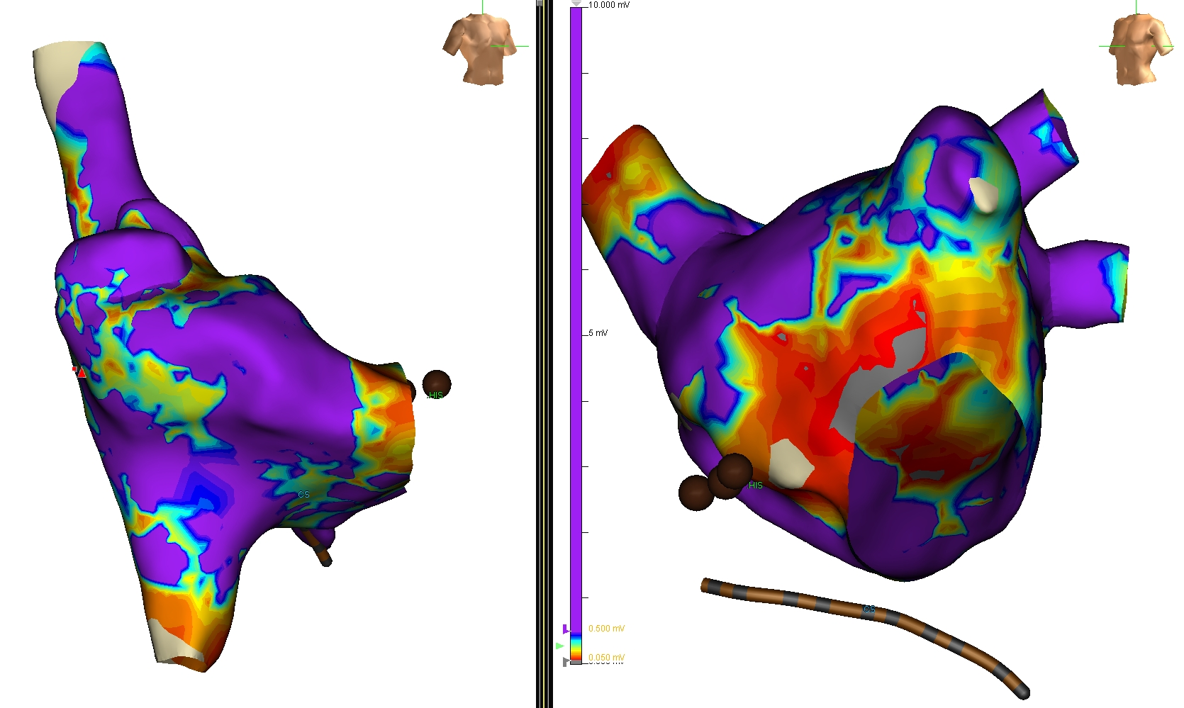
Volume from raw xml
\PrecisionMaps\study_dwsG700471_2020_10_28_08_38_34\images\ IMAGE_000049.jpg
Raw\Velocity_Export\study_dwsG700471_2020_10_28_08_38_34\2020_10_28_13_39_31\ModelGroups.xml

Slide 3
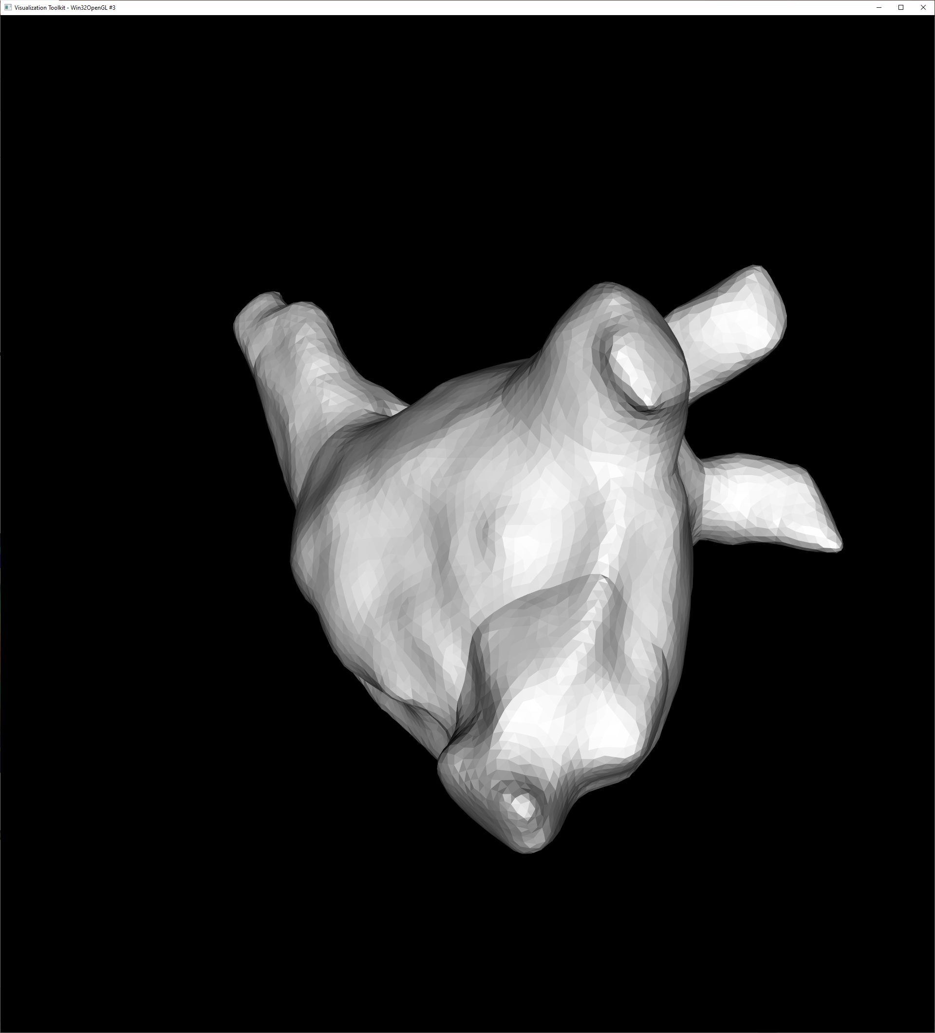
Volume from raw xml
\PrecisionMaps\study_dwsG700471_2020_10_28_08_38_34\images\ IMAGE_000049.jpg
Raw\Velocity_Export\study_dwsG700471_2020_10_28_08_38_34\2020_10_28_13_39_31\ModelGroups.xml

Slide 4
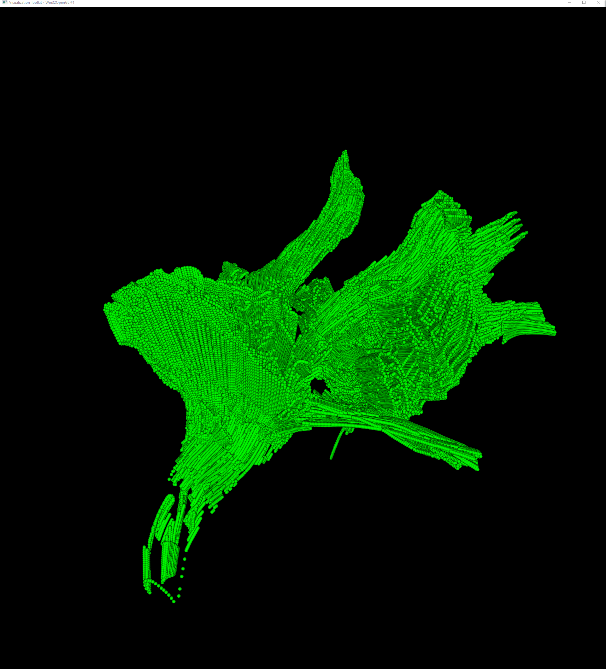
Point clouds from CSV
\PrecisionMaps\study_dwsG700471_2020_10_28_08_38_34\images\ IMAGE_000048.jpg
Raw\Velocity_Export\study_dwsG700471_2020_10_28_08_38_34\2020_10_28_13_39_31\ModelPointCloud.csv

