Slide 1
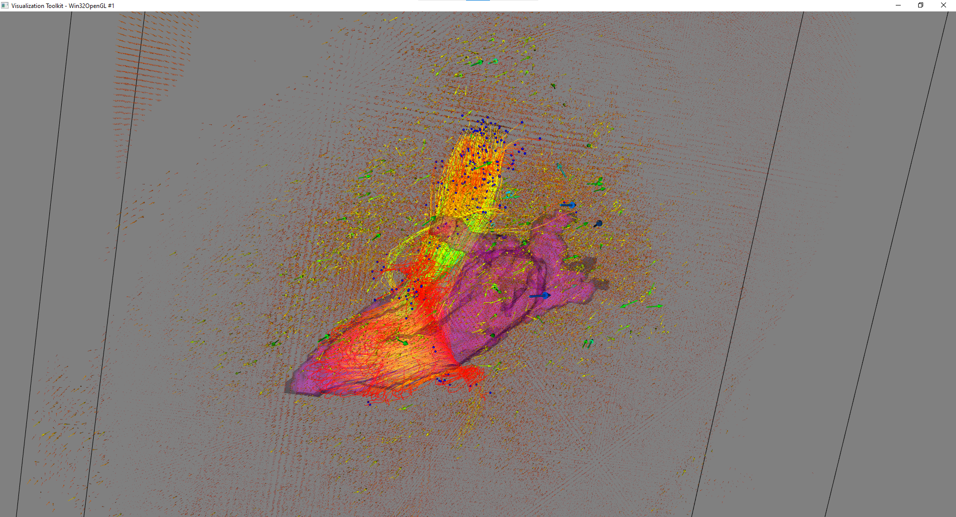
Draw flow vector, pathline and LA+LV mask altogether

Slide 2
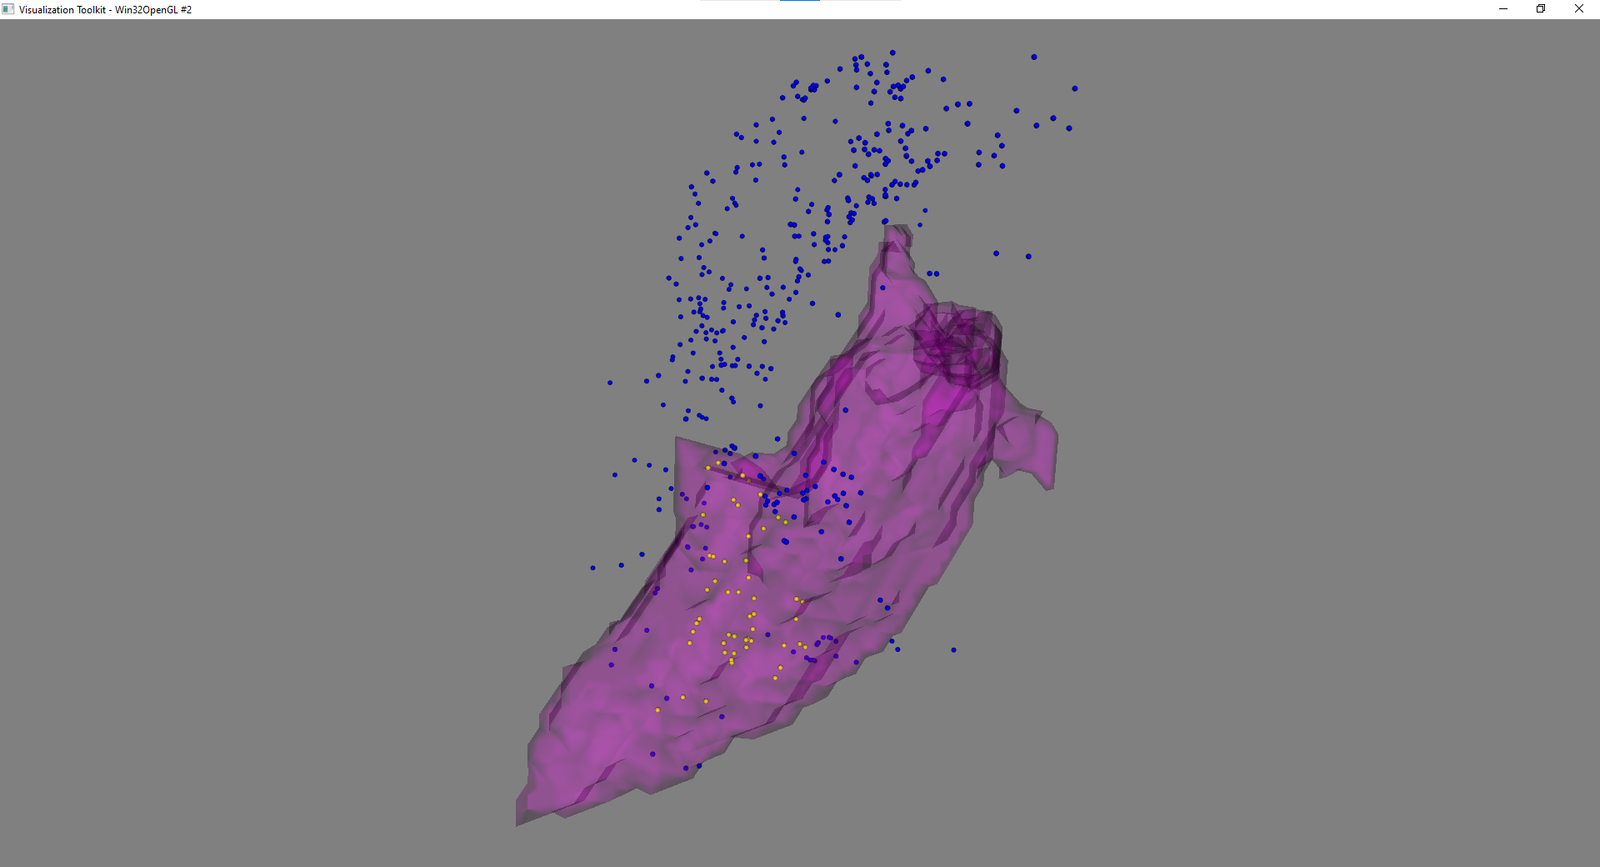
Final points of pathlines
At final time phase
Yellow: Particles are INSIDE the mask
Blue: Particles are OUTSIDE the mask

Slide 3
Data Output
##### Points inside Mask #####
0: (169.16714477539062, 132.41006469726562, 69.61857604980469)
1: (202.48733520507812, 126.08797454833984, 72.51835632324219)
2: (193.9864044189453, 139.56776428222656, 70.39860534667969)
3: (181.75912475585938, 144.23960876464844, 59.604583740234375)
4: (166.96888732910156, 150.95944213867188, 62.96535110473633)
5: (187.6699676513672, 137.3038787841797, 77.98304748535156)
6: (180.10385131835938, 143.8254852294922, 69.98900604248047)
7: (191.76316833496094, 128.21957397460938, 80.8935546875)
8: (184.79136657714844, 139.39889526367188, 72.70024871826172)
9: (190.25730895996094, 132.5782012939453, 78.84180450439453)
10: (193.7136993408203, 145.92779541015625, 83.02860260009766)
…
##### Points outside Mask #####
0: (148.80450439453125, 141.69161987304688, 66.64213562011719)
1: (132.66554260253906, 146.8546905517578, 73.93468475341797)
2: (91.14938354492188, 152.49278259277344, 73.52915954589844)
3: (106.6415023803711, 159.40245056152344, 53.93578338623047)
4: (109.35588836669922, 143.1392059326172, 57.99093246459961)
5: (98.6794662475586, 148.2266845703125, 92.90601348876953)
6: (132.5641326904297, 145.79806518554688, 50.163536071777344)
7: (103.31932830810547, 149.4641571044922, 103.92959594726562)
8: (183.29322814941406, 129.7930908203125, 50.085968017578125)
9: (171.58273315429688, 145.27516174316406, 50.11757278442383)
10: (169.84518432617188, 140.11001586914062, 35.59637451171875)
…

